Slide 1
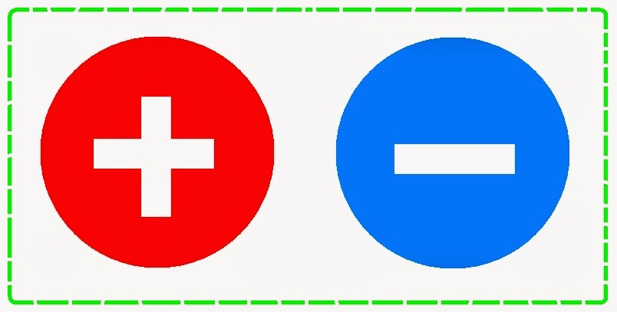
Electric Charge
History
Ancient Greek:
Noticed that:
If a piece of Amber is rubbed, it attracts bits of straw
Some stones attracts metals.
Hans Oersted (1820):
Discovered that:
Electric current in a wire can deflect a magnetic compass
( first connection between Electricity and Magnetism.)
Faraday:
did many excellent experiments in both electricity and magnetism.
Maxwell:
Managed to put all of them in mathematical formulas.

Slide 2
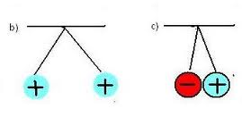
What is Electric Charge?
An intrinsic property of some elementary particles that composes matter.
There are two types of charges, positive and negative
Charge is quantized
q = ne , n = integer , e: electron charge
Charged objects exerts forces on each other
Charged objects with similar charges rebel each other
Charged objects with opposite charges attract each other.
Charge is conserved: the amount of charge
In any process is conserved

Slide 3
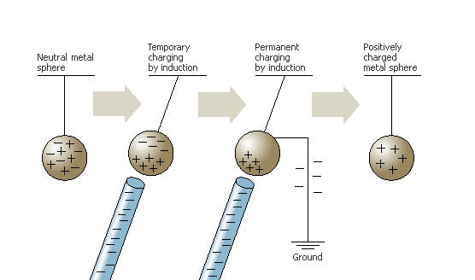
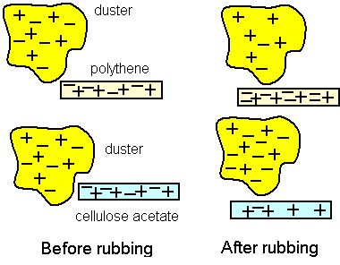
How to charge an object
By Friction
By Connection:
touching an object with a charges object
By induction

Slide 4
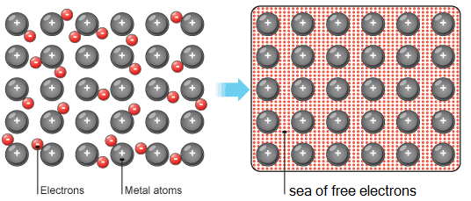
Conductors and Insulators
Conductors: has electrons that can move freely
Insulators: electrons are tied to their sites firmly
Semi conductors: electrons are tied to their sites but with some energy they are able to move freely
Super conductors: electrons move without facing any resistance from nucleus sites

Slide 5
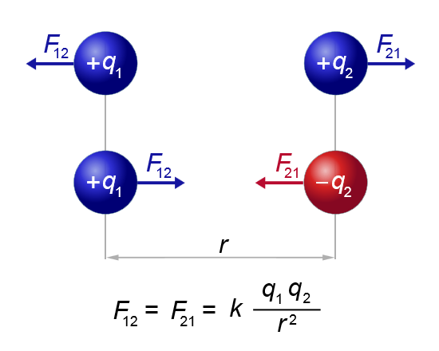
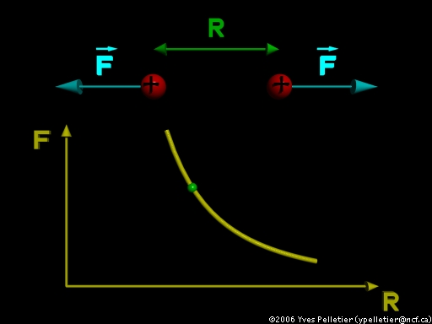
Coulomb’s Law
How charged bodies attract or rebel each other
How the electric force change with distance
Inverse square law

Slide 6
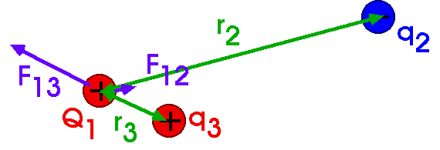
Coulomb’s Law II
The electric force between two charged particles is an action reaction pair. Its direction depends on the type of charges involved.
Electric forces similar to other forces are vector quantities they add and multiply like vectors.
For the three charges shown in the figure

Slide 7
Shell theorems
A shell of uniform charge attracts or repels a charged particle that is outside the shell as if all the shell’s charge were concentrated in its center.
If charged particle is located inside a shell of uniform charge, there is no net electrostatic force on it from the shell.
Spherical conductors
If a spherical conductor has excess charge, the charge is spreads uniformly over its external surface.

Slide 8
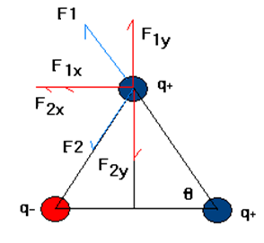
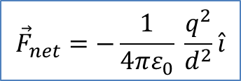
Example
Three objects with the same amount of charge, two are positive and the third is negative as shown in the figure, are placed at the vertices of an equilateral triangle with arm (d) . Find the electric force on the top most object.
Solution:
The directions of the two forces are shown in the figure
$${\vec{F}}_{net}=−\frac{1}{4πε_{0}} \frac{q^{2}}{d^{2}}\hat{i}$$

Slide 9
Exercises for you to workout
Two charges (+q) and( +2q) are placed at a distance (d) from each other . at what distance a charge (+q) should be placed so that it experiences no net force?
Two charges (+q) and( -2q) are placed at a distance (d) from each other . at what distance a charge (+q) should be placed so that it experiences no net force?
Four identical charges (+q) are placed at the corners of a square of arm (L) find the force on a fifth charge (+q) placed at a) the center of the square? B) midway between two adjacent charges.

