Slide 1
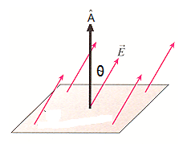
Gauss’ Law
What is Electric Flux?
If the electric field makes an angle Θ with the normal to the surface (A) then the electric flux is defined as:
or
Here we treated the surface (A) as a vector with a direction that is perpendicular to its surface
Why is that?
Assume two dimensional electric field
Yet the x-component direction is parallel to the surface and the only one that “crosses the surface” is:

Slide 2
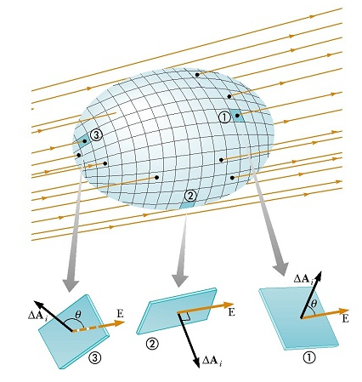
Flux of an Electric Field
Electric flux can be positive, negative or Zero depending on the angle between the directions of A and E
To find the flux, divide the closed surface into small surface elements ΔA and add the flux through all of them
In the limit when ΔA ― 0

Slide 3
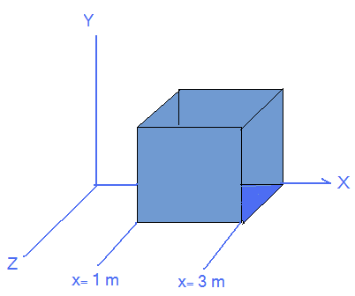
Example:
A Cubical Gaussian surface is placed in a non-uniform Electric field.
Find the flux through the right face
Find the flux through the upper face

Slide 4
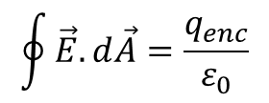
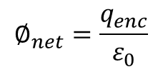
Gauss’s Law:
The amount of charge inside a closed surface is proportional to the net flux through that surface.
$$∅_{net}=\frac{q_{enc}}{ε_{0}}$$
$$\oint{\vec{E}.d\vec{A}=\frac{q_{enc}}{ε_{0}}}$$

Slide 5
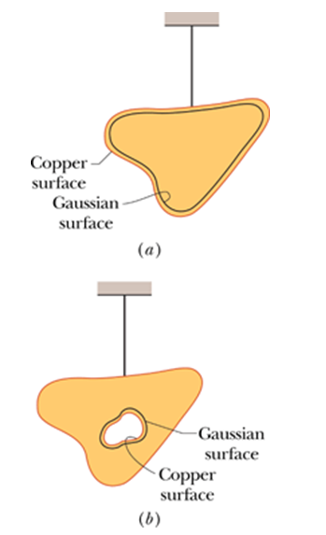
A Charged Isolated Conductor
If a conductor is charged, the charges, due to the electric forces between them, resides on the outer surface eliminating the electric field inside the conductor.
The electric field at a Gaussian closed surface placed just inside the surface must be zero and that means no charge is enclosed by it.
If a cavity is drilled in the conductor it will not change the charge distribution. The E field at a Gaussian surface just outside the cavity but inside the conductor must be zero meaning that no charge is enclosed.

Slide 6
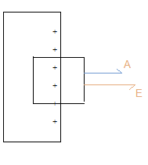
Electric Field Outside a Conductor
In the figure a side show of a charged conductor surface. The Gaussian surface is a cylinder with one face outside the conductor and the other is inside. We need to find E outside the conductor.
The electric field can’t have a component parallel to the surface because that will result in free charges drifting in that direction.
The electric field inside the conductor must equal Zero.
The only flux possible is that through the outside face of the cylinder.
If the surface charge density is
Then
A is the face area
For the inner face inside the conductor
so the flux is zero
For the sides of the cylinder the flux is zero because E and A are perpendicular to each other. The flux through the outside face is:
As E is constant at all points of the outside surface
E is constant and independent on the distance.

Slide 7
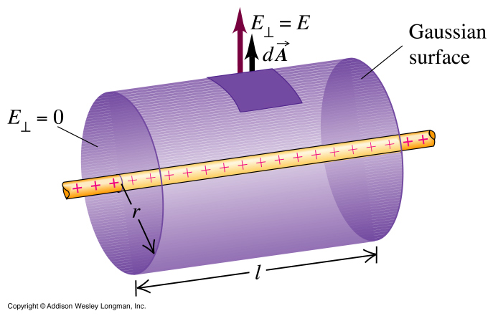
Gauss’ Law cylindrical Symmetry
E at the faces of the cylinder = zero
At distance r from the charged wire E = Constant

Slide 8
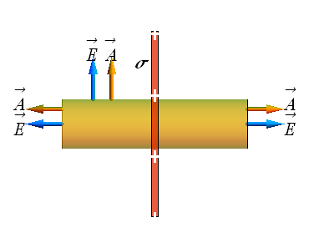
Gauss’ Law Planar Symmetry
The Gaussian surface for a sheet of positive charge is a cylinder as in the figure
Due to symmetry there is no flux through the surface of the cylinder, only through its faces.
At both faces E and A are in the same direction

Slide 9
Bringing two conducting plates close to each other
For plate (a) charge will be distributed at both faces as shown in the figure.
As E = 0 inside the plate, the E field at each side points to the outside and is given by
For plate (b) it is the same except the E field will point inwards.
If the two plates are put close to each other the positive charge on one of them attracts the negative charge of the other doubling the charge density at both.
As E inside the conductor = 0 the electric field in the outside on both sides = 0
The E field in between will be:

Slide 10
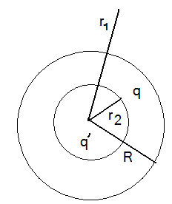
Gauss’ Law Spherical Symmetry
A spherical distribution of charge with radius R, find the E field at distance r1, that is outside the sphere, and at r2 that is inside the sphere.
for a point outside the spherical shell of charge we already know that:
for a point inside the spherical shell of charge the E field is:

Slide 11
Example:
+q
-2q
A charge +q is placed at the center of a spherical shell of uniform charge of -2q. Find the E at r1 and r2 as shown inn the figure.
Solution:
The red shells are two Gaussian surfaces.
R
r2
r1

