Slide 1
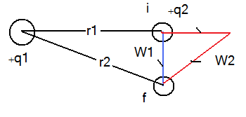
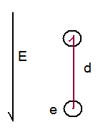
Electric Potential Energy
Electrostatic force is a conservative force
If the state of the system changes from I to f by moving q2 from position r1 to r2, the E force does work (W)
The work is path independent: W1 = W2
The change of the potential Energy due to the work done is:
Let us choose
then
Example: find the work needed to move an electron a distance d in a uniform E field as shown in the figure.

Slide 2
Electric Potential
The electric potential at any point in an Electric Field is the electric potential energy per unit charge
The potential difference between two points in an electric field is:
Using
Work done by an applied force:
if a force is applied to a charge to move it from state I to state f and if the K.E does not change then

Slide 3
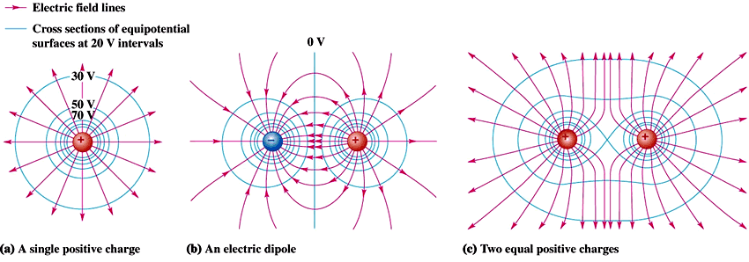
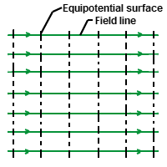
Equipotential Surfaces
Equipotential Surfaces have the same potential.
No work is needed to move a charge on the surface
Equipotential Surfaces are always perpendicular to electric field lines

Slide 4
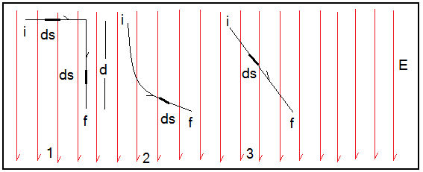
Calculating the Potential from the Field
The work done to move a test charge
from point I to point f in an electric field is given by:
If we choose Vi = 0 then
V is path independent.
The angle between the direction of E and that of ds
Case (1) in the first section the angle between E and ds =90 degree so V=0 . In the second section the angle is zero leading to:
V at f should have the same value regardless of the path of motion.

Slide 5
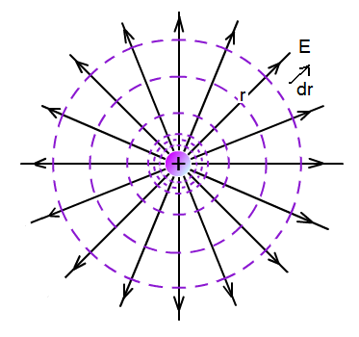
Potential due to a point charge
E and dr are in the same direction therefore
We need to solve the line integral
Integrate from r to infinity

Slide 6
Potential due to a group of point charges
Example:
A charge +q is located a distance D from a charge -3q. find the point at which V=0
For V to equal Zero

Slide 7
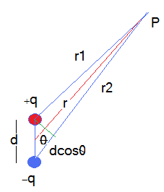
Potential due to an electric dipole
If r >> d then use the following approximations:
The dipole moment is defined as:

Slide 8
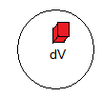
Electric Potential due a charge distribution
If charges are packed together to form a line or a surface or a volume, we can define charge density:
(C/m) charge per unit length
(C/m²) charge per unit area
(C/m³) charge per unit volume.
Find the Potential dV due to charge dq then add/ integrate over the entire charge distribution

Slide 9
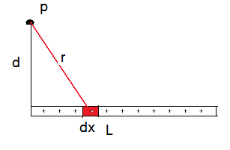
Line of Charge
The solution of this integral, from integral tables, is:

Slide 10
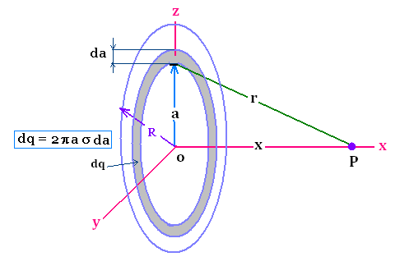
Potential due to a Charged Disk
Note that a is the variable not x
To solve the integral let:
Substitute and integrate.

Slide 11
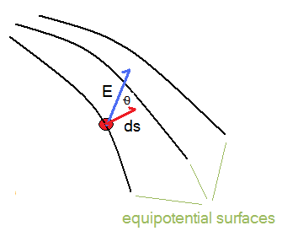
Calculating the electric field from the electric potential
EcosΘ is the E-field component in the direction of S.
So in general we can find the three components of the electric field:
Incase E is constant, all equipotential surfaces will be perpendicular to the E-field lines and

Slide 12
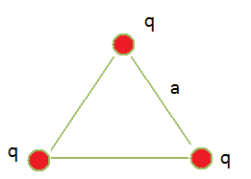
Electric potential Energy of a system of point charges
The electric potential energy of system of fixed point charges equal the work done by an external agent to bring them from infinity to their fixed positions.
Assume you want to assemble three identical charges at the vertices of an equilateral triangle of arm (a)
To bring the first one you need no work.
To bring the second you need to do work:
To bring the third charge

Slide 13
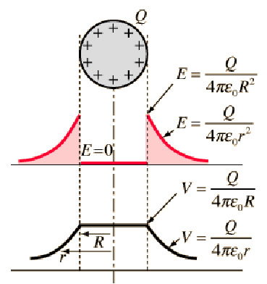
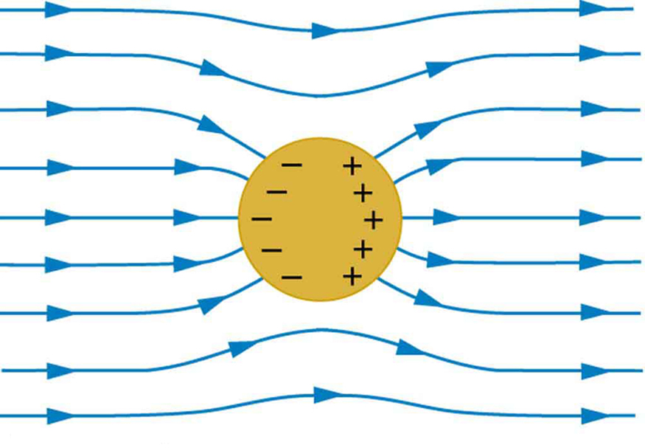
Potential of a charged Isolated conductor
The figure shows how the potential changes with distance. Charges arrange to make a constant potential inside the conductor.
If a conductor is placed in an electric field. Charges arrange to eliminate electric field inside and unify the potential inside.

Slide 14
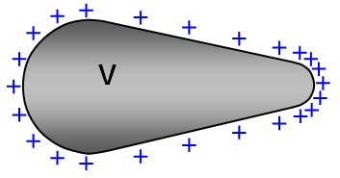
Charged Conductors;
Any conductor in electrostatic equilibrium is an equipotential
r2
The large conducting sphere of radius r2has charge Q. the small sphere of radius r1 is not charged.
r1
before connecting both spheres
After connecting them the charge distributes itself such that both become an equipotential
The smaller sphere has the higher charge density

