Slide 1
C is measured in the unit Farad ( F )

Slide 2
The electric field between two conducting plates is found using Gauss’s Law as follows:
Take the path of integral from the negative plate to the positive one then
To increase C increase the plates surface area and bring the plates closer.

Slide 3
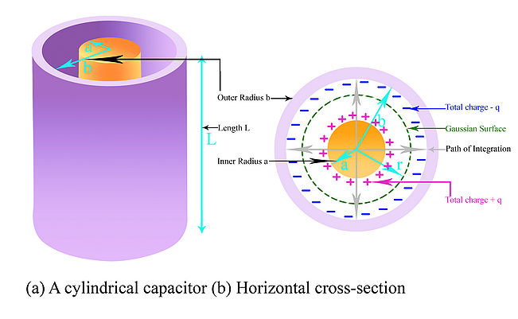
Cylindrical Capacitor
For the Gaussian surface shown, the Electric field is:
E and dA are in the same direction
Take the path of integration from b to a then
But dr = -ds then

Slide 4
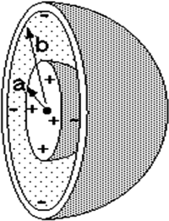
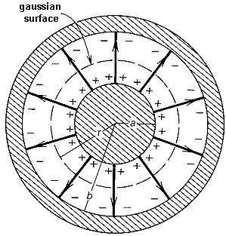
Spherical Capacitor
Take the path of integration from b to a then
But dr = -ds then
Isolated sphere:
Imagine that the larger sphere has infinite radius

Slide 5
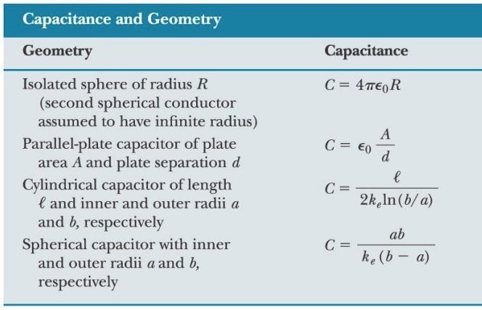

Slide 6
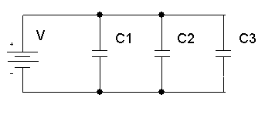
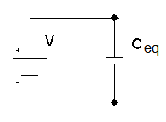
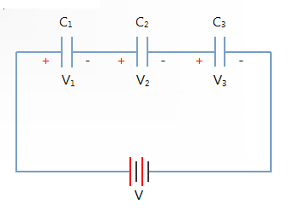
Capacitors in parallel
The charge is distributed to the three capacitors so that:
The total charge in the circuit is
The three capacitors can be replaced with one capacitor
Capacitors in series
The charge is equally distributed between the three capacitors

Slide 8
Energy density
For a parallel plates capacitor we define the energy density:
A:the area of the plate.
d: the separation between the plates.
For a uniform electric field

Slide 9
Energy in ununiform Electric field:
In a ununiform electric field the total energy is the product of the energy density and the volume
Example:
A sphere of radius R1 carries charge Q distributed uniformly over its surface. How much work is needed to compress the sphere to a smaller radius R2?

Slide 10
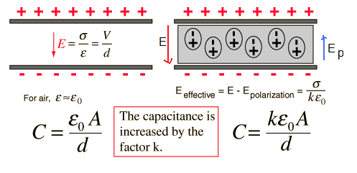
Capacitor with a dielectric
If a dielectric material is placed between the plates of a charged capacitor its molecules become polarized and induce an electric field opposite to the capacitor electric field.
The capacitance of any capacitor regardless of its shape can be presented as:
L is a geometric factor that has the dimensions of length.
For example for a parallel plates capacitor
Faraday found that when a dielectric is inserted between the plates of a capacitor the voltage difference between them drops. Then the capacitance must have increased by some factor
For a parallel plates capacitor
In the presence of dielectric material the electric field for a point charge becomes
For a conducting plate

Slide 11
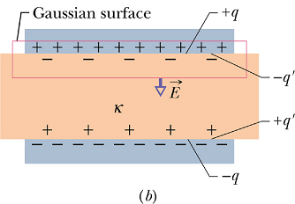
Dielectrics and Gauss’ Law
For a conducting plate:
Gauss’ law:
For charged parallel plates with dielectric as shown in the figure:
Where
is the negative charge due to the polarization of the dielectric
But
Effect of dielectric on the electric field
Therefore
Then
Gauss’ law in the existence of a dielectric. K is kept inside the integral in case k is not constant through the entire area.

