Slide 1
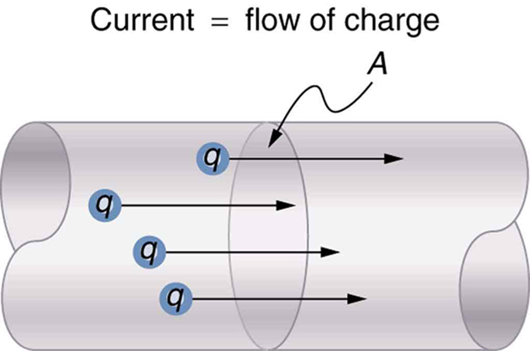
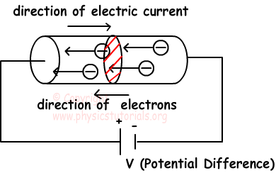
Electric current:
What is electric current:
Free electrons in conducting materials, like metals, are in random motion.
If free electrons are subjected to an electric force there will be a charge drift in the direction of the force.
A charge drift in a certain direction constitutes a current.
Electric current is: The amount of charge crossing a cross section area per unit time.
The direction of current is the drift direction of positive charges.
The amount of charge crossing a cross section area is:

Slide 2
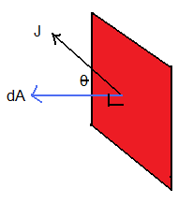
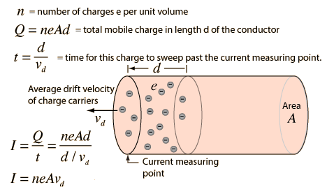
Current density:
Definition of current density( J ):
the current per cross section area.
The current is then defined as:
The current is defined similar mathematically to the flux in an electric field.
Drift Speed:

Slide 3
Resistance and Resistivity
Each material resists the motion of electrons inside it.
It was experimentally found that
R: the resistance
V: voltage difference across the material
i: the current passing through it
The unit of R is Ohm (
R is a property of an object
Resistivity
Definition: resistivity is the Electric field divided over the current density
Or
Is a property of a material
Conductivity
Conductivity is the inverse of resistivity
Or

Slide 4
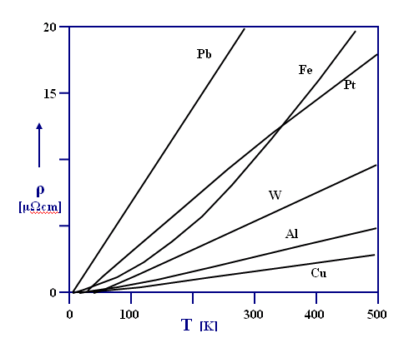
Calculating Resistance from Resistivity
For an object with length L and cross section A
How resistivity changes with temperature?
This relation between ρ and T could be, to a good approximation, presented as:
is resistivity at room temperature
is temperature coefficient of resistivity
The figure shows how resistivity changes with temperature for different materials.
The relation between ρ and T is approximately linear with the exception of Iron (Fe)

Slide 5
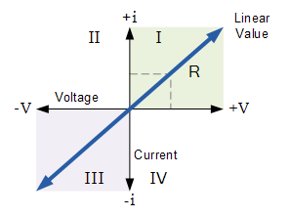
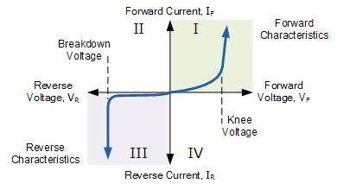
Ohm’s Law
The current ( I ) passing through a device is always directly proportional to the potential difference ( V ) across it.
A conducting device obeys Ohm’s law only when the resistance ( R ) of the device is independent of the magnitude and polarity of the applied potential difference ( V ).
Obeys Ohm’s law
A conducting material obeys Ohm’s law when the resistivity of the material ( ρ ) is independent of the magnitude and direction of the applied electric field ( E ).
Does not obey Ohm’s law

Slide 6
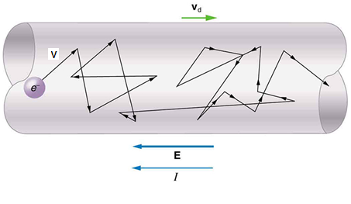
A microscopic view of Ohm’s Law
Free electron model:
In metals electrons move freely in a random way.
Electrons only collide with nucleus sites not with each other.
The velocity of a free electron was found to be around
When an electric field is applied, the electrons drift in the direction of the field with a drift velocity.
The electric field causes an electron with mass (m) to accelerate:
We know that
The drift velocity of the electron:
( τ ) is the average time between collisions
If τ is independent on E, ρ is independent on E. as the random velocity of the electron is much larger than that of the drift velocity, caused by the electric field, one can assume that τ is independent on E
The current density J is given by:

Slide 7
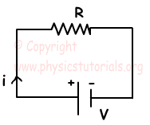
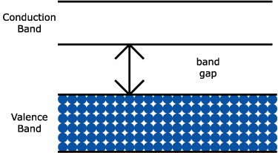
Power in Electric Circuits
Super conductors
To move charge dq between two points with a potential difference V, the electric potential energy changes by the amount:
The power transferred is:
This is the rate at which the power source transfer electric energy to any device
If the device has a resistance R
Semi conductors
Energy Levels
IV Characteristics

