Slide 1
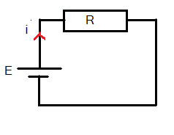
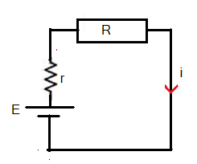
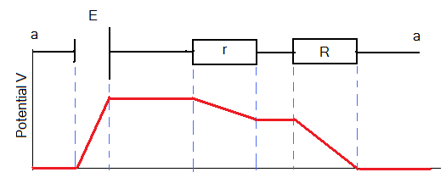
Circuits:
Work, Energy, and Emf
Voltage method:
An electromotive force device like a battery provides a potential difference in a circuit to force charges to flow from a high potential point to a low potential point, the charges inside the battery must move from a low potential point to a high potential point. This requires work to be done by the battery.
Electromotive force with internal resistance (r):
The electromotive force is defined as: the rate of work done per unit charge.
Current in a single loop circuit:
Energy Method:
Diagram shows how the potential changes across the circuit

Slide 2
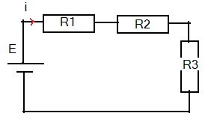
Resistors in series:
Power, Potential, and Emf
A power source, such as a battery, transfer energy to the circuit at a rate:
V is the voltage across the battery
One can replace the three resistors with one resistance
If the battery has an internal resistance r then:
on series with the source.
Resistors in Parallel:
Let
One can replace the three resistors with one resistor
On series with the source

Slide 3
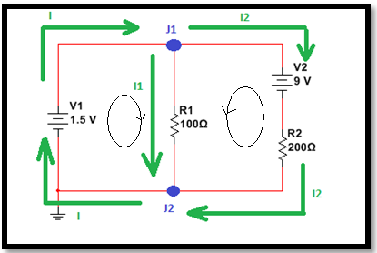
Multiloop circuits, Kirchhoff's Laws:
Junction Rule: conservation of charge
The sum of currents entering a junction must equal the sum of the currents leaving the junction
Potential Rule: conservation of Energy
The sum of potential changes in any closed loop should equal zero.
In the above circuit:
Junction rule:
Potential Rule:
define a direction for the current in a loop in the circuit. (any direction you like.)
Loop 1:
Loop 2:
define the directions of the currents at each junction the way you like. Don’t define them as all entering or leaving the junction
Note 1: if I passes a source from –ve to +ve (like in V1) give it a +ve sign. If not give it a –ve sign (like in V2)
Note 2: if I passes R with Loop direction give IR a –ve sign. If not give it a +ve sign.
In the circuit above the chosen directions for the two loops are shown as well as the directions of the currents.

Slide 4
Kirchhoff's Laws II:
Note 1: if I passes a source from –ve to +ve (like in V1) give it a +ve sign. If not give it a –ve sign.
Note 2: if I passes R with Loop direction give IR a –ve sign. If not give it a +ve sign.
Note 3: when you find the currents, for the ones that ends up –ve you need to reverse the assigned direction.
The algebraic solution:
Note 4: there is a third loop, the one that includes V1 and V2. yet you only have two independent solutions.

Slide 5
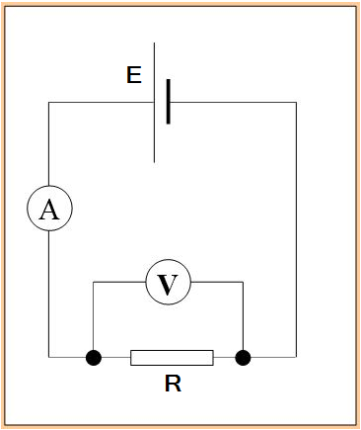
Ammeters and Voltmeters:
Ammeter is a device used to measure the current in an electric circuit. It has a small internal resistance and is connected in series with the element that the current passes through.
Voltmeter is a device used to measure the potential difference ( Voltage) across any circuit element. It has a very large internal resistance and is connected in parallel with the element that we need to measure the voltage difference across it.

Slide 6
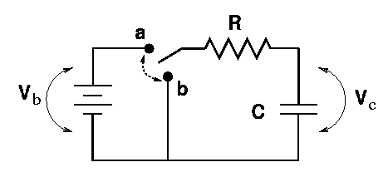
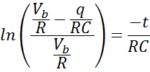
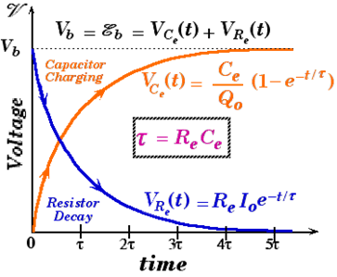
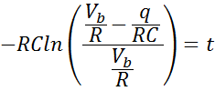
RC Circuits: Charging a capacitor
How do we charge a capacitor?
At what rate does charge accumulate on the capacitor plate?
Assume that we close the circuit to charge the capacitor. Using the potential Rule

Slide 7
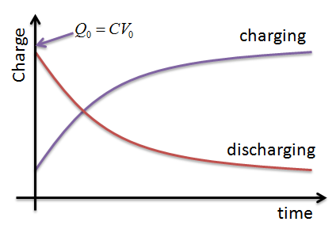
Discharging a capacitor
Move the switch to point b. the capacitor starts to discharge.
Voltage loop Rule:
Define the time constant as:
At

