Slide 1
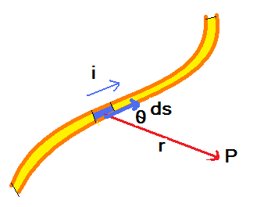
Magnetic Fields due to currents:
Calculating the magnetic field due to a current:
We divide the wire into small strips each of length ds. Then we find dB that the current in the small strip ds causes at point P. then to find B we sum/integrate over the entire length.
It was empirically found by Biot-Savart that:
Which could be written, if we consider ds a vector in the current direction, as:
Biot-Savart law
is called permeability constant.

Slide 2
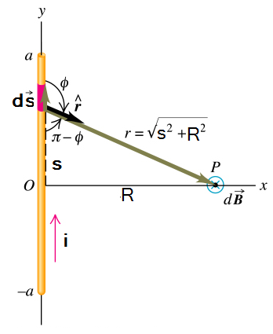
Magnetic Field due to a current in a long straight wire:
The direction of dB from all the wire segment is into the page. So all of them will add.
There are similar contributions from segments from positive and negative y, therefore:
From integration tables

Slide 3
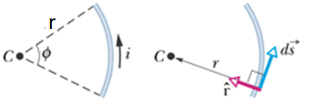
Magnetic Field due to a current in a circular arc of wire:
The magnetic field at the center of the arc

Slide 4
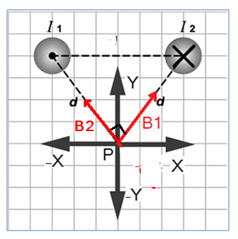
Example:
Two long wires in the Z-direction carry equal and opposite current, I1 = I2. find the magnetic field at point P in the figure.
The direction of B1 is shown in the figure.
The direction of B1 is shown in the figure.
The X-components of both vectors cancel each other.
The y-components add.

Slide 5
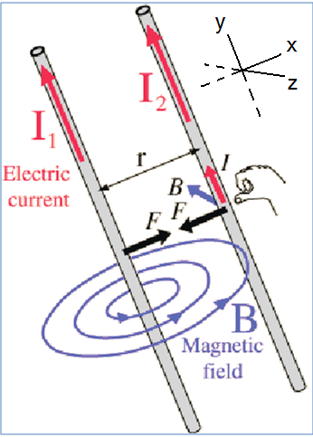
Force between two parallel currents:
For the direction of the magnetic force use the right hand rule as shown in the figure
If the currents in the two wires are in the same direction, they attract each other
If the currents in the two wires are in opposite direction, they rebel each other.

Slide 6
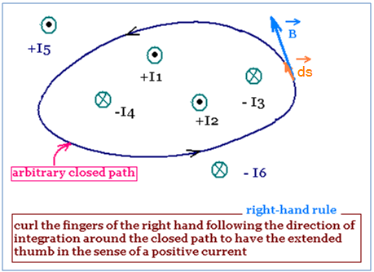
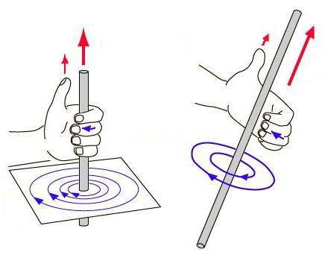
Ampere’s Law
The left side term is integrated over a closed loop.
In the shown figure:
Use the Right Hand Rule to find the direction of the magnetic field:
Point your thumb to the direction of the net enclosed current, the curl of your fingers define the magnetic field direction.
If there exists a good level of symmetry, Ampere’s Law provides an easier method to find the magnetic field than Biot-Savart law.

Slide 7
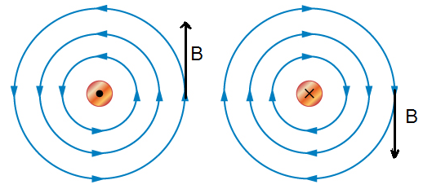
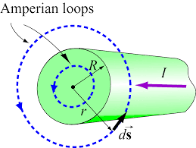
The magnetic field outside and inside a long straight wire with current
Outside:
Choose an Amperian loop outside the wire as shown in the figure.
The direction of B outside a wire with current once pointing out of page and once into it.
The magnitude B is constant over the entire loop and the angle between B and ds is zero .

Slide 8
The magnetic field outside and inside a long straight wire with current II
Inside:
Choose an Amperian loop inside the wire as shown in the figure
The current density is:

Slide 9
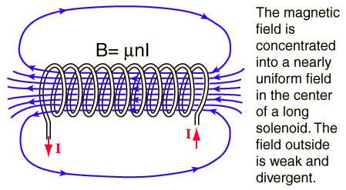
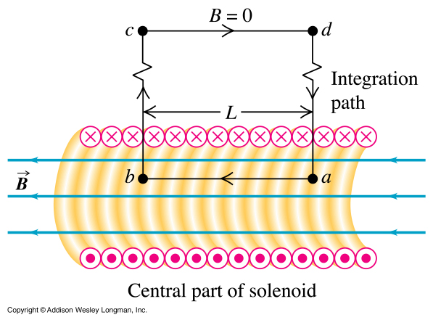
Solenoids:
If the length of the solenoid is much greater than its diameter B outside the solenoid almost vanishes. B inside it is almost uniform as shown in the figure.
One can use Amperes=‘s law to find B inside the solenoid as shown in the second figure.
B equal zero outside the solenoid and in sections bc and da the angle is 90 degrees
n: number of turns per unit length

Slide 10
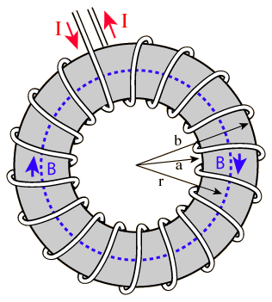
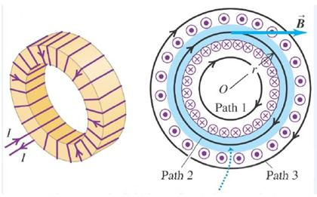
Toroids:
Toriod is a solenoid bent to form a circular closed tube.
If we take an Amperian circular loop with radius r as shown in the figure
As B is constant at the entire loop.
N is the total number of Toroid’s turns
Note that B inside the Toroid is ununiform

Slide 11
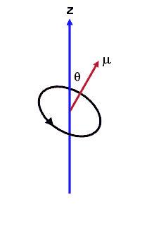
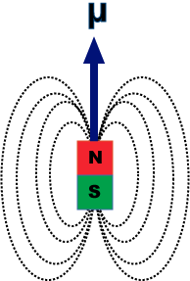
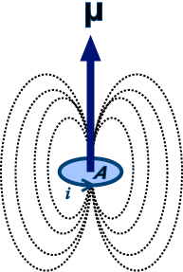
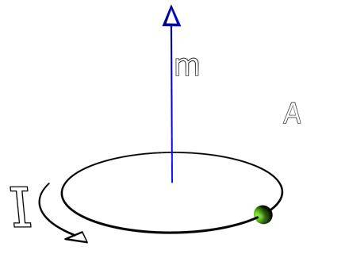
A current carrying coil as a magnetic dipole
A current carrying coil produces a magnetic field similar to that produced by a magnet
The magnitude of the magnetic dipole moment is defined as:
curl your hand with the current direction, your thump points to The direction of the magnetic dipole moment.
If a magnetic dipole is placed in a magnetic field it experiences a torque:
Here we want to study the magnetic field produced by a magnetic dipole ( a coil )
As such magnetic field lacks symmetry, we revert to Biot-Savart Law.

Slide 12
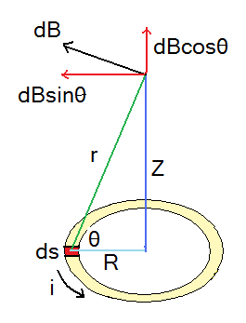
A current carrying coil as a magnetic dipole II
Due to symmetry the X and Y components of the magnetic field due to all segments ds cancel. Therefore
The angle between ds and r is 90°

