Slide 1
Charges and Forces
Two important Questions:
If we have two charges located at distance (r) from each other How does one knows that the other exists?
If one charge moves closer to the other would the other know that instantaneously or does that takes time?
The field concept might provide an answer to both
Any charge q sets a field in its surrounding which has magnitude and direction at any given point.
If a second charge is placed at point P in the field of q it experience a force. This is how it knows q exists.
As the charge moves it sends an electromagnetic wave with the speed of light to change the field at P. So it takes time

Slide 2
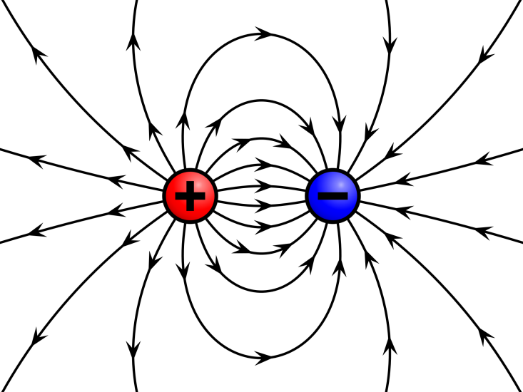
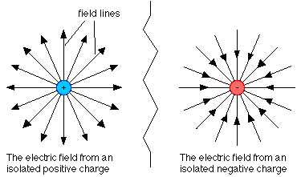
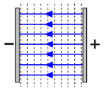
Electric Field
If a test charge s placed a distance r from a charge q the electric force it experience is:
The electric field at that point is:
Electric Field Lines
Starts at positive charges and ends at negative charges
The direction of E is always tangent to the field line
Field lines never cross each other

Slide 3
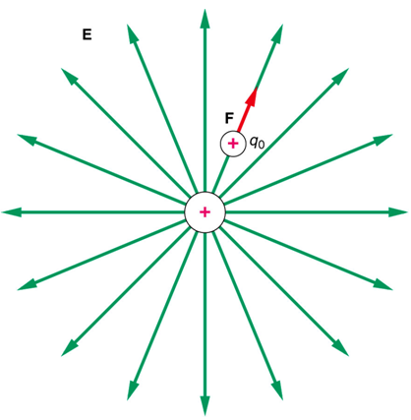
Electric Field Due to a point charge
The electric field decreases with the distance from the point charge.
The electric field is proportional to the number of field lines crossing a cross section area at any point.

Slide 4
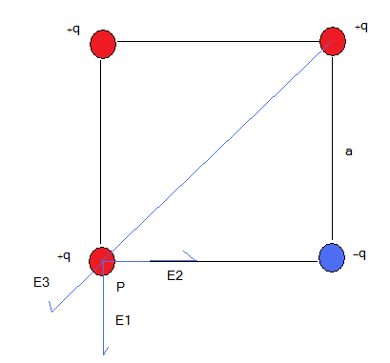
Electric Field due to more than one charge
Example:
Four equal charges, one is negative and the others are positive are placed at the vertices of square as shown. Find the electric field at point P and the electric force the charge at P experiences.
Solution:
Hint: Find The vector fields due to each charge at the required point and add them

Slide 5
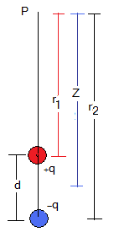
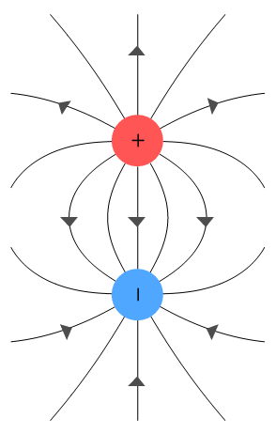
Electric Field due to Electric Dipole
At far enough distances when
we can do the following approximation:
Define dipole momentum:
The direction of d is from negative to positive charge.
It does not matter if d or q changes as long as their product remains the same.

Slide 6
Electric dipole, different orientation:
y
E1
θ
From symmetry, the y-component of both cancels each other.
E2
r
r
-q
θ
+q
x
-a
0
+a

Slide 7
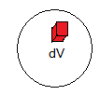
Electric Field due a charge distribution
If charges are packed together to form a line or a surface or a volume, we can define charge density:
(C/m) charge per unit length
(C/m²) charge per unit area
(C/m³) charge per unit volume.
Find the electric field dE due to charge dq then add/ integrate over the entire charge distribution

Slide 8
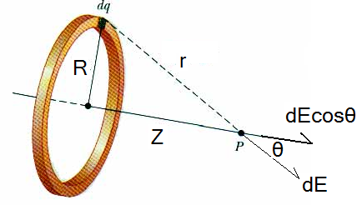
Electric Field due to a line of charge
The electric field has three components. The Z-component adds but the X and Y components cancels due the symmetry of the ring.
Note that if
Then
The ring behaves as if all the charge is located at its center.

Slide 9
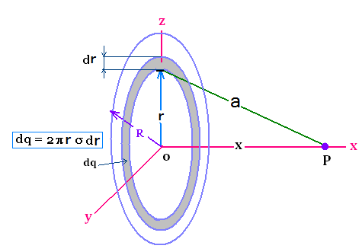
E Field Due to Charged Disk
Only the X- component of the field adds, other components cancel due symmetry
Note that if
Then
E is constant and independent on the distance from the disk

Slide 10
Electric field outside a Infinite line of charge
Due to symmetry, the x-components of the electric field cancel each other
E1y
E2y
E1
E2
θ
θ
r
θ
θ
r
y
x
The solution from table of integrals is:

