Slide 1
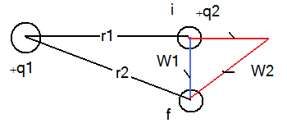
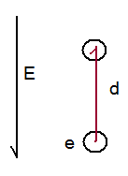
Electric Potential Energy
Electrostatic force is a conservative force
If the state of the system changes from I to f by moving q2 from position r1 to r2, the E force does work (W)
The work is path independent: W1 = W2
The change of the potential Energy due to the work done is:
Let us choose
then
Example: find the work needed to move an electron a distance d in a uniform E field as shown in the figure.

Slide 2
Electric Potential
The electric potential at any point in an Electric Field is the electric potential energy per unit charge
The potential difference between two points in an electric field is:
Using
Work done by an applied force:
if a force is applied to a charge to move it from state I to state f and if the K.E does not change then

Slide 3
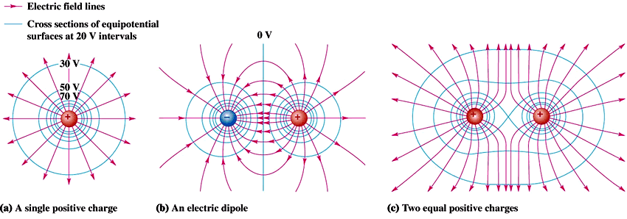
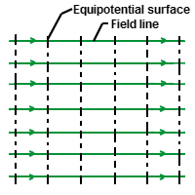
Equipotential Surfaces
Equipotential Surfaces have the same potential.
No work is needed to move a charge on the surface
Equipotential Surfaces are always perpendicular to electric field lines

Slide 4
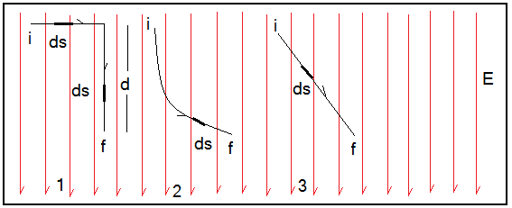
Calculating the Potential from the Field
The work done to move a test charge
from point I to point f in an electric field is given by:
If we choose Vi = 0 then
V is path independent.
The angle between the direction of E and that of ds
Case (1) in the first section the angle between E and ds =90 degree so V=0 . In the second section the angle is zero leading to:
V at f should have the same value regardless of the path of motion.

Slide 5
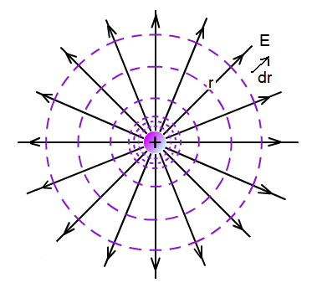
Potential due to a point charge
E and dr are in the same direction therefore
We need to solve the line integral
Integrate from r to infinity

Slide 6
Potential due to a group of point charges
Example:
A charge +q is located a distance D from a charge -3q. find the point at which V=0
For V to equal Zero

Slide 7
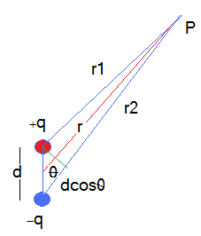
Potential due to an electric dipole
If r >> d then use the following approximations:
The dipole moment is defined as:

