Slide 1
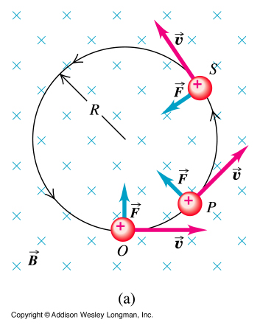
Rotating Charged Particles
if a positively charged particle enters a uniform magnetic field region with a velocity V as shown in the figure, it will be subject to a force that is perpendicular to both V and B
such force causes the particle to move in a close circle with constant speed.
The period of rotation:
The charged particle will rotate in a closed circuit with radius R
ω is independent on the particle’s velocity
Fast particles rotates in a circle with a larger radius but have the same period of slow ones which rotates in a circle with smaller radius.

Slide 2
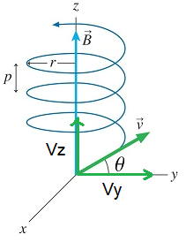
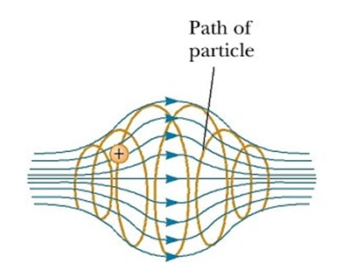
Helical Paths
If a charged particle enters a uniform magnetic field with a velocity that has a component in the field direction, as shown in the figure, it will move in a helical path.
The velocity Y-component determines the radius (r) of the helix.
The velocity Z-component determines the pitch (P), the distance between two adjacent rings, of the helix.
A charged particle entering an non-uniform magnetic field, as shown in the figure, spirals with a changing radius depending on the intensity of the magnetic field at each point. At the end points the magnetic force on the particle has a component that forces the particle to spiral back.
The particle is confined oscillating between the end points in a spiral path.

Slide 3
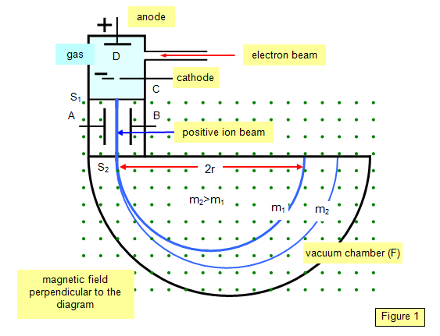
Mass Spectrometer
A positive ion is accelerated by a potential difference V enters a chamber of a uniform magnetic field. It moves in a semi circle and hits a photographic plate.
Use conservation of mechanical energy to find the velocity of the beam:
The radius of the semi circle is given by:
Substitute for v:
Solving this equation for m:
All quantities to the right are measurable.

Slide 4
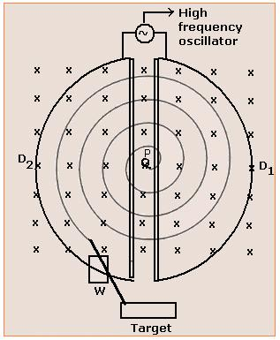
The two D shape hollow objects are made of copper (dees)
The oscillator alternates the electric potential difference at the gap between the dees.
The system is immersed in a uniform magnetic field
If a proton is ejected in the system at point P, it accelerates towards the negative dee. Once inside it, it is shielded from the electric field and will circle due to the magnetic field.
As it leaves the dee, it is accelerated by the electric field until et enters the second dee where it circles with a larger radius.
Note that each time the proton leaves a dee, the electric field reverses direction.
The frequency of the proton circulation is independent on its velocity.
The Cyclotron
Resonance occurs when the proton frequency equals the oscillator frequency.
Resonance condition
Therefore the oscillator frequency should equal:

Slide 5
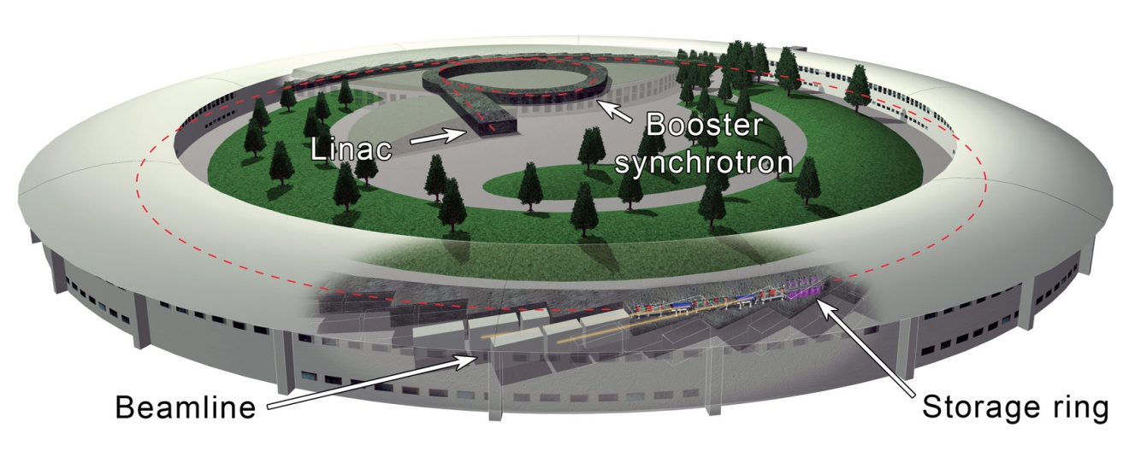
In the cyclotron, we assumed that the frequency of the circular path is independent on the velocity of the charged particle.
This is true for velocities that are much smaller than that of light. But if the velocity reach values that are a fraction of the speed of light this assumption fails.
Relativity shows that under such conditions the proton frequency decreases rapidly.
When that happens there is no more resonance condition and the proton and the oscillator frequencies are out of face.
As well, for energies more than 500Gev the radius of the needed radius of the cyclotron would be more than 1 Km. very expensive to do.
The Proton Synchrotron
In the Synchrotron those difficulties were met by:
Both the magnetic field and the oscillator frequency vary with time to keep the proton and oscillator frequencies in resonance.
The proton motion is made circular not spiral therefore lowering the cost dramatically.

Slide 6
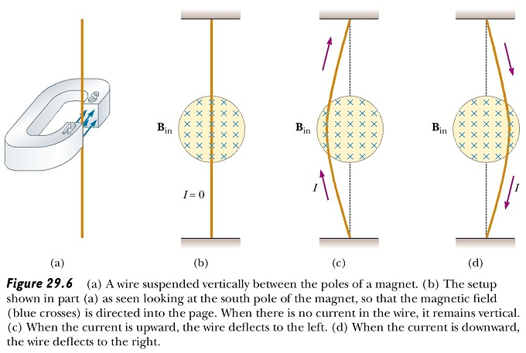
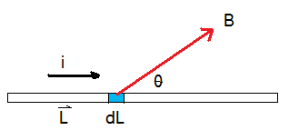
Magnetic force on a current-carrying conductor
If a current-carrying conducting wire is placed in a magnetic field as shown in the figure the charge carriers in the wire are subjected to a magnetic force. As the charge carriers can’t escape the wire, the wire itself will be deflected as shown in the figure.
Use the right hand rule to define the direction of the magnetic force
If the wire is not straight or the Magnetic field in not uniform we can divide the wire into small segments (dL) and find the magnetic force due to it and then add/integrate over the entire length

Slide 7
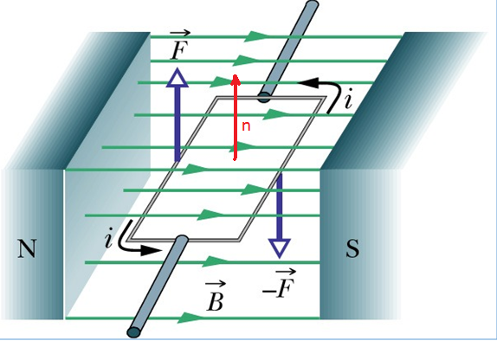
Torque on a current Loop
Assume that the plane of the loop is the X-Y plane and that the length of the loop is L and its width is W
The loop is divided in 4 sections.
For the two sections that are parallel to the magnetic field:
Therefore the magnetic force on both sections is zero
In the two sections that are perpendicular to the magnetic field line:
The right side
The left side
The loop can rotate about the shown axe

Slide 8
Torque on a current Loop II
If the loop consists of N turns
When the loop turns so that the angle between the direction of the current and that of the magnetic field is
As for the magnetic force on the current passing through the width of the loop, the magnetic force acts parallel to the axis of rotation therefore it does not contribute to the torque.
To simplify the direction analysis we can use the direction of a normal to the loop surface area (n). in any rotation the torque tends to rotate n towards the direction of the magnetic field. To define the direction of n Rotate your fingers with I, your thumb defines the direction of n.

Slide 9
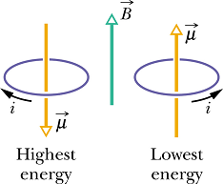
The magnetic dipole moment
We can describe the current-carrying loop by a single vector: magnetic dipole moment μ.
The direction of μ is defined in the figure.
Then the torque on the loop by the magnetic force is:
For example the work done by the magnetic field to rotate the dipole from
We can generalize this equation as:
The work done by an external agent needed to rotate the dipole from
Then the magnetic potential Energy is:
without a change in the K.E is:
The dipole has its minimum potential energy when:
The dipole has its maximum potential energy when:
When a magnetic dipole rotates from
The work done by the magnetic field is:

