Slide 1
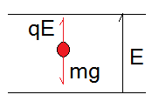
Point Charge in an Electric Field
The point charge will experience an electric force:
If q is positive F is in the direction of E, if negative F is in the opposite direction of E.
Millikan’s Experiment:
Measuring the electron charge (the elementary charge)
Freely falling charged drops of oil are subjected to un upwards constant electric field
By monitoring the motion of the drop, which moves under the influence of its weight and the electric force, Millikan managed to prove that charge is quantized and that the charge of the electron is a fundamental constant of nature.

Slide 2
Charge moving in a uniform E-field:
E-field
y
A particle with charge q and mass m and an initial velocity
Enters a region of a uniform E-field
As shown in the figure. How far it is
Deflected in the y-direction as it leaves the region?
x
q
L

Slide 3
Electrostatic Analyzer:
E field
Proton beam

Slide 4
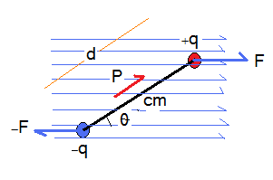
Dipole in an Electric Field
If a dipole is placed in a uniform electric field it will be subjected to torque and rotate about its center of mass.
The torque tends to rotate the dipole towards the direction of the Electric Field, therefore minimizing the angle between them

Slide 5
Potential Energy of an Electric Dipole
As the electric force is conservative, we can associate potential energy to a dipole in an electric field.
In rotational motion work is defined as:
It was found that the equation is simplified if we choose
The greatest U is at
When E and P are in opposite directions
And least at
When E and P are in the same directions

