Slide 1
Chapter 2
An Overview of the Financial System
Notes:
‹#›

Slide 2
Functions of Financial Markets
Perform the essential function of channeling funds from economic players that have saved surplus funds to those that have a shortage of funds
Promote economic efficiency by producing an efficient allocation of capital, which increases production
Directly improve the well-being of consumers by allowing them to time purchases better
Copyright © 2007 Pearson Addison-Wesley. All rights reserved.
2-‹#›
Notes:
‹#›

Slide 3
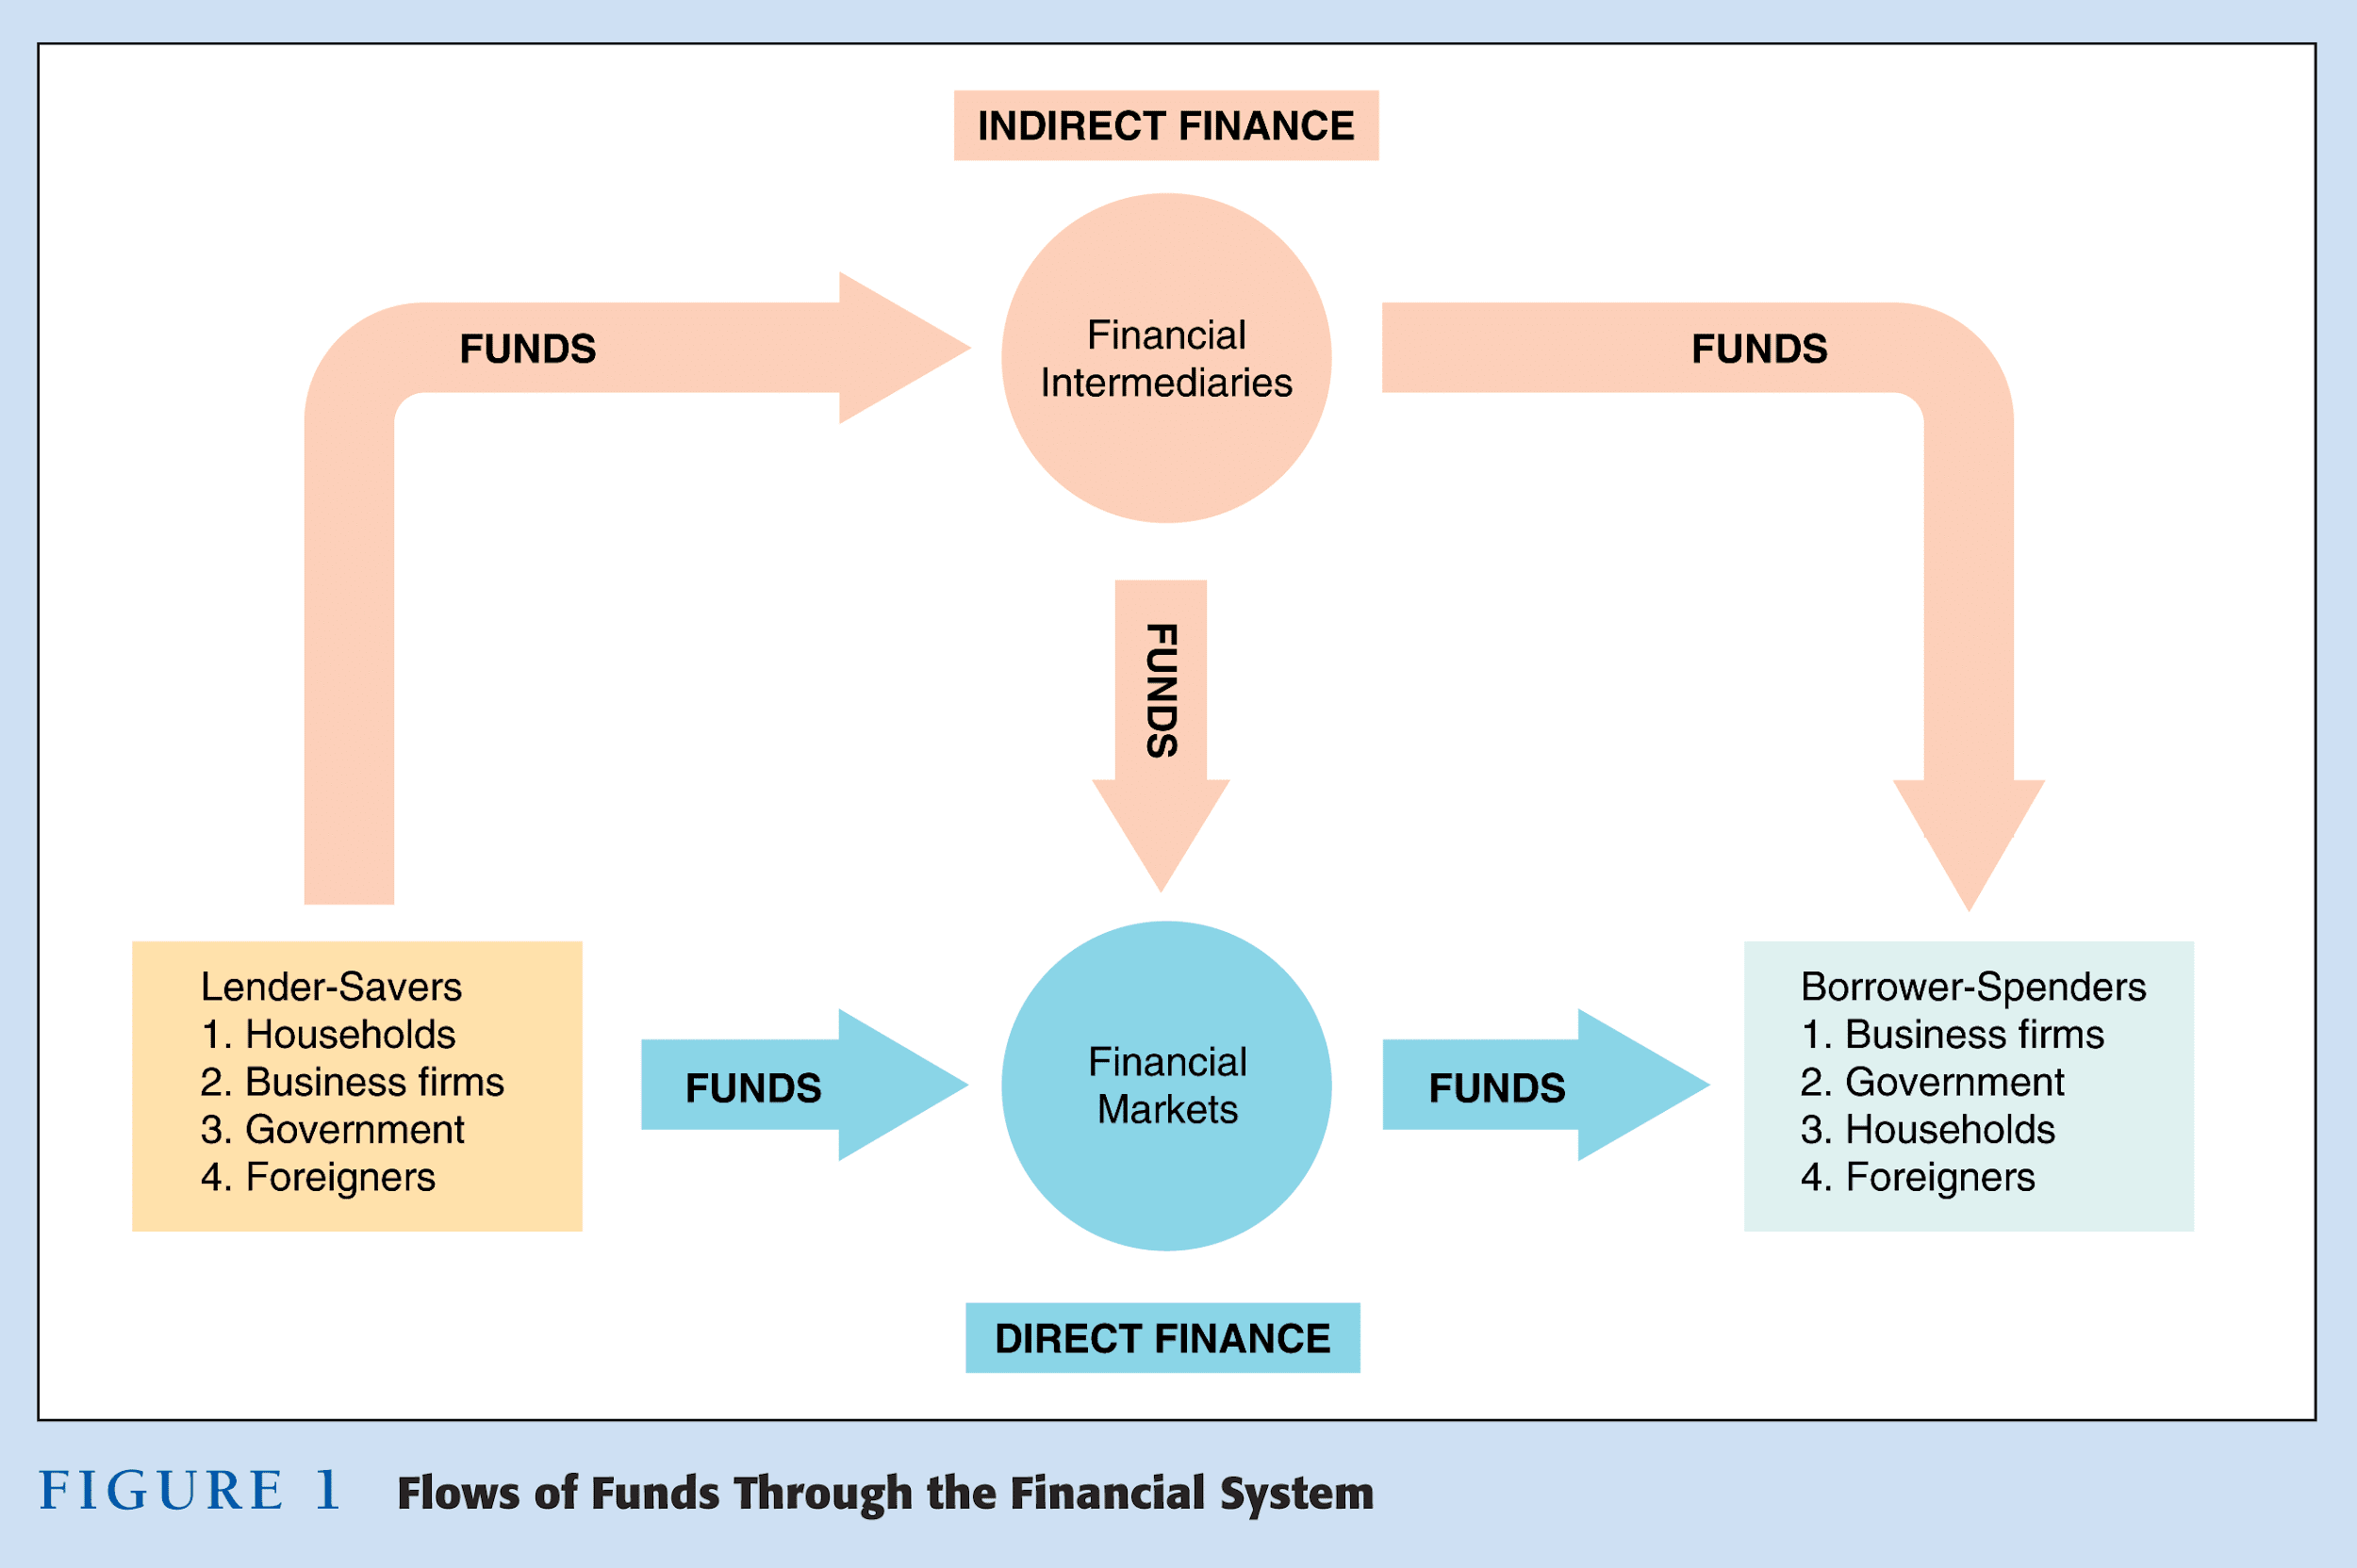
Copyright © 2007 Pearson Addison-Wesley. All rights reserved.
2-‹#›
Notes:
‹#›

Slide 4
Structure of Financial Markets (Classifications of them)
Debt and Equity Markets
Primary and Secondary Markets
Exchange and Over-the-Counter (OTC) Markets
Money and Capital Markets
Copyright © 2007 Pearson Addison-Wesley. All rights reserved.
2-‹#›
Notes:
‹#›

Slide 5
Debt and Equity Markets
Two methods to obtain funds (Debt & Equity)
Issue Debt instruments (bond or mortgage)
The debt is paid at regular intervals (principal + interest)
Maturity of the debt: number of years until expiration date
SR-term, LR-term, and intermediate.
Issue Equities
They are claims to share net income and assets of firms
Dividends
Voting and electing
Disadvantage: residual claimant
Advantage: profitability and assets
Copyright © 2007 Pearson Addison-Wesley. All rights reserved.
2-‹#›
Notes:
‹#›

Slide 6
Primary and Secondary Markets
PM in which new issues of securities (B & S) are sold to initial buyers by a firm or the gov. that borrow funds
Investment Banks underwrite securities in primary markets
Not very well-known
SM in which securities that have been previously issued can be resold
second hand
well-known
Brokers and dealers work in these markets
Brokers are agents of investors who match buyers & sellers
Dealers link buyers and sellers at a specific price
Copyright © 2007 Pearson Addison-Wesley. All rights reserved.
2-‹#›
Notes:
‹#›

Slide 7
Exchange and (OTC) Markets
They are methods to organize secondary markets
Exchange Markets:
Buyers and sellers of securities meet in one central location
Recall brokers and dealers
NY stock exchange market
Over-the-Counter (OTC) Markets:
Dealers at different locations stand ready to buy and sell securities OTC
Computer contact
Very competitive
Gov. bonds
The exchange markets are more popular than the (OTC)
Copyright © 2007 Pearson Addison-Wesley. All rights reserved.
2-‹#›
Notes:
‹#›

Slide 8
Money and Capital Markets
Money markets are financial markets in which only SR-term debt instrument are traded
Their maturity is less than one year
Capital markets are financial markets in which longer-term debt instrument are traded
Their maturity is one year or more
Copyright © 2007 Pearson Addison-Wesley. All rights reserved.
2-‹#›

Slide 9
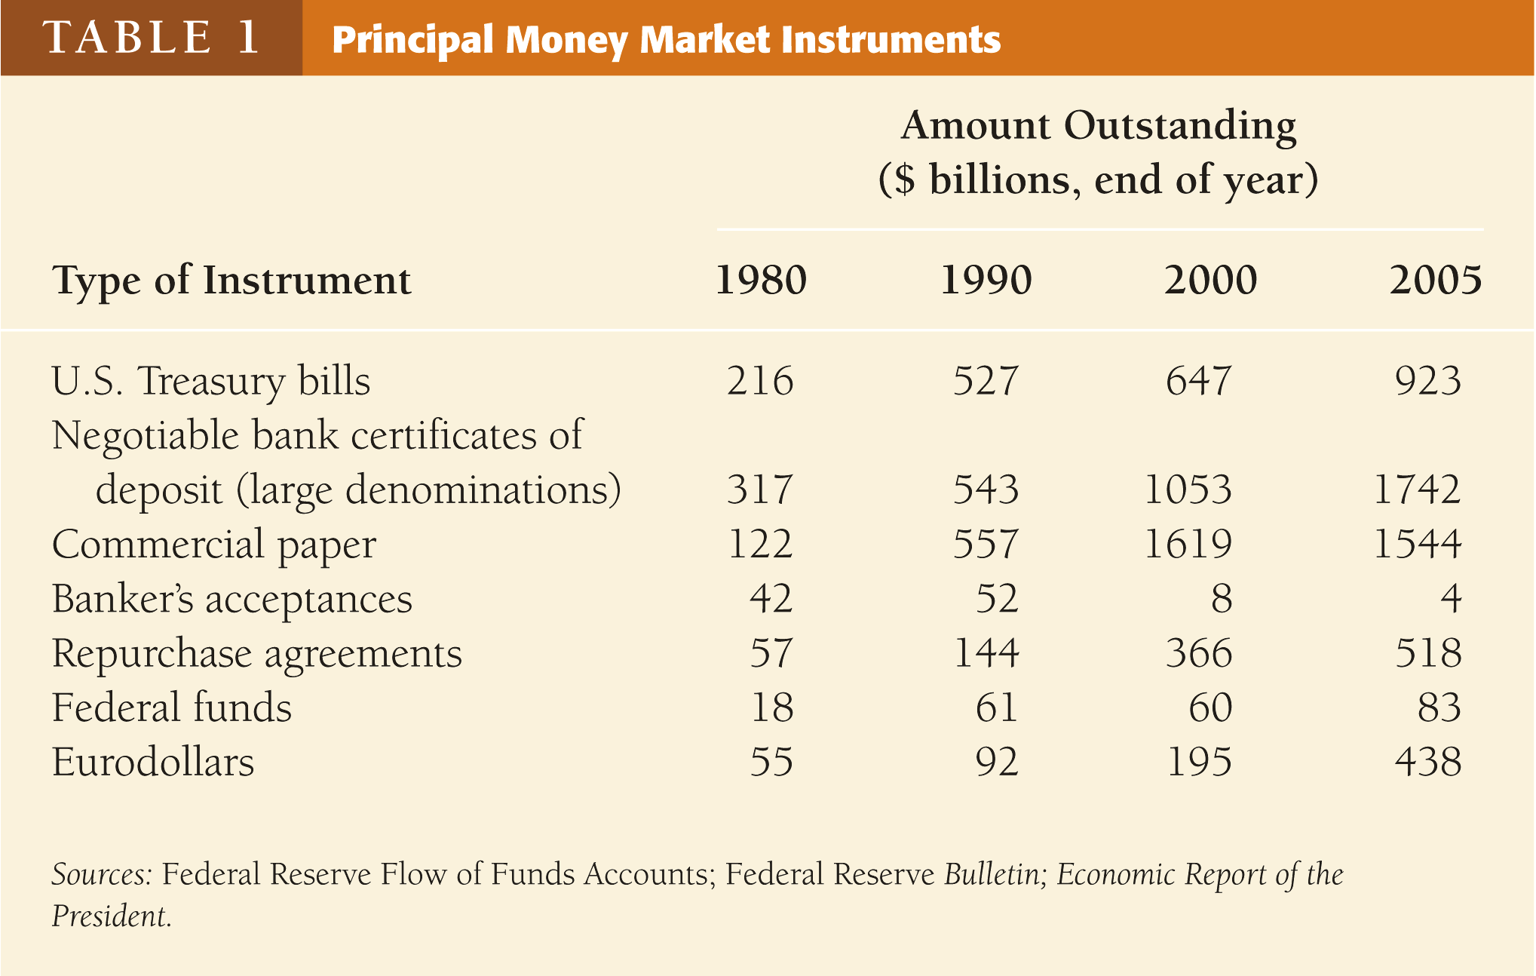
Copyright © 2007 Pearson Addison-Wesley. All rights reserved.
2-‹#›
Notes:
‹#›

Slide 10
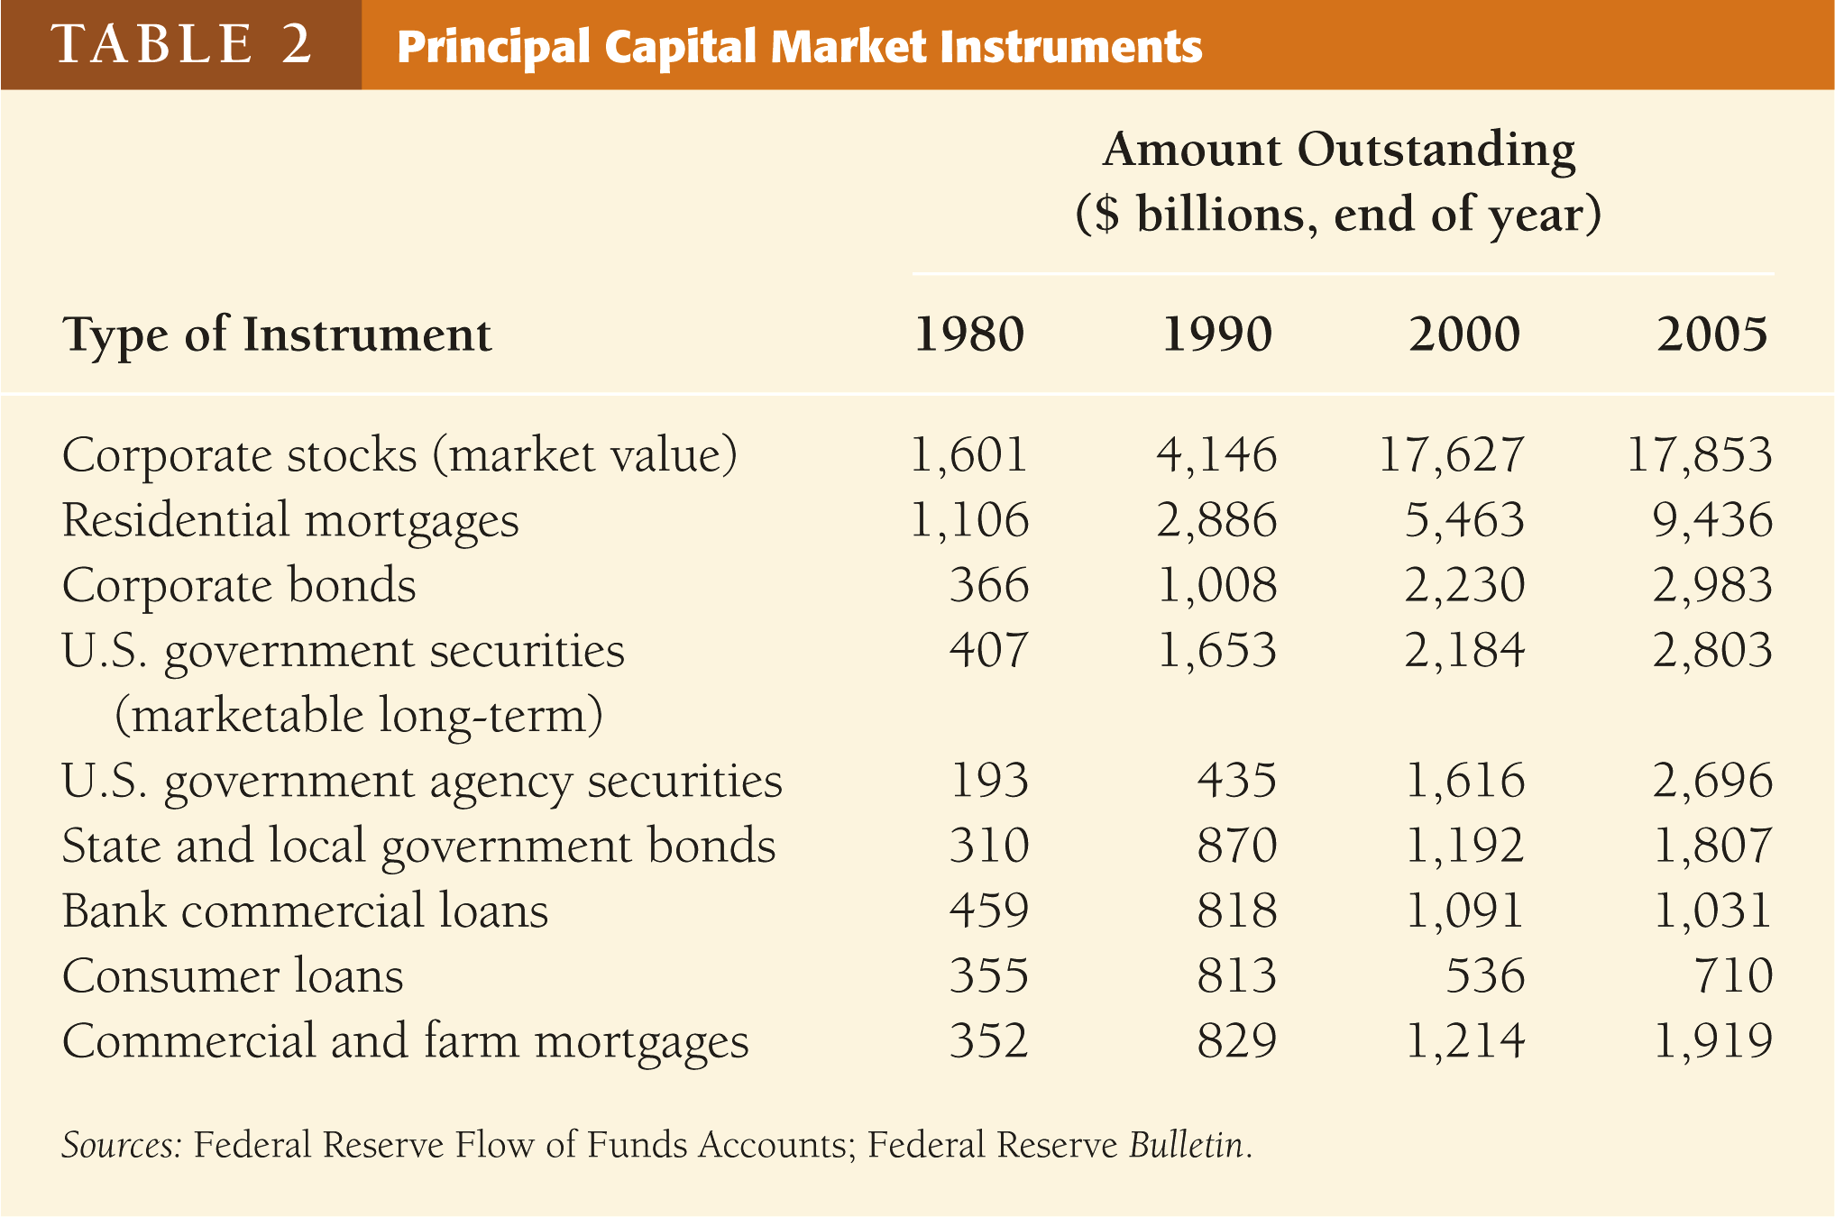
Copyright © 2007 Pearson Addison-Wesley. All rights reserved.
2-‹#›
Notes:
‹#›

Slide 11
Internationalization of Financial Markets
It is a trend
The dominance of the US financial market is disappearing
Growth of international financial markets is due to:
Large savings (Japan)
Deregulation of financial markets
Actions made:
Borrowing from foreign countries (Bonds)
Investing in foreign countries (Stocks)
Instruments of international fin. Market (Next)
Copyright © 2007 Pearson Addison-Wesley. All rights reserved.
2-‹#›
Notes:
‹#›

Slide 12
Instruments of International F. Markets
Foreign Bonds—bonds sold in a foreign country and denominated in that country’s currency
(German firm sells bonds in the US in $)
Eurobonds—bonds denominated in a currency other than that of the country in which it is sold
(bonds in $ sold in London)
Eurocurrencies—foreign currencies deposited in banks outside the home country or in foreign branches of national banks
Eurodollars—U.S. dollars deposited in foreign banks outside the U.S. or in foreign branches of U.S. banks
World Stock Markets
Copyright © 2007 Pearson Addison-Wesley. All rights reserved.
2-‹#›
Notes:
‹#›

Slide 13
Function of Financial Intermediaries: Indirect Finance
Lower transaction costs: time and money spent in carrying financial transactions:
Economies of scale
Liquidity services
Reduce Risk: uncertainty about returns earnings:
Risk Sharing (Asset Transformation)
Diversification
Asymmetric Information: unequal knowledge (L - B)
Adverse Selection (before the transaction)—more likely to select risky borrower
Moral Hazard (after the transaction)—undesirable behavior of a party to others
Copyright © 2007 Pearson Addison-Wesley. All rights reserved.
2-‹#›
Notes:
‹#›

Slide 14
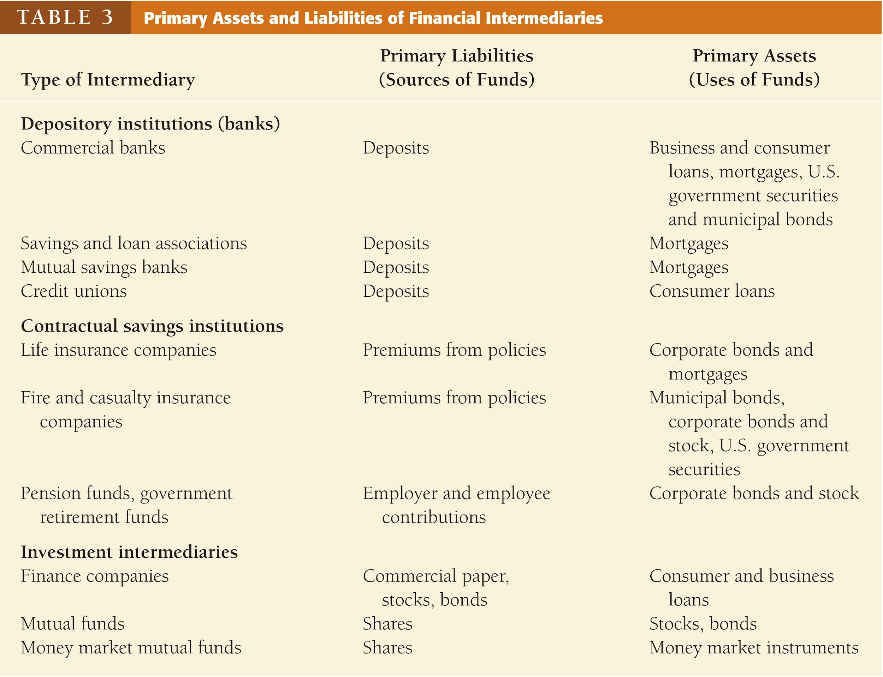
Copyright © 2007 Pearson Addison-Wesley. All rights reserved.
2-‹#›
Notes:
‹#›

Slide 15
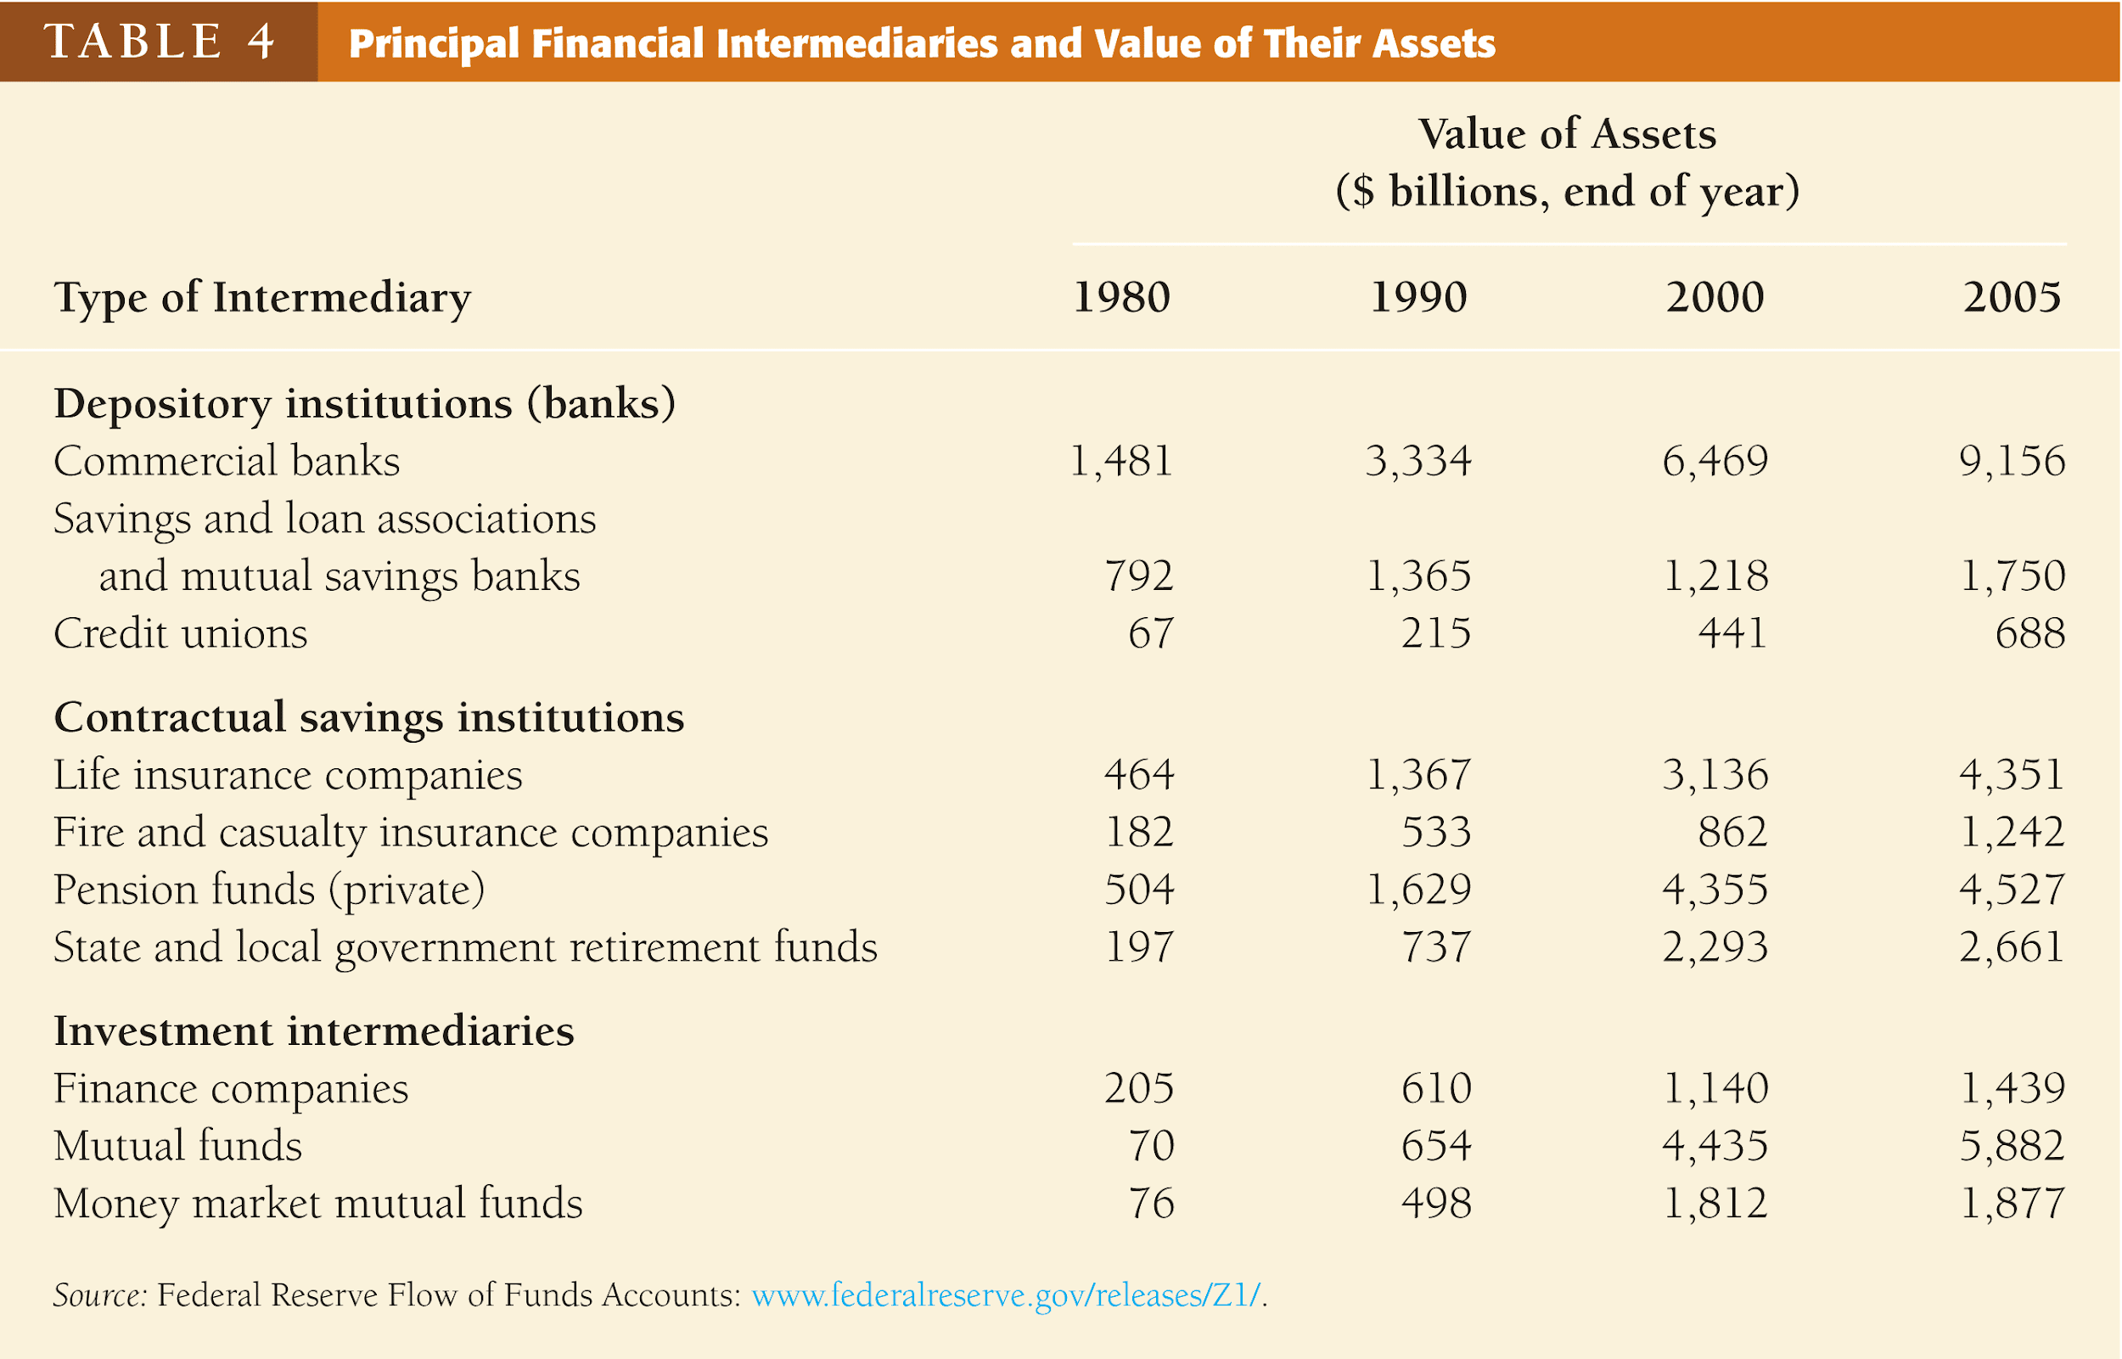
Copyright © 2007 Pearson Addison-Wesley. All rights reserved.
2-‹#›
Notes:
‹#›

Slide 16
Regulation of the Financial System
To increase the information available to investors:
Reduce adverse selection and moral hazard problems
Reduce insider trading
To ensure the soundness of financial intermediaries:
Restrictions on entry
Disclosure
Restrictions on Assets and Activities
Deposit Insurance
Limits on Competition
Restrictions on Interest Rates
Copyright © 2007 Pearson Addison-Wesley. All rights reserved.
2-‹#›
Notes:
‹#›

Slide 17
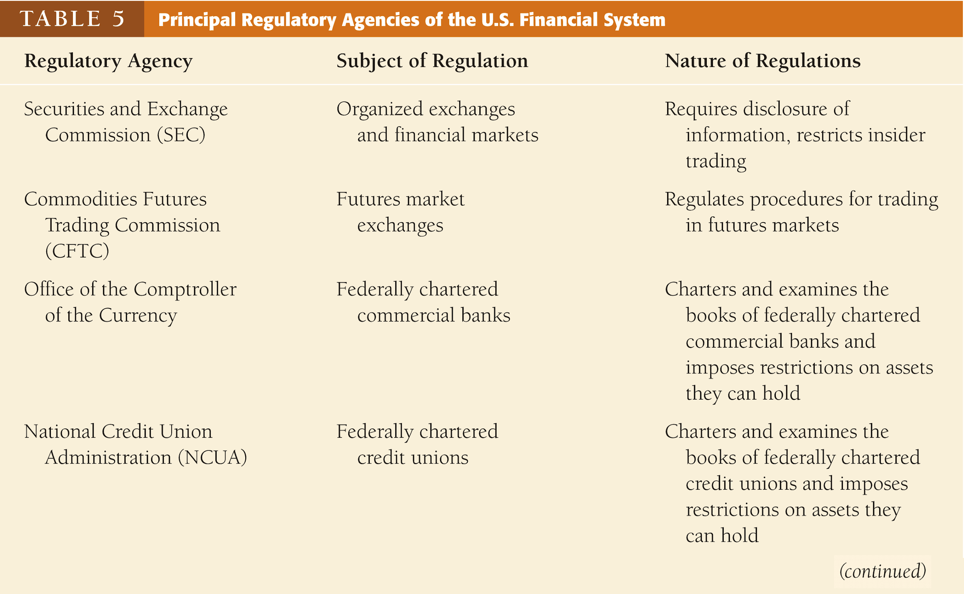
Copyright © 2007 Pearson Addison-Wesley. All rights reserved.
2-‹#›
Notes:
‹#›

Slide 18
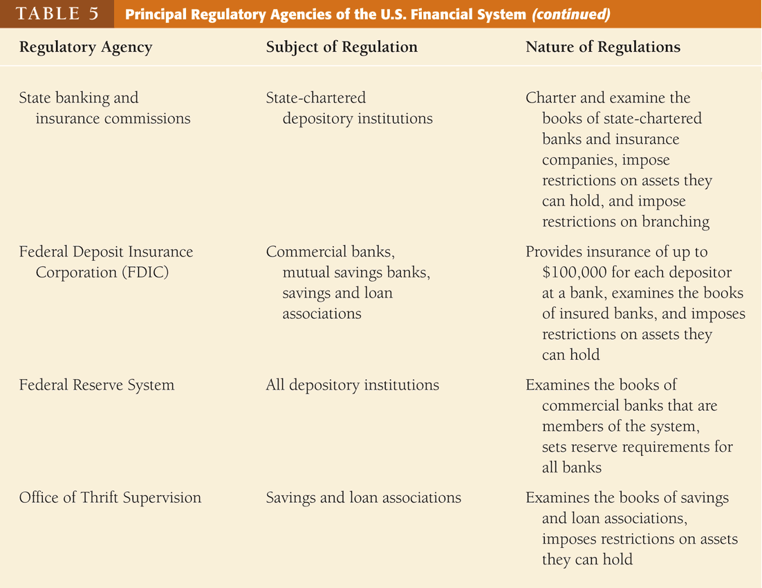
Copyright © 2007 Pearson Addison-Wesley. All rights reserved.
2-‹#›
Notes:
‹#›

Slide 19
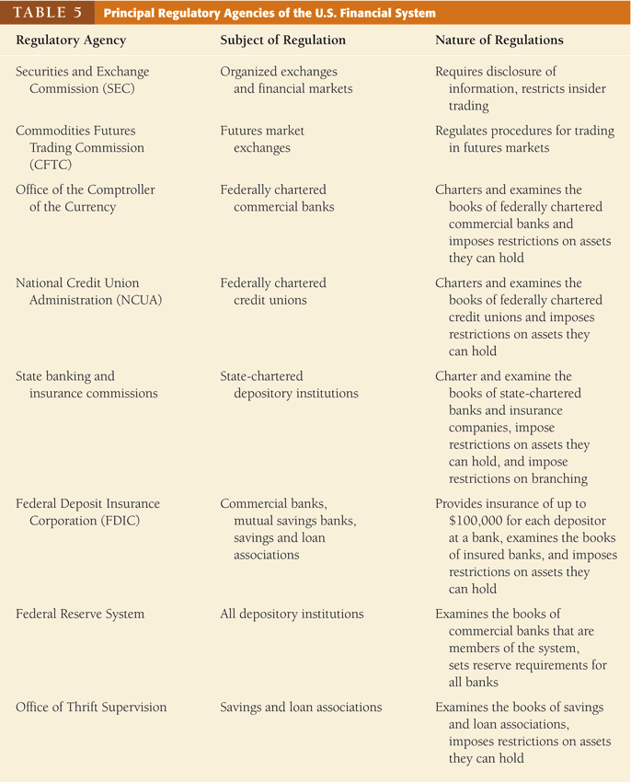
Copyright © 2007 Pearson Addison-Wesley. All rights reserved.
2-‹#›
Notes:
‹#›

