Slide 1
Chapter 3
What Is Money?
Notes:
‹#›

Slide 2
Meaning of Money
It is anything that is generally accepted in payment for goods or services or in the repayment of debts; (stock concept)
It includes currency (coins & bills) and checking account deposits.
Narrow vs. broad definition of money
Copyright © 2007 Pearson Addison-Wesley. All rights reserved.
3-‹#›
Notes:
‹#›

Slide 3
Wealth and Income
Wealth—the total collection of pieces of property that serve to store value (stock)
Example of collections: bonds, stocks, land, art, furniture, cars, houses, …
Income—flow of earnings per unit of time
Copyright © 2007 Pearson Addison-Wesley. All rights reserved.
3-‹#›

Slide 4
Functions of Money
Medium of Exchange— exchanging goods and services
Unit of Account— measure values in the economy
Store of Value— save purchasing power
Copyright © 2007 Pearson Addison-Wesley. All rights reserved.
3-‹#›

Slide 5
Medium of Exchange
Payments: currency and checks
It promotes economic efficiency by minimizing the time spent in exchanging G & S (vs. Barter)
Number of prices of a good
Double coincidence
Specialization in work
Characteristics of a commodity to function as money (next slide)
Copyright © 2007 Pearson Addison-Wesley. All rights reserved.
3-‹#›
Notes:
‹#›

Slide 6
Characteristics of a commodity to function as money
Must be easily standardized
Must be widely accepted
Must be divisible
Must be easy to carry
Must not deteriorate quickly
Must be scarce

Slide 7
Unit of Account
We need to measure values in the economy (meters & tons)
Money is used to measure values in the economy
Copyright © 2007 Pearson Addison-Wesley. All rights reserved.
3-‹#›

Slide 8
Store of Value
Most of people do not want to spend money immediately
Money is used to save purchasing power
Money is not the only thing that can be used as a store of value (other assets)
Money is the most liquid of all assets
However, it loses value during inflation
Why do people hold money (next slide)
Copyright © 2007 Pearson Addison-Wesley. All rights reserved.
3-‹#›

Slide 9
Why do people hold money? Why do they demand money
Transaction demand for money: to meet foreseen (expected) purchases
Precautionary demand for money: to meet unforeseen (unexpected) purchases
Speculative demand for money: to meet investment opportunities

Slide 10
Evolution of the Payments System
The payment system is the method of conducting transaction in the economy
The payment system and the form of money have been evolving
Copyright © 2007 Pearson Addison-Wesley. All rights reserved.
3-‹#›
Notes:
‹#›

Slide 11
Types of Payment Systems (Forms of Money)
Commodity Money
Fiat Money
Checks
Electronic Payment
E-Money
Copyright © 2007 Pearson Addison-Wesley. All rights reserved.
3-‹#›

Slide 12
Commodity Money
Money made up of precious metals or other valuable commodity
Gold and silver
Problem: very heavy and difficult to transport.
Copyright © 2007 Pearson Addison-Wesley. All rights reserved.
3-‹#›

Slide 13
Fiat Money
It is paper money decreed by the gov
It is a legal tender but not convertible into precious metals
It is much lighter than coins and precious metals, and there is a trust in the issuer
Problems: easily stolen and expensive to transport
Copyright © 2007 Pearson Addison-Wesley. All rights reserved.
3-‹#›

Slide 14
Checks
A check is an instrument (order) from you to your bank to pay a certain amount of money from your account to someone else
We do not need to carry large amounts of currency
They improve efficiency in the payment system (reduce the transaction cost)
Payment for large amounts
Loss from theft is reduced
Convenient receipts for purchases
Problems: time to be cleared, shuffling of paper is costly
3-‹#›
Copyright © 2007 Pearson Addison-Wesley. All rights reserved.

Slide 15
Electronic Payment
Payments of bills through the computer and the internet
Cheap, fast, less effort, fun
Europeans, then Americans, then the rest of developed countries and some of the developing countries
Copyright © 2007 Pearson Addison-Wesley. All rights reserved.
3-‹#›

Slide 16
e-Money
Money that exists only in electronic form
They are substitutes for cash
Three types of them
1. debit cards
2. stored-value cards
3. e-cash
Copyright © 2007 Pearson Addison-Wesley. All rights reserved.
3-‹#›

Slide 17
Debit Cards
They enable consumers to purchase G&S by electronically transferring funds directly from their bank accounts to a merchant account
They are used in the same places that accept credit cards
Copyright © 2007 Pearson Addison-Wesley. All rights reserved.
3-‹#›

Slide 18
Stored-Value Cards
They are more advanced than the debit cards
The simplest form of them is the prepaid cards
A more sophisticated form is called smart cards
A smart card contains a computer chip that allows it to be loaded with digital cash from the owner’s bank account whenever needed
Copyright © 2007 Pearson Addison-Wesley. All rights reserved.
3-‹#›

Slide 19
e-cash
It is used on the internet to purchase G&S
The consumer sets up an account with a bank that has links to the internet and then has the e-cash transferred from her PC
She surfs to a store on the web and click “buy”
E-cash transfers from her account to the merchant account
Copyright © 2007 Pearson Addison-Wesley. All rights reserved.
3-‹#›

Slide 20
Copyright © 2007 Pearson Addison-Wesley. All rights reserved.
3-‹#›
Notes:
‹#›

Slide 21
How Reliable are the Money Data?
Revisions are issued because:
Small depository institutions report infrequently
Adjustments must be made for seasonal variation
We probably should not pay much attention to short-run movements in the M^{s} numbers, but should be concerned only with longer-run movements
Copyright © 2007 Pearson Addison-Wesley. All rights reserved.
3-‹#›
Notes:
‹#›

Slide 22
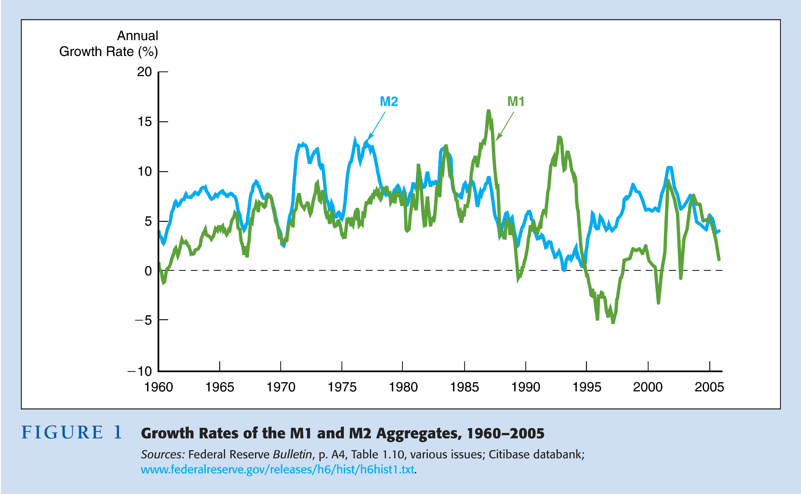
Copyright © 2007 Pearson Addison-Wesley. All rights reserved.
3-‹#›
Notes:
‹#›

Slide 23
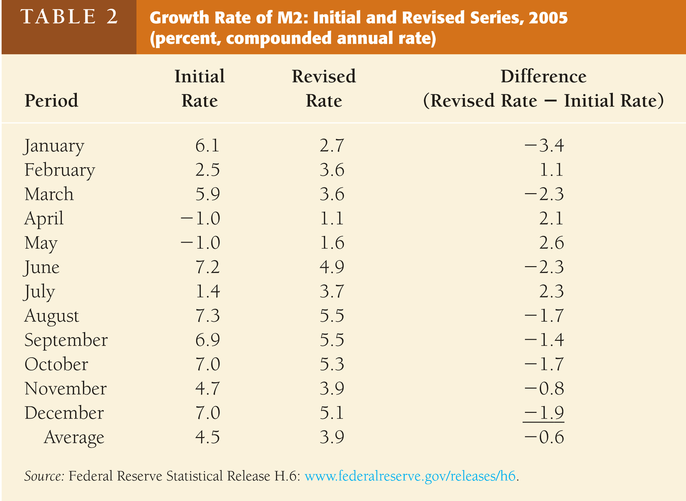
Copyright © 2007 Pearson Addison-Wesley. All rights reserved.
3-‹#›
Notes:
‹#›

