Slide 1
Chapter 4
Understanding Interest Rates
Notes:
‹#›

Slide 2
Democratic Parents
They offer you a JD1,000 now, or at your graduation party !!!!!!!!!!!!!!! Now for sure
1. a bird on a hand
2. inflation
3. investment
4. buy securities or deposit them in a bank
Copyright © 2007 Pearson Addison-Wesley. All rights reserved.
4-‹#›

Slide 3
Measuring Interest Rates
Different debt instruments have very different streams of cash payment to the holder with very different timing
Stream of cash payments to the holder is also called cash flows
Before measuring interest rates, we need to understand how can we compare the value of one kind of debt instrument to another.
Copyright © 2007 Pearson Addison-Wesley. All rights reserved.
4-‹#›

Slide 4
Present Value
A dollar paid to you one year from now is less valuable than a dollar paid to you today
Copyright © 2007 Pearson Addison-Wesley. All rights reserved.
4-‹#›
Notes:
‹#›

Slide 5
Discounting the Future
Copyright © 2007 Pearson Addison-Wesley. All rights reserved.
4-‹#›
Notes:
‹#›

Slide 6
Simple Present Value
Copyright © 2007 Pearson Addison-Wesley. All rights reserved.
4-‹#›
Notes:
‹#›

Slide 7
Application: You won a lottery of JD20m, but to be paid JD1m a year. Have you really won a JD20m? Absolutely NO
Year | Formula (PV) | Value of JD1m
1 | 1000,000 | 1,000,000
2 | 1,000,000/(1+0.1) | 909,090
3 | 1,000,000/(1+0.1)² | 826,446
…. | …. | ….
Sum |  | 9,400,000

Slide 8
Four Types of Credit Market Instruments
Simple Loan
Fixed Payment Loan
Coupon Bond
Discount Bond
Copyright © 2007 Pearson Addison-Wesley. All rights reserved.
4-‹#›
Notes:
‹#›

Slide 9
Yield to Maturity
Also called the internal rate of return
The interest rate that equates the present value of cash flow payments received from a debt instrument with its value today
Economists consider it the most accurate measure of interest rate
How is it calculated for the four kinds of debt instruments?
Copyright © 2007 Pearson Addison-Wesley. All rights reserved.
4-‹#›
Notes:
‹#›

Slide 10
Simple Loan
The lender provides the borrower with an amount of fund
Funds must be repaid to the lender at the maturity date along with an additional payment for the interest
eg.: commercial loans business
Copyright © 2007 Pearson Addison-Wesley. All rights reserved.
4-‹#›

Slide 11
Simple Loan—Yield to Maturity
Copyright © 2007 Pearson Addison-Wesley. All rights reserved.
4-‹#›
Notes:
‹#›

Slide 12
Fixed-payment Loan (Fully Amortized Loan)
The lender provides the borrower with an amount of fund
Funds must be repaid by making the same payment every period (a month)
The repayment consists of part of the principal and interest for a set number of years
eg.: installment loans, car loans, and mortgage loans
Copyright © 2007 Pearson Addison-Wesley. All rights reserved.
4-‹#›

Slide 13
Fixed Payment Loan— Yield to Maturity
Copyright © 2007 Pearson Addison-Wesley. All rights reserved.
4-‹#›
Notes:
‹#›

Slide 14
Application
You decide to purchase a new home and need JD100,000 mortgage. You take out a loan from a bank that has an interest rate of 7%. What is the yearly payment to the bank to pay of the loan in 20 years?

Slide 15
Coupon Bond
It pays the owner of the bond a fixed interest payment (coupon payment) every year until the maturity date, when a specified final amount (face value or par value) is repaid
Name?
Coupon information: issuer, maturity, and the coupon rate
eg.: treasury bond and corporate bonds
Copyright © 2007 Pearson Addison-Wesley. All rights reserved.
4-‹#›

Slide 16
Coupon Bond—Yield to Maturity
Copyright © 2007 Pearson Addison-Wesley. All rights reserved.
4-‹#›
Notes:
‹#›

Slide 17
Application
Find the price of 1 10% coupon bond with a face value of JD1000, a 12.25% yield to maturity, and 8 years to maturity

Slide 18
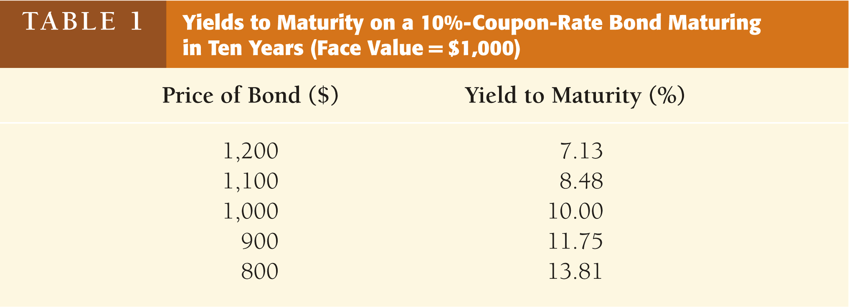
When the coupon bond is priced at its face value, the yield to maturity equals the coupon rate
The price of a coupon bond and the yield to maturity are negatively related
The yield to maturity is greater than the coupon rate when the bond price is below its face value
Copyright © 2007 Pearson Addison-Wesley. All rights reserved.
4-‹#›
Notes:
‹#›

Slide 19
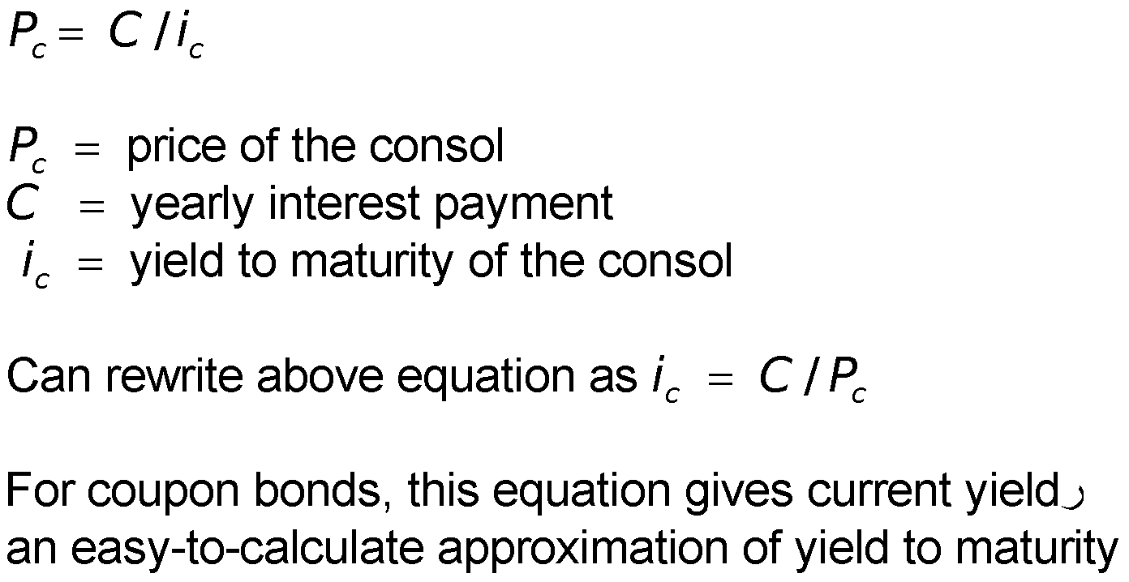
Consol or Perpetuity
A bond with no maturity date that does not repay principal but pays fixed coupon payments forever
Copyright © 2007 Pearson Addison-Wesley. All rights reserved.
4-‹#›
Notes:
‹#›

Slide 20
Discount Bond (Zero coupon Bond)
It is bought at a price below its face value (at a discount)
The face value is repaid at the maturity date
A discount bond does not make any interest payment; it just pays off the face value
eg.: treasury bills and saving bonds
Copyright © 2007 Pearson Addison-Wesley. All rights reserved.
4-‹#›

Slide 21
Discount Bond—Yield to Maturity
Copyright © 2007 Pearson Addison-Wesley. All rights reserved.
4-‹#›
Notes:
‹#›

Slide 22
Yield on a Discount Basis
Copyright © 2007 Pearson Addison-Wesley. All rights reserved.
4-‹#›
Notes:
‹#›

Slide 23
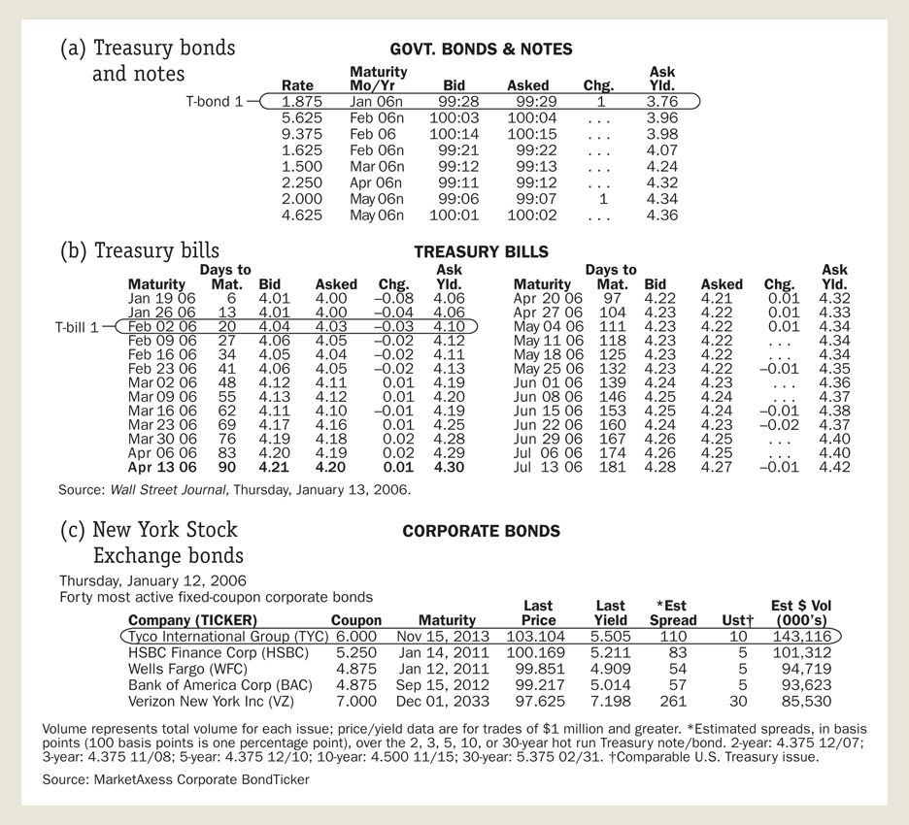
Following the Financial News: Bond Prices and Interest Rates
Notes:
‹#›

Slide 24
Rate of Return
Copyright © 2007 Pearson Addison-Wesley. All rights reserved.
4-‹#›
Notes:
‹#›

Slide 25
Copyright © 2007 Pearson Addison-Wesley. All rights reserved.
4-‹#›

Slide 26
Rate of Return and Interest Rates
The return equals the yield to maturity only if the holding period equals the time to maturity
A rise in interest rates is associated with a fall in bond prices, resulting in a capital loss if time to maturity is longer than the holding period
The more distant a bond’s maturity, the greater the size of the percentage price change associated with an interest-rate change
Copyright © 2007 Pearson Addison-Wesley. All rights reserved.
4-‹#›
Notes:
‹#›

Slide 27
Rate of Return and Interest Rates (cont’d)
The more distant a bond’s maturity, the lower the rate of return that occurs as a result of an increase in the interest rate
Even if a bond has a substantial initial interest rate, its return can be negative if interest rates rise
Copyright © 2007 Pearson Addison-Wesley. All rights reserved.
4-‹#›
Notes:
‹#›

Slide 28
Interest-Rate Risk
Prices and returns for long-term bonds are more volatile than those for shorter-term bonds
There is no interest-rate risk for any bond whose time to maturity matches the holding period
Copyright © 2007 Pearson Addison-Wesley. All rights reserved.
4-‹#›
Notes:
‹#›

Slide 29
Real and Nominal Interest Rates
Nominal interest rate makes no allowance for inflation
Real interest rate is adjusted for changes in price level so it more accurately reflects the cost of borrowing
Ex ante real interest rate is adjusted for expected changes in the price level
Ex post real interest rate is adjusted for actual changes in the price level
Copyright © 2007 Pearson Addison-Wesley. All rights reserved.
4-‹#›
Notes:
‹#›

Slide 30
Fisher Equation
Copyright © 2007 Pearson Addison-Wesley. All rights reserved.
4-‹#›
Notes:
‹#›

Slide 31
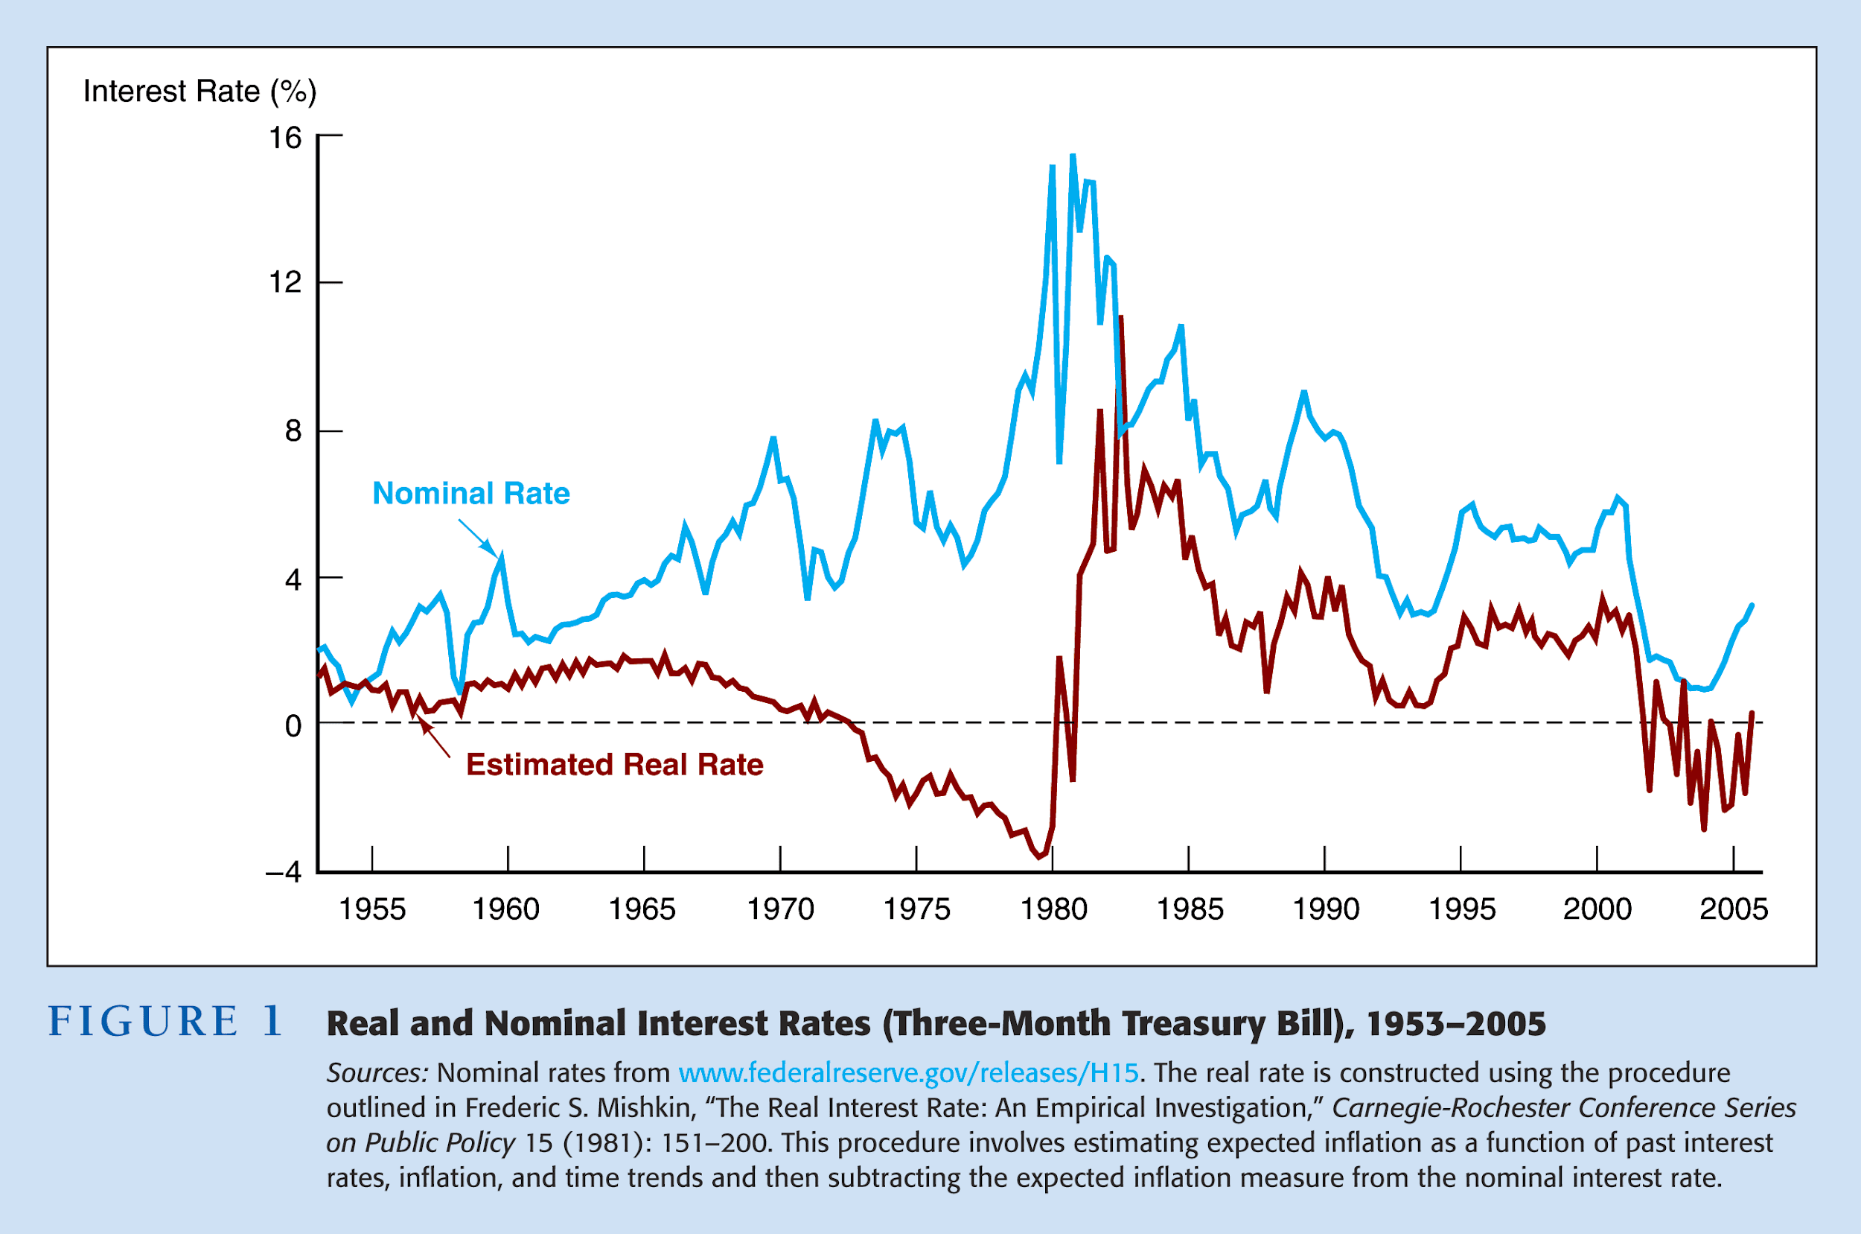
Copyright © 2007 Pearson Addison-Wesley. All rights reserved.
4-‹#›
Notes:
‹#›

