Slide 1
Chapter 9
Banking and the Management of Financial Institutions
Notes:
‹#›

Slide 2
Introduction
Banking plays a major role in channeling funds
The financial activity is important in ensuring that the financial system and the economy run smoothly and efficiently
Banks provide loans to business
They help us in purchasing houses and finance our education …
How banking is conducted to maximize profits
Copyright © 2007 Pearson Addison-Wesley. All rights reserved.
9-‹#›

Slide 3
The Bank Balance Sheet
It is a list of bank’s assets and liabilities
This list balances
Total Assets = Total Liabilities + capital
Liabilities are sources of bank funds
Assets are the uses of those funds
Examples of sources of funds: borrowing and deposits
Examples of uses of funds: lending and securities
Copyright © 2007 Pearson Addison-Wesley. All rights reserved.
9-‹#›

Slide 4
The Banks Profits
Banks make profits
They charge an interest rate on their holdings of securities and loans
They make expenses on their liabilities
The interest charged is higher than the expenses
Look at the example of banks balance sheet
Copyright © 2007 Pearson Addison-Wesley. All rights reserved.
9-‹#›

Slide 5
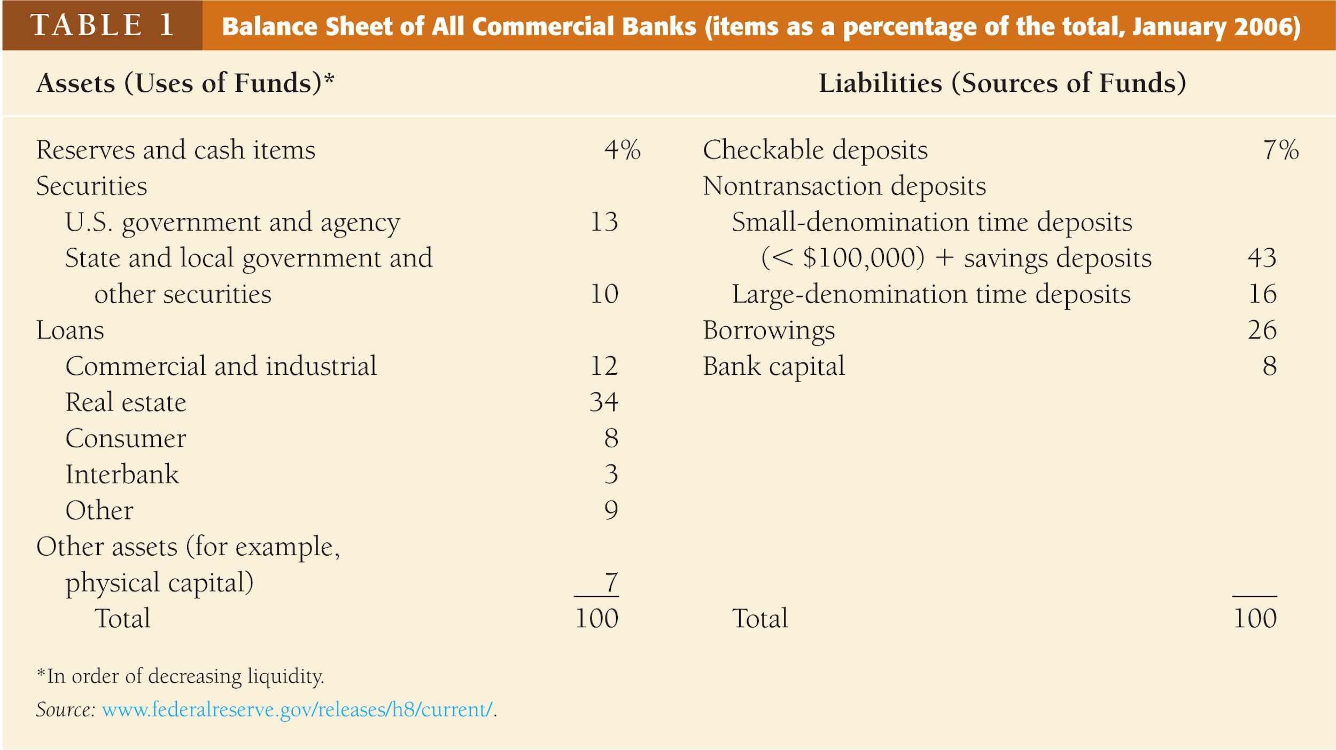
Copyright © 2007 Pearson Addison-Wesley. All rights reserved.
9-‹#›
Notes:
‹#›

Slide 6
Liabilities: Checkable Deposits
They are bank accounts that allow the owner of the account to write checks to third parties
Examples: non-interest bearing demand deposits, NOW, and MMDAs
Differences between DDs and MMDAs: no required reserves and not included in M₁
They are payable on demand
They are assets for the depositor
They are the lowest cost source of funds
Copyright © 2007 Pearson Addison-Wesley. All rights reserved.
9-‹#›

Slide 7
Liabilities: Non-transaction Deposits
They are the primary source of funds
Owners cannot write checks to third parties
The interest rate is higher than that on DDs
Saving deposits: add/withdraw at any time, and interest is recorded accordingly
Time deposits: fixed maturity length, substantial penalties for early withdrawal, and interest rate
Small-denomination time deposits: liquidity, interest, and cost
Large-denomination: corporations, negotiable, resold in secondary markets, alternatives
Copyright © 2007 Pearson Addison-Wesley. All rights reserved.
9-‹#›

Slide 8
Liabilities: Borrowing
From the CB, other banks, and corporations
Discount loans (advances)
Overnight: from the CB, other banks, other financial institutions
Overnight loans to meet the required reserves
From their parent companies, loan arrangement with corporations, Eurodollars
Copyright © 2007 Pearson Addison-Wesley. All rights reserved.
9-‹#›

Slide 9
Liabilities: Bank Capital
The bank’s net worth
The difference between total assets and total liabilities
Selling new equity (stocks) or from retained earnings
Bank capital is a cushion against a drop in the value of its assets (insolvency or liquidation)
Copyright © 2007 Pearson Addison-Wesley. All rights reserved.
9-‹#›

Slide 10
Assets: Reserves
Deposits at the CB
Currency at the bank (vault, teller, ATM)
Purpose:
1. required reserves (regulation rrr)
2. excess reserves (most liquid asset and used to meet obligations: withdrawals directly or indirectly)
Copyright © 2007 Pearson Addison-Wesley. All rights reserved.
9-‹#›

Slide 11
Assets: Cash Items in the Process of Collection
Checks are written on accounts at other banks
These checks are deposited at your bank
Time needed to clear the check
Needs few days
Copyright © 2007 Pearson Addison-Wesley. All rights reserved.
9-‹#›

Slide 12
Deposits at other Banks
Small banks hold deposits at large banks
They do that in exchange of a variety of services: check collection, foreign exchange transactions, security purchases (correspondent banking)
Cash items: reserves + cash in process of collection + deposits at other banks
Copyright © 2007 Pearson Addison-Wesley. All rights reserved.
9-‹#›

Slide 13
Assets: Securities
The most important income earning asset (Debt instrument)
Banks are not allowed to hold stocks
Categories: government and others
Short term gov. securities: secondary reserves
Banks prefer gov. securities (interest + risk)
Copyright © 2007 Pearson Addison-Wesley. All rights reserved.
9-‹#›

Slide 14
Assets: loans
Banks make profit by making loans
The loan is a liability for the borrower
It is an asset to the bank (generates income)
Loans are less liquid than other assets (maturity)
inter banks loans
Copyright © 2007 Pearson Addison-Wesley. All rights reserved.
9-‹#›

Slide 15
Assets: Other Assets
Physical capital:
Buildings
Computers
Other equipments
Copyright © 2007 Pearson Addison-Wesley. All rights reserved.
9-‹#›

Slide 16
Basic Banking
Recall how banks make profits
Asset transformation process is the process of selling liabilities with a set of characteristics and using the proceeds to buy assets with a different set of characteristics
Characteristics: liquidity, risk, size, return
Asset transformation and providing other services is the production process of banks
Operation of banks through T-accounts which are a simplified balance sheet that list only changes in the balance sheet
9-‹#›

Slide 17
Basic Banking—Cash Deposit
First National Bank |  |  |  | First National Bank
Assets |  | Liabilities |  | Assets |  | Liabilities
Vault Cash | +$100 | Checkable deposits | +$100 | Reserves | +$100 | Checkable deposits | +$100
Opening of a checking account leads to an increase in the bank’s reserves equal to the increase in checkable deposits
Copyright © 2007 Pearson Addison-Wesley. All rights reserved.
9-‹#›
Notes:
‹#›

Slide 18
Basic Banking—Check Deposit
First National Bank
Assets |  | Liabilities
Cash items in process of collection | +$100 | Checkable deposits | +$100
First National Bank |  |  |  | Second National Bank
Assets |  | Liabilities |  | Assets |  | Liabilities
Reserves | +$100 | Checkable deposits | +$100 | Reserves | -$100 | Checkable deposits | -$100
Copyright © 2007 Pearson Addison-Wesley. All rights reserved.
9-‹#›
Notes:
‹#›

Slide 19
Basic Banking—Making a Profit
First National Bank |  |  |  |  | First National Bank
Assets |  | Liabilities |  |  | Assets |  | Liabilities
Required reserves | +$10 | Checkable deposits | +$100 |  | Required reserves | +$10 | Checkable deposits | +$100
Excess reserves | +$90 |  |  |  | Loans | +$90
Asset transformation-selling liabilities with one set of characteristics and using the proceeds to buy assets with a different set of characteristics
The bank borrows short and lends long
Copyright © 2007 Pearson Addison-Wesley. All rights reserved.
9-‹#›
Notes:
‹#›

Slide 20
Bank Management
Liquidity Management
Asset Management
Liability Management
Capital Adequacy Management
Copyright © 2007 Pearson Addison-Wesley. All rights reserved.
9-‹#›
Notes:
‹#›

Slide 21
Liquidity Management
It is the acquisition of sufficiently liquid assets to meet the banks obligations to depositors (withdrawals)
How the bank deals with deposit outflows as a result of depositors withdrawals
Copyright © 2007 Pearson Addison-Wesley. All rights reserved.
9-‹#›

Slide 22
Liquidity Management: Ample Excess Reserves
Assets |  | Liabilities |  |  | Assets |  | Liabilities
Reserves | $20M | Deposits | $100M |  | Reserves | $10M | Deposits | $90M
Loans | $80M | Bank Capital | $10M |  | Loans | $80M | Bank Capital | $10M
Securities | $10M |  |  |  | Securities | $10M
If a bank has ample excess reserves, a deposit outflow does not necessitate changes in other parts of its balance sheet
Copyright © 2007 Pearson Addison-Wesley. All rights reserved.
9-‹#›
Notes:
‹#›

Slide 23
Liquidity Management: Shortfall in Reserves
Assets |  | Liabilities |  |  | Assets |  | Liabilities
Reserves | $10M | Deposits | $100M |  | Reserves | $0 | Deposits | $90M
Loans | $90M | Bank Capital | $10M |  | Loans | $90M | Bank Capital | $10M
Securities | $10M |  |  |  | Securities | $10M
Required Reserves are a legal requirement and the shortfall must be eliminated
Excess reserves are insurance against the costs associated with deposit outflows
Copyright © 2007 Pearson Addison-Wesley. All rights reserved.
9-‹#›
Notes:
‹#›

Slide 24
Tools of Liquidity Management
Borrowing
Securities sales
Federal reserves
Reduce loans
Copyright © 2007 Pearson Addison-Wesley. All rights reserved.
9-‹#›

Slide 25
Liquidity Management: Borrowing
Assets |  | Liabilities
Reserves | $9M | Deposits | $90M
Loans | $90M | Borrowing | $9M
Securities | $10M | Bank Capital | $10M
Cost incurred is the interest rate paid on the borrowed funds
Copyright © 2007 Pearson Addison-Wesley. All rights reserved.
9-‹#›
Notes:
‹#›

Slide 26
Liquidity Management: Securities Sale
Assets |  | Liabilities
Reserves | $9M | Deposits | $90M
Loans | $90M | Bank Capital | $10M
Securities | $1M
The cost of selling securities is the brokerage and other transaction costs
Copyright © 2007 Pearson Addison-Wesley. All rights reserved.
9-‹#›
Notes:
‹#›

Slide 27
Liquidity Management: Federal Reserve
Assets |  | Liabilities
Reserves | $9M | Deposits | $90M
Loans | $90M | Borrow from Fed | $9M
Securities | $10M | Bank Capital | $10M
Borrowing from the Fed also incurs interest payments based on the discount rate
Copyright © 2007 Pearson Addison-Wesley. All rights reserved.
9-‹#›
Notes:
‹#›

Slide 28
Liquidity Management: Reduce Loans
Assets |  | Liabilities
Reserves | $9M | Deposits | $90M
Loans | $81M | Bank Capital | $10M
Securities | $10M
Reduction of loans is the most costly way of acquiring reserves
Calling in loans antagonizes customers
Other banks may only agree to purchase loans at a substantial discount
Copyright © 2007 Pearson Addison-Wesley. All rights reserved.
9-‹#›
Notes:
‹#›

Slide 29
Asset Management: Three Goals
Managers must pursue low level of risk by acquiring assets that have a low rate of default and by diversifying asset holding
In order to maximize, its profits, banks must:
1. Seek the highest possible returns on loans and securities
2. Reduce risk
3. Have adequate liquidity
Copyright © 2007 Pearson Addison-Wesley. All rights reserved.
9-‹#›
Notes:
‹#›

Slide 30
Asset Management: Four Tools
Find borrowers who will pay high interest rates and have low possibility of defaulting
Purchase securities with high returns and low risk
Lower risk by diversifying
Balance need for liquidity against increased returns from less liquid assets
Copyright © 2007 Pearson Addison-Wesley. All rights reserved.
9-‹#›
Notes:
‹#›

Slide 31
Liability Management
Managers should acquire funds at low cost
Recent phenomenon due to rise of money center banks
Expansion of overnight loan markets and new financial instruments
Checkable deposits have decreased in importance as source of bank funds
Banks set target goals for their asset growth and try to acquire funds as needed
Asset-Liability management
Copyright © 2007 Pearson Addison-Wesley. All rights reserved.
9-‹#›
Notes:
‹#›

Slide 32
Capital Adequacy Management
Managers must decide how much of capital the bank should maintain
Capital is needed for three reasons:
1. Bank capital helps prevent bank failure
2. The amount of capital affects return for the owners (equity holders) of the bank
3. Regulatory requirement (minimum)
Copyright © 2007 Pearson Addison-Wesley. All rights reserved.
9-‹#›
Notes:
‹#›

Slide 33
Capital Adequacy Management: Preventing Bank Failure When Assets Decline
High Bank Capital |  |  |  | Low Bank Capital
Assets |  | Liabilities |  | Assets |  | Liabilities
Reserves | $10M | Deposits | $90M | Reserves | $10M | Deposits | $96M
Loans | $90M | Bank Capital | $10M | Loans | $90M | Bank Capital | $4M
High Bank Capital |  |  |  | Low Bank Capital
Assets |  | Liabilities |  | Assets |  | Liabilities
Reserves | $10M | Deposits | $90M | Reserves | $10M | Deposits | $96M
Loans | $85M | Bank Capital | $5M | Loans | $85M | Bank Capital | -$1M
Copyright © 2007 Pearson Addison-Wesley. All rights reserved.
9-‹#›
Notes:
‹#›

Slide 34
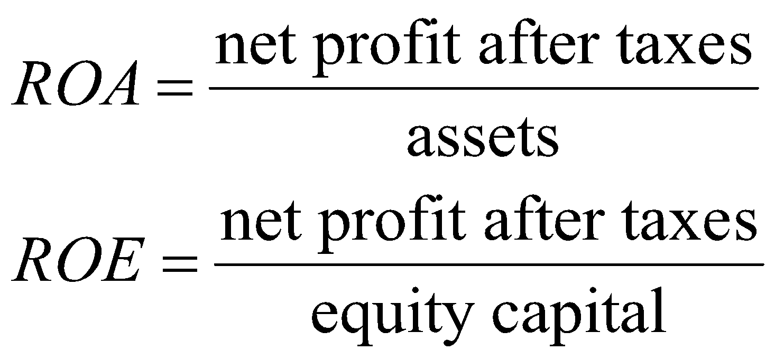
Capital Adequacy Management: Returns to Equity Holders
Return on Assets is net profit after taxes per dollar of assets (ROA)
Return on Equity is the net profit after taxes per dollar of equity capital (ROE)
Copyright © 2007 Pearson Addison-Wesley. All rights reserved.
9-‹#›

Slide 35
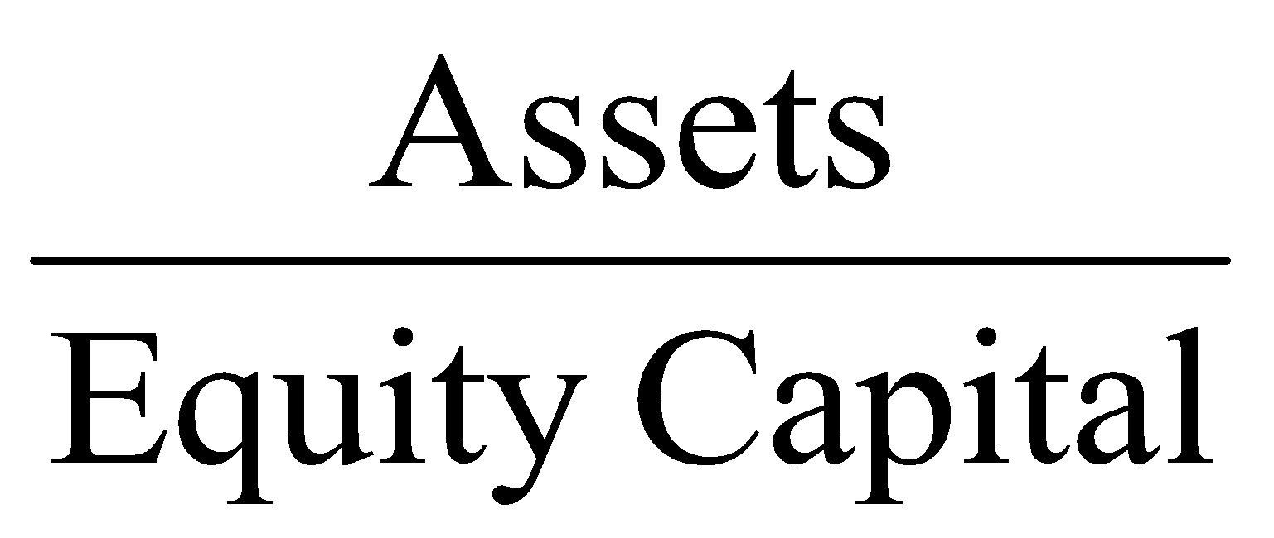
Relationship between ROA &ROE
This relationship is expressed by the equity multiplier (EM)
EM is the amount of assets per dollar of equity:
Copyright © 2007 Pearson Addison-Wesley. All rights reserved.
9-‹#›

Slide 36
The Equation
It shows what happens to returns on equity when a bank holds smaller amount of capital (equity) for a given amount of assets
Back to the two banks in our example above and assuming that both have the same ROA (1%), H’s ROE= 1(10)=10% and L’s ROE= 1(25)=25%
The situation of L is better than H
Conclusion: Given ROA, the lower the bank capital, the higher the return for owners of the bank.

Slide 37
Capital Adequacy Management: Safety
Benefits the owners of a bank by making their investment safe
Costly to owners of a bank because the higher the bank capital, the lower the return on equity
Choice depends on the state of the economy and levels of confidence
Copyright © 2007 Pearson Addison-Wesley. All rights reserved.
9-‹#›
Notes:
‹#›

