Slide 1
Chapter 14
The Money Supply Process

Slide 2
Players in the Money Supply Process
Central bank (main player)
Banks (depository institutions; financial intermediaries)
Depositors (individuals and institutions)
Borrowers (individuals and institutions)

Slide 3
CB’s Balance Sheet
Assets | Liabilities
Government Securities | Currency in Circulation
Discount Loans | Reserves
Liabilities:
Currency in circulation—in the hands of the public (IOU, acceptable: by law or general agreement)
Reserves—bank deposits at the CB and vault cash (Assets for banks: required and excess reserves)
An increase in either of them will increase money supply
Assets:
Government securities—holdings by the CB that affect money supply and earn interest
Discount loans—provide reserves to banks and earn the discount rate. Importance: 1) change in assets → change in R→Ms. 2) CBs make millions of $ (interest)

Slide 4
Monetary Base
High-powered money
MB = C + R
C = currency in circulation
R = total reserves in the banking system
The CB controls the MB using two methods:
1) Open Market Operations (OMO) - OMP (increase MB) - OMS (decrease MB)
2) Discount loans to banks

Slide 5
Open Market Purchase from a Bank
The Banking System
Assets | Liabilities
Securities -100
Reserves +100
The Central Bank
Assets | Liabilities
Securities +100 | Reserves +100

Slide 6
Open Market Purchase from a Bank (Conclusions)
Net result is that reserves have increased by $100
No change in currency
Monetary base has risen by $100

Slide 7
Open Market Purchase from Nonbank Public Case I (Deposit the check in a bank)
Nonbank Public
Assets | Liabilities
Securities -100
Checkable deposits +100
Banking System
Assets | Liabilities
Reserves +100 | Checkable deposits +100
Central Bank
Assets | Liabilities
Securities +100 | Reserves +100

Slide 8
Open Market Purchase from Nonbank Public (Deposit the check in a bank: Conclusions)
A person selling bonds to the CB
He deposits the CB’s check in the bank
Identical result as the purchase from a bank

Slide 9
Open Market Purchase from Nonbank Public Case II (Cashes the check)
Nonbank Public
Assets | Liabilities
Securities -100
Currency +100
Central Bank
Assets | Liabilities
Securities +100 | Currency in Circulation +100

Slide 10
Open Market Purchase from Nonbank Public II (Cashes the check: conclusions)
The person selling the bonds cashes the CB’s check
Reserves are unchanged
Currency in circulation increases by the amount of the open market purchase
Monetary base increases by the amount of the open market purchase

Slide 11
Open Market Purchase: Summary
The effect of an open market purchase on reserves depends on whether the seller of the bonds keeps the proceeds from the sale in currency or in deposits
The effect of an open market purchase on the monetary base always increases the base by the amount of the purchase

Slide 12
Open Market Sale (The person pays in cash)
Nonbank Public
Assets | Liabilities
Securities + 100
Currency -100
Central Bank
Assets | Liabilities
Securities -100 | Currency in Circulation -100

Slide 13
Open Market Sale (The person pays in cash: conclusions)
Reduces the monetary base by the amount of the sale
Reserves remain unchanged
The effect of open market operations on the monetary base is much more certain than the effect on reserves

Slide 14
Shifts from Deposits into Currency: closing account by withdrawing
Nonbank Public
Assets | Liabilities
Checkable deposits -100
Currency +100
Banking System
Assets | Liabilities
Reserves -100 | Checkable deposits -100
Central Bank
Assets | Liabilities
 | Currency in Circulation +100
 | Reserves -100

Slide 15
Shifts from Deposits into Currency: closing account by withdrawing (conclusions)
Net effect on liabilities is zero
Reserves are changed by random fluctuations
Monetary base is a more stable variable

Slide 16
Making a Discount to a Bank
Banking System
Assets | Liabilities
Reserves +100 | Discount Loan +100
Central Bank
Assets | Liabilities
Discount Loan +100 | Reserves +100

Slide 17
Making a Discount to a Bank (Conclusion)
Monetary liabilities of the Fed have increased by $100
Monetary base also increases by this amount

Slide 18
Paying off a Discount to the CB
Banking System
Assets | Liabilities
Reserves -100 | Discount Loan -100
Central Bank
Assets | Liabilities
Discount Loan -100 | Reserves -100

Slide 19
Paying off a Discount to the CB (Conclusion)
Net effect on monetary base is a reduction
Monetary base changes one-for-one with a change in the borrowings from the CB System

Slide 20
Other Factors Affecting the Monetary Base
Float (The CB credits the bank that deposited the check and debits the bank where the check is withdrawn):
Temporary increase in reserves and MB
Treasury deposits at the CB:
Moving its deposits from banks to the CB, lead to a decrease in the MB

Slide 21
The CB’s Ability to Control the MB
Two features that determine the MB:
1. open market operations
2. discount lending
The first is the non-borrowed MB (MB_{n}) and is completely controlled by the CB
The second is the borrowed reserves from the CB (BR) and is not completely controlled by the CB
MB = MB_{n} + BR
MB_{n} = MB – BR

Slide 22
Deposit Creation: Single Bank (purchase From the First National Bank)
First National Bank
Assets | Liabilities
Securities -100
Reserves +100
First National Bank
Assets | Liabilities
Securities -100
Loans +100
Excess reserves increase → Bank loans out the excess reserves → Creates a checking account Borrower makes purchases → The money supply has increased

Slide 23
Deposit Creation: Banking System (Bank A)
Assets | Liabilities
Reserves +100 | Checking Deposits +100
Assets | Liabilities
Required Reserves +10 Excess Reserves +90 | Checking Deposits +100
Assets | Liabilities
Required Reserves +10 Loans +90 | Checking Deposits +100

Slide 24
Deposit Creation: Banking System (Bank B)
Assets | Liabilities
Reserves +90 | Checking Deposits +90
Assets | Liabilities
Required Reserves +9 Excess Reserves +81 | Checking Deposits +90
Assets | Liabilities
Required Reserves +9 Loans +81 | Checking Deposits +90

Slide 25
Deposit Creation (rrr = 0.10)
Bank | ↑ in Deposits | ↑ in Loans | ↑in Reserves
FNB | 0.00 | 100.00 | 0.00
A | 100.00 | 90.00 | 10.00
B | 90.00 | 81.00 | 9.00
C | 81.00 | 72.90 | 8.10
D | 72.90 | 65.61 | 7.29
E | 65.61 | 59.05 | 6.56
F | 59.05 | 53.14 | 5.91
… | … | … | …
Total | 1,000.00 | 1,000.00 | 100.00

Slide 26
The Formula for Multiple Deposit Creation
Assuming banks do not hold excess reserves
Required Reserves (RR) = Total Reserves (R)
RR = Required Reserve Ratio (r ) times the total amount of checkable deposits (D)
Substituting: r D = R
Dividing both sides by r

Slide 27
Critique of the Simple Model
Holding cash stops the process
Banks may not use all of their excess reserves to buy securities or make loans

Slide 28
The Money Supply Model
Define money as currency plus checkable deposits: M1
The CB can control the monetary base better than it can control reserves
Link the money supply (M) to the monetary base (MB) and let m be the money multiplier
.
Notes:
‹#›

Slide 29
Deriving the Money Multiplier I
The level of desired currency (C)
The level of desired reserve (ER)
Assume that both C and ER grow proportionally with checkable deposits
c is the currency ratio and e in the excess reserves ratio

Slide 30
Deriving the Money Multiplier II
Total reserves (R) equals the sum of required reserves (RR) and excess reserves (ER), that is: R = RR + ER
Required reserves (RR) equals the required reserve ratio (r) times checkable deposits (D), that is: RR = r D
Substitute for RR in the first equation:
R = (r D) + ER
The CB sets r to less than one

Slide 31
Deriving the Money Multiplier III
Recall that MB = R + C = r D + ER +C
The equation reveals the amount of MB needed to support the existing amount of checkable deposits, currency, and excess reserves
An increase in the monetary base that goes into currency is not multiplied, whereas an increase that goes into supporting deposits is multiplied
An additional dollar of MB that goes into ER does not support any additional deposit or currency

Slide 32
Deriving the Money Multiplier IV
c = C / D → C = c D
e = ER / D → ER = e D
Substitute in the previous equation
MB = r D + e D + c D = D (r + e + c)
Divide both sides by the term in brackets

Slide 33
Deriving the Money Multiplier V
Recall that M = C + D and C = c D
That is, M = c D + D = D (1+c)
That is, M = (1+c) D

Slide 34
Intuition Behind the Money Multiplier
Notes:
‹#›

Slide 35
Factors that Determine the Money Multiplier
Changes in the required reserve ratio r
The money multiplier and the money supply are negatively related to r
Changes in the currency ratio c
The money multiplier and the money supply are negatively related to c
Changes in the excess reserves ratio e
The money multiplier and the money supply are negatively related to the excess reserves ratio e
14-‹#›
Notes:
‹#›

Slide 36
Factors that Determine the Money Multiplier (cont’d)
The excess reserves ratio e is negatively related to the market interest rate
The excess reserves ratio e is positively related to expected deposit outflows
Notes:
‹#›

Slide 37
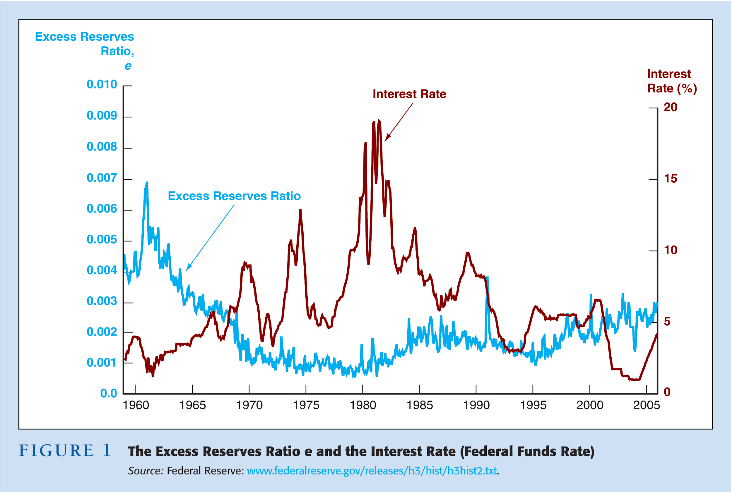
Notes:
‹#›

Slide 38
Additional Factors
Open market operations are controlled by the CB
The CB cannot determine the amount of borrowing by banks from the Fed
Split the monetary base into two components
MB = MB_{n} +BR → M = m(MB_{n} + BR)
The money supply is positively related to both the non-borrowed monetary base MB_{n} and to the level of borrowed reserves, BR, from the CB
Notes:
‹#›

Slide 39
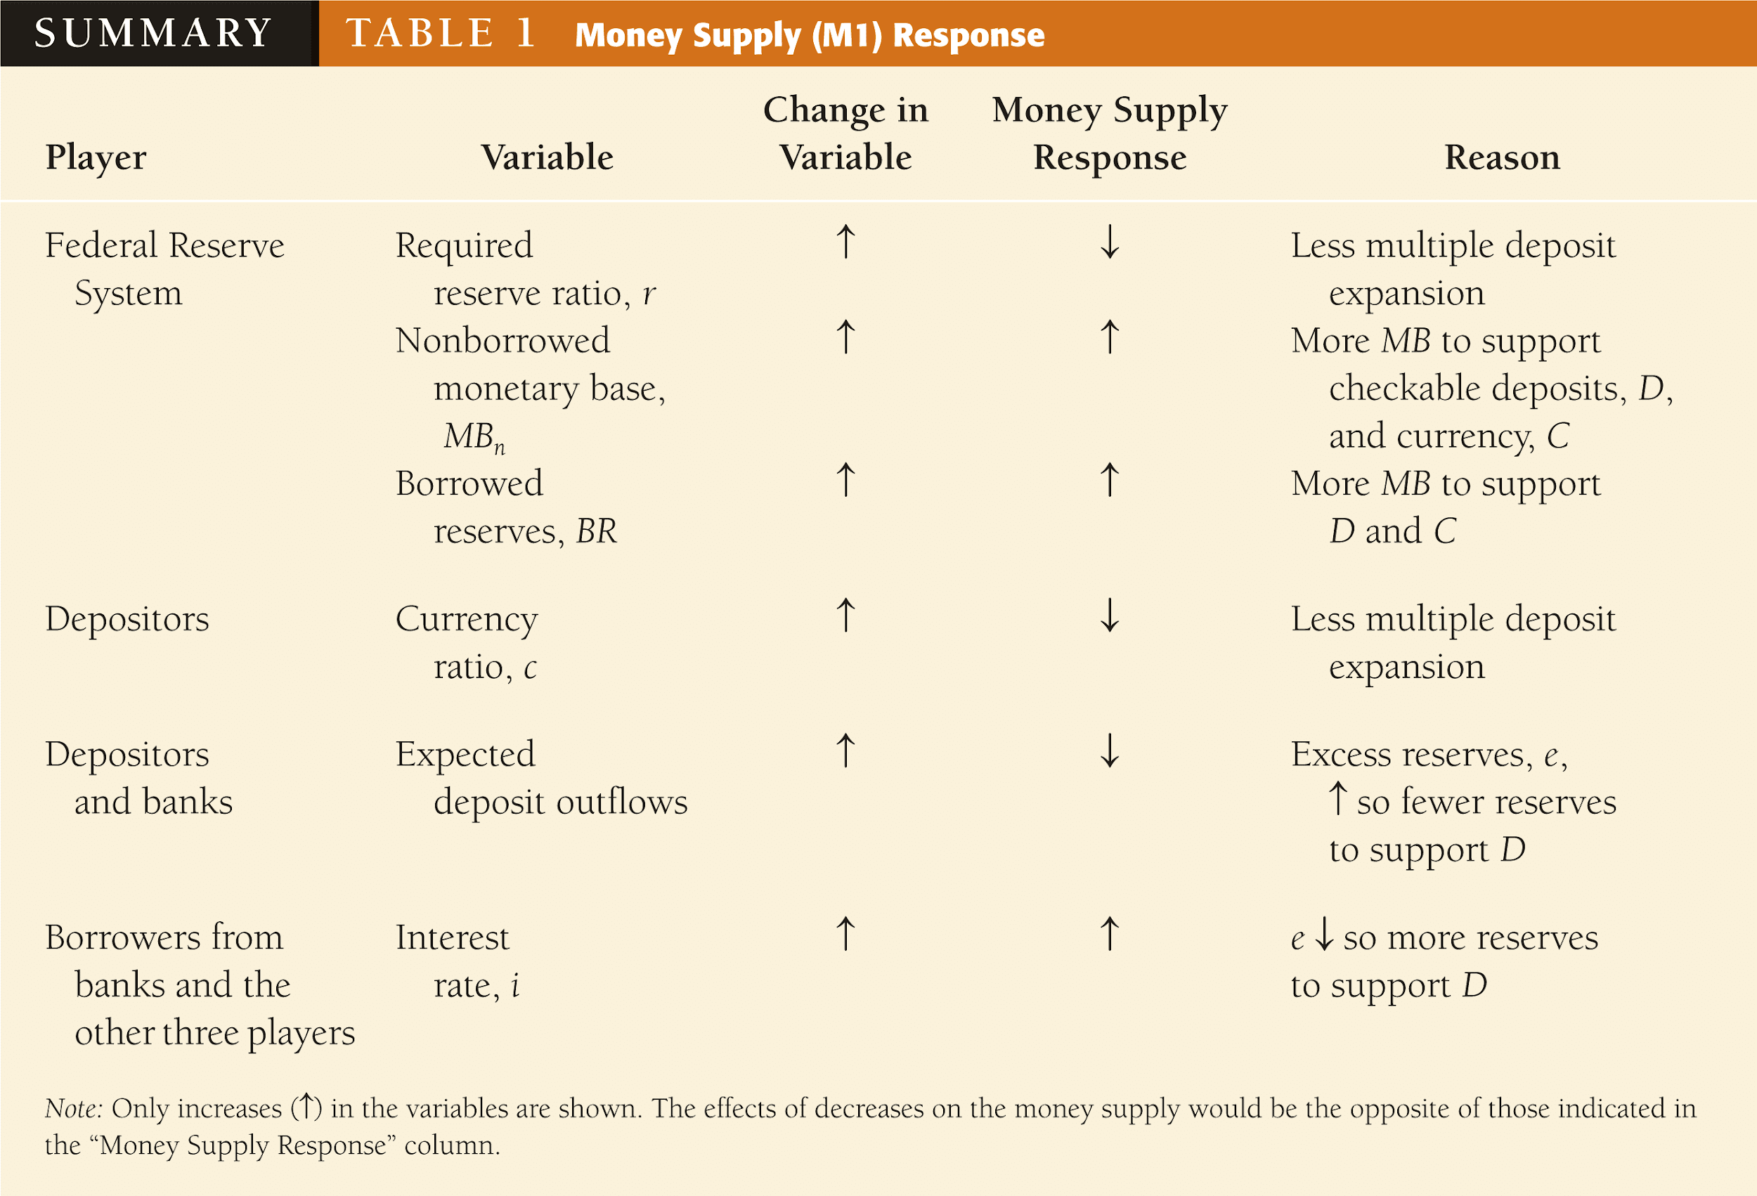
Notes:
‹#›

Slide 40
Explaining Movements in the Money Supply
Over long periods, the primary determinant of movements in the money supply is the non-borrowed monetary base, which is controlled by the CB’s open market operations
Notes:
‹#›

