Slide 1
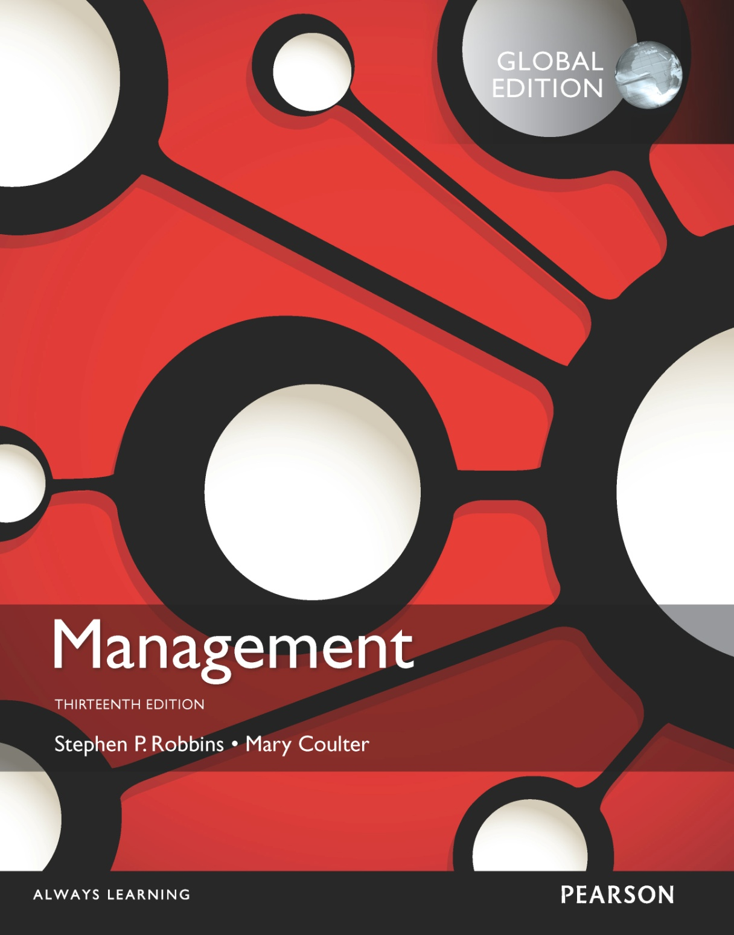
Monitoring and Controlling
18
18 - 1

Slide 2
Learning Objectives
Explain the nature and importance of control.
Describe the three steps in the control process.
Explain how organizational and employee performance are measured.
Know how to be effective at giving feedback.
Describe tools used to measure organizational performance.
Discuss contemporary issues in control.
Develop your skill at dealing with difficult people.
18 - 2

Slide 3
What Is Controlling? Page 556
Controlling – the process of monitoring, comparing, and correcting work performance.
The Purpose of Control
To ensure that activities are completed in ways that lead to the accomplishment of organizational goals.
18 - 3
Notes:
What is controlling? It’s the process of monitoring, comparing, and correcting work performance. All managers should control even if their units are performing as planned because they can’t really know that unless they’ve evaluated what activities have been done and compared actual performance against the desired standard.
Effective controls ensure that activities are completed in ways that lead to the attainment of goals. Whether controls are effective, then, is determined by how well they help employees and managers achieve their goals.

Slide 4
Why Is Controlling Important?
the final link in management functions:
Planning – controls let managers know whether their goals and plans are on target and what future actions to take.
Empowering employees – control systems provide managers with information and feedback on employee performance.
Protecting the workplace – controls enhance physical security and help minimize workplace disruptions.
As
18 - 4
Notes:
Why is control so important? Planning can be done, an organizational structure created to facilitate efficient achievement of goals, and employees motivated through effective leadership. But there’s no assurance that activities are going as planned and that the goals employees and managers are working toward are, in fact, being attained.
Control is important, therefore, because it’s the only way that managers know whether organizational goals are being met and if not, the reasons why. The value of the control function can be seen in three specific areas: planning, empowering employees, and protecting the workplace.
Many managers are reluctant to empower their employees because they fear something will go wrong for which they would be held responsible. But an effective control system can provide information and feedback on employee performance and minimize the chance of potential problems.
The final reason why managers control is to protect the organization and its assets. Today’s environment brings heightened threats from natural disasters, financial scandals, workplace violence, global supply chain disruptions, security breaches, and even possible terrorist attacks. Managers must protect organizational assets in the event that any of these things should happen.

Slide 5
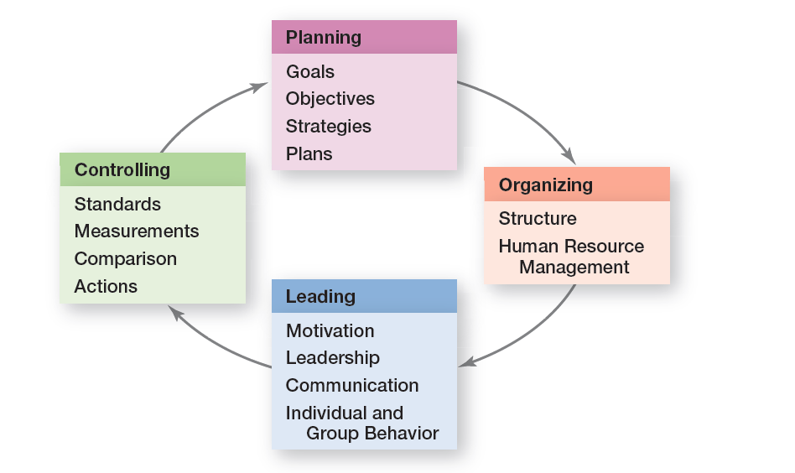
Exhibit 18-1 Planning-Controlling Link
18 - 5
Notes:
Controlling provides a critical link back to planning (see Exhibit 18-1.) If managers didn’t control, they’d have no way of knowing whether their goals and plans were being achieved and what future actions to take.

Slide 6
The Control Process
– a three-step process of measuring actual performance, comparing actual performance against a standard, and taking managerial action to correct deviations or inadequate standards.
Control process
18 - 6
Notes:
The control process is a three-step process of measuring actual performance, comparing actual performance against a standard, and taking managerial action to correct deviations or to address inadequate standards. The control process assumes that performance standards already exist, and they do. They’re the specific goals created during the planning process.

Slide 7
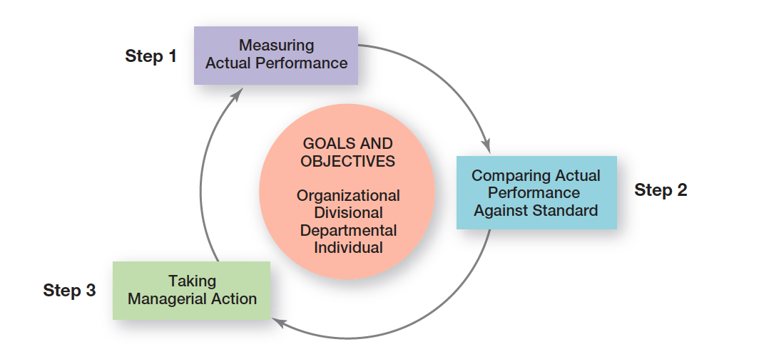
Exhibit 18-2 The Control Process
18 - 7

Slide 8
The Control Process (cont.)
Measuring Actual Performance
How We Measure – personal observations, statistical reports, oral reports, and written reports.
What We Measure – what is measured is probably more critical to the control process than how it’s measured. (criteria)- KPI key performance indictors
Step 1:
18 - 8
Notes:
To determine what actual performance is, a manager must first get information about it. Thus, the first step in control is measuring.
What is measured is probably more critical to the control process than how it’s measured. Why? Because selecting the wrong criteria can create serious problems. Besides, what is measured often determines what employees will do.
Most work activities can be expressed in quantifiable terms. However, managers should use subjective measures when they can’t. Although such measures may have limitations, they’re better than having no standards at all and doing no controlling.

Slide 9
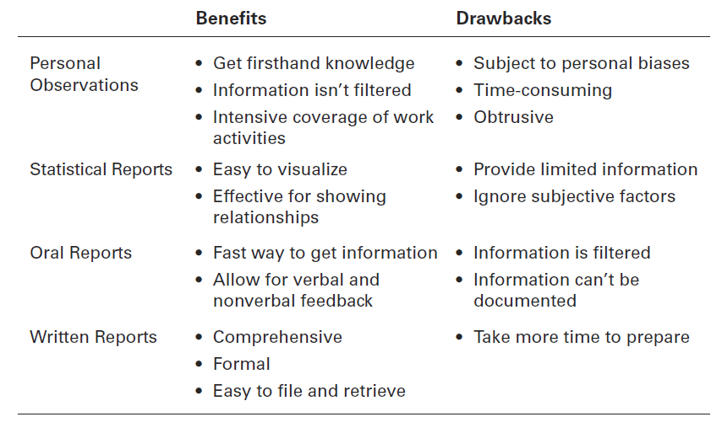
Exhibit 18-3 Sources of Information for Measuring Performance
18 - 9
Notes:
Four approaches used by managers to measure and report actual performance are personal observations, statistical reports, oral reports, and written reports. Exhibit 18-3 summarizes the advantages and drawbacks of each approach. Most managers use a combination of these approaches.

Slide 10
The Control Process (cont.)
Comparing Actual Performance Against the Standard:
Determining the degree of variation between actual performance and the standard.
Range of variation – the acceptable parameters of variance between actual performance and the standard.
Example standard sale 20%, actual result 17.5%,( range 17% -22%) or 16% ??
Step 2:
18 - 10
Notes:
The comparing step determines the variation between actual performance and the standard. Although some variation in performance can be expected in all activities, it’s critical to determine an acceptable range of variation.

Slide 11
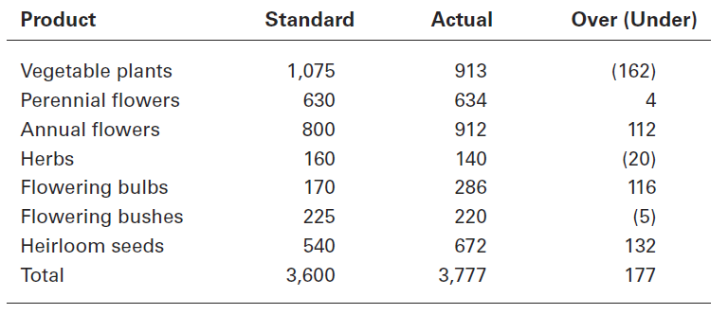
Exhibit 18-5 Green Earth Gardening Supply—June Sales
18 - 12
Notes:
Let’s work through an example. Chris Tanner is a sales manager for Green Earth Gardening Supply, a distributor of specialty plants and seeds in the Pacific Northwest. Chris prepares a report during the first week of each month that describes sales for the previous month, classified by product line. Exhibit 18-5 displays both the sales goals (standard) and actual sales figures for the month of June.
After looking at the numbers, should Chris be concerned? Sales were a bit higher than originally targeted, but does that mean there were no significant deviations? That depends on what Chris thinks is significant; that is, outside the acceptable range of variation. Even though overall performance was generally quite favorable, some product lines need closer scrutiny. For instance, if sales of heirloom seeds, flowering bulbs, and annual flowers continue to be over what was expected, Chris might need to order more product from nurseries to meet customer demand. Because sales of vegetable plants were 15 percent below goal, Chris may need to run a special on them. As this example shows, both overvariance and undervariance may require managerial attention, which is the third step in the control process.

Slide 12
The Control Process (cont.)
Taking Managerial Action
Correcting Actual performance
Immediate corrective action – corrective action that corrects problems at once in order to get performance back on track.
Basic corrective action – corrective action that looks at how and why performance deviated before correcting the source of deviation.
Step 3:
18 - 13
Notes:
Managers can choose among three possible courses of action: do nothing, correct the actual performance, or revise the standards. Because “do nothing” is self-explanatory, let’s look at the other two.
One decision a manager must make is whether to take immediate corrective action, which corrects problems at once to get performance back on track, or to use basic corrective action, which looks at how and why performance deviated before correcting the source of deviation.

Slide 13
The Control Process (cont.)
(cont.)
Revise the Standard – if performance consistently exceeds the goal, then a manager should look at whether the goal is too easy and needs to be raised.
Managers must be cautious about revising a standard downward.
Step 3
18 - 14
Notes:
It’s possible that the variance was a result of an unrealistic standard—too low or too high a goal. In that situation, the standard needs the corrective action, not the performance. If performance consistently exceeds the goal, then a manager should look at whether the goal is too easy and needs to be raised. On the other hand, managers must be cautious about revising a standard downward.

Slide 14
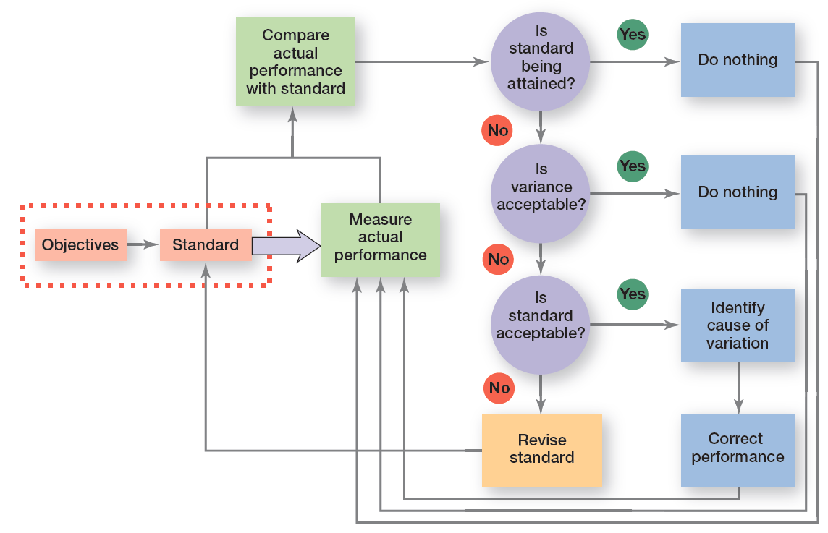
Exhibit 18-6 Managerial Decisions in the Control Process
18 - 15
Notes:
Exhibit 18-6 summarizes the decisions a manager makes in controlling.

Slide 15
Tools for Measuring Organizational Performance
Feed forward control – control that takes place before a work activity is done.
Concurrent control – control that takes place while a work activity is in progress.
Management by walking around – a term used to describe when a manager is out in the work area interacting directly with employees.(Direct supervisor )
Feedback control – control that takes place after a work activity is done.
18 - 21
Notes:
The most desirable type of control—feedforward control—prevents problems because it takes place before the actual activity. The key to feedforward controls is taking managerial action before a problem occurs. That way, problems can be prevented rather than having to correct them after any damage (poor-quality products, lost customers, lost revenue, etc.) has already been done.
Concurrent control, as its name implies, takes place while a work activity is in progress.
The best-known form of concurrent control is direct supervision. Another term for it is management by walking around, which is when a manager is in the work area interacting directly with employees.
The most popular type of control relies on feedback. In feedback control, the control takes place after the activity is done. Feedback controls have two advantages. First, feedback gives managers meaningful information on how effective their planning efforts were. Feedback that shows little variance between standard and actual performance indicates that the planning was generally on target. Second, feedback can enhance motivation. People want to know how well they’re doing and feedback provides that information.

Slide 16
Feedback control advantage
Two advantage :
gives managers information on how their planning efforts .
Feedback can enhance motivation .

Slide 17
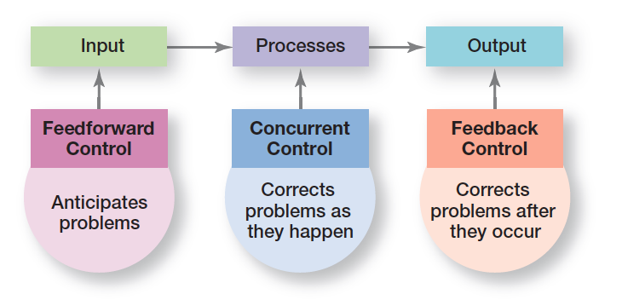
Exhibit 18-9 Types of Control
18 - 22
Notes:
Managers can implement controls before an activity begins, during the time the activity is going on, and after the activity has been completed. The first type is called feedforward control; the second, concurrent control; and the last, feedback control (see Exhibit 18-9).

