Slide 1
Making Decisions
2

Slide 2
Learning Objectives
Describe the eight steps in the decision-making process.
Develop your skill at being creative.
Explain the four ways managers make decisions.
Classify decisions and decision-making conditions.
Describe different decision-making styles and discuss how biases affect decision-making.
Know how to recognize when you’re using decision-making errors and biases and what to do about it.
Identify effective decision-making techniques.

Slide 3
A key to success in management and in your career is knowing how to be an effective decision-maker.

Slide 4
The Decision-Making Process
Decision – making a choice from two or more alternatives.
Managers at all levels and in all areas
Notes:
Managers at all levels and in all areas of organizations make decisions. That is, they make choices. Although decision-making is typically described as choosing among alternatives, this view is too simplistic. Why? Because decision-making is (and should be) a process, not just a simple act of choosing among alternatives.

Slide 5
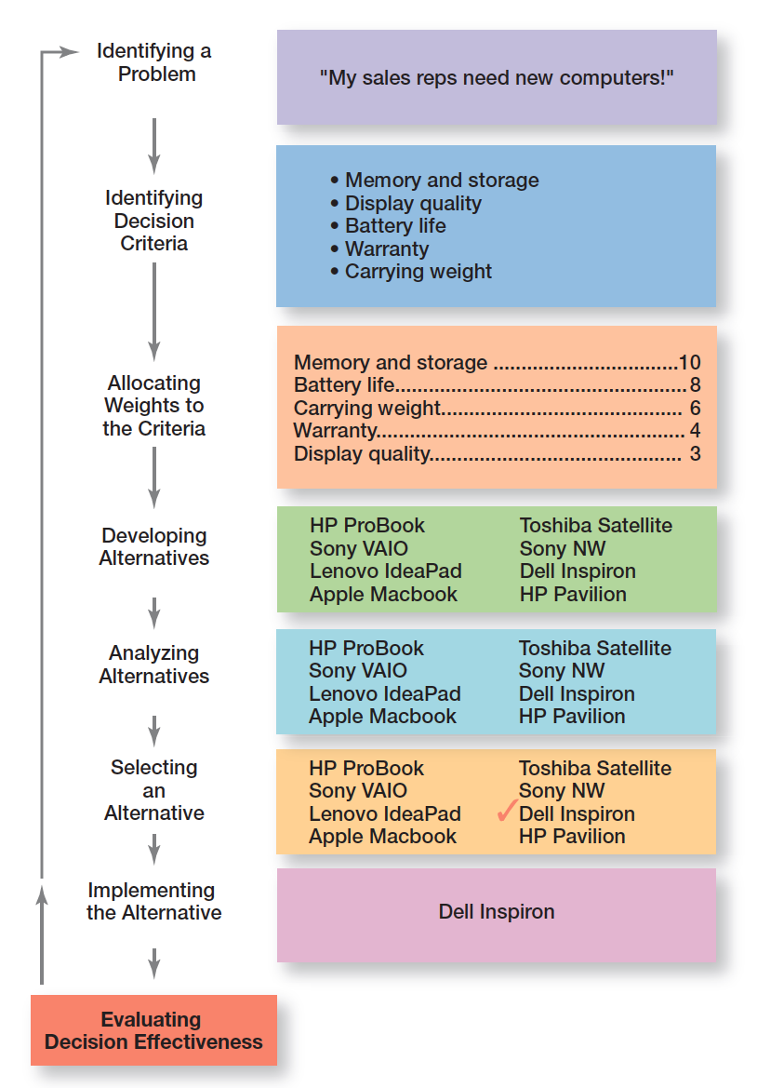
Exhibit 2-1 Decision-Making Process

Slide 6
X Company cosmetics
Decline sales 4% sept – problem
Symptoms عارض
3conditions:
1. aware of
2.authority
Act under pressure

Slide 7
The Decision-Making Process (cont.)
Step 1: Identify a Problem (Need )
Problem – an obstacle that makes it difficult to achieve a desired goal or purpose.
Every decision starts with a problem, a discrepancy تناقض between an existing and a desired condition.
Sales Araw decrease 3%:symptoms عارض
Example – Amanda is a sales manager whose reps need new laptops.
Example : new business (restaurant )
Notes:
Every decision starts with a problem, a discrepancy between an existing and a desired condition. For our example, Amanda is a sales manager whose reps need new laptops because their old ones are outdated and inadequate for doing their job. To make it simple, assume it’s not economical to add memory to the old computers and it’s the company’s policy to purchase, not lease. Now we have a problem—a disparity between the sales reps’ current computers (existing condition) and their need to have more efficient ones (desired condition). Amanda has a decision to make.

Slide 8
The Decision-Making Process (cont.)
Step 2: Identify Decision Criteria
Decision criteria are factors that are important (relevant) to resolving the problem.
Example – Amanda decides that memory and storage capabilities, display quality, battery life, warranty, and carrying weight are the relevant criteria in her decision.
Notes:
Once a manager has identified a problem, he or she must identify the decision criteria important or relevant to resolving
the problem. Every decision maker has criteria guiding his or her decisions even if they’re not explicitly stated. In our example,
Amanda decides after careful consideration that memory and storage capabilities, display quality, battery life, warranty, and carrying weight are the relevant criteria in her decision.

Slide 9
Identify problem :restaurant
2. Identify decision Criteria 3.allocate weights to the criteria (1 L - 10 H ) IMPORTANCE (subjective )
Start up cost 10
Location 7
Team 9
Competition 6
4. Develop alternatives (only list )
1.Scratch
2.Existing business 3. franchising

Slide 10
The Decision-Making Process (cont.)
Step 3: Allocate Weights to the Criteria
If the relevant criteria aren’t equally important, the decision maker must weight the items in order to give them the correct priority in the decision.
Less important – high importance
1-10
The weighted criteria for our example is shown in Exhibit 2-2.
Notes:
If the relevant criteria aren’t equally important, the decision maker must weight the items in order to give them the correct
priority in the decision. How? A simple way is to give the most important criterion a weight of 10 and then assign weights to the rest using that standard. Of course, you could use any number as the highest weight. The weighted criteria for our example is shown in Exhibit 2-2.

Slide 11
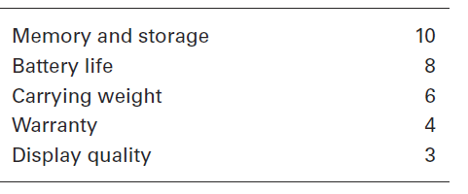
Exhibit 2-2 Important Decision Criteria

Slide 12
The Decision-Making Process (cont.)
Step 4: Develop Alternatives
List viable alternatives that could resolve the problem
Example – Amanda, identifies eight laptops as possible choices. (See Exhibit 2-3.)
Notes:
The fourth step in the decision-making process requires the decision maker to list viable alternatives that could resolve the problem. In this step, a decision maker needs to be creative, and the alternatives are only listed—not evaluated—just yet. Our sales manager, Amanda, identifies eight laptops as possible choices. (See Exhibit 2-3.)

Slide 13
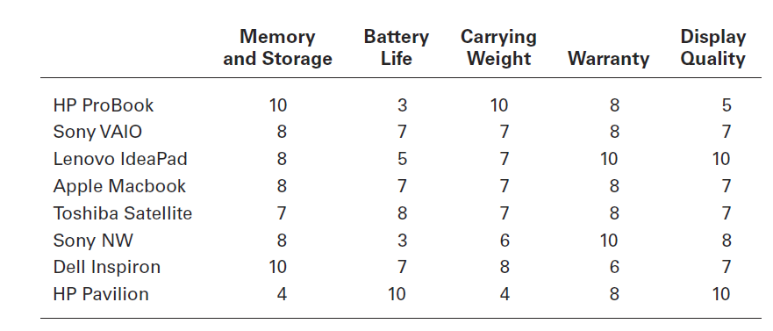
Exhibit 2-3 Possible Alternatives

Slide 14
The Decision-Making Process (cont.)
Step 5: Analyze Alternatives
Appraising each alternative’s strengths and weaknesses.
An alternative’s appraisal is based on its ability to resolve the issues related to the criteria and criteria weight.
Notes:
Once alternatives have been identified, a decision maker must evaluate each one. How? By using the criteria established in Step 2. Exhibit 2-3 shows the assessed values that Amanda gave each alternative after doing some research on them. Keep in mind that this data represents an assessment of the eight alternatives using the decision criteria, but not the weighting. When you multiply each alternative by the assigned weight, you get the weighted alternatives as shown in Exhibit 2-4. The total score for each alternative, then, is the sum of its weighted criteria.
Sometimes a decision maker might be able to skip this step. If one alternative scores highest on every criterion, you wouldn’t need to consider the weights because that alternative would already be the top choice. Or if the weights were all equal, you could evaluate an alternative merely by summing up the assessed values for each one. (Look again at Exhibit 2-3.) For example, the score for the HP ProBook would be 36, and the score for the Sony NW would be 35.

Slide 15
The Decision-Making Process (cont.)
Step 6: Select an Alternative
Choosing the best alternative
The alternative with the highest total weight is chosen.
Notes:
The sixth step in the decision-making process is choosing the best alternative or the one that generated the highest total in Step 5. In our example (Exhibit 2-4), Amanda would choose the Dell Inspiron because it scored higher than all other alternatives (249 total).

Slide 16
Step 5 page 76 ch.2
Alternative \criteria | Startup cost | Location | Team | Competition
Scratch | 6 | 10 | 4 | 5
existing | 9 | 8 | 10 | 7
Franchising | 7 | 9 | 10 | 9
 | Startup cost 10 from step #. 3 | Location 7 | Team 9 | Competition 6 | score
Scratch | 60 |  |  |  | 280
existing | 90 |  |  |  | 350
Franchising | 70 |  |  |  | 400

Slide 17
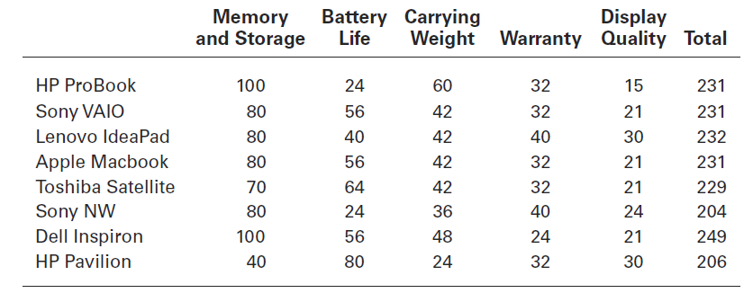
Exhibit 2-4 Evaluation of Alternatives

Slide 18
The Decision-Making Process (cont.)
Step 7: Implement the Alternative
Putting the chosen alternative into action
Conveying the decision to and gaining commitment from those who will carry out the alternative
Notes:
In Step 7 in the decision-making process, you put the decision into action by conveying it to those affected and getting their commitment to it. We know that if the people who must implement a decision participate in the process, they’re more likely to support it than if you just tell them what to do. Another thing managers may need to do during implementation is reassess the environment for any changes, especially if it’s a long-term decision. Are the criteria, alternatives, and choice still the best ones, or has the environment changed in such a way that we need to reevaluate?

Slide 19
The Decision-Making Process (cont.)
Step 8: Evaluate Decision Effectiveness
The soundness of the decision is judged by its outcomes.
How effectively was the problem resolved by outcomes resulting from the chosen alternatives?
If the problem was not resolved, what went wrong?
Notes:
The last step in the decision-making process involves evaluating the outcome or result of the decision to see whether the problem was resolved. If the evaluation shows that the problem still exists, then the manager needs to assess what went wrong. Was the problem incorrectly defined? Were errors made when evaluating alternatives? Was the right alternative selected but poorly implemented? The answers might lead you to redo an earlier step or might even require starting the whole process over.

Slide 20
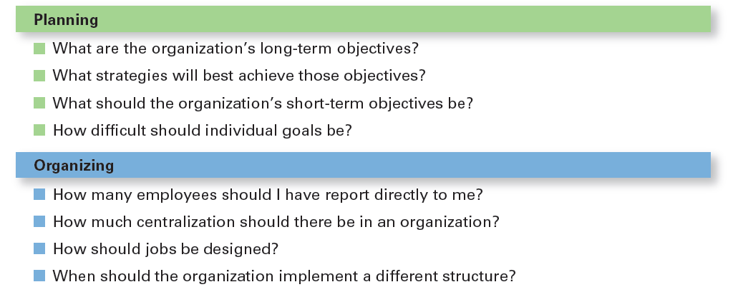
Exhibit 2-5 Decisions – an essence جوهر of managers job
Notes:
Although everyone in an organization makes decisions, decision-making is particularly important to managers. As Exhibit 6-5 shows, it’s part of all four managerial functions. In fact, that’s why we say that decision-making is the essence of management. And that’s why managers—when they plan, organize, lead, and control—are called decision makers.

Slide 21
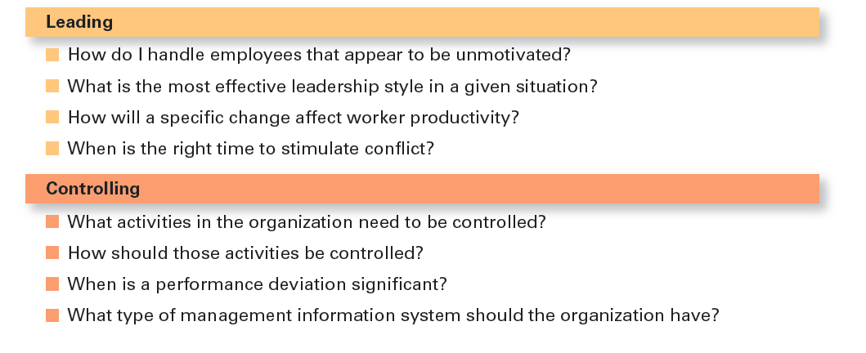
Exhibit 2-5 Decisions Managers May Make (cont.)

Slide 22
4 perspective on how mangers make decision Making Decisions: Rationality
1.Rational Decision-Making – describes choices that are logical and consistent while maximizing value.
Assumptions of Rationality
The decision maker would be fully objective and logical
The problem faced would be clear and unambiguous
The decision maker would have a clear and specific goal and
know all possible alternatives and consequences and consistently select the alternative that maximizes achieving that goal
Notes:
We assume that managers will use rational decision-making; that is, they’ll make logical and consistent choices to maximize value. After all, managers have all sorts of tools and techniques to help them be rational decision makers. Managers aren’t always rational. What does it mean to be a “rational” decision maker? A rational decision maker would be fully objective and logical. The problem faced would be clear and unambiguous, and the decision maker would have a clear and specific goal and know all possible alternatives and consequences. Finally, making decisions rationally would consistently lead to selecting the alternative that maximizes the likelihood of achieving that goal.

Slide 23
Making Decisions: Bounded Rationality
2.Bounded Rationality – decision-making that’s rational, but limited (bounded) by an individual’s ability to process information.
Satisfice – accepting solutions that are “good enough.”
Example : job offer
Escalation of commitment – an increased commitment to a previous decision despite evidence it may have been wrong.
Notes:
A more realistic approach to describing how managers make decisions is the concept of bounded rationality, which says that managers make decisions rationally, but are limited (bounded) by their ability to process information. Because they can’t possibly analyze all information on all alternatives, managers satisfice, rather than maximize. That is, they accept solutions that are “good enough.” They’re being rational within the limits (bounds) of their ability to process information.
However, keep in mind that their decision-making is also likely influenced by the organization’s culture, internal politics, power considerations, and by a phenomenon called escalation of commitment, an increased commitment to a previous decision despite evidence that it may have been wrong.

Slide 24
Making Decisions: The Role of Intuition
3.Intuitive decision- making
Making decisions on the basis of experience, feelings, and accumulated judgment.
Notes:
What is intuitive decision making? It’s making decisions on the basis of experience, feelings, and accumulated judgment. Researchers studying managers’ use of intuitive decision-making have identified five different aspects of intuition, which are described in Exhibit 6-6.

Slide 25
Exhibit 2-6 What Is Intuition?

Slide 26
Making Decisions: The Role of Evidence-Based Management
4.Evidence-based management (EBMgt) – the systematic use of the best available evidence to improve management practice.
Note :any decision making process is likely to be enhanced through the use of relevant and reliable evidence.
Notes:
“Any decision-making process is likely to be enhanced through the use of relevant and reliable evidence, whether it’s buying someone a birthday present or wondering which new washing machine to buy.” That’s the premise behind evidence-based management (EBMgt), the “systematic use of the best available evidence to improve management practice.
EBMgt is quite relevant to managerial decision-making. The four essential elements of EBMgt are the decision maker’s expertise and judgment; external evidence that’s been evaluated by the decision maker; opinions, preferences, and values of those who have a stake in the decision; and relevant organizational (internal) factors such as context, circumstances, and organizational members.

Slide 27
The four essential elements of EBMgt are the decision-maker’s page 80-81
the decision maker’s expertise and judgment;
external evidence that’s been evaluated by the decision-maker;
opinions, preferences, and values of those who have a stake in the decision;
and relevant organizational (internal) factors such as context, circumstances, and organizational members.
The strength or influence of each of these elements on a decision will vary with each decision.
The key for managers is to recognize and understand the mindfulالوعي ،مدرك , consciousمدرك choice as to which element(s) are most important and should be emphasized in making a decision.

Slide 28
Structured Problems and Programmed Decisions
Structured Problems – straightforward, familiar, and easily defined problems. information is available
Programmed decision – a repetitive decision that can be handled by a routine approach.
Notes:
Some problems are straightforward. The decision maker’s goal is clear, the problem is familiar, and information about the problem is easily defined and complete. Such situations are called structured problems because they’re straightforward, familiar, and easily defined. Because it’s not an unusual occurrence, there’s probably some standardized routine for handling it. This is what we call a programmed decision, a
repetitive decision that can be handled by a routine approach. Because the problem is structured, the manager doesn’t have to go to the trouble and expense of going through an involved decision process. The “develop-the-alternatives” stage of the decision-making process either doesn’t exist or is given little attention. Why? Because once the structured problem is defined, the solution is usually self-evident or at least reduced to a few alternatives that are familiar and have proved successful in the past.

Slide 29
Structured Problems and Programmed Decisions (cont.)
Procedure – a series of sequential steps used to respond to a well-structured problem.
Rule – an explicit statement that tells managers what can or cannot be done.
Policy – a guideline for making decisions.
General parameters
Notes:
A procedure is a series of sequential steps a manager uses to respond to a structured problem. The only difficulty is identifying the problem. Once it’s clear, so is the procedure. For instance, a purchasing manager receives a request from a warehouse manager for 15 tablets for the inventory clerks.
A rule is an explicit statement that tells a manager what can or cannot be done. Rules are frequently used because they’re simple to follow and ensure consistency. For example, rules about lateness and absenteeism permit supervisors to make disciplinary decisions rapidly and fairly.
The third type of programmed decisions is a policy, a guideline for making a decision. In contrast to a rule, a policy establishes general parameters for the decision maker rather than specifically stating what should or should not be done. Policies typically contain an ambiguous term that leaves interpretation up to the decision maker.

Slide 30
Unstructured Problems and Nonprogrammed Decisions
Unstructured Problems – problems that are new or unusual and for which information is ambiguous or incomplete.
Nonprogrammed decisions – unique and nonrecurring and involve custom made solutions.
Notes:
Not all the problems managers face can be solved using programmed decisions. Many organizational situations involve unstructured problems, new or unusual problems for which information is ambiguous or incomplete. Whether to build a new manufacturing facility in China is an example of an unstructured problem.

Slide 31
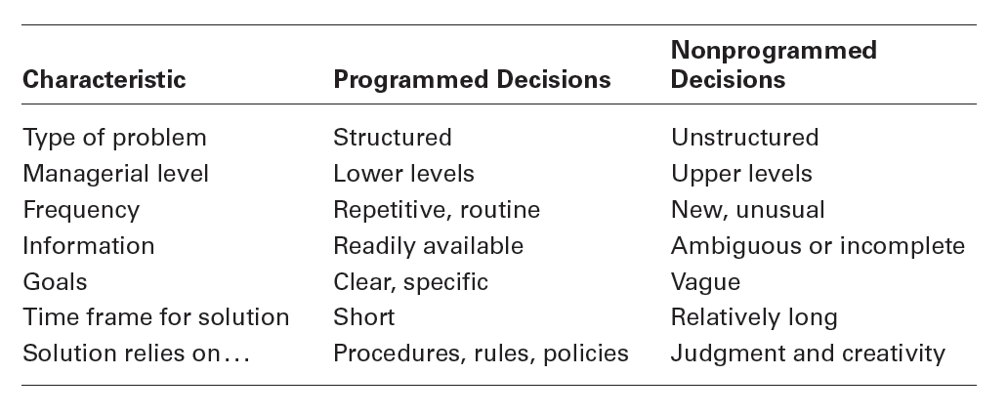
Exhibit 2-7 Programmed Versus Nonprogrammed Decisions
Notes:
Exhibit 2-7 describes the differences between programmed and nonprogrammed decisions. Lower-level managers mostly rely on programmed decisions (procedures, rules, and policies) because they confront familiar and repetitive problems. As managers move up the organizational hierarchy, the problems they confront become more unstructured.

Slide 32
Decision-Making Conditions p.83
Certainty – a situation in which a manager can make accurate decisions because all outcomes are known. for example : 1000jd interest rate 5%
Risk – a situation in which the decision maker is able to estimate the likelihood of certain outcomes.1. personal experience 2.secondary information (assign probability )
Uncertainty – a situation in which a decision maker has neither certainty nor reasonable probability estimates available.
Notes:
The ideal situation for making decisions is one of certainty, a situation where a manager can make accurate decisions because the outcome of every alternative is known. For example, when Wyoming’s state treasurer decides where to deposit excess state funds, he knows exactly the interest rate offered by each bank and the amount that will be earned on the funds. He is certain about the outcomes of each alternative. As you might expect, most managerial decisions aren’t like this.
A far more common situation is one of risk, conditions in which the decision maker is able to estimate the likelihood of certain outcomes. Under risk, managers have historical data from past personal experiences or secondary information that lets them assign probabilities to different alternatives.
What happens if you face a decision where you’re not certain about the outcomes and can’t even make reasonable probability estimates? We call this condition uncertainty. Managers face decision-making situations of uncertainty. Under these conditions, the choice of alternative is influenced by the limited amount of available information and by the psychological orientation of the decision maker.

Slide 33
Uncertainty
Little information
Psychological orientation – mangers
Optimistic متفائل follow Maxi max choice
Pessimistic متشائم follow maxi min choice
Regret (Most likely ) realistic يقلل الندم المدير يكون اكثر- واقعية follow minimax choice

Slide 34
Managing Risk
Managers can use historical data from past experiences or secondary information that lets them assign probabilities to different alternatives.
Managers use this information to help make decisions by calculating the expected value – the expected return from each possible outcome – by multiplying expected revenues by (the probability).
This exercise will give the manager an idea of the average revenue that they can expect over time if everything relative to the probability remains constant.

Slide 35
Exhibit 2-8 expected value

Slide 36
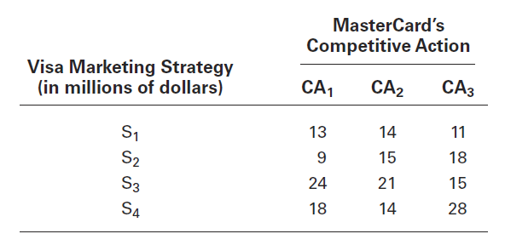
Exhibit 2-9 Payoff Matrix
Notes:
A marketing manager at Visa has determined four possible strategies (S1, S2, S3, and S4) for promoting the Visa card throughout the West Coast region of the United States. The marketing manager also knows that major competitor MasterCard has three competitive actions (CA1, CA2, and CA3) it’s using to promote its card in the same region. For this example, we’ll assume that the Visa manager had no previous knowledge that would allow her to determine probabilities of success of any of the four strategies. She formulates the matrix shown in Exhibit 2-9 to show the various Visa strategies and the resulting profit, depending on the competitive action used by MasterCard.

Slide 37
Exhibit 2-10 Regret Matrix

Slide 38
Decision-Making Styles p.86
Your thinking style reflects two things :
1.The source of information you tend to use (external data and facts or internal sources such as feeling and intuition ).
2. Whether you process that information in a linear way (rational ,logical ,analytical )or nonlinear way (intuitive ,creative )
These four dimensions are collapsed into two styles
Notes:
Your thinking style reflects two things: (1) the source of information you tend to use (external data and facts OR internal sources
such as feelings and intuition), and (2) whether you process that information in a linear way (rational, logical, analytical) OR a nonlinear way (intuitive, creative, insightful). These four dimensions are collapsed into two styles. The first, linear thinking style, is characterized by a person’s preference for using external data and facts and processing this information through rational, logical thinking to guide decisions and actions. The second, nonlinear thinking style, is characterized by a preference for internal sources of information (feelings and intuition) and processing this information with internal insights, feelings, and hunches to guide decisions and actions.

Slide 39
Decision-Making Styles
Linear Thinking Style – a person’s tendency to use external data/facts; the habit of processing information through rational, logical thinking.
Nonlinear Thinking Style – a person’s preference for internal sources of information; a method of processing this information with internal insights, feelings, and hunches الحس الباطني ،الشعور.

Slide 40
Decision-Making Biases and Errors p.86
Heuristics الموجه ،المرشد – using “rules of thumb” to simplify decision-making.
They help to make sense of complex ,uncertain and ambiguous information
Mistakes :use rules of thumb that doesn’t mean those rules are reliable
End
Notes:
When managers make decisions, they not only use their own particular style, they may use “rules of thumb,” or heuristics, to simplify their decision- making. Rules of thumb can be useful because they help make sense of complex, uncertain, and ambiguous information. Even though managers may use rules of thumb, that doesn’t mean those rules are reliable. Why? Because they may lead to errors and biases in
processing and evaluating information. Let’s look at each.
When decision makers tend to think they know more than they do or hold unrealistically positive views of themselves and their performance, they’re exhibiting the overconfidence bias. The immediate gratification bias describes decision makers who tend to want immediate rewards and to avoid immediate costs. For these individuals, decision choices that provide quick payoffs are more appealing than those with payoffs
in the future.

