Slide 1
Managing the Environment and the Organization’s Culture
3
3 -1

Slide 2
Learning Objectives
Contrast the actions of managers according to the omnipotent and symbolic views.
Describe the constraints and challenges facing managers in today’s external environment.
Develop your skill at scanning the environment so you can anticipate and interpret changes taking place.
Discuss the characteristics and importance of organizational culture.
Know how to read and assess an organization’s culture.
Describe current issues in organizational culture.
3 - 2

Slide 3
Reading an Organization’s Culture: Find One Where You'll Be Happy
“A key to success in
management and in your
career is knowing how to
“read” an organization’s
culture so you can find one
in which you’ll be happy.”
3 - 3

Slide 4
Scanning the Environment
Do background work. Check out the company’s Web site.
What impression do you get from it? Are corporate values listed? Mission Statement?
Observe the physical surroundings and corporate symbols.
Notice visible symbols of organizational culture, such as, logos, signs, posters, pictures, photos, style of dress, etc.
How would you characterize the people who work there ? Are they formal? Casual? Serious? Jovial? Open?
3 -4

Slide 5
The Manager: Omnipotent or Symbolic?
Omnipotent view of management(Dominant view )قادر على كل شي : The view that managers are directly responsible for an organization’s success or failure.
Symbolic view of management: The view that much of an organization’s success or failure is due to external forces outside managers’ control.
3 - 5

Slide 6
Managerial Constraints
In reality, managers are neither all-powerful nor helpless. But their decisions and actions are constrained.
As you can see in Exhibit 3-1, external constraints come from the organization’s environment and internal constraints come from the organization’s culture.
3 - 6

Slide 7
Exhibit 3-1 Constraints on Managerial Discretion
3 - 7

Slide 8
The External Environment
The External Environment: Those factors and forces outside the organization that affect it’s performance. The external environment includes several different components.
3 - 9

Slide 9
Exhibit 3-2 Components of the External Environment
3 -12

Slide 10
General Environmental Force/Factor | Description | Examples
Economic Conditions | Encompasses factors such as interest rates, inflation, changes in disposable incomeالدخل المتاح للانفاق , stock market fluctuations, and business cycle stages. | العنصر الاقتصادي ويتمثل بغلاء المعيشة وارتفاع الأسعار صافي الدخل كلها عوامل تؤثر على قرارات المدير على سبيل المثال تكاليف التصنيع ترتفع سنويا وهي احدى المتغيرات التي توثر على ارتفاع الأسعار وبالتالي التأثير على قرارات الشركة....

Slide 11
General Environmental Force/Factor | Description | Examples
The Demographic Environment | Including physical characteristics of a population (e.g., gender, age, level of education, geographic loca­tion, income, composition of family) can change, and managers must adapt to these changes. | الشرائح المجتمعية مهمة جدا في أي سوق لانها تشكل عنصر أساسي لكيفية اتخاذ القرارات لدى أي مدير. هناك مجتمعات فيها أطفال بنسب تفوق كبار السن او العكس، لا يمكن تغطية اسواق بشرائح مختلفة بنفس آلية اتخاذ القرارات مثال : اخذ مواصفات الشريحة التي تستهدفها الشركة اذا كانت الشريحة مخصصة للمواليد الجدد من عمر يوم الى سنتين اكيد على الشركة تطوير منتج بما يتناسب الاعمال هذا مثال الحليب

Slide 12
General Environmental Force/Factor | Description | Examples
Political/Legal Conditions | Include the general political stability of countries in which an organization does business and the specific atti­tudes that elected officials have toward business. Local governments can influence what organizations can and cannot do.(local Laws) | القوانين المتبعة في كل دولة لها تأثير كبير على كيفية اتخاذ القرارات مثال 1: قوانين الحكومة في اختيار المناطق الصناعية لبناء المصنع وليس في الأماكن السكنية مثال 2: دخل الحكومة أيضا في التعينات فمثلا وزارة العمل تحدد تعين 5% من ذوي الاحتياجات الخاصة

Slide 13
General Environmental Force/Factor | Description | Examples
Sociocultural | Include the changing expectations of society. Societal values, customs, and tastes can change, and managers must be aware of these changes. | أنماط الحياة المختلفة تأثر أيضا على قرارات المدراء مثال تغير نمط حياة الناس واذواقهم فالبعض يتوجه الى الاكل الصحي والصديق للبيئة من هنا نعلم انه ينعكس على المؤسسة في اتخاذ قرارتها
Global | Include global competitors and global consumer mar­kets. | العولمة والانفتاح والسوق العالمي كلها تؤثر على قرارات المدراء
Technological Conditions | which have changed more rapidly than any other element of the general environment such as innovations | وجود الانترنت وسهولة المقارنة بالأسعار والمواصفات للمنتجات الشبيهة تؤثر على قرارات المدراء سواء بعملية التسعير او طرح منتجات أخرى وغيرها

Slide 14
How the External Environment Affects Managers
The most important organizational factors affected by changes in the external environment is:
1. Jobs and employment: For example, economic downturns result in higher unemployment and place constraints on staffing and production quotas for managers.
Not only does the external environment affect the number of jobs available, but it also affects how jobs are managed and created. Changing conditions can create demands for more temporary work and alternative work arrangements The way jobs were created causing flexible work arrangements, freelancers, job sharing.
For example: Global recession الكساد العالمي caused millions of jobs to be eliminated causing unemployment.

Slide 15
2. Assessing Environmental Uncertainty
Environmental uncertainty refers to the degree of change and complexity in an organization’s environment.
The first dimension of uncertainty is change.
Organizations are stable, minimal change
Organizations are dynamic, frequent change
the second dimension Organizational Complexity refers to the number of components in an organization’s environment and the extent of the organization’s knowledge about those components.
3 - 18

Slide 16
Assessing Environmental Uncertainty
If the number of components and the need for sophisticated knowledge is minimal, the environment is classified as simple.
If a number of dissimilar components المتغيرات الكثيرة and a high need for so­phisticated knowledge exist, the environment is complex.
Because uncertainty is a threat to organizational effectiveness, managers try to minimize environmental uncertainty.

Slide 17
Exhibit 3-3 Environmental Uncertainty Matrix
3 - 19

Slide 18
3.Managing Stakeholder Relationships
The nature of stakeholder relationships is another way in which the environment influences managers. The more obvious and secure these relationships, the more influence managers will have over organizational outcomes.
Stakeholders – Any constituencies in an organization’s decisions and actions.
Stockholder أصحاب الأسهم
Exhibit 3 - 4 identifies some of the organization’s most common stakeholders which includes both internal and external constituent groups.
3 - 20

Slide 19
Exhibit 3-4 Organizational Stakeholders
3 - 21

Slide 20
The benefits of good stakeholder relationships
Improved predictability of environmental changes
Increased successful innovations
Increased trust among stakeholders
Greater organizational flexibility to reduce the impact of change
Ethics (right things to do )
3 -22

Slide 21
Organizational Culture: constraints and Challenges

Slide 22
Organizational Culture: constraints and Challenges
Just as each individual has a unique personality — traits and characteristics influence the way we act and interact with others. An organization, too, has a personality, which is referred to as organizational culture.
An organization’s culture can make employees feel included, empowered, and supported or it can make them feel the opposite.
3 - 23
Notes:
Because culture can be a very powerful agent in organizations, therefore, it is very important for managers to pay attention to it.

Slide 23
Organizational culture
Organizational Culture —The shared values, principles, traditions, and ways of doing things that influence the way organizational members act and that distinguish the organization from other organizations.
Cultural Values and practices evolve over time.
Organizational Culture is:
Perception — based on employee experience within the organization.
Descriptive — how members describe it.
Shared aspects — employees share perception and experiences.
Research suggests seven dimensions of culture that seem to capture the essence of an organization’s culture. These dimensions are shown in Exhibit 3-5 and range from low to high.
3 -24
Notes:
Describing an organization using these seven dimensions gives a composite picture of the organization’s culture. In many organizations, one cultural dimension often is emphasized more than the others and essentially shapes the organization’s personality and the way the organization works.

Slide 24
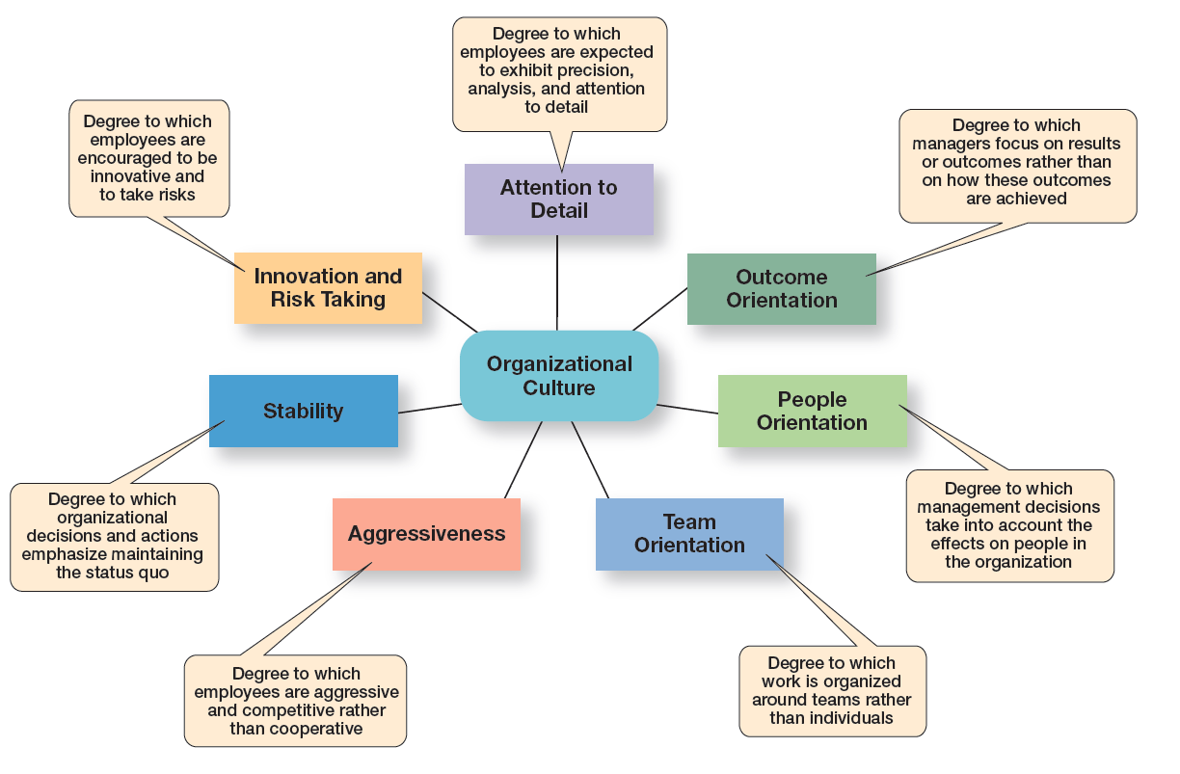
Exhibit 3–5 Dimensions of Organizational culture
3 – 25

Slide 25
Contrasting Organizational culture
In many organizations, one cultural dimension is often emphasized more than others and essentially shapes the organization’s personality and the way the organization works.
For example, Sony Corporation focuses on product innovation and risk-taking. The company “lives and breaths” innovations, and employees’ behaviors support that goal. (Product Orientation).
Conversely, Southwest Airlines focuses on it’s employees and has made them a central focus of it’s culture. (People Orientation).
3 - 26

Slide 26
Exhibit 3-6 Contrasting Organizational Culture

Slide 27
Exhibit 3-6 Contrasting Organizational Culture
Risk-taking and change discouraged
Creativity discouraged
Close managerial supervision
Work activities designed around the individual employee
Risk-taking and change rewarded
Creativity and innovation rewarded
Management trusts employees
Work designed around teams
3 - 27

Slide 28
Contrasting Cultural Values (cont.)
Exhibit 3-6 illustrates how the dimensions of culture can create significantly different cultures.
Both Organization A and Organization B are manufacturing firms, but each company emphasizes a different dimension that have shaped organizational culture.
3 - 28

Slide 29
Exhibit 3-7 Strong Versus Weak Cultures
3 - 29

Slide 30
Strong Cultures
All organizations have cultures, but not all cultures equally influence employees’ behaviors and actions.
Strong Cultures—Organizational cultures in which the key values are intensely held and widely shared.
The more employees accept the organization's key values and greater their commitment to those values, the stronger the culture.
The stronger the culture becomes, the more it affects the way managers plan, organize, lead, and control.
Strong Cultures are associated with high organizational performance.
.
3 - 30

Slide 31
Strong Cultures
Apple’s strong culture of product innovation and customer-service reflects the core values of it’s visionary cofounder, Steve Jobs. Jobs instilled these core values in all employees, from top executives to sales associates, such as the Genius Bar employee shown here training a customer at the Apple Store in Manhattan.
3 - 31

Slide 32
Where Culture Comes From and How it Continues
Exhibit 3-8 illustrates how an organization’s culture is established and maintained.
Organizational Culture usually reflects the vision of the founder.
The small size of most new organizations makes it easier to establish organizational culture.
Once culture is established, organizational practices help to maintain it.
3 - 32
Notes:
The actions of top managers also have a major impact on the organization’s culture. Former IBM CEO, Sam Palmisano, wanted employees to value teamwork so he chose to take several million dollars from his yearly bonus and give it to his top executives based on their teamwork.

Slide 33
Exhibit 3-8 Establishing and Maintaining Culture
3 - 33

Slide 34
How Employees learn culture
Employees “learn” an organization’s culture in a number of ways. The most common are stories, rituals, material symbols, and language.
Stories — organizational stories about significant events in the life of the company help keep culture alive.
Rituals الطقوس— repetitive sequences of activities that express and reinforce important organizational values and goals.
3 - 34

Slide 35
How Employees learn culture (cont.)
Material Artifacts and Symbols — convey to employees what is important and the kinds of expected behaviors, ex. Risk-taking, etc.
Language — many organizations or units of an organization use language to identify and unite members of a culture. New employees are frequently overwhelmed with acronyms and jargon that quickly becomes a part of their language.
Example Build -A- Bear workshop stores :strive for five
JCP :worth (welcome –offer- respect – thank –help)
3 - 35

Slide 36
Exhibit 3-9 Types of Managerial Decisions Affected by Culture
3 - 36
Notes:
As shown in Exhibit 3-9, a manager’s decisions are influenced by the culture in which he or she operates. An organization’s culture, especially a strong one, influences and constrains the way managers plan, organize, organize, lead, and control.

