Slide 1
Online shopping

Slide 2
Members
Mohanad Haji 1160634
Qossay ZeinElddin 1180235
Aseel Saleh 1181793
Abdalrahman Mansour 1182955
Haneen Saleh 1191605

Slide 3
Project Structure
1. Defining the Project
1.1 Project Scope
1.1.1 Project objective
1.1.2 Deliverables
1.1.3 Milestones
1.1.4 Tech requirements
1.1.5 Limits, and exclusions
1.2 Project Priorities
1.3 WBS
1.4 Coding the WBS
2. Project Times and Costs
3. Developing a Project Plan
4. Managing Risk…………………………………………………………………………………………………….
4.1 Risk Identification…………………………………………………………………………
4.2 Risk assessment…………………………………………………………………………..
4.3 Risk Response Matrix ……………………………………………………………………
4.4 Contingency Plan ………………………………………………………………………….
4.5 Risk Response Control…………………………………………………………………..

Slide 4
Online Shopping System
This project is about creating a platform for selling and buying products online to overcome the limitations of the traditional way of doing so.
A detailed description of the project in terms of objectives, deliverables, limitations and risks is presented in this presentation and a complete management plan is proposed.

Slide 5
Project Objectives
Connecting sellers and buyers easily without any physical interaction
Giving people a chance to sell used items
Increasing the availability and variety of products
Provides customers with options and suggestions for products
Facilitating the operation of buying goods for the public
Creating jobs for warehouse operations and product delivery and customer support
Attract local shops to join our online platform
Giving buyers a platform to provide trusted reviews and comments

Slide 6
Project Deliverables
Online platform for users to view and purchase items
A way for sellers to open seller account to present their products
A way for local shops to move online on our platform
A delivery service with tracking system

Slide 7
Limits, and exclusions
strong local and global competition
The ability to convince stores and merchants to extend their business to the platform
Obstacles in reserving warehouses for storage with the desired sizes and locations
Handling multiple simultaneous orders with limited delivery resources
Obtaining the required funding and investment for the project
Dealing with spam reviews and false payment information and scamming attempts

Slide 8
Milestones
Milestone 1 : Finishing the feasibility study and making precise time and resource estimations for the Project along with assigning roles to several personnel.
Milestone 2 : Pitching the idea to local stores and merchants to to join and contribute to the online . .
Milestone 3 : Reserving warehouse locations and having them arranged to be used for product storage.
Milestone 4 : Developing a web based application which provides the main services.
Milestone 5 : Introduce the application to the involved stores and merchants.
Milestone 6 : Advertising the platform through social media , posters and public meetings and talks.
Milestone 7 : Extending the online platform to a mobile application.

Slide 9
Technical requirements
Performance of the application
Support multiple languages
Technical support for all types of users
Refund policy in case of dissatisfaction
Efficient and quick delivery service

Slide 10
Project Priorities

Slide 11
Project Priorities
Urgent and important
Not urgent but important
Urgent but Not important
Not urgent and Not important

Slide 12
Project Priorities

Slide 13
Project Priorities examples
Urgent and important: warehouses, Web site and Staff, Advertisement.
Not urgent but important: Store physical location, Strategic planning
Urgent but not important: responding to stakeholders emails and calls
Not urgent and Not important: storeowners and merchant feedback, app for mobiles

Slide 14
Work Breakdown Structure

Slide 16
Coding Work Breakdown Structure
1. Project Management
1.1 Team Organization
1.1.1 Resources Allocation
1.2 Activities Scheduling
1.2.1 Cost Analysis
2. Commercial Advertising
2.1 Salesmen
3. System Development
3.1 Requirement Analysis
3.2 Software Design
3.3 Software Implementation
3.4 Quality Assurance
4. Products management
4.1 Orders Registration
4.2 Deliveries Management
4.2.1 Customer Service
4.2.2 Warehouse Management
2.2 Social Media Ads
2.3 Posters & Graphic Ads

Slide 17
Estimating project costs and time

Slide 18
Estimating project costs and time
Item | Description | Time \ month (Days) | Cost \month (NIS) | Total cost (NIS)
Project Management | Team Organization Resources Allocation Activities Scheduling Costs Analysis | everyday 3 5 7 | 1500 1000 500 2500 | 4600
Web site Development | T1.1: Requirement Analysis T1.2 : Software Design T1.3 : Software Implementation | everyday 5 20 | 2500 500 3000 | 6000
Products management | Orders Registration Customer Service Deliveries Management Warehouse Management | 10 15 8 everyday | 25800 600 3000 5000 | 27200
Marketing | Salesmen Social Media Ads | 8 everyday | 3000 (2000-4000) | 5500

Slide 19
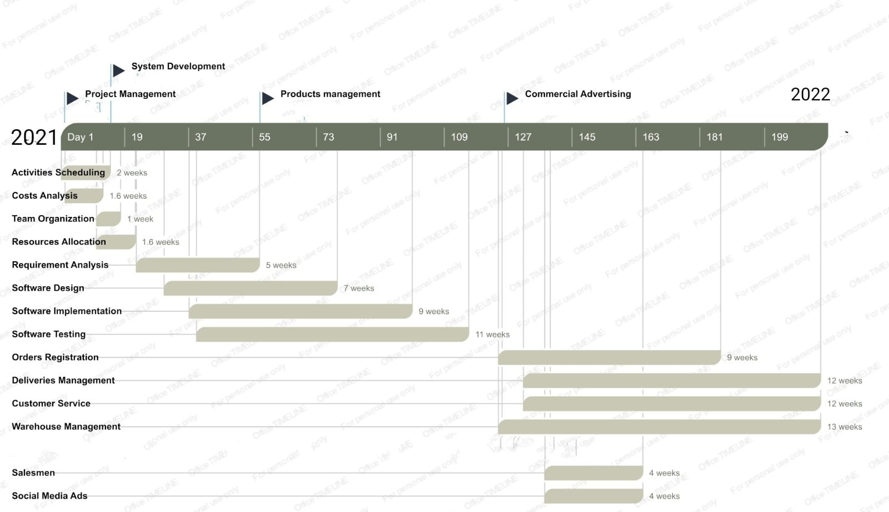
Estimating Project Times and Costs

Slide 20
Project Planning
project planning comes in order to layout the resource allocation and organizational hierarchy to achieve our goals.

Slide 21
Resource Allocation
Resource allocation can be discussed in terms of stakeholders' needs
merchants and shop owners
platform customers (buyers and sellers)
physical storage and technological resources.

Slide 22
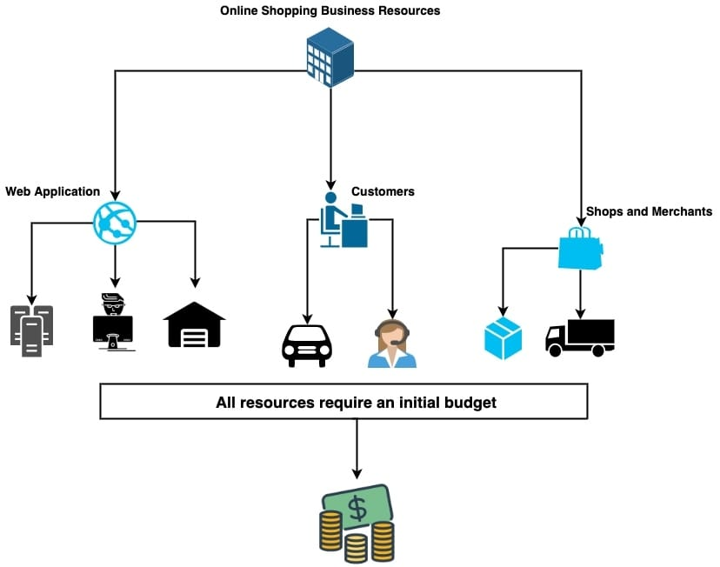
Resource Allocation

Slide 23
Organization Hierarchy
formalizing a valid organizational hierarchy which in turn divides roles among the business’s employees

Slide 25
Risk
Risk identification means naming the risks that could harm your project, function, or enterprise. In this step, you make a list, using your imagination to think of every bad thing that could happen.

Slide 26
Risk assignment
Exposure to customs
Sometimes the goods may not arrive exactly as they are describedLong delivery time (The product delivered is completely different than what was required)
The customer refused to receive his order.
The order is late
This site is not secure that poses a risk to your card (VISA, MASTERCARD). Funds are withdrawn without your permission
The store is robbed if it is in a remote area

Slide 28
Risk event | Response | Impact | Appropriate strategy
Exposure to customs | Avoid | Miduam | Distribution of orders provided that the price of one order is less than 75 dollars
The product delivered is completely different than what was required | Transfer | big | Make an insurance that shows the complete product, and if it is not the same, the piece will be returned
The customer refused to receive his order. | Mitigate | small | We must accept it in order to preserve the reputation
The order is late | Accept | Big | Place the order well in advance of the occasions
This site is not secure | Avoid | Big | Avoid accessing these sites entirely
The store is robbed if it is in a remote area | Transfer | big | Secure the store to avoid any damage

Slide 29
Contingency Planning
Contingency Planning arises from the fact that exposure to risk in business is unavoidable. In business, risk can be defined as a threat that might prevent the business or organization from hitting its objectives. The purpose of contingency planning is thus to create planned responses to events that might adversely impact an organization.

Slide 30
Risk Response Control
Distribution of orders provided that the price of one order is less than 75 dollars to avoid Exposure to customs
The product delivered is completely different than what was required➔ Make an insurance that shows the complete product, and if it is not the same, the piece will be returned
The customer refused to receive his order ➔We must accept it in order to preserve the reputation
The order is late ➔Place the order well in advance of the occasions
This site is not secure ➔Avoid accessing these sites entirely
The store is robbed if it is in a remote area➔Secure the store to avoid any damage

