Slide 1

Project Management
3
PowerPoint presentation to accompany
Heizer, Render, Munson
Operations Management, Twelfth Edition
Principles of Operations Management, Tenth Edition
PowerPoint slides by Jeff Heyl

Slide 2
Outline
Global Company Profile:
Bechtel Group
The Importance of Project Management
Project Planning
Project Scheduling
Project Controlling

Slide 3
Outline - Continued
Project Management Techniques: PERT and CPM
Determining the Project Schedule
Variability in Activity Times
Cost-Time Trade-offs and Project Crashing

Slide 4
Outline - Continued
A Critique of PERT and CPM
Using Microsoft Project to Manage Projects

Slide 5
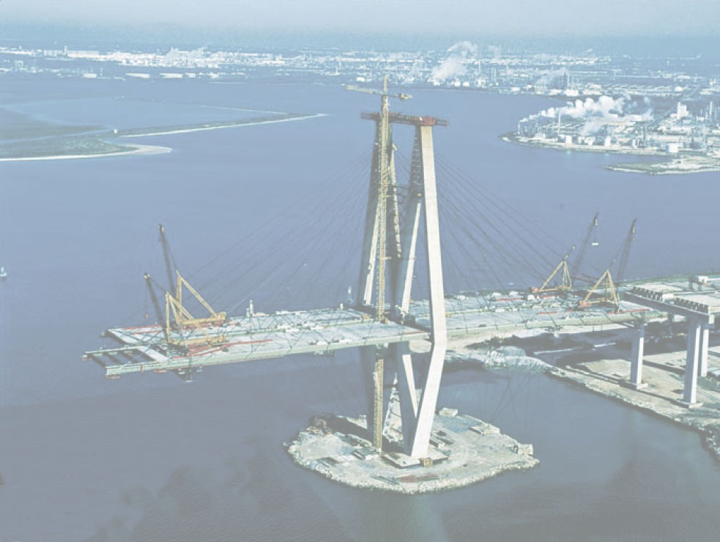
Bechtel Projects
Constructing 30 high-security data centers worldwide for Equinix, Inc. ($1.2 billion)
Building a rail line between London and the Channel Tunnel ($4.6 billion)
Developing an oil pipeline from the Caspian Sea region to Russia ($850 million)
Expanding the Dubai Airport in the UAE ($600 million), and the Miami Airport in Florida ($2 billion)
© 2014 Pearson Education, Inc.

Slide 6
Bechtel Projects
Building liquid natural gas plants in Yemen ($2 billion) and in Trinidad, West Indies ($1 billion)
Building a new subway for Athens, Greece ($2.6 billion)
Constructing a natural gas pipeline in Thailand ($700 million)
Building 30 plants for iMotors.com, a company that sells refurbished autos online ($300 million)
Building a highway to link the north and south of Croatia ($303 million)
© 2014 Pearson Education, Inc.

Slide 7
Learning Objectives
When you complete this chapter you should be able to:
3.1 Use a Gantt chart for scheduling
3.2 Draw AOA and AON networks
3.3 Complete forward and backward passes for a project
3.4 Determine a critical path

Slide 8
Learning Objectives
When you complete this chapter you should be able to:
3.5 Calculate the variance of activity times
3.6 Crash a project

Slide 9
Importance of
Project Management
Bechtel Project Management
  International workforce, construction professionals, cooks, medical personnel, security
  Strategic value of time-based competition
  Quality mandate for continual improvement

Slide 10
Project Characteristics
Single unit
Many related activities
Difficult production planning and inventory control
General purpose equipment
High labor skills

Slide 11


Examples of Projects
Building Construction
Research Project

Slide 12
Management of Projects
Planning - goal setting, defining the project, team organization
Scheduling - relate people, money, and supplies to specific activities and activities to each other
Controlling - monitor resources, costs, quality, and budgets; revise plans and shift resources to meet time and cost demands

Slide 13
Project Management Activities
Planning
  Objectives
  Resources
  Work break-down structure
  Organization
Scheduling
  Project activities
  Start and end times
  Network
Controlling
  Monitor, compare, revise, action

Slide 14
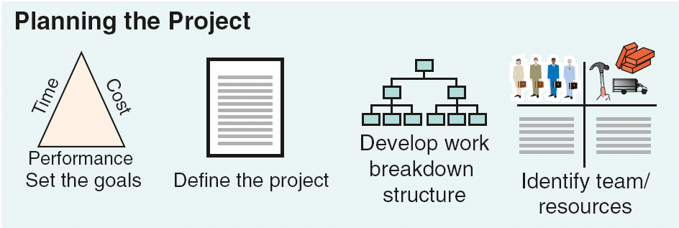
Project Planning, Scheduling, and Controlling
Figure 3.1

Slide 15
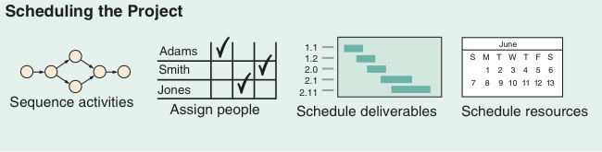
Project Planning, Scheduling, and Controlling
Figure 3.1

Slide 16
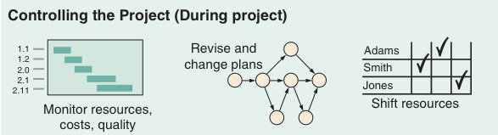
Project Planning, Scheduling, and Controlling
Figure 3.1

Slide 17
Project Planning, Scheduling, and Controlling
Figure 3.1

Slide 18
Project Planning, Scheduling, and Controlling
Time/cost estimates
Budgets
Engineering diagrams
Cash flow charts
Material availability details
Budgets
Delayed activities report
Slack activities report
CPM/PERT
Gantt charts
Milestone charts
Cash flow schedules
Figure 3.1

Slide 19

Project Planning
Establishing objectives
Defining project
Creating work breakdown structure
Determining
resources
Forming organization

Slide 20
Project Organization
Often temporary structure
Uses specialists from entire company
Headed by project manager
  Coordinates activities
  Monitors schedule
  and costs
Permanent
structure called
‘matrix organization’

Slide 21
Project Organization
Most Helpful When:
Work can be defined with a specific goal and deadline
The job is unique or somewhat unfamiliar to the existing organization
The work contains complex interrelated tasks requiring specialized skills
The project is temporary but critical to the organization
The project cuts across organizational lines

Slide 22
A Sample Project Organization
President
Human
Resources
Marketing
Finance
Design
Quality
Mgt
Production
Project No. 1
Project
Manager
Mechanical
Engineer
Test
Engineer
Technician
Project No. 2
Project
Manager
Electrical
Engineer
Computer
Engineer
Technician
Figure 3.2

Slide 23




Matrix Organization
Marketing Operations Engineering Finance
Project 1
Project 2
Project 3
Project 4

Slide 24
The Role of the Project Manager
Highly visible
Responsible for making sure that:
All necessary activities are finished in order and on time
The project comes in within budget
The project meets quality goals
The people assigned to the project receive motivation, direction, and information

Slide 25
The Role of the Project Manager
Highly visible
Responsible for making sure that:
Project managers should be:
Good coaches
Good communicators
Able to organize activities from a variety of disciplines
All necessary activities are finished in order and on time
The project comes in within budget
The project meets quality goals
The people assigned to the project receive motivation, direction, and information

Slide 26
Ethical Issues
Project managers face many ethical decisions on a daily basis
The Project Management Institute has established an ethical code to deal with problems such as:
Offers of gifts from contractors
Pressure to alter status reports to mask delays
False reports for charges of time and expenses
Pressure to compromise quality to meet schedules

Slide 27
Work Breakdown Structure
Level
1. Project
2. Major tasks in the project
3. Subtasks in the major tasks
4. Activities (or “work packages”)
to be completed

Slide 28
Work Breakdown Structure
Level 1
Develop Windows 8 Operating System
1.0
Level 2
Software Design
1.1
Cost Management Plan
1.2
System Testing
1.3
Level 3
Develop GUIs
1.1.1
Design Cost Tracking Reports
1.2.1
Module Testing
1.3.1
Ensure Compatibility with Earlier Versions
1.1.2
Develop Cost/Schedule Interface
1.2.2
Defect Testing
1.3.2
Level 4
Compatible with Windows 7
1.1.2.1
(Work packages)
Compatible with Windows Vista
1.1.2.2
Compatible with Windows XP
1.1.2.3
Figure 3.3

Slide 29

Project Scheduling Techniques
Ensure that all activities
are planned for
Their order of
performance is
accounted for
The activity time
estimates are recorded
The overall project time is developed

Slide 30
Purposes of Project Scheduling
Shows the relationship of each activity to others and to the whole project
Identifies the precedence relationships among activities
Encourages the setting of realistic time and cost estimates for each activity
Helps make better use of people, money, and material resources by identifying critical bottlenecks in the project

Slide 31
Project Management Techniques
Gantt chart
Critical Path Method (CPM)
Program Evaluation and Review Technique (PERT)

Slide 32
A Simple Gantt Chart
Time
J F M A M J J A S
Design
Prototype
Test
Revise
Production

Slide 33
Service For a Delta Jet
Passengers
Baggage
Fueling
Cargo and mail
Galley servicing
Lavatory servicing
Drinking water
Cabin cleaning
Cargo and mail
Flight services
Operating crew
Baggage
Passengers
Deplaning
Baggage claim
Container offload
Pumping
Engine injection water
Container offload
Main cabin door
Aft cabin door
Aft, center, forward
Loading
First-class section
Economy section
Container/bulk loading
Galley/cabin check
Receive passengers
Aircraft check
Loading
Boarding
0 10 20 30 40
Time, Minutes
Figure 3.4

Slide 34
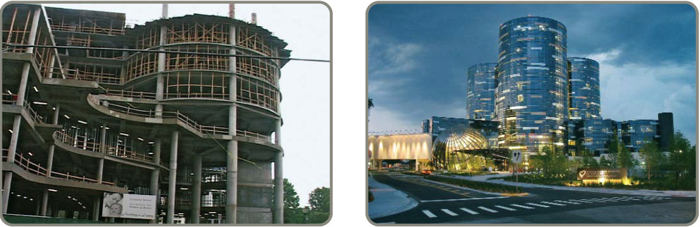
Project Controlling
Close monitoring of resources, costs, quality, budgets
Feedback enables revising the project plan and shift resources
Computerized tools produce extensive reports

Slide 35
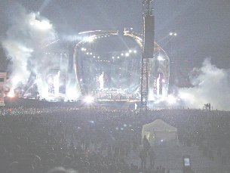
Project Management Software
There are several popular packages for managing projects
  Oracle Primavera
  MindView
  HP Project
  Fast Track
  Microsoft Project

Slide 36
Project Control Reports
Detailed cost breakdowns for each task
Labor requirements
Cost and hour summaries
Raw materials and expenditure forecasts
Variance reports
Time analysis reports
Work status reports

Slide 37
PERT and CPM
Network techniques
Developed in 1950s
  CPM by DuPont for chemical plants (1957)
  PERT by Booz, Allen & Hamilton with the U.S. Navy, for Polaris missile (1958)
Consider precedence relationships and interdependencies
Each uses a different estimate of activity times

Slide 38
Six Steps PERT and CPM
Define the project and prepare the work breakdown structure
Develop relationships among the activities – decide which activities must precede and which must follow others
Draw the network connecting all of the activities

Slide 39
Six Steps PERT and CPM
Assign time and/or cost estimates to each activity
Compute the longest time path through the network – this is called the critical path
Use the network to help plan, schedule, monitor, and control the project

Slide 40
Questions PERT and CPM
Can Answer
When will the entire project be completed?
What are the critical activities or tasks in the project?
Which are the noncritical activities?
What is the probability the project will be completed by a specific date?

Slide 41
Questions PERT and CPM
Can Answer
Is the project on schedule, behind schedule, or ahead of schedule?
Is the money spent equal to, less than, or greater than the budget?
Are there enough resources available to finish the project on time?
If the project must be finished in a shorter time, what is the way to accomplish this at least cost?

Slide 42
A Comparison of AON and AOA Network Conventions
Activity on Activity Activity on
Node (AON) Meaning Arrow (AOA)
A comes before B, which comes before C
(a)
A
B
C
A
B
C
A
A
A and B must both be completed before C can start
(b)
C
C
B
B
B
B and C cannot begin until A is completed
B
(c)
A
A
C
C

Slide 43
A Comparison of AON and AOA Network Conventions
Activity on Activity Activity on
Node (AON) Meaning Arrow (AOA)
A
C
C and D cannot begin until both A and B are completed
A
C
(d)
B
D
B
D
C cannot begin until both A and B are completed
D cannot begin until B is completed
A dummy activity is introduced in AOA
A
C
A
C
(e)
Dummy activity
B
D
B
D

Slide 44
A Comparison of AON and AOA Network Conventions
Activity on Activity Activity on
Node (AON) Meaning Arrow (AOA)
B and C cannot begin until A is completed
D cannot begin until both B and C are completed
A dummy activity is again introduced in AOA
A
B
D
A
B
D
(f)
Dummy activity
C
C

Slide 45
AON Example
Table 3.1 | Milwaukee Paper Manufacturing’s Activities and Predecessors
ACTIVITY |  | DESCRIPTION | IMMEDIATE PREDECESSORS
A |  | Build internal components | —
B |  | Modify roof and floor | —
C |  | Construct collection stack | A
D |  | Pour concrete and install frame | A, B
E |  | Build high-temperature burner | C
F |  | Install pollution control system | C
G |  | Install air pollution device | D, E
H |  | Inspect and test | F, G

Slide 46
AON Network for Milwaukee Paper
Activity A
(Build Internal Components)
A
Start
Activity B
(Modify Roof and Floor)
Start Activity
B
Figure 3.5

Slide 47
AON Network for Milwaukee Paper
Activity A Precedes Activity C
A
C
Start
B
D
Activities A and B Precede Activity D
Figure 3.6

Slide 48
AON Network for Milwaukee Paper
F
A
C
E
Start
H
B
D
G
Arrows Show Precedence Relationships
Figure 3.7

Slide 49
AOA Network for Milwaukee Paper
C
(Construct Stack)
2
4
F
(Install Controls)
A
(Build Internal Components)
E
(Build Burner)
H
(Inspect/ Test)
1
Dummy Activity
6
7
B
(Modify Roof/Floor)
G
(Install Pollution Device)
D
(Pour Concrete/ Install Frame)
3
5
Figure 3.8

Slide 50
Determining the Project Schedule
Perform a Critical Path Analysis
The critical path is the longest path through the network
The critical path is the shortest time in which the project can be completed
Any delay in critical path activities delays the project
Critical path activities have no slack time

Slide 51
Determining the Project Schedule
Table 3.2 | Time Estimates for Milwaukee Paper Manufacturing
ACTIVITY |  | DESCRIPTION | TIME (WEEKS)
A |  | Build internal components | 2
B |  | Modify roof and floor | 3
C |  | Construct collection stack | 2
D |  | Pour concrete and install frame | 4
E |  | Build high-temperature burner | 4
F |  | Install pollution control system | 3
G |  | Install air pollution device | 5
H |  | Inspect and test | 2
 |  | Total time (weeks) | 25

Slide 52
Determining the Project Schedule
Perform a Critical Path Analysis
Earliest start (ES) = earliest time at which an activity can start, assuming all predecessors have been completed
Earliest finish (EF) = earliest time at which an activity can be finished
Latest start (LS) = latest time at which an activity can start so as to not delay the completion time of the entire project
Latest finish (LF) = latest time by which an activity has to be finished so as to not delay the completion time of the entire project

Slide 53
Determining the Project Schedule
Activity Format
Figure 3.9
Activity Name or Symbol
A
Earliest Finish
Earliest Start
ES
EF
Latest Start
LS
LF
Latest Finish
2
Activity Duration

Slide 54
Forward Pass
Begin at starting event and work forward
Earliest Start Time Rule:
If an activity has only a single immediate predecessor, its ES equals the EF of the predecessor
If an activity has multiple immediate predecessors, its ES is the maximum of all the EF values of its predecessors
ES = Max {EF of all immediate predecessors}

Slide 55
Forward Pass
Begin at starting event and work forward
Earliest Finish Time Rule:
The earliest finish time (EF) of an activity is the sum of its earliest start time (ES) and its activity time
EF = ES + Activity time

Slide 56
ES/EF Network for Milwaukee Paper
ES
EF = ES + Activity time
Start
0
0
0

Slide 58
ES/EF Network for Milwaukee Paper
EF of A =
ES of A + 2
ES
of A
A
2
0
2
0
Start
0
0

Slide 59
ES/EF Network for Milwaukee Paper
A
2
0
2
EF of B =
ES of B + 3
ES
of B
0
Start
0
B
3
0
3
0

Slide 60
ES/EF Network for Milwaukee Paper
A
2
C
2
0
2
2
4
0
Start
0
0
B
3
0
3

Slide 61
ES/EF Network for Milwaukee Paper
A
2
C
2
0
2
2
4
0
Start
0
= Max (2, 3)
D
4
0
3
7
B
3
0
3

Slide 62
ES/EF Network for Milwaukee Paper
A
2
C
2
0
2
2
4
0
Start
0
0
B
3
D
4
0
3
3
7

Slide 63
ES/EF Network for Milwaukee Paper
A
2
C
2
F
3
0
2
2
4
4
7
Start
0
E
4
H
2
0
4
8
13
15
0
B
3
D
4
G
5
0
3
3
7
8
13
Figure 3.10

Slide 64
Backward Pass
Begin with the last event and work backwards
Latest Finish Time Rule:
If an activity is an immediate predecessor for just a single activity, its LF equals the LS of the activity that immediately follows it
If an activity is an immediate predecessor to more than one activity, its LF is the minimum of all LS values of all activities that immediately follow it
LF = Min {LS of all immediate following activities}

Slide 65
Backward Pass
Begin with the last event and work backwards
Latest Start Time Rule:
The latest start time (LS) of an activity is the difference of its latest finish time (LF) and its activity time
LS = LF – Activity time

Slide 66
LS/LF Times for
Milwaukee Paper
A
2
C
2
F
3
0
2
2
4
4
7
Start
0
E
4
H
2
0
4
8
13
15
13
15
0
LS = LF – Activity time
B
3
D
4
G
5
0
3
3
7
8
13
LF = EF
of Project

Slide 67
LS/LF Times for
Milwaukee Paper
A
2
C
2
F
3
0
2
2
4
4
7
10
13
Start
0
E
4
H
2
0
LF = Min(LS of following activity)
4
8
13
15
13
15
0
B
3
D
4
G
5
0
3
3
7
8
13

Slide 68
LS/LF Times for
Milwaukee Paper
LF = Min(4, 10)
A
2
C
2
F
3
0
2
2
4
4
7
2
4
10
13
Start
0
E
4
H
2
0
4
8
13
15
4
8
13
15
0
B
3
D
4
G
5
0
3
3
7
8
13
8
13

Slide 69
LS/LF Times for
Milwaukee Paper
A
2
C
2
F
3
0
2
2
4
4
7
0
2
2
4
10
13
Start
0
E
4
H
2
0
4
8
13
15
0
0
4
8
13
15
0
B
3
D
4
G
5
0
3
3
7
8
13
1
4
4
8
8
13

Slide 70
Computing Slack Time
After computing the ES, EF, LS, and LF times for all activities, compute the slack or free time for each activity
Slack is the length of time an activity can be delayed without delaying the entire project
Slack = LS – ES or Slack = LF – EF

Slide 71
Computing Slack Time
TABLE 3.3 | Milwaukee Paper’s Schedule and Slack Times
ACTIVITY | EARLIEST START ES | EARLIEST FINISH EF | LATEST START LS | LATEST FINISH LF | SLACK LS – ES | ON CRITICAL PATH
A | 0 | 2 | 0 | 2 | 0 | Yes
B | 0 | 3 | 1 | 4 | 1 | No
C | 2 | 4 | 2 | 4 | 0 | Yes
D | 3 | 7 | 4 | 8 | 1 | No
E | 4 | 8 | 4 | 8 | 0 | Yes
F | 4 | 7 | 10 | 13 | 6 | No
G | 8 | 13 | 8 | 13 | 0 | Yes
H | 13 | 15 | 13 | 15 | 0 | Yes

Slide 72
Computing Slack Time
Activities with zero slack are on the critical path. It:
Starts at the first activity in the project
Terminates at the last activity in the project
Includes only critical activities
TABLE 3.3 | Milwaukee Paper’s Schedule and Slack Times
ACTIVITY | EARLIEST START ES | EARLIEST FINISH EF | LATEST START LS | LATEST FINISH LF | SLACK LS – ES | ON CRITICAL PATH
A | 0 | 2 | 0 | 2 | 0 | Yes
B | 0 | 3 | 1 | 4 | 1 | No
C | 2 | 4 | 2 | 4 | 0 | Yes
D | 3 | 7 | 4 | 8 | 1 | No
E | 4 | 8 | 4 | 8 | 0 | Yes
F | 4 | 7 | 10 | 13 | 6 | No
G | 8 | 13 | 8 | 13 | 0 | Yes
H | 13 | 15 | 13 | 15 | 0 | Yes

Slide 73
Critical Path for
Milwaukee Paper
A
2
C
2
F
3
0
2
2
4
4
7
0
2
2
4
10
13
Start
0
E
4
H
2
0
4
8
13
15
0
0
4
8
13
15
0
B
3
D
4
G
5
0
3
3
7
8
13
1
4
4
8
8
13

Slide 74
ES – EF Gantt Chart for Milwaukee Paper
1 2 3 4 5 6 7 8 9 10 11 12 13 14 15 16
A Build internal components
B Modify roof and floor
C Construct collection stack
D Pour concrete and install frame
E Build high-temperature burner
F Install pollution control system
G Install air pollution device
H Inspect and test

Slide 75
LS – LF Gantt Chart for Milwaukee Paper
1 2 3 4 5 6 7 8 9 10 11 12 13 14 15 16
A Build internal components
B Modify roof and floor
C Construct collection stack
D Pour concrete and install frame
E Build high-temperature burner
F Install pollution control system
G Install air pollution device
H Inspect and test

Slide 76
Variability in Activity Times
CPM assumes we know a fixed time estimate for each activity and there is no variability in activity times
PERT uses a probability distribution for activity times to allow for variability

Slide 77
Variability in Activity Times
Three time estimates are required
  Optimistic time (a) – if everything goes according to plan
  Pessimistic time (b) – assuming very
  unfavorable conditions
  Most likely time (m) – most realistic estimate

Slide 78
Variability in Activity Times
Estimate follows beta distribution
Expected activity time:
Variance of activity completion times:
t = (a + 4m + b)/6
v = [(b – a)/6]²

Slide 79
Variability in Activity Times
Estimate follows beta distribution
t = (a + 4m + b)/6
v = [(b − a)/6]2
Expected activity time:
Variance of activity completion times:
Figure 3.11
t = (a + 4m + b)/6
v = [(b – a)/6]²
Probability of 1 in 100
of < a occurring
Probability of 1 in 100
of > b occurring
Probability
Activity Time
Optimistic Time (a)
Most Likely
Time (m)
Pessimistic
Time (b)

Slide 80
Computing Variance
TABLE 3.4 |  | Time Estimates (in weeks) for Milwaukee Paper's Project
ACTIVITY | OPTIMISTIC a |  | MOST LIKELY m | PESSIMISTIC b | EXPECTED TIME t = (a + 4m + b)/6 | VARIANCE [(b – a)/6]²
A | 1 |  | 2 | 3 | 2 | .11
B | 2 |  | 3 | 4 | 3 | .11
C | 1 |  | 2 | 3 | 2 | .11
D | 2 |  | 4 | 6 | 4 | .44
E | 1 |  | 4 | 7 | 4 | 1.00
F | 1 |  | 2 | 9 | 3 | 1.78
G | 3 |  | 4 | 11 | 5 | 1.78
H | 1 |  | 2 | 3 | 2 | .11

Slide 81
Probability of Project Completion
Project variance is computed by summing the variances of critical activities
σ² = Project variance
= ∑(variances of activities
on critical path)
p

Slide 82
Probability of Project Completion
Project variance is computed by summing the variances of critical activities
Project variance
σ² = .11 + .11 + 1.00 + 1.78 + .11 = 3.11
Project standard deviation
σ_{p} = Project variance
= 3.11 = 1.76 weeks
p

Slide 83
Probability of Project Completion
PERT makes two more assumptions:
Total project completion times follow a normal probability distribution
Activity times are statistically independent

Slide 84
Probability of Project Completion
Figure 3.12
Standard deviation = 1.76 weeks
15 Weeks
(Expected Completion Time)

Slide 85
Probability of Project Completion
What is the probability this project can be completed on or before the 16 week deadline?
Z = – /σ_{p}
= (16 weeks – 15 weeks)/1.76
= 0.57
Due Expected date
date of completion
Where Z is the number of standard deviations the due date or target date lies from the mean or expected date

Slide 86
Probability of Project Completion
From Appendix I
What is the probability this project can be completed on or before the 16 week deadline?
.00 .01 .07 .08
.1 .50000 .50399 .52790 .53188
.2 .53983 .54380 .56749 .57142
.5 .69146 .69497 .71566 .71904
.6 .72575 .72907 .74857 .75175
Z = − /σ_{p}
= (16 wks − 15 wks)/1.76
= 0.57
due expected date
date of completion
Where Z is the number of standard deviations the due date or target date lies from the mean or expected date

Slide 87
Probability of Project Completion
0.57 Standard deviations
Probability
(T ≤ 16 weeks)
is 71.57%
15 16
Weeks Weeks
Time
Figure 3.13

Slide 88
Determining Project Completion Time
Probability of 0.99
Probability of 0.01
2.33 Standard deviations
Z
From Appendix I
0
2.33
Figure 3.14

Slide 89
Variability of Completion Time for Noncritical Paths
Variability of times for activities on noncritical paths must be considered when finding the probability of finishing in a specified time
Variation in noncritical activity may cause change in critical path

Slide 90
What Project Management Has Provided So Far
The project’s expected completion time is 15 weeks
There is a 71.57% chance the equipment will be in place by the 16 week deadline
Five activities (A, C, E, G, and H) are on the critical path
Three activities (B, D, F) are not on the critical path and have slack time
A detailed schedule is available

Slide 91
Cost–Time Trade-Offs and Project Crashing
It is not uncommon to face the following situations:
The project is behind schedule
The completion time has been moved forward
Shortening the duration of the project is called project crashing

Slide 92
Factors to Consider When Crashing a Project
The amount by which an activity is crashed is, in fact, permissible
Taken together, the shortened activity durations will enable us to finish the project by the due date
The total cost of crashing is as small as possible

Slide 93
Steps in Project Crashing
Step 1: Compute the crash cost per time period. If crash costs are linear over time:
(Crash cost – Normal cost)
(Normal time – Crash time)
Crash cost
per period
=
Step 2: Using current activity times, find the critical path and identify the critical activities

Slide 94
Steps in Project Crashing
Step 3: If there is only one critical path, then select the activity on this critical path that (a) can still be crashed, and (b) has the smallest crash cost per period. If there is more than one critical path, then select one activity from each critical path such that (a) each selected activity can still be crashed, and (b) the total crash cost of all selected activities is the smallest. Note that the same activity may be common to more than one critical path.

Slide 95
Steps in Project Crashing
Step 4: Update all activity times. If the desired due date has been reached, stop. If not, return to Step 2.

Slide 96
Crashing The Project
TABLE 3.5 |  | Normal and Crash Data for Milwaukee Paper Manufacturing
ACTIVITY | TIME (WEEKS) |  |  | COST ($) |  | CRASH COST PER WEEK ($) | CRITICAL PATH ?
 | NORMAL |  | CRASH | NORMAL | CRASH
A | 2 |  | 1 | 22,000 | 22,750 | 750 | Yes
B | 3 |  | 1 | 30,000 | 34,000 | 2,000 | No
C | 2 |  | 1 | 26,000 | 27,000 | 1,000 | Yes
D | 4 |  | 3 | 48,000 | 49,000 | 1,000 | No
E | 4 |  | 2 | 56,000 | 58,000 | 1,000 | Yes
F | 3 |  | 2 | 30,000 | 30,500 | 500 | No
G | 5 |  | 2 | 80,000 | 84,500 | 1,500 | Yes
H | 2 |  | 1 | 16,000 | 19,000 | 3,000 | Yes

Slide 97
Crash and Normal Times and Costs for Activity B
Activity Cost
Crash
$34,000 —
$33,000 —
$32,000 —
$31,000 —
$30,000 —
—
Crash Cost – Normal Cost
Normal Time – Crash Time
Crash Cost/Wk =
Crash Cost
=
$34,000 – $30,000
3 – 1
$4,000
2 Wks
= = $2,000/Week
Normal
Normal Cost
| | |
1 2 3 Time (Weeks)
Figure 3.15
Crash Time
Normal Time

Slide 98
Critical Path and Slack Times for Milwaukee Paper
Figure 3.16
A
2
C
2
F
3
0
2
2
4
4
7
0
2
2
4
10
13
Start
Slack = 0
Slack = 0
E
4
Slack = 6
H
2
0
0
4
8
13
15
0
0
4
8
13
15
0
B
3
D
4
Slack = 0
G
5
Slack = 0
0
3
3
7
8
13
1
4
4
8
8
13
Slack = 1
Slack = 1
Slack = 0

Slide 99
Advantages of PERT/CPM
Especially useful when scheduling and controlling large projects
Straightforward concept and not mathematically complex
Graphical networks help highlight relationships among project activities
Critical path and slack time analyses help pinpoint activities that need to be closely watched

Slide 100
Advantages of PERT/CPM
Project documentation and graphics point out who is responsible for various activities
Applicable to a wide variety of projects
Useful in monitoring not only schedules but costs as well

Slide 101
Limitations of PERT/CPM
Project activities have to be clearly defined, independent, and stable in their relationships
Precedence relationships must be specified and networked together
Time estimates tend to be subjective and are subject to fudging by managers
There is an inherent danger of too much emphasis being placed on the longest, or critical, path

Slide 102
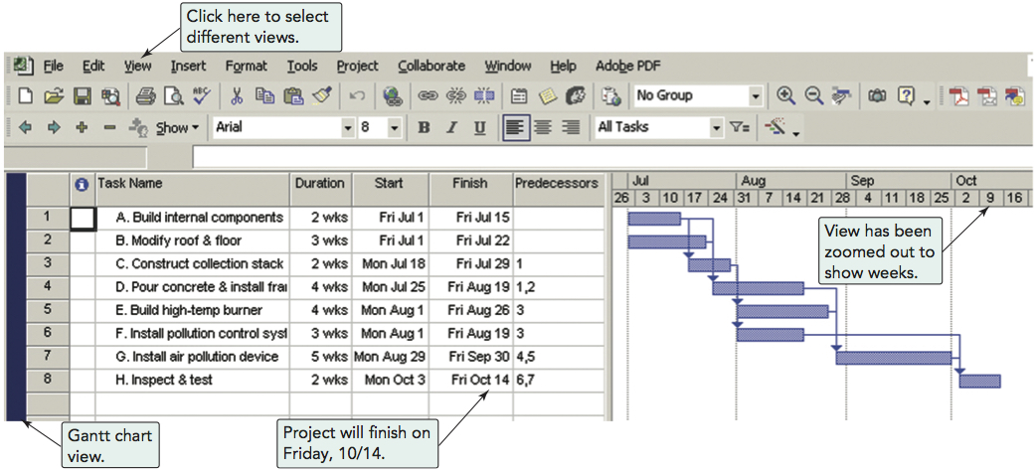
Using Microsoft Project
Program 3.1

Slide 103
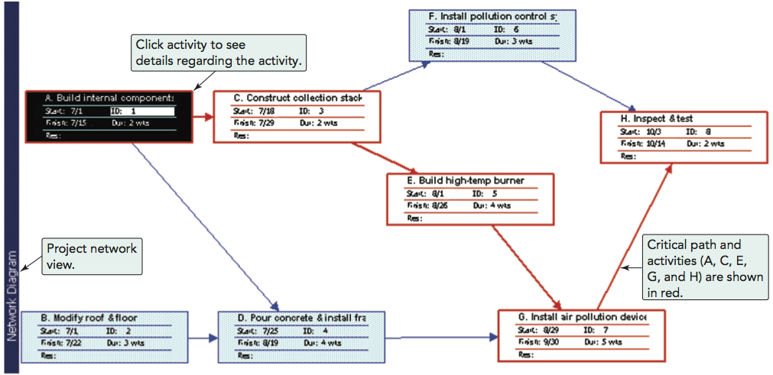
Using Microsoft Project
Program 3.2

Slide 104
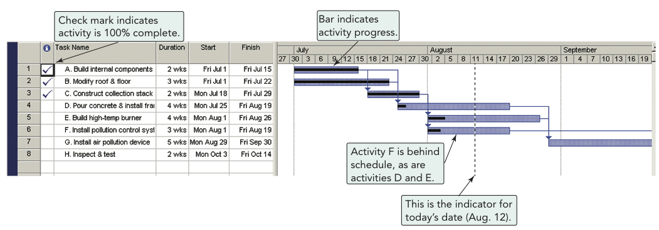
Using Microsoft Project
Pollution Project Percentage Completed on Aug. 12
ACTIVITY | COMPLETED
A | 100
B | 100
C | 100
D | 10
E | 20
F | 20
G | 0
H | 0
Program 3.3

Slide 105

All rights reserved. No part of this publication may be reproduced, stored in a retrieval system, or transmitted, in any form or by any means, electronic, mechanical, photocopying, recording, or otherwise, without the prior written permission of the publisher.
Printed in the United States of America.

