Slide 1
Chapter 3
A brief overview of the
classical linear regression model

Slide 2
Regression
Regression is probably the single most important tool at the econometrician’s disposal.
But what is regression analysis?
It is concerned with describing and evaluating the relationship between a given variable (usually called the dependent variable) and one or more other variables (usually known as the independent variable(s)).
Regression is the degree of dependency of the dependent variable on the explanatory variables

Slide 3
Some Notation
Denote the dependent variable by y and the independent variable(s) by x₁, x₂, ... , x_{k} where there are k independent variables.
Some alternative names for the y and x variables:
y x
dependent variable independent variables
regressand regressors
effect variable causal variables
explained variable explanatory variable
Response variable Control variable
Predicted variable Predictor
Note that there can be many x variables but we will limit ourselves to the case where there is only one x variable to start with. In our setup, there is only one y variable.

Slide 4
Regression is different from Correlation
If we say y and x are correlated, it means that we are treating y and x in a completely symmetrical way. Correlation measures the strength of a linear association between two variables.
Regression does not imply causation, causation suggests the dependent variable depends on previous values of the explanatory variable
In regression, we treat the dependent variable (y) and the independent variable(s) (x’s) very differently.
  The y variable is assumed to be random or “stochastic” in some way, i.e. to have a probability distribution.
    a variable whose values depend on outcomes of a random phenomenon
  The x variables are, however, assumed to have fixed (“non-stochastic”) values in repeated samples.
    A non-random (deterministic, non-stochastic variable) is one whose value is known ahead of time or one whose past value is known. EX: Tomorrow's date, yesterday's temperature.

Slide 5
Simple Regression
For simplicity, say k=1. This is the situation where y depends on only one x variable.
Two (observable) variables "y" and "x".
Y = β₀ + β₁X + u; (1)
Equation (1) defines the simple regression model.
Examples of the kind of relationship that may be of interest include:
  How asset returns vary with their level of market risk
  Measuring the long-term relationship between stock prices and dividends.

Slide 6
Simple Regression: An Example
Suppose that we have the following data on the excess returns on a fund manager’s portfolio (“fund XXX”) together with the excess returns on a market index:
We have some intuition that the beta on this fund is positive, and we therefore want to find whether there appears to be a relationship between x and y given the data that we have. The first stage would be to form a scatter plot of the two variables.

Slide 7
Graph (Scatter Diagram)

Slide 8
Finding a Line of Best Fit
We can use the general equation for a straight line,
y = α + βx
to get the line that best “fits” the data.
However, this equation (y = α + βx) is completely deterministic (no randomness is involved in the development of future states of the system).
Is this realistic? No. So we add a random disturbance term, u into the equation.
y_{t} = α + βx_{t} + u_{t}
where t = 1,2,3,4,5

Slide 9
Why do we include a Disturbance term?
The variable u is also called the error term or noise component.
The disturbance term can capture a number of features:
  Omitted variables: we always leave out some determinants of y_{t}
  Measurement errors: there may be errors in the measurement of y_{t} that cannot be modelled.
  Unpredictable effects: Random outside influences on y_{t} which we cannot model; inherently unpredictable random effects, particularly in human behaviour.
  Nonlinearities: captures the effects of nonlinearities between y and x. Thus, if the true model is y_{t} = α + βx_{t} + γx_{t}² + v_{t} , and we assume that it is y_{t} = α + βx_{t} + u_{t} , then the effect of x_{t}² is absorbed to u_{t} . In fact, u_{t} = γx_{t}² + v_{t} .

Slide 10
Determining the Regression Coefficients
So how do we determine what α and β are?
Choose α and β so that the (vertical) distances from the data points to the fitted lines are minimised (so that the line fits the data as closely as possible):

Slide 11
Determining the Regression Coefficients
α is the intercept (called also the constant term) and and β is the slope of the regression line.
That is, if the other factors (in u) are held fixed (ceteris paribus), so that the change in u is zero,
Δy = β Δx, if Δu=0
Thus, the (expected) change in y is β times the change in x.
In particular if x changes by one unit, the (expected) change in y is β units.

Slide 12
Ordinary Least Squares
The most common method used to fit a line to the data is known as OLS (ordinary least squares).
The aim of this approach is to minimize the residual for all residuals
What we actually do is take each distance and square it (i.e. take the area of each of the squares in the diagram) and minimise the total sum of the squares (hence least squares).
Tightening up the notation, let
y_{t} denote the actual data point t
denote the fitted value from the regression line
denote the residual, y_{t} -

Slide 13
Actual and Fitted Value
= y_{t} -

Slide 14
How OLS Works
So min. , or minimise . This is known as the residual sum of squares.
But what was ? It was the difference between the actual point and the line, y_{t} - .
So minimising is equivalent to minimising
with respect to and .

Slide 15
Deriving the OLS Estimator
But , so let
Want to minimise L with respect to (w.r.t.) and , so differentiate L w.r.t. and
(1)
(2)
From (1),
But and .

Slide 16
Deriving the OLS Estimator (cont’d)
So we can write or (3)
From (2), (4)
From (3), (5)
Substitute into (4) for from (5),

Slide 17
Deriving the OLS Estimator (cont’d)
Rearranging for ,
So overall we have
This method of finding the optimum is known as ordinary least squares.

Slide 18
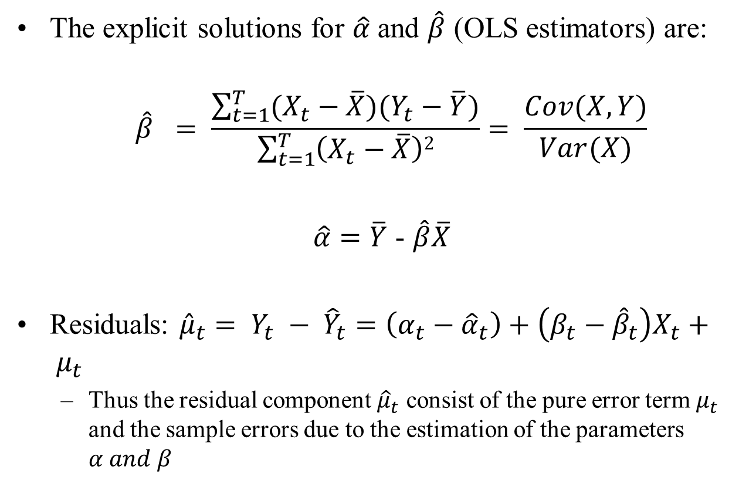
Deriving the OLS Estimator (cont’d)
The explicit solutions for $\hat{α}$ and $\hat{β}$ (OLS estimators) are:
$$\hat{β} = \frac{\sum_{t=1}^{T}{(X_{t}−\overline{X})(Y_{t}−\overline{Y})}}{\sum_{t=1}^{T}{\left(X_{t}−\overline{X}\right)2}}= \frac{Cov(X,Y)}{Var(X)}$$
$\hat{α}=\overline{Y}$ - $\hat{β}\overline{X}$
Residuals: ${\hat{μ}}_{t}= Y_{t} − {\hat{Y}}_{t}=\left(α_{t}−{\hat{α}}_{t}\right)+\left(β_{t}−{\hat{β}}_{t}\right)X_{t}+ μ_{t}$
  Thus the residual component ${\hat{μ}}_{t}$ consist of the pure error term $μ_{t}$ and the sample errors due to the estimation of the parameters $α and β$

Slide 19
What do We Use and For?
In the CAPM example used above, plugging the 5 observations in to make up the formulae given above would lead to the estimates
= -1.74 and = 1.64. We would write the fitted line as:
Question: If an analyst tells you that she expects the market to yield a return 20% higher than the risk-free rate next year, what would you expect the return on fund XXX to be?
Solution: We can say that the expected value of y = “-1.74 + 1.64 * value of x”, so plug x = 20 into the equation to get the expected value for y:

Slide 20
Example 1
Relationship between wage and education.
  wage = average hourly earnings
  educ = years of education
  Data is collected in 1976, n = 526
  Excerpt of the data set wage.raw (Wooldridge)
wage (y) | educ (x)
3.1 | 11
3.2 | 12
3 | 11
6 | 8
5.3 | 12
8.7 | 16
11.25 | 18
5 | 12
3.6 | 12
18.18 | 17
6.2 | 16

Slide 21
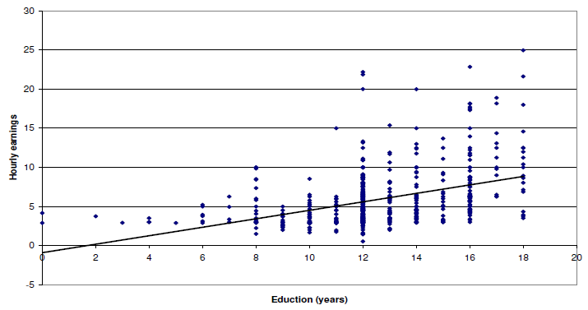
Example 1: scatterplot of the data with regression line

Slide 22
Example 1 cont’
Sample statistics:
 | Wage | Educ
Mean | 5.9 | 12.56
Standard deviation | 3.69 | 2.769
n | 526 | 526
Correlation | 0.406

Slide 23
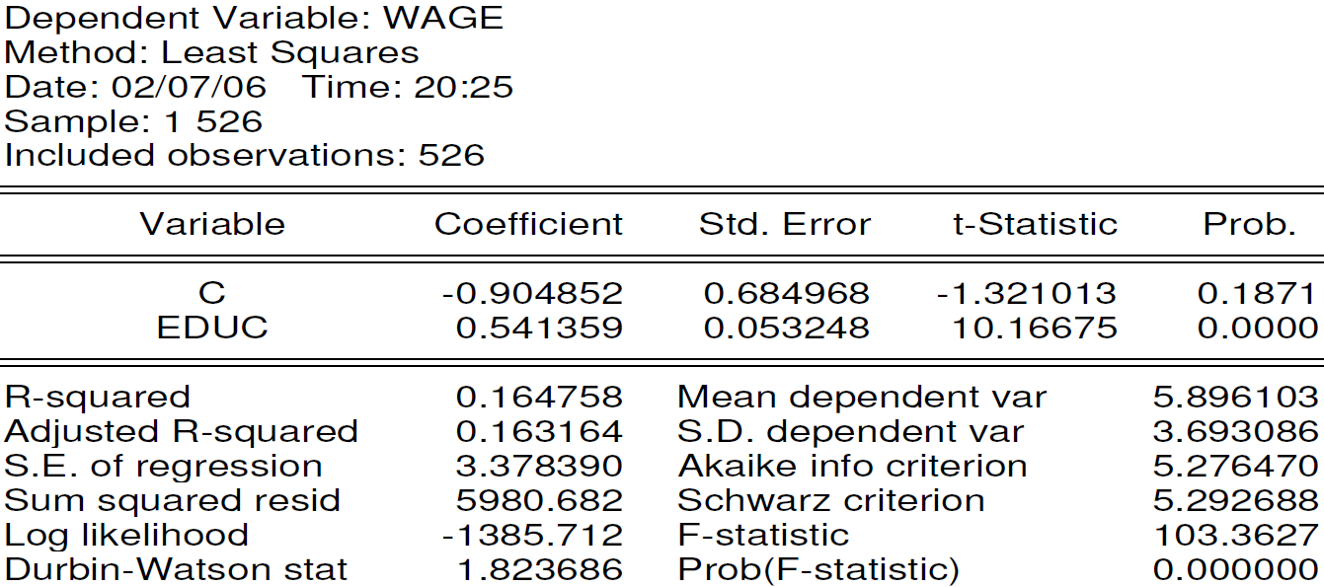
Example 1 cont’
Eviews estimation results:

Slide 24
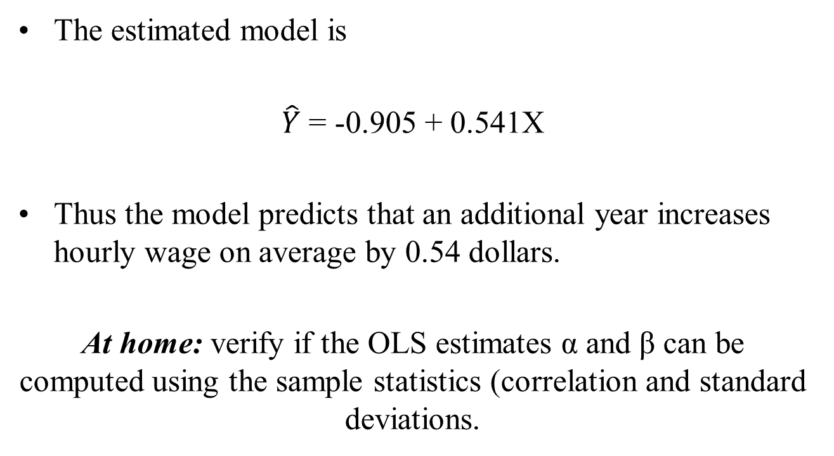
Example 1 cont’
The estimated model is
$\hat{Y}$ = -0.905 + 0.541X
Thus the model predicts that an additional year increases hourly wage on average by 0.54 dollars.
At home: verify if the OLS estimates α and β can be computed using the sample statistics (correlation and standard deviations.

Slide 25
Accuracy of Intercept Estimate
Care needs to be exercised when considering the intercept estimate, particularly if there are no or few observations close to the y-axis:

Slide 26
The Population and the Sample
The population is the total collection of all objects or people to be studied, for example,
Interested in Population of interest
predicting outcome the entire electorate
of an election
A sample is a selection of just some items from the population.
A random sample is a sample in which each individual item in the population is equally likely to be drawn.

Slide 27
The DGP and the PRF
The population regression function (PRF) is a description of the model that is thought to be generating the actual data and the true relationship between the variables (i.e. the true values of α and β). It is notable that PRF is something xed, but unknown, in the population.
The PRF is
The sample regression function (SRF) is
and we also know that .
We use the SRF to infer likely values of the PRF, a new sample will generate new a slope and intercept in, and therefore different lines (that vary around PRF).
We also want to know how “good” our estimates of α and β are.

Slide 28
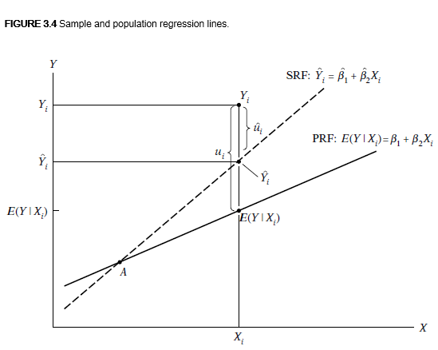
The DGP and the PRF

Slide 29
Linearity
In order to use OLS, we need a model which is linear in the parameters (α and β ). It does not necessarily have to be linear in the variables (y and x).
Linear in the parameters means that the parameters are not multiplied together, divided, squared or cubed etc.
Some models can be transformed to linear ones by a suitable substitution or manipulation, e.g. the exponential regression model
Then let y_{t}=ln Y_{t} and x_{t}=ln X_{t}

Slide 30
Linear and Non-linear Models
This is known as the exponential regression model. Here, the coefficients can be interpreted as elasticities.
Similarly, if theory suggests that y and x should be inversely related:
then the regression can be estimated using OLS by substituting
But some models are intrinsically non-linear, e.g.

Slide 31
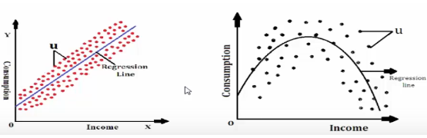
Linearity in the Variables

Slide 32
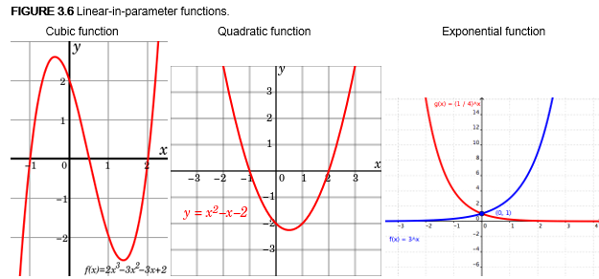
Linearity in the Parameters

Slide 33
Estimator or Estimate?
Estimators are the formulas used to calculate the coefficients
Estimates are the actual numerical values for the coefficients.
An estimator is a statistic that you apply to data in order to obtain the estimate

Slide 34
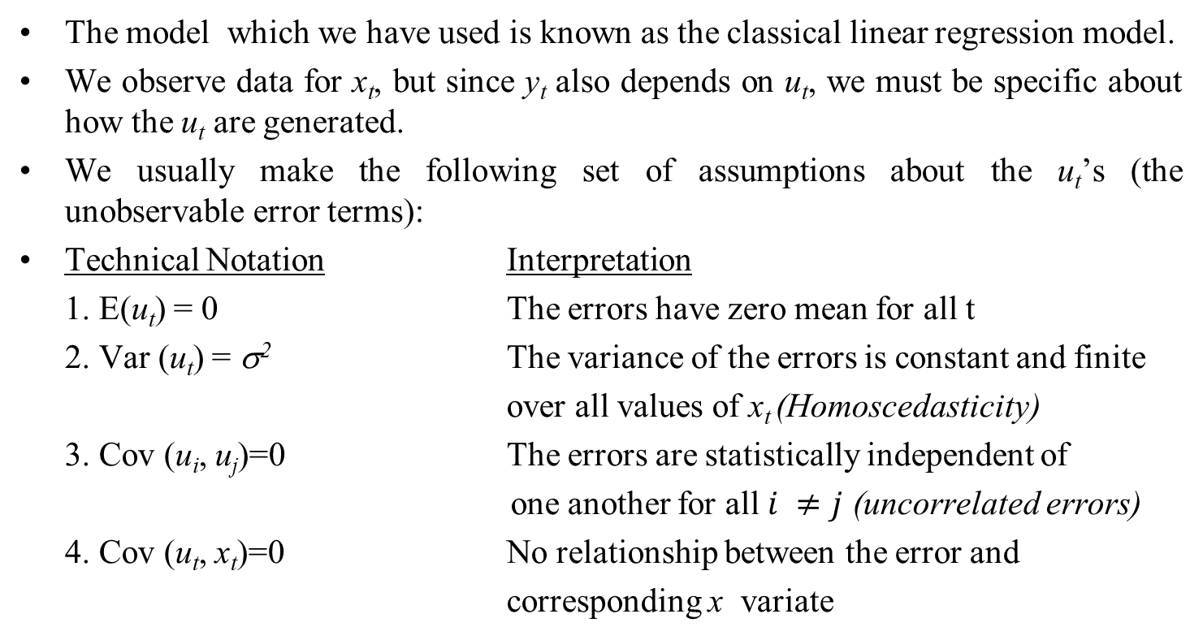
The Assumptions Underlying the
Classical Linear Regression Model (CLRM)
The model which we have used is known as the classical linear regression model.
We observe data for x_{t}, but since y_{t} also depends on u_{t}, we must be specific about how the u_{t} are generated.
We usually make the following set of assumptions about the u_{t}’s (the unobservable error terms):
Technical Notation Interpretation
1. E(u_{t}) = 0 The errors have zero mean for all t
2. Var (u_{t}) = σ² The variance of the errors is constant and finite
over all values of x_{t} (Homoscedasticity)
3. Cov (u_{i}, u_{j})=0 The errors are statistically independent of
one another for all $i ≠j$ (uncorrelated errors)
4. Cov (u_{t}, x_{t})=0 No relationship between the error and
corresponding x variate

Slide 35
The Assumptions Underlying the
CLRM Again
An alternative assumption to 4., which is slightly stronger, is that the x_{t}’s are non-stochastic or fixed in repeated samples
A fifth assumption is required if we want to make inferences about the population parameters (the actual α and β) from the sample parameters ( and )
Additional Assumption
5. u_{t} is normally distributed

Slide 36
Remarks
Assumptions 1 and 2 are related to distributional properties of the error term of which Assumption 1 can always be fulfilled when the intercept term α is included in the regression. We discuss Assumption 2 later on.
Assumption 3. is mostly relevant in time series data or "clustered" data. Beyond the scope of this course.
Assumption 4 is the key assumption on how x and u are related

Slide 37
Question 1
Suppose that a score on a final exam, score, depends on classes attended (attend) and unobserved factors that affect exam performance (such as student ability). Then
score = α + β attend + u
When would you expect this model to satisfy assumption 4?

Slide 38
Answer to Question 1
You would expect this to be the case if the unobserved variables that can affect exam performance (such as student ability) are NOT correlated with attendance. This seems pretty unlikely, though.

Slide 39
Question 2
If child is the number of children born to a woman (fertility), and edu the level of education that she has obtained (in years). A simple model relating fertility to years of education is:
child = α + β edu + u
What kinds of factors are contained in u? Are these likely to be correlated with the level of education?
Will a simple regression analysis uncover the ceteris paribus effect of education on fertility? Explain.

Slide 40
Answer to Question 2
Other factors that might be contained in the error term would be age of the mother, income level, type of locality, etc. Surely age and income would be highly correlated with education.
If you ran the above regression, you wouldn’t be controlling for any other effects (there are no other effects in the model: no other RHS variables) so you would NOT be looking at the ceteris paribus effect of education on fertility. A simple regression would tell you the OVER-ALL effect of education on kids (controlling for nothing else at all).

Slide 41
Properties of the OLS Estimator
If assumptions 1. through 4. hold, then the estimators and determined by OLS are known as Best Linear Unbiased Estimators (BLUE).
What does the acronym stand for?
“Estimator” - is an estimator of the true value of β.
“Linear” - is a linear estimator
“Unbiased” - On average, the actual value of the and ’s will be equal to the true values.
“Best” - means that the OLS estimator has minimum variance among the class of linear unbiased estimators. The Gauss-Markov theorem proves that the OLS estimator is best.

Slide 42
Consistency/Unbiasedness/Efficiency
Consistent
The least squares estimators and are consistent. That is, the estimates will converge to their true values as the sample size increases to infinity. We need the assumptions E(x_{t}u_{t})=0 and Var(u_{t})=σ² < ∞ to prove this. Consistency implies that
Unbiased
The least squares estimates of and are unbiased. That is E( )=α and E( )=β
Thus on average the estimated value will be equal to the true values. To prove this also requires the assumption that Cov(u_{t,} x_{t})=0. Unbiasedness is a stronger condition than consistency.
Efficiency
An estimator of parameter β is said to be efficient if it is unbiased and no other unbiased estimator has a smaller variance. If the estimator is efficient, we are minimising the probability that it is a long way off from the true value of β.

Slide 43
Precision and Standard Errors
Any set of regression estimates of and are specific to the sample used in their estimation.
Recall that the estimators of α and β from the sample parameters ( and ) are given by
What we need is some measure of the reliability or precision of the estimators
( and ). The precision of the estimate is given by its standard error. Given assumptions 1 - 4 above, then the standard errors can be shown to be given by
where s is the estimated standard deviation of the residuals.

Slide 44
Estimating the Variance of the Disturbance Term
The variance of the random variable u_{t} is given by
Var(u_{t}) = E[(u_{t})-E(u_{t})]²
which reduces to
Var(u_{t}) = E(u_{t}²)
We could estimate this using the average of :
Unfortunately this is not workable since u_{t} is not observable. We can use the sample counterpart to u_{t}, which is :
But this estimator is a biased estimator of σ².

Slide 45
Estimating the Variance of the Disturbance Term
(cont’d)
An unbiased estimator of σ is given by
where is the residual sum of squares and T is the sample size.
Some Comments on the Standard Error Estimators
1. Both SE( ) and SE( ) depend on s² (or s). The greater the variance s², then the more dispersed the errors are about their mean value and therefore the more dispersed y will be about its mean value.
2. The sum of the squares of x about their mean appears in both formulae.
The larger the sum of squares, the smaller the coefficient variances.

Slide 46
Some Comments on the Standard Error Estimators
Consider what happens if is small or large:

Slide 47
Some Comments on the Standard Error Estimators (cont’d)
3. The larger the sample size, T, the smaller will be the coefficient variances. T appears explicitly in SE( ) and implicitly in SE( ).
T appears implicitly since the sum is from t = 1 to T.
4. The term appears in the SE( ).
The reason is that measures how far the points are away from the y-axis.

Slide 48
Example: How to Calculate the Parameters and Standard Errors
Assume we have the following data calculated from a regression of y on a single variable x and a constant over 22 observations.
Data:
Calculations:
We write

Slide 49

Example (cont’d)
SE(regression),
We now write the results as

Slide 50
An Introduction to Statistical Inference
We want to make inferences about the likely population values from the regression parameters.
Example: Suppose we have the following regression results:
is a single (point) estimate of the unknown population parameter, β. How “reliable” is this estimate?
The reliability of the point estimate is measured by the coefficient’s standard error.

Slide 51
Hypothesis Testing: Some Concepts
We can use the information in the sample to make inferences about the population.
We will always have two hypotheses that go together, the null hypothesis (denoted H₀) and the alternative hypothesis (denoted H₁).
The null hypothesis is the statement or the statistical hypothesis that is actually being tested. The alternative hypothesis represents the remaining outcomes of interest.
For example, suppose given the regression results above, we are interested in the hypothesis that the true value of β is in fact 0.5. We would use the notation
H₀ : β = 0.5
H₁ : β ≠ 0.5
This would be known as a two-sided test.

Slide 52
One-Sided Hypothesis Tests
Sometimes we may have some prior information that, for example, we would expect β > 0.5 rather than β < 0.5. In this case, we would do a one-sided test:
H₀ : β = 0.5
H₁ : β > 0.5
or we could have had
H₀ : β = 0.5
H₁ : β < 0.5
There are two ways to conduct a hypothesis test: via the test of significance approach or via the confidence interval approach.

Slide 53
The Probability Distribution of the
Least Squares Estimators
We assume that u_{t} ∼ N(0,σ²)
Since the least squares estimators are linear combinations of the random variables
i.e.
The weighted sum of normal random variables is also normally distributed, so
∼ N(α, Var(α))
∼ N(β, Var(β))
What if the errors are not normally distributed? Will the parameter estimates still be normally distributed?
Yes, if the other assumptions of the CLRM hold, and the sample size is sufficiently large.

Slide 54
The Probability Distribution of the
Least Squares Estimators (cont’d)
Standard normal variates can be constructed from and :
and
But var(α) and var(β) are unknown, so
and

Slide 55
Testing Hypotheses:
The Test of Significance Approach
Assume the regression equation is given by ,
for t=1,2,...,T
The steps involved in doing a test of significance are:
1. Estimate , and , in the usual way
2. Calculate the test statistic. This is given by the formula
where is the value of β under the null hypothesis.

Slide 56
The Test of Significance Approach (cont’d)
3. We need some tabulated distribution with which to compare the estimated test statistics. Test statistics derived in this way can be shown to follow a t-distribution with T-2 degrees of freedom.
As the number of degrees of freedom increases, we need to be less cautious in our approach since we can be more sure that our results are robust.
4. We need to choose a “significance level”, often denoted α. This is also sometimes called the size of the test and it determines the region where we will reject or not reject the null hypothesis that we are testing. It is conventional to use a significance level of 5%.
Intuitive explanation is that we would only expect a result as extreme as this or more extreme 5% of the time as a consequence of chance alone.
Conventional to use a 5% size of test, but 10% and 1% are also commonly used.

Slide 57
Determining the Rejection Region for a Test of Significance
5. Given a significance level, we can determine a rejection region and non-rejection region. For a 2-sided test:

Slide 58
The Rejection Region for a 1-Sided Test (Upper Tail)

Slide 59
The Rejection Region for a 1-Sided Test (Lower Tail)

Slide 60
The Test of Significance Approach: Drawing Conclusions
6. Use the t-tables to obtain a critical value or values with which to compare the test statistic.
7. Finally perform the test. If the test statistic lies in the rejection region then reject the null hypothesis (H₀), else do not reject H₀.

Slide 61
A Note on the t and the Normal Distribution
You should all be familiar with the normal distribution and its characteristic “bell” shape.
We can scale a normal variate to have zero mean and unit variance by subtracting its mean and dividing by its standard deviation.
There is, however, a specific relationship between the t- and the standard normal distribution. Both are symmetrical and centred on zero. The t-distribution has another parameter, its degrees of freedom. We will always know this (for the time being from the number of observations -2).

Slide 62
What Does the t-Distribution Look Like?

Slide 63
Comparing the t and the Normal Distribution
In the limit, a t-distribution with an infinite number of degrees of freedom is a standard normal, i.e.
Examples from statistical tables:
Significance level N(0,1) t(40) t(4)
50% 0 0 0
5% 1.64 1.68 2.13
2.5% 1.96 2.02 2.78
0.5% 2.57 2.70 4.60
The reason for using the t-distribution rather than the standard normal is that we had to estimate , the variance of the disturbances.

Slide 64
The Confidence Interval Approach to Hypothesis Testing
An example of its usage: We estimate a parameter, say to be 0.93, and a “95% confidence interval” to be (0.77,1.09). This means that we are 95% confident that the interval containing the true (but unknown) value of β.
Confidence intervals are almost invariably two-sided, although in theory a one-sided interval can be constructed.

Slide 65
How to Carry out a Hypothesis Test
Using Confidence Intervals
1. Calculate , and , as before.
2. Choose a significance level, α, (again the convention is 5%). This is equivalent to choosing a (1-α)×100% confidence interval, i.e. 5% significance level = 95% confidence interval
3. Use the t-tables to find the appropriate critical value, which will again have T-2 degrees of freedom.
4. The confidence interval is given by
5. Perform the test: If the hypothesised value of β (β*) lies outside the confidence interval, then reject the null hypothesis that β = β*, otherwise do not reject the null.

Slide 66
Confidence Intervals Versus Tests of Significance
Note that the Test of Significance and Confidence Interval approaches always give the same answer.
Under the test of significance approach, we would not reject H₀ that β = β* if the test statistic lies within the non-rejection region, i.e. if
Rearranging, we would not reject if
But this is just the rule under the confidence interval approach.

Slide 67
Constructing Tests of Significance and
Confidence Intervals: An Example
Using the regression results above,
, T=22
Using both the test of significance and confidence interval approaches, test the hypothesis that β =1 against a two-sided alternative.
The first step is to obtain the critical value. We want t_{crit} = t_{20;5%}

Slide 68
Determining the Rejection Region

Slide 69
Performing the Test
The hypotheses are:
H₀ : β = 1
H₁ : β ≠ 1
Test of significance Confidence interval
approach approach
Do not reject H₀ since Since 1 lies within the
test stat lies within confidence interval,
non-rejection region do not reject H₀

Slide 70
Testing other Hypotheses
What if we wanted to test H₀ : β = 0 or H₀ : β = 2?
Note that we can test these with the confidence interval approach.
For interest (!), test
H₀ : β = 0
vs. H₁ : β ≠ 0
H₀ : β = 2
vs. H₁ : β ≠ 2

Slide 71
Changing the Size of the Test
But note that we looked at only a 5% size of test. In marginal cases
(e.g. H₀ : β = 1), we may get a completely different answer if we use a different size of test. This is where the test of significance approach is better than a confidence interval.
For example, say we wanted to use a 10% size of test. Using the test of significance approach,
as above. The only thing that changes is the critical t-value.

Slide 72
Changing the Size of the Test:
The New Rejection Regions

Slide 73
Changing the Size of the Test:
The Conclusion
t_{20;10%} = 1.725. So now, as the test statistic lies in the rejection region, we would reject H₀.
Caution should therefore be used when placing emphasis on or making decisions in marginal cases (i.e. in cases where we only just reject or not reject).

Slide 74
Some More Terminology
If we reject the null hypothesis at the 5% level, we say that the result of the test is statistically significant.
Note that a statistically significant result may be of no practical significance. E.g. if a shipment of cans of beans is expected to weigh 450g per tin, but the actual mean weight of some tins is 449g, the result may be highly statistically significant but presumably nobody would care about 1g of beans.

Slide 75
The Errors That We Can Make
Using Hypothesis Tests
We usually reject H₀ if the test statistic is statistically significant at a chosen significance level.
There are two possible errors we could make:
1. Rejecting H₀ when it was really true. This is called a type I error.
2. Not rejecting H₀ when it was in fact false. This is called a type II error.

Slide 76
The Trade-off Between Type I and Type II Errors
The probability of a type I error is just α, the significance level or size of test we chose. To see this, recall what we said significance at the 5% level meant: it is only 5% likely that a result as or more extreme as this could have occurred purely by chance.
Note that there is no chance for a free lunch here! What happens if we reduce the size of the test (e.g. from a 5% test to a 1% test)? We reduce the chances of making a type I error ... but we also reduce the probability that we will reject the null hypothesis at all, so we increase the probability of a type II error:
So there is always a trade-off between type I and type II errors when choosing a significance level. The only way we can reduce the chances of both is to increase the sample size.

Slide 77
A Special Type of Hypothesis Test: The t-ratio
Recall that the formula for a test of significance approach to hypothesis testing using a t-test was
If the test is H₀ : β_{i} = 0
H₁ : β_{i} ≠ 0
i.e. a test that the population coefficient is zero against a two-sided alternative, this is known as a t-ratio test:
Since β _{i}* = 0,
The ratio of the coefficient to its SE is known as the t-ratio or t-statistic.

Slide 78
The t-ratio: An Example
Suppose that we have the following parameter estimates, standard errors and t-ratios for an intercept and slope, respectively.
Coefficient 1.10 -4.40
SE 1.35 0.96
t-ratio 0.81 -4.63
Compare this with a t_{crit} with 15-3 = 12 d.f.
(2½% in each tail for a 5% test) = 2.179 5%
= 3.055 1%
Do we reject H₀: β₁ = 0? (No)
H₀: β₂ = 0? (Yes)

Slide 79
What Does the t-ratio tell us?
If we reject H₀, we say that the result is significant. If the coefficient is not “significant” (e.g. the intercept coefficient in the last regression above), then it means that the variable is not helping to explain variations in y. Variables that are not significant are usually removed from the regression model.
In practice there are good statistical reasons for always having a constant even if it is not significant. Look at what happens if no intercept is included:

Slide 80
The Exact Significance Level or p-value
This is equivalent to choosing an infinite number of critical t-values from tables. It gives us the marginal significance level where we would be indifferent between rejecting and not rejecting the null hypothesis.
If the test statistic is large in absolute value, the p-value will be small, and vice versa. The p-value gives the plausibility of the null hypothesis.
e.g. a test statistic is distributed as a t₆₂ = 1.47.
The p-value = 0.12.
Do we reject at the 5% level?...........................No
Do we reject at the 10% level?.........................No
Do we reject at the 20% level?.........................Yes

