Slide 1
Chapter 7 Financial Operations of Insurers
Notes:
‹#›

Slide 2
Agenda
Property and Casualty Insurers
Life Insurance Companies
Ratemaking in Property and Casualty Insurance
Ratemaking in Life Insurance

Slide 3
“To manage an insurance enterprise successfully, you must understand the volatility inherent in each portfolio of risks and investments. Further, you must understand the impact that unexpected volatility has on the balance sheet, income statement, and cash flows”

Slide 4
Financial Statements of Property and Casualty Insurers
A balance sheet is a summary of what a company owns (assets) and what it owes (liabilities), and the difference between total assets and total liabilities (owners’ equity)
Total Assets = Total Liabilities + Owners’ Equity

Slide 5
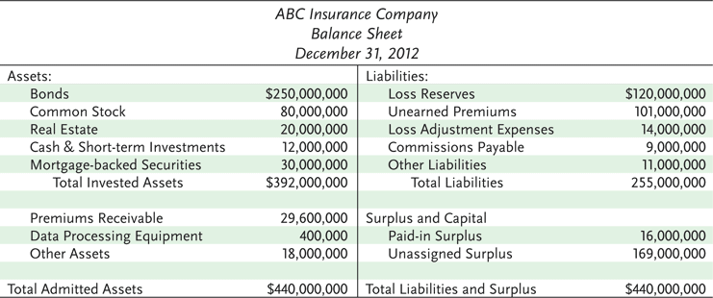
Exhibit 7.1 ABC Insurance Company

Slide 6
Financial Statements of Property and Casualty Insurers
The primary assets for an insurance company are financial assets
Insurers’ liabilities include required reserves
A loss reserve is an estimated amount for:
Claims reported and adjusted, but not yet paid
Claims reported and filed, but not yet adjusted
Claims incurred but not yet reported to the company

Slide 7
Financial Statements of Property and Casualty Insurers
Case reserves are loss reserves that are established for each individual claim
Methods for determining case reserves include:
The judgment method: a claim reserve is established for each individual claim
The average value method: an average value is assigned to each claim
The tabular method: loss reserves are determined for certain claims for which the amounts paid depend on data derived from mortality, morbidity, and remarriage tables

Slide 8
Financial Statements of Property and Casualty Insurers
The loss ratio method establishes aggregate loss reserves for a specific coverage line
A formula based on the expected loss ratio is used to estimate the loss reserve
The incurred-but-not-reported (IBNR) reserve is a reserve that must be established for claims that have already occurred but that have not yet been reported

Slide 9
Financial Statements of Property and Casualty Insurers
The unearned premium reserve is a liability item that represents the unearned portion of gross premiums on all outstanding policies at the time of valuation
Its purpose is to pay for losses that occur during the policy period
It is also needed so that refunds can be paid to policyholders that cancel their coverage
It also serves as the basis for determining the amount that must be paid to a reinsurer for carrying reinsured polices
The annual pro rata method is one method of calculating the reserve

Slide 10
Financial Statements of Property and Casualty Insurers
Policyholders’ surplus is the difference between an insurance company’s assets and liabilities
The stronger a company’s surplus position, the greater is the security for its policyholders
The level of surplus is an important determinant of the amount of new business that an insurance company can write

Slide 11
Financial Statements of Property and Casualty Insurers
The income and expense statement summarizes revenues and expenses paid over a specified period of time
The two principal sources of revenue for an insurance company are premiums and investment income
Earned premiums are those premiums for which the service for which the premiums were paid (insurance protection) has been rendered
Expenses include the cost of adjusting claims, paying the insured losses that occurred, commissions to agents, premium taxes, and general insurance expenses

Slide 12
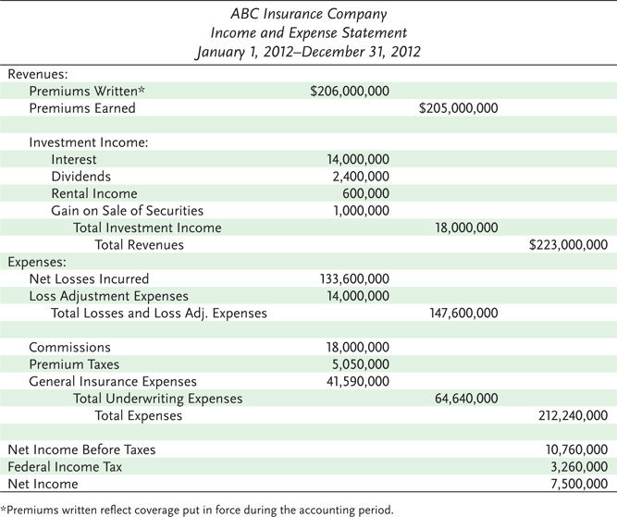
Exhibit 7.2 ABC Insurance Company

Slide 13
Measuring Profit or Loss
The loss ratio is the ratio of incurred losses and loss adjustment expenses to premiums earned
The expense ratio is equal to the company’s underwriting expenses divided by written premiums
The combined ratio is the sum of the loss ratio and the expense ratio. A positive ratio indicates an underwriting loss

Slide 14
Measuring Profit or Loss
The investment income ratio compares net investment income to earned premiums
The overall operating ratio is equal to the combined ratio minus the investment income ratio

Slide 16
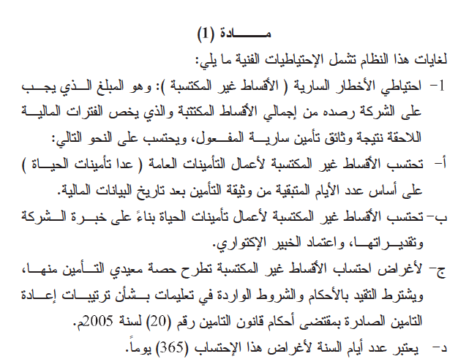

Slide 19
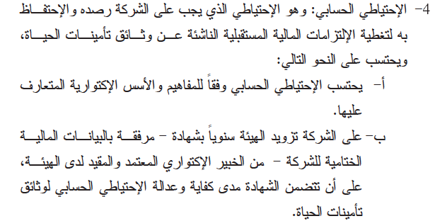

Slide 21
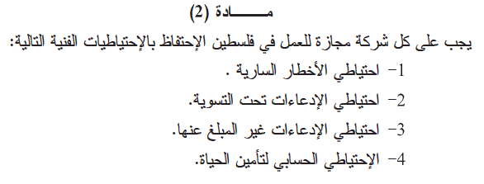

Slide 22
Ratemaking in Property and Casualty Insurance
State Laws Require:
Rates should be adequate for paying all losses and expenses
Rates should not be excessive, such that policyholders are paying more than the actual value of their protection
Rates must not be unfairly discriminatory; exposures that are similar with respect to losses and expenses should not be charged significantly different rates

Slide 23
Ratemaking in Property and Casualty Insurance
Business Rate-Making Objectives include:
Rates should be easy to understand
Rates should be stable over short periods of time
Rates should be responsive over time to changing loss exposures and changing economic conditions
The rating system should encourage loss control activities

Slide 24
Basic Ratemaking Definitions
A rate is the price per unit of insurance.
An exposure unit is the unit of measurement used in insurance pricing, e.g., a car-year
The pure premium is the portion of the rate needed to pay losses and loss adjustment expenses
Loading is the amount that must be added to the pure premium for other expenses, profit, and a margin for contingencies
The gross rate consists of the pure premium and a loading element
The gross premium paid by the insured consists of the gross rate multiplied by the number of exposure units

Slide 25
Ratemaking in Property and Casualty Insurance
There are three basic rate making methods in property and casualty insurance
Judgment rating means that each exposure is individually evaluated, and the rate is determined largely by the judgment of the underwriter
Class, or manual rating means that exposures with similar characteristics are placed in the same underwriting class, and each is charged the same rate

Slide 26
Ratemaking in Property and Casualty Insurance
Class rates are determined using two basic methods:
Under the pure premium method, the pure premium can be determined by dividing the dollar amount of incurred losses and loss-adjustment expenses by the number of exposure units
Under the loss ratio method, the actual loss ratio is compared with the expected loss ratio, and the rate is adjusted accordingly

Slide 27
Ratemaking in Property and Casualty Insurance
Merit rating is a rating plan by which class rates are adjusted upward or downward based on individual loss experience
Under a schedule rating plan, each exposure is individually rated
Under experience rating, the class or manual rate is adjusted upward or downward based on past loss experience
Under a retrospective rating plan, the insured’s loss experience during the current policy period determines the actual premium paid for that period

Slide 28
Ratemaking in Life Insurance
Life insurance actuaries use a mortality table or individual company experience to determine the probability of death at each attained age
Expected future payments are discounted back to the start of the coverage period and summed to determine the net single premium or level installment premiums
The annual expected value of death claims equals the probability of death times the amount the insurer must pay if death occurs

