Slide 1
Notes:
‹#›

Slide 2
Learning Goals
LG1 Describe interest rate fundamentals, the term structure of interest rates, and risk premiums.
LG2 Review the legal aspects of bond financing and bond cost.
LG3 Discuss the general features, yields, prices, popular types, and international issues of corporate bonds.

Slide 3
Learning Goals (cont.)
LG4 Understand the key inputs and basic model used in the valuation process.
LG5 Apply the basic valuation model to bonds and describe the impact of required return and time to maturity on bond values.
LG6 Explain yield to maturity (YTM), its calculation, and the procedure used to value bonds that pay interest semiannually.

Slide 4
Interest Rates and Required Returns: Interest Rate Fundamentals
The term interest rate is usually applied to debt instruments such as bank loans or bonds; the compensation paid by the borrower of funds to the lender; from the borrower’s point of view, the cost of borrowing funds.
The term required return is usually applied to equity instruments such as common stock; the cost of funds obtained by selling an ownership interest.

Slide 5
Interest Rates and Required Returns: Interest Rate Fundamentals
Several factors can influence the equilibrium interest rate:
Inflation, which is a rising trend in the prices of most goods and services.
Risk, which leads investors to expect a higher return on their investment
Liquidity preference, which refers to the general tendency of investors to prefer short-term securities

Slide 6
Matter of Fact
Fear Turns T-bill Rates Negative
Near the height of the financial crisis in December 2008, interest rates on Treasury bills briefly turned negative, meaning that investors paid more to the Treasury than the Treasury promised to pay back.
Why would anyone put their money into an investment that they know will lose money?
Remember that 2008 saw the demise of Lehman Brothers, and fears that other commercial banks and investments banks might fail were rampant.
Evidently, some investors were willing to pay the U.S. Treasury to keep their money safe for a short time.

Slide 7
Interest Rates and Required Returns: The Real Rate of Interest
The real rate of interest is the rate that creates equilibrium between the supply of savings and the demand for investment funds in a perfect world, without inflation, where suppliers and demanders of funds have no liquidity preferences and there is no risk.
The real rate of interest changes with changing economic conditions, tastes, and preferences.
The supply-demand relationship that determines the real rate is shown in Figure 6.1 on the following slide.

Slide 8
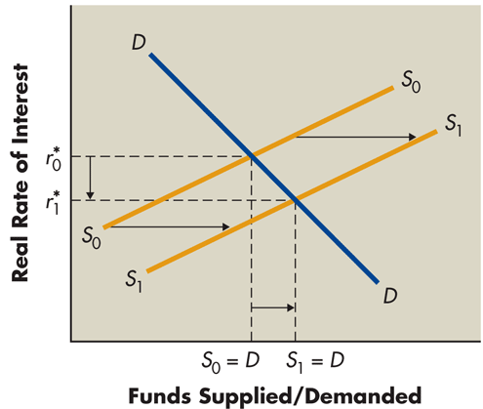
Figure 6.1 Supply–Demand Relationship

Slide 9
Interest Rates and Required Returns: Nominal or Actual Rate of Interest (Return)
The nominal rate of interest is the actual rate of interest charged by the supplier of funds and paid by the demander.
The nominal rate differs from the real rate of interest, r* as a result of two factors:
Inflationary expectations reflected in an inflation premium (IP), and
Issuer and issue characteristics such as default risks and contractual provisions as reflected in a risk premium (RP).

Slide 10
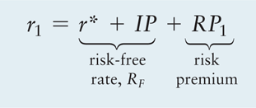
Interest Rates and Required Returns: Nominal or Actual Rate of Interest (cont.)
The nominal rate of interest for security 1, r₁, is given by the following equation:
The nominal rate can be viewed as having two basic components: a risk-free rate of return, R_{F}, and a risk premium, RP₁:

Slide 11
Interest Rates and Required Returns: Nominal or Actual Rate of Interest (cont.)
For the moment, ignore the risk premium, RP₁, and focus exclusively on the risk-free rate. The risk free rate can be represented as:
R_{F} = r* + IP
The risk-free rate (as shown in the preceding equation) embodies the real rate of interest plus the expected inflation premium.
The inflation premium is driven by investors’ expectations about inflation—the more inflation they expect, the higher will be the inflation premium and the higher will be the nominal interest rate.

Slide 12
Personal Finance Example
Marilyn Carbo has $10 that she can spend on candy costing $0.25 per piece. She could buy 40 pieces of candy ($10.00/$0.25) today. The nominal rate of interest on a 1-year deposit is currently 7%, and the expected rate of inflation over the coming year is 4%.
If Marilyn invested the $10, how many pieces of candy could she buy in one year?
In one year, Marilyn would have (1 + 0.07) × $10.00 = $10.70
Due to inflation, one piece of candy would cost (1 + 0.04) × $0.25 = $0.26
As a result, Marilyn would be able to buy $10.70/$0.26 = 41.2 pieces
This 3% increase in buying power (41.2/40) is Marilyn’s real rate of return

Slide 13
Focus on Practice
I-Bonds Adjust for Inflation
One of the disadvantages of bonds is that they usually offer a fixed interest rate.
This presents a serious risk to bond investors, because if inflation rises while the nominal rate on the bond remains fixed, the real rate of return falls.
The U.S. Treasury Department now offers the I-bond, which is an inflation-adjusted savings bond.
A Series-I bond earns interest through the application of a composite rate. The composite rate consists of a fixed rate that remains the same for the life of the bond and an adjustable rate equal to the actual rate of inflation.
The adjustable rate changes twice per year and is based on movements in the Consumer Price Index for All Urban Consumers (CPI-U).
What effect do you think the inflation-adjusted interest rate has on the cost of an I-bond in comparison with similar bonds with no allowance for inflation?

Slide 14
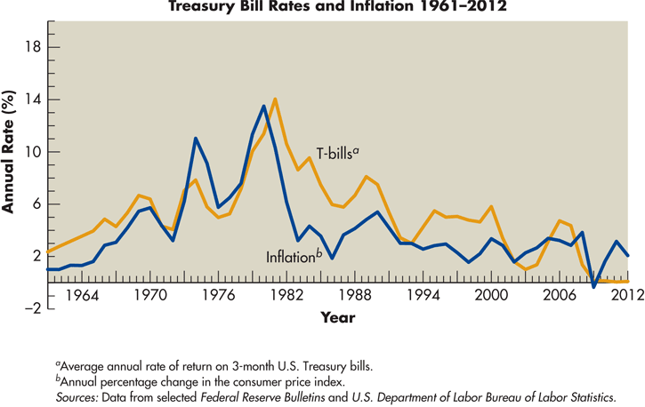
Figure 6.2 Impact of Inflation

Slide 15
Term Structure of Interest Rates
The term structure of interest rates is the relationship between the maturity and rate of return for bonds with similar levels of risk.
A graphic depiction of the term structure of interest rates is called the yield curve.
The yield to maturity is the compound annual rate of return earned on a debt security purchased on a given day and held to maturity.

Slide 16
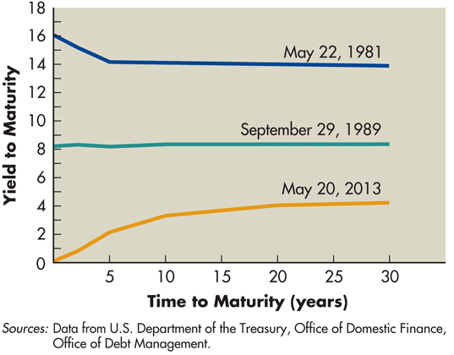
Figure 6.3 Treasury Yield Curves

Slide 17
Term Structure of Interest Rates: Yield Curves (cont.)
A normal yield curve is an upward-sloping yield curve indicates that long-term interest rates are generally higher than short-term interest rates.
An inverted yield curve is a downward-sloping yield curve indicates that short-term interest rates are generally higher than long-term interest rates.
A flat yield curve is a yield curve that indicates that interest rates do not vary much at different maturities.

Slide 18
Matter of Fact
Bond Yield Hits Record Lows
On July 25, 2012, the 10-year Treasury note and 30-year Treasury bond yields reached all-time lows of 1.43% and 2.46%.
That was good news for the housing market. Many mortgage rates are linked to rates on Treasury securities. For example, the traditional 30-year mortgage rate is typically linked to the yield on 10-year Treasury notes.
With mortgage rates reaching new lows, potential buyers found that they could afford more expensive homes, and existing homeowners were able to refinance their existing loans, lowering their monthly mortgage payments and leaving them with money to spend on other things.
This kind of activity is precisely what the Federal Reserve hoped to stimulate by keeping interest rates low during the economic recovery.

Slide 19
Theories of Term Structure
Three theories are frequently cited to explain the general shape of the yield curve:
Expectations theory
Liquidity preference theory
Market segmentation theory

Slide 20
Theories of Term Structure
Expectations Theory
Expectations theory is the theory that the yield curve reflects investor expectations about future interest rates; an expectation of rising interest rates results in an upward-sloping yield curve, and an expectation of declining rates results in a downward-sloping yield curve.

Slide 21
Theories of Term Structure (cont.)
Expectations Theory (example)
Suppose that a 5-year Treasury note currently offers a 3% annual return. Investors believe that interest rates are going to decline, and 5 years from now, they expect the rate on a 5-year Treasury note to be 2.5%. According to the expectations theory, what is the return that a 10-year Treasury note has to offer today? What does this imply about the slope of the yield curve?

Slide 22
Theories of Term Structure (cont.)
Expectations Theory (example)
Consider an investor who purchases a 5-year note today and plans to reinvest in another 5-year note in the future. Over the 10-year investment horizon, this investor expects to earn about 27.5%, ignoring compounding (that’s 3% per year for the first 5 years and 2.5% per year for the next 5 years). To compete with that return, a 10-year bond today could offer 2.75% per year. That is, a bond that pays 2.75% for each of the next 10 years produces the same 27.5% total return that the series of two, 5-year notes is expected to produce. Therefore, the 5-year rate today is 3% and the 10-year rate today is 2.75%, and the yield curve is downward sloping.

Slide 23
Theories of Term Structure (cont.)
Liquidity Preference Theory
Liquidity preference theory suggests that long-term rates are generally higher than short-term rates (hence, the yield curve is upward sloping) because investors perceive short-term investments to be more liquid and less risky than long-term investments. Borrowers must offer higher rates on long-term bonds to entice investors away from their preferred short-term securities.

Slide 24
Theories of Term Structure (cont.)
Market Segmentation Theory
Market segmentation theory suggests that the market for loans is segmented on the basis of maturity and that the supply of and demand for loans within each segment determine its prevailing interest rate; the slope of the yield curve is determined by the general relationship between the prevailing rates in each market segment.

Slide 25
Risk Premiums: Issue and Issuer Characteristicsq
So far, we have considered only risk-free U.S. Treasury securities.
The nominal rate of interest for a security is equal to the risk-free rate (consisting of the real rate of interest plus the inflation expectation premium) plus the risk premium.
The risk premium varies with specific issuer and issue characteristics.

Slide 26
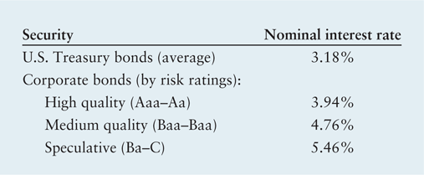
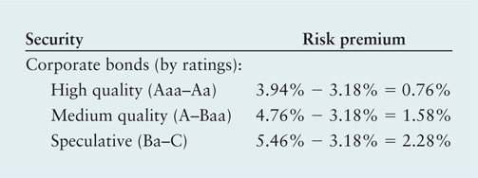
Risk Premiums: Issue and Issuer Characteristics
The nominal rates on a number of classes of long-term securities in May 2013 were:
Because the Treasury bond would represent the risk-free, long-term security, we can calculate the risk premium of the other securities by subtracting the risk-free rate.

Slide 27
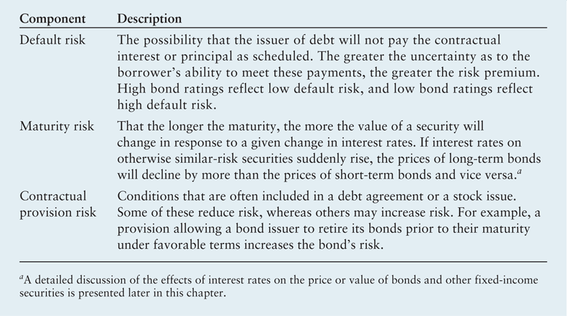
Table 6.1 Debt-Specific Risk Premium Components

Slide 28
Corporate Bonds
A corporate bond is a long-term debt instrument indicating that a corporation has borrowed a certain amount of money and promises to repay it in the future under clearly defined terms.
The coupon interest rate is the percentage of a bond’s par value that will be paid annually, typically in two equal semiannual payments, as interest.
The bond’s par value, or face value, is the amount borrowed by the company and the amount owed to the bond holder on the maturity date.
The bond’s maturity date is the time at which a bond becomes due and the principal must be repaid.

Slide 29
Corporate Bonds: Legal Aspects of Corporate Bonds
The bond indenture is a legal document that specifies both the rights of the bondholders and the duties of the issuing corporation.
Standard debt provisions are provisions in a bond indenture specifying certain record-keeping and general business practices that the bond issuer must follow; normally, they do not place a burden on a financially sound business.
Restrictive covenants are provisions in a bond indenture that place operating and financial constraints on the borrower.

Slide 30
Corporate Bonds: Legal Aspects of Corporate Bonds (cont.)
The most common restrictive covenants do the following:
Require a minimum level of liquidity, to ensure against loan default.
Prohibit the sale of accounts receivable to generate cash. Selling receivables could cause a long-run cash shortage if proceeds were used to meet current obligations.
Impose fixed-asset restrictions. The borrower must maintain a specified level of fixed assets to guarantee its ability to repay the bonds.
Constrain subsequent borrowing. Additional long-term debt may be prohibited, or additional borrowing may be subordinated to the original loan. Subordination means that subsequent creditors agree to wait until all claims of the senior debt are satisfied.
Limit the firm’s annual cash dividend payments to a specified percentage or amount.

Slide 31
Corporate Bonds: Legal Aspects of Corporate Bonds (cont.)
Sinking fund requirements are a restrictive provision often included in a bond indenture, providing for the systematic retirement of bonds prior to their maturity.
A security interest is a provision in the bond indenture that identifies any collateral pledged against the bond and how it is to be maintained. The protection of bond collateral is crucial to guarantee the safety of a bond issue.
A trustee is a paid individual, corporation, or commercial bank trust department that acts as the third party to a bond indenture and can take specified actions on behalf of the bondholders if the terms of the indenture are violated.

Slide 32
Corporate Bonds: Cost of Bonds to the Issuer
In general, the longer the bond’s maturity, the higher the interest rate (or cost) to the firm.
In addition, the larger the size of the offering, the lower will be the cost (in % terms) of the bond.
Also, the greater the default risk of the issuing firm, the higher the cost of the issue.
Finally, the cost of money in the capital market is the basis form determining a bond’s coupon interest rate.

Slide 33
Corporate Bonds: General Features of a Bond Issue
A conversion feature for convertible bonds allows bondholders to change each bond into a stated number of shares of common stock.
Bondholders will exercise this option only when the market price of the stock is greater than the conversion price.
A call feature, which is included in nearly all corporate bond issues, gives the issuer the opportunity to repurchase bonds at a stated call price prior to maturity.
The call price is the stated price at which a bond may be repurchased, by use of a call feature, prior to maturity.
The call premium is the amount by which a bond’s call price exceeds its par value.

Slide 34
Corporate Bonds: General Features of a Bond Issue (cont.)
In general, the call premium is equal to one year of coupon interest and compensates the holder for having it called prior to maturity.
Furthermore, issuers will exercise the call feature when interest rates fall and the issuer can refund the issue at a lower cost.
Issuers typically must pay a higher rate to investors for the call feature compared to issues without the feature.

Slide 35
Corporate Bonds: General Features of a Bond Issue (cont.)
Bonds also are occasionally issued with stock purchase warrants, which are instruments that give their holders the right to purchase a certain number of shares of the issuer’s common stock at a specified price over a certain period of time. Occasionally attached to bonds as “sweeteners.”
Including warrants typically allows the firm to raise debt capital at a lower cost than would be possible in their absence.

Slide 36
Corporate Bonds: Bond Yields
The three most widely cited yields are:
Current yield
Yield to maturity (YTM)
Yield to call (YTC)

Slide 37
Corporate Bonds: Bond Prices
Because most corporate bonds are purchased and held by institutional investors, such as banks, insurance companies, and mutual funds, rather than individual investors, bond trading and price data are not readily available to individuals.
Although most corporate bonds are issued with a par, or face, value of $1,000, all bonds are quoted as a percentage of par.
A $1,000-par-value bond quoted at 94.007 is priced at $940.07 (94.007% × $1,000). Corporate bonds are quoted in dollars and cents. Thus, Company C’s price of 103.143 for the day was $1,031.43—that is, 103.143% × $1,000.

Slide 38
Table 6.2 Data on Selected Bonds

Slide 39
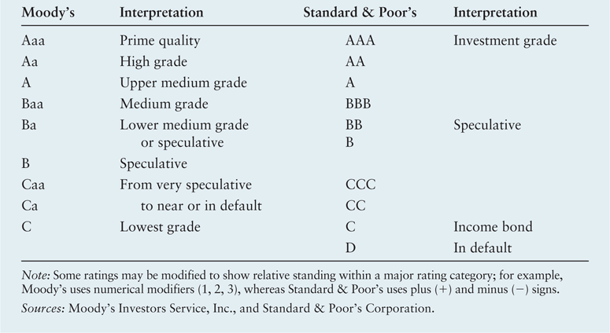
Table 6.3 Moody’s and Standard & Poor’s Bond Ratings

Slide 40
Focus on Ethics
Can We Trust the Bond Raters?
Credit-rating agencies evaluate and attach ratings to credit instruments (e.g, bonds). Historically, bonds that received higher ratings were almost always repaid, while lower rated more speculative “junk” bonds experienced much higher default rates.
Recently, the credit-rating agencies have been criticized for their role in the subprime crisis. The agencies attached ratings to complex securities that did not reflect the true risk of the underlying investments.
What ethical issues may arise because the companies that issue bonds pay the rating agencies to rate their bonds?

Slide 41
Table 6.4 Characteristics and Priority of Lender’s Claim of Traditional Types of Bonds

Slide 42
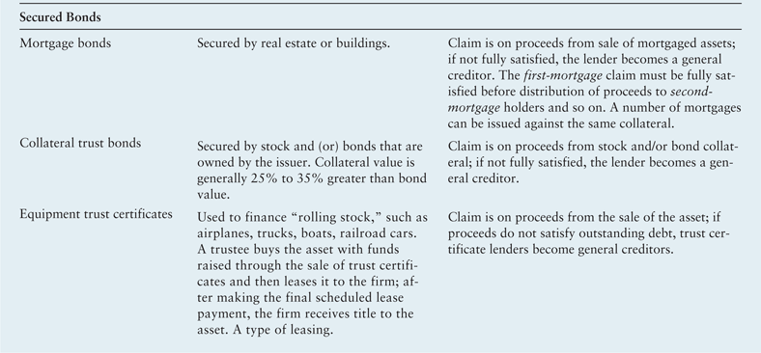
Table 6.4 Characteristics and Priority of Lender’s Claim of Traditional Types of Bonds (Cont.)

Slide 43
Corporate Bonds: International Bond Issues
Companies and governments borrow internationally by issuing bonds in two principal financial markets:
A Eurobond is a bond issued by an international borrower and sold to investors in countries with currencies other than the currency in which the bond is denominated.
In contrast, a foreign bond is a bond issued in a host country’s financial market, in the host country’s currency, by a foreign borrower.
Both markets give borrowers the opportunity to obtain large amounts of long-term debt financing quickly, in the currency of their choice and with flexible repayment terms.

Slide 44
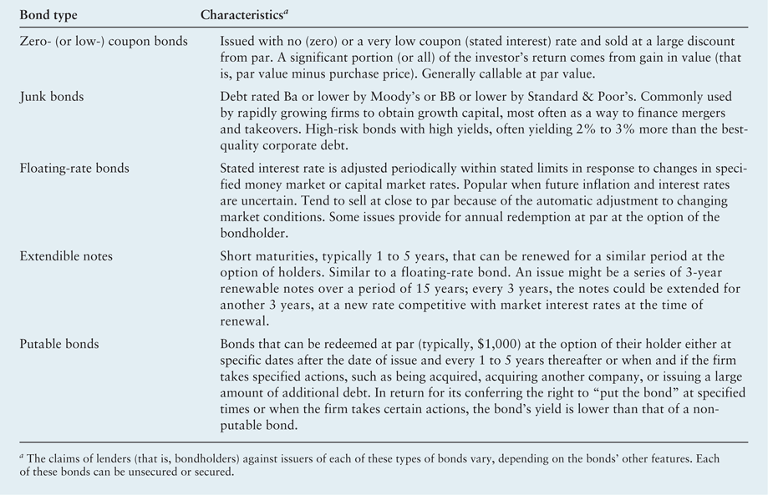
Table 6.5 Characteristics of Contemporary Types of Bonds

Slide 45
Valuation Fundamentals
Valuation is the process that links risk and return to determine the worth of an asset.
There are three key inputs to the valuation process:
Cash flows (returns)
Timing
A measure of risk, which determines the required return

Slide 46
Personal Finance Example
Celia Sargent wishes to estimate the value of three assets she is considering investing in:
Stock in Michaels Enterprises Expect to receive cash dividends of $300 per year indefinitely.
Oil well Expect to receive cash flow of $2,000 at the end of year 1, $4,000 at the end of year 2, and $10,000 at the end of year 4, when the well is to be sold.
Original painting Expect to be able to sell the painting in 5 years for $85,000.
With these cash flow estimates, Celia has taken the first step toward placing a value on each of the assets.

Slide 47
Personal Finance Example
Consider two scenarios:
Scenario 1—Certainty A major art gallery has contracted to buy the painting for $85,000 at the end of 5 years. Because this is considered a certain situation, Celia views this asset as “money in the bank.” She thus would use the prevailing risk-free rate of 3% as the required return when calculating the value of the painting. Oil well Expect to receive cash flow of $2,000 at the end of year 1, $4,000 at the end of year 2, and $10,000 at the end of year 4, when the well is to be sold.
Scenario 2—High Risk The values of original paintings by this artist have fluctuated widely over the past 10 years. Although Celia expects to be able to sell the painting for $85,000, she realizes that its sale price in 5 years could range between $30,000 and $140,000. Because of the high uncertainty surrounding the painting’s value, Celia believes that a 15% required return is appropriate.

Slide 48
Basic Valuation Model
The value of any asset is the present value of all future cash flows it is expected to provide over the relevant time period.
The value of any asset at time zero, V₀, can be expressed as
where
v₀ | = | Value of the asset at time zero
CF_{T} | = | cash flow expected at the end of year t
r | = | appropriate required return (discount rate)
n | = | relevant time period

Slide 49
Personal Finance Example
In the case of Michaels stock, the annual cash flow is $300, and Celia decides that a 12% discount rate is appropriate for this investment. Therefore, her estimate of the value of Michaels Enterprises stock is
$300 ÷ 0.12 = $2,500
Using a 20% required return, Celia estimates the oil well’s value to be
Finally, Celia estimates the value of the painting by discount the expected $85,000 lump sum payment in 5 years at 15%
$85,000 ÷ (1 + 0.15)⁵ = $42,260.02

Slide 50
Bond Valuation: Bond Fundamentals
As noted earlier, bonds are long-term debt instruments used by businesses and government to raise large sums of money, typically from a diverse group of lenders.
Most bonds pay interest semiannually at a stated coupon interest rate, have an initial maturity of 10 to 30 years, and have a par value of $1,000 that must be repaid at maturity.

Slide 51
Bond Valuation: Basic Bond Valuation
The basic model for the value, B₀, of a bond is given by the following equation:
Where
B₀ | = | value of the bond at time zero
I | = | annual interest paid in dollars
n | = | number of years to maturity
M | = | par value in dollars
r_{d} | = | required return on a bond

Slide 52
Bond Valuation: Basic Bond Valuation (cont.)
Mills Company, a large defense contractor, on January 1, 2016, issued a 10% coupon interest rate, 10-year bond with a $1,000 par value that pays interest annually.
Investors who buy this bond receive the contractual right to two cash flows: (1) $100 annual interest (10% coupon interest rate × $1,000 par value) at the end of each year, and (2) the $1,000 par value at the end of the tenth year.
Assuming that interest on the Mills Company bond issue is paid annually and that the required return is equal to the bond’s coupon interest rate, I = $100, r_{d} = 10%, M = $1,000, and n = 10 years.

Slide 53
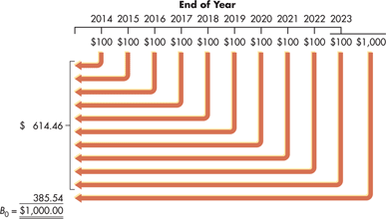
Bond Valuation: Basic Bond Valuation (cont.)

Slide 54
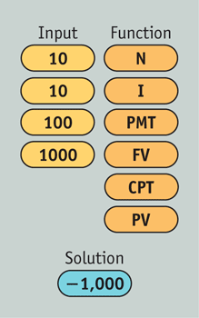
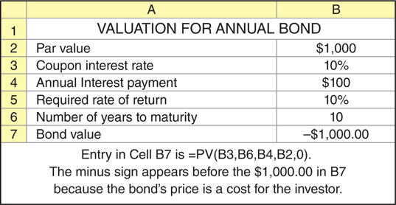
Bond Valuation: Basic Bond Valuation (cont.)

Slide 55
Bond Valuation: Bond Value Behavior
In practice, the value of a bond in the marketplace is rarely equal to its par value.
Whenever the required return on a bond differs from the bond’s coupon interest rate, the bond’s value will differ from its par value.
The required return is likely to differ from the coupon interest rate because either (1) economic conditions have changed, causing a shift in the basic cost of long-term funds, or (2) the firm’s risk has changed.
Increases in the basic cost of long-term funds or in risk will raise the required return; decreases in the cost of funds or in risk will lower the required return.

Slide 56
Bond Valuation: Bond Value Behavior (cont.)
What if the required rate for Mills Company’s bonds rose to 12% or fell to 8%?
Table 6.6 Bond Values for Various Required Returns (Mills Company’s 10% Coupon Interest Rate, 10-Year Maturity, $1,000 Par, January 1, 2014, Issue Date, Paying Annual Interest)

Slide 57
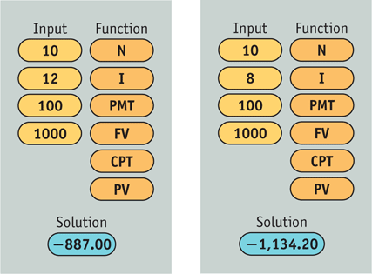
Bond Valuation: Bond Value Behavior (cont.)

Slide 58
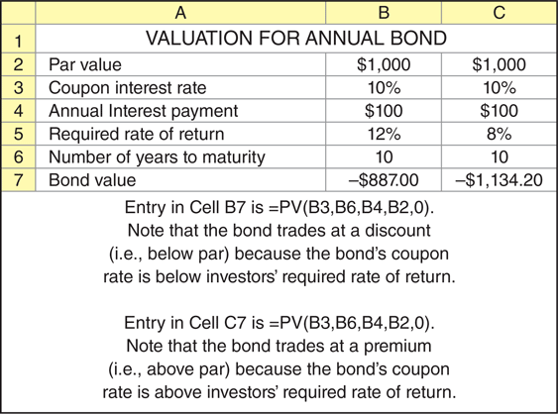
Bond Valuation: Bond Value Behavior (cont.)

Slide 59
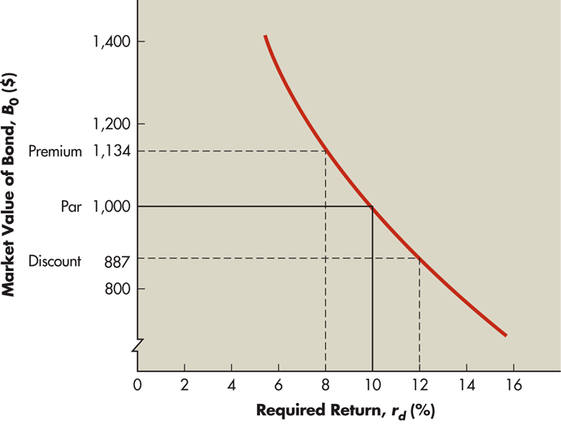
Figure 6.4 Bond Values and Required Returns

Slide 60
Bond Valuation: Bond Value Behavior (cont.)
Interest rate risk is the chance that interest rates will change and thereby change the required return and bond value.
Rising rates, which result in decreasing bond values, are of greatest concern.
The shorter the amount of time until a bond’s maturity, the less responsive is its market value to a given change in the required return.

Slide 61
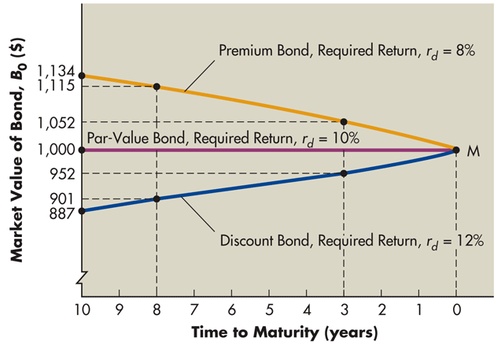
Figure 6.5 Time to Maturity and Bond Values

Slide 62
Yield to Maturity (YTM)
The yield to maturity (YTM) is the rate of return that investors earn if they buy a bond at a specific price and hold it until maturity. (Assumes that the issuer makes all scheduled interest and principal payments as promised.)
The yield to maturity on a bond with a current price equal to its par value will always equal the coupon interest rate.
When the bond value differs from par, the yield to maturity will differ from the coupon interest rate.

Slide 63
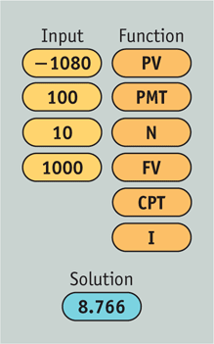
Personal Finance Example
The Mills Company bond, which currently sells for $1,080, has a 10% coupon interest rate and $1,000 par value, pays interest annually, and has 10 years to maturity. What is the bond’s YTM?

Slide 64
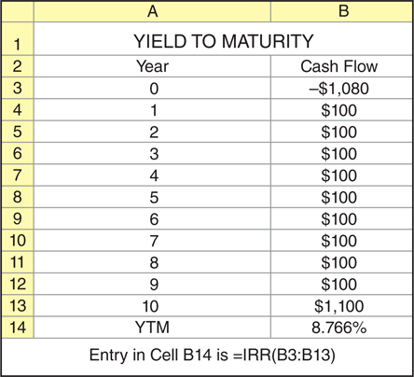
Personal Finance Example (cont.)

Slide 65
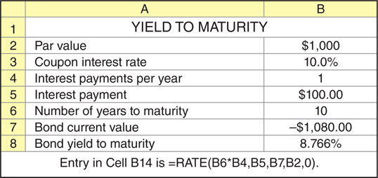
Personal Finance Example (cont.)

Slide 66
Yield to Maturity (YTM): Semiannual Interest and Bond Values
The procedure used to value bonds paying interest semiannually is similar to that shown in Chapter 5 for compounding interest more frequently than annually, except that here we need to find present value instead of future value. It involves
Converting annual interest, I, to semiannual interest by dividing I by 2.
Converting the number of years to maturity, n, to the number of 6-month periods to maturity by multiplying n by 2.
Converting the required stated (rather than effective) annual return for similar-risk bonds that also pay semiannual interest from an annual rate, r_{d}, to a semiannual rate by dividing r_{d} by 2.

Slide 67
Yield to Maturity (YTM): Semiannual Interest and Bond Values (cont.)
Assuming that the Mills Company bond pays interest semiannually and that the required stated annual return, r_{d} is 12% for similar risk bonds that also pay semiannual interest, substituting these values into the previous equation yields

Slide 68
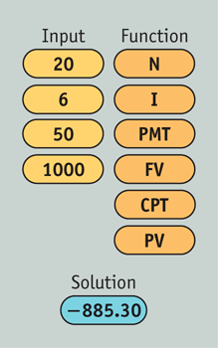
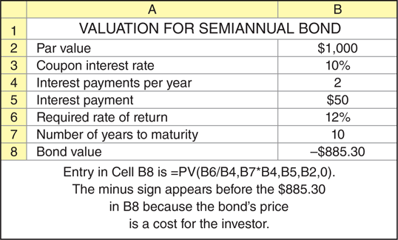
Yield to Maturity (YTM): Semiannual Interest and Bond Values (cont.)

Slide 69
Review of Learning Goals
LG1 Describe interest rate fundamentals, the term structure of interest rates, and risk premiums.
The flow of funds between savers and borrowers is regulated by the interest rate or required return. In a perfect, inflation-free, certain world there would be one cost of money—the real rate of interest. The nominal or actual interest rate is the sum of the risk-free rate and a risk premium reflecting issuer and issue characteristics. The risk-free rate is the real rate of interest plus an inflation premium.
For any class of similar-risk securities, the term structure of interest rates reflects the relationship between the interest rate or rate of return and the time to maturity. Yield curves can be downward sloping (inverted), upward sloping (normal), or flat. The expectations theory, liquidity preference theory, and market segmentation theory are cited to explain the shape of the yield curve. Risk premiums for non-Treasury debt issues result from business risk, financial risk, interest rate risk, liquidity risk, tax risk, default risk, maturity risk, and contractual provision risk.

Slide 70
Review of Learning Goals (cont.)
LG2 Review the legal aspects of bond financing and bond cost.
Corporate bonds are long-term debt instruments indicating that a corporation has borrowed an amount that it promises to repay in the future under clearly defined terms. The bond indenture, enforced by a trustee, states all conditions of the bond issue. It contains both standard debt provisions and restrictive covenants, which may include a sinking-fund requirement and/or a security interest. The cost of a bond to an issuer depends on its maturity, offering size, and issuer risk and on the basic cost of money.

Slide 71
Review of Learning Goals (cont.)
LG3 Discuss the general features, yields, prices, ratings, popular types, and international issues of corporate bonds.
A bond issue may include a conversion feature, a call feature, or stock purchase warrants. The yield, or rate of return, on a bond can be measured by its current yield, yield to maturity (YTM), or yield to call (YTC). Bond prices are typically reported along with their coupon, maturity date, and yield to maturity (YTM). Bond ratings by independent agencies indicate the risk of a bond issue. Various types of traditional and contemporary bonds are available. Eurobonds and foreign bonds enable established creditworthy companies and governments to borrow large amounts internationally.

Slide 72
Review of Learning Goals (cont.)
LG4 Understand the key inputs and basic model used in the valuation process.
Key inputs to the valuation process include cash flows (returns), timing, and risk and the required return. The value of any asset is equal to the present value of all future cash flows it is expected to provide over the relevant time period.

Slide 73
Review of Learning Goals (cont.)
LG5 Apply the basic valuation model to bonds and describe the impact of required return and time to maturity on bond values.
The value of a bond is the present value of its interest payments plus the present value of its par value. The discount rate used to determine bond value is the required return, which may differ from the bond’s coupon interest rate. The amount of time to maturity affects bond values. The value of a bond will approach its par value as the bond moves closer to maturity. The chance that interest rates will change and thereby change the required return and bond value is called interest rate risk. The shorter the amount of time until a bond’s maturity, the less responsive is its market value to a given change in the required return.

Slide 74
Review of Learning Goals (cont.)
LG6 Explain yield to maturity (YTM), its calculation, and the procedure used to value bonds that pay interest semiannually.
Yield to maturity is the rate of return investors earn if they buy a bond at a specific price and hold it until maturity. YTM can be calculated by using a financial calculator or by using an Excel spreadsheet. Bonds that pay interest semiannually are valued by using the same procedure used to value bonds paying annual interest, except that the interest payments are one-half of the annual interest payments, the number of periods is twice the number of years to maturity, and the required return is one-half of the stated annual required return on similar-risk bonds.

Slide 75
Chapter Resources on MyFinanceLab
Chapter Cases
Group Exercises
Critical Thinking Problems

