Slide 1
Chapter 9
The Cost of Capital
Notes:
‹#›

Slide 2
Learning Goals
LG1 Understand the basic concept and sources of capital associated with the cost of capital.
LG2 Explain what is meant by the marginal cost of capital.
LG3 Determine the cost of long-term debt, and explain why the after-tax cost of debt is the relevant cost of debt.

Slide 3
Learning Goals (cont.)
LG4 Determine the cost of preferred stock.
LG5 Calculate the cost of common stock equity, and convert it into the cost of retained earnings and the cost of new issues of common stock.
LG6 Calculate the weighted average cost of capital (WACC) and discuss alternative weighting schemes.

Slide 4
Overview of the Cost of Capital
The cost of capital represents the firm’s cost of financing, and is the minimum rate of return that a project must earn to increase firm value.
Financial managers are ethically bound to only invest in projects that they expect to exceed the cost of capital.
The cost of capital reflects the entirety of the firm’s financing activities.
Most firms attempt to maintain an optimal mix of debt and equity financing.
To capture all of the relevant financing costs, assuming some desired mix of financing, we need to look at the overall cost of capital rather than just the cost of any single source of financing.

Slide 5
Overview of the Cost of Capital (cont.)
A firm is currently faced with two investment opportunities. Assume the following:
Investment A
Cost = $100,000
Life = 20 years
Expected Return = 7%
Least costly financing source available
Debt (bonds) = 6%
Because the firm can earn 7% on the investment of funds costing only 6%, the analyst recommends that the firm undertake this investment.

Slide 6
Overview of the Cost of Capital (cont.)
Investment B
Cost = $100,000
Life = 20 years
Expected Return = 12%
Least costly financing source available
Equity = 14%
In this instance, the analyst recommends that the firm reject the opportunity, because the 14% financing cost is greater than the 12% expected return.

Slide 7
Overview of the Cost of Capital (cont.)
What if instead the firm used a combined cost of financing?
Assuming that a 50–50 mix of debt and equity is targeted, the weighted average cost here would be:
(0.50 × 6% debt) + (0.50 × 14% equity) = 10%
With this average cost of financing, the first opportunity would have been rejected (7% expected return < 10% weighted average cost), and the second would have been accepted (12% expected return > 10% weighted average cost).

Slide 8
Focus on Ethics
The Ethics of Profit
Introduced in 1999, Vioxx was an immediate success, quickly reaching $2.5 billion in annual sales.
However, a Merck study launched in 1999 eventually found that patients who took Vioxx suffered from an increased risk of heart attacks and strokes.
Despite the risks, Merck continued to market and sell Vioxx.
Vioxx was withdrawn from the market in 2006, dealing a severe blow to the firm’s reputation, profits, and stock price.
The Vioxx recall increased Merck’s cost of capital. What effect would an increased cost of capital have on a firm’s future investments?

Slide 9
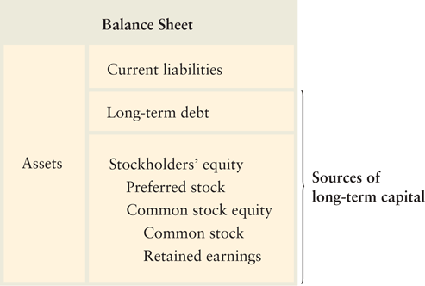
Overview of the Cost of Capital: Sources of Long-Term Capital

Slide 10
Cost of Long-Term Debt
The pretax cost of debt is the financing cost associated with new funds through long-term borrowing.
Typically, the funds are raised through the sale of corporate bonds.
Net proceeds are the funds actually received by the firm from the sale of a security.
Flotation costs are the total costs of issuing and selling a security. They include two components:
Underwriting costs—compensation earned by investment bankers for selling the security.
Administrative costs—issuer expenses such as legal, accounting, and printing.

Slide 11
Cost of Long-Term Debt (cont.)
Duchess Corporation, a major hardware manufacturer, is contemplating selling $10 million worth of 20-year, 9% coupon bonds with a par value of $1,000. Because current market interest rates are greater than 9%, the firm must sell the bonds at $980. Flotation costs are 2% or $20. The net proceeds to the firm for each bond is therefore $960 ($980 – $20).

Slide 12
market price = 2000$
par value = 1000$
issued 6 bonds
6*2000= 12,000$
total proceed
net proceed = total proceed - floating cost -> underwrites / admin. costs
floating c = 2%
np=tp*(1-f.c.r)

Slide 13
Cost of Long-Term Debt (cont.)
The before-tax cost of debt, r_{d}, is simply the rate of return the firm must pay on new borrowing.
The before-tax cost of debt can be calculated in any one of three ways:
Using market quotations: observe the yield to maturity (YTM) on the firm’s existing bonds or bonds of similar risk issued by other companies
Calculating the cost: find the before-tax cost of debt by calculating the YTM generated by the bond cash flows
Approximating the cost

Slide 14
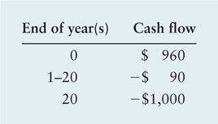
Cost of Long-Term Debt (cont.)
The cash flows associated with the sale of Duchess Corporation’s bond issue are as follows:
We can determine the cost of debt by finding the YTM, which is the discount rate that equates the present value of the bond outflows to the initial outflow.

Slide 15
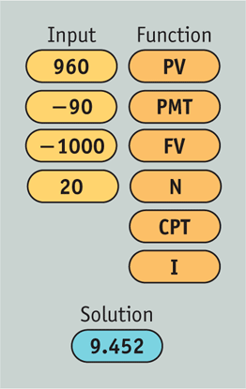
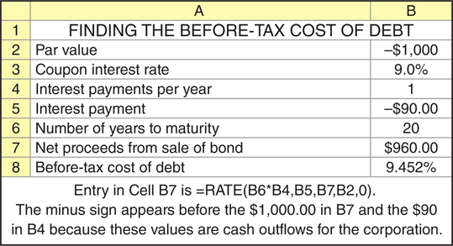
Cost of Long-Term Debt (cont.)

Slide 16
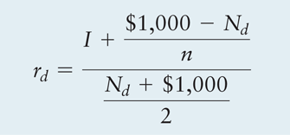
Cost of Long-Term Debt (cont.)
Approximating the cost
where
I | = | annual interest in dollars
N_{d} | = | net proceeds from the sale of debt (bond)
n | = | number of years to the bond’s maturity

Slide 17
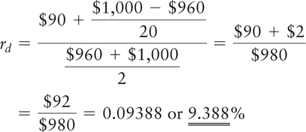
Cost of Long-Term Debt (cont.)
Approximating the cost

Slide 18
Cost of Long-Term Debt: After-Tax Cost of Debt
The interest payments paid to bondholders are tax deductable for the firm, so the interest expense on debt reduces the firm’s taxable income and, therefore, the firm’s tax liability.
The after-tax cost of debt, r_{i}, can be found by multiplying the before-tax cost, r_{d}, by 1 minus the tax rate, T, as stated in the following equation:
r_{i} = r_{d} × (1 – T)

Slide 19
Cost of Long-Term Debt: After-Tax Cost of Debt (cont.)
Duchess Corporation has a 40% tax rate. Using the 9.452% before-tax debt cost calculated using Excel or a financial calculator, we find an after-tax cost of debt of 5.67% [9.452% × (1 – 0.40)].
Typically, the cost of long-term debt for a given firm is less than the cost of preferred or common stock, partly because of the tax deductibility of interest.

Slide 20
Personal Finance Example
Kait and Kasim Sullivan, a married couple in the 28% federal income-tax bracket, wish to borrow $60,000 for a new car.
They can either borrow the $60,000 through the auto dealer at an annual interest rate of 6.0%, or they can take a $60,000 second mortgage on their home at an annual interest rate of 7.2%.
If they borrow from the auto dealer, the interest on this “consumer loan” will not be deductible for federal tax purposes. However, the interest on the second mortgage would be tax-deductible because the tax law allows individuals to deduct interest paid on a home mortgage.
Because interest on the auto loan is not tax-deductible, its after-tax cost equals its stated cost of 6.0%.
Because interest on the auto loan is tax-deductible, its after-tax cost equals its stated cost of 7.2% × (1 – 0.28) = 5.2%.

Slide 21
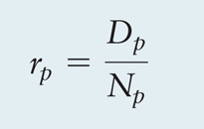
Cost of Preferred Stock
Preferred stock gives preferred stockholders the right to receive their stated dividends before the firm can distribute any earnings to common stockholders.
Preferred stock dividends may be stated as a dollar amount.
Sometimes preferred stock dividends are stated as an annual percentage rate, which represents the percentage of the stock’s par, or face, value that equals the annual dividend.
The cost of preferred stock, r_{p}, is the ratio of the preferred stock dividend to the firm’s net proceeds from the sale of preferred stock.

Slide 22
Cost of Preferred Stock (cont.)
Duchess Corporation is contemplating the issuance of a 10% preferred stock that they expect to sell for $87 per share. The cost of issuing and selling the stock is expected to be $5 per share. The dividend is $8.70 (10% × $87). The net proceeds (N_{p}) equal $82 ($87 – $5), the share price less the flotation costs. The cost of Duchess’ preferred stock is:
r_{P} = D_{P}/N_{p} = $8.70/$82 = 10.6%

Slide 23
Cost of Common Stock
The cost of common stock is the return required on the stock by investors in the marketplace.
There are two forms of common stock financing:
retained earnings
new issues of common stock
The cost of common stock equity, r_{s}, is the rate at which investors discount the expected dividends of the firm to determine its share value.

Slide 24
Cost of Common Stock (cont.)
The constant-growth valuation (Gordon) model assumes that the value of a share of stock equals the present value of all future dividends (assumed to grow at a constant rate) that it is expected to provide over an infinite time horizon.
where
P₀ | = | value of common stock
D₁ | = | per-share dividend expected at the end of year 1
r_{s} | = | required return on common stock
g | = | constant rate of growth in dividends

Slide 25
Cost of Common Stock (cont.)
Solving for r_{s} results in the following expression for the cost of common stock equity:
The equation indicates that the cost of common stock equity can be found by dividing the dividend expected at the end of year 1 by the current market price of the stock (the “dividend yield”) and adding the expected growth rate (the “capital gains yield”).
Notes:
‹#›

Slide 26
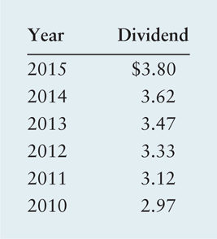
Cost of Common Stock (cont.)
Duchess Corporation wishes to determine its cost of common stock equity, r_{s}. The market price, P₀, of its common stock is $50 per share. The firm expects to pay a dividend, D₁, of $4 at the end of the coming year, 2016. The dividends paid on the outstanding stock over the past 6 years (2010–2015) were as follows:

Slide 27
Cost of Common Stock (cont.)
We can calculate the annual rate at which dividends have grown, g, from 2007 to 2012. It turns out to be approximately 5% (more precisely, it is 5.05%).
Substituting D₁ = $4, P₀ = $50, and g = 5% into the previous equation yields the cost of common stock equity:
r_{s} = ($4/$50) + 0.05 = 0.08 + 0.05 = 0.130, or 13.0%

Slide 28
Cost of Common Stock (cont.)
The capital asset pricing model (CAPM) describes the relationship between the required return, r_{s}, and the nondiversifiable risk of the firm as measured by the beta coefficient, b.
r_{s} = R_{F} + [b × (r_{m} – R_{F})]
where
R_{F} = risk-free rate of return
r_{m} = market return; return on the market portfolio of assets

Slide 29
Cost of Common Stock (cont.)
Duchess Corporation now wishes to calculate its cost of common stock equity, r_{s}, by using the capital asset pricing model. The firm’s investment advisors and its own analysts indicate that the risk-free rate, R_{F}, equals 7%; the firm’s beta, b, equals 1.5; and the market return, r_{m}, equals 11%.
Substituting these values into the CAPM, the company estimates the cost of common stock equity, r_{s}, to be:
r_{s} = 7.0% + [1.5 × (11.0% – 7.0%)] = 7.0% + 6.0% = 13.0%

Slide 30
Cost of Common Stock (cont.)
The CAPM technique differs from the constant-growth valuation model in that it directly considers the firm’s risk, as reflected by beta, in determining the required return or cost of common stock equity.
The constant-growth model does not look at risk; it uses the market price, P₀, as a reflection of the expected risk–return preference of investors in the marketplace.
The constant-growth valuation and CAPM techniques for finding r_{s} are theoretically equivalent, though in practice estimates from the two methods do not always agree.

Slide 31
Cost of Common Stock (cont.)
Another difference is that when the constant-growth valuation model is used to find the cost of common stock equity, it can easily be adjusted for flotation costs to find the cost of new common stock; the CAPM does not provide a simple adjustment mechanism.
The difficulty in adjusting the cost of common stock equity calculated by using CAPM occurs because in its common form the model does not include the market price, P₀, a variable needed to make such an adjustment.

Slide 32
Cost of Common Stock: Cost of Retained Earnings
The cost of retained earnings, r_{r}, is the same as the cost of an equivalent fully subscribed issue of additional common stock, which is equal to the cost of common stock equity, r_{s}.
r_{r} = r_{s}
The cost of retained earnings for Duchess Corporation was actually calculated in the preceding examples: It is equal to the cost of common stock equity. Thus r_{r} equals 13.0%.

Slide 33
Matter of Fact
Retained Earnings, the Preferred Source of Financing
In the United States and most other countries, firms rely more heavily on retained earnings than any other source of financing.
For example, a 2013 survey of Chinese firms found that 64% of the companies surveyed listed retained earnings as one of their primary sources of funds.
Bank loans were a distant second choice, mentioned as a primary source of funds by just 44% of companies.

Slide 34
Cost of Common Stock: Cost of New Issues of Common Stock
The cost of a new issue of common stock, r_{n}, is the cost of common stock, net of underpricing and associated flotation costs.
New shares are underpriced if the stock is sold at a price below its current market price, P₀.

Slide 35
Cost of Common Stock: Cost of New Issues of Common Stock (cont.)
We can use the constant-growth valuation model expression for the cost of existing common stock, r_{s}, as a starting point. If we let N_{n} represent the net proceeds from the sale of new common stock after subtracting underpricing and flotation costs, the cost of the new issue, r_{n}, can be expressed as follows:

Slide 36
Cost of Common Stock: Cost of New Issues of Common Stock (cont.)
The net proceeds from sale of new common stock, N_{n}, will be less than the current market price, P₀.
Therefore, the cost of new issues, r_{n}, will always be greater than the cost of existing issues, r_{s}, which is equal to the cost of retained earnings, r_{r}.
The cost of new common stock is normally greater than any other long-term financing cost.

Slide 37
Cost of Common Stock: Cost of New Issues of Common Stock (cont.)
Duchess Corporation common stock is currently selling at $50 per share. To determine its cost of new common stock, r_{n}, Duchess Corporation has estimated that on average, new shares can be sold for $47. The $3-per-share underpricing is due to the competitive nature of the market. A second cost associated with a new issue is flotation costs of $2.50 per share that would be paid to issue and sell the new shares. The total underpricing and flotation costs per share are therefore $5.50.
r_{n} = ($4.00/$44.50) + 0.05 = 0.09 + 0.05 = 0.140, or 14.0%

Slide 38
Weighted Average Cost of Capital
The weighted average cost of capital (WACC), r_{a}, reflects the expected average future cost of capital over the long run; found by weighting the cost of each specific type of capital by its proportion in the firm’s capital structure.
r_{a} = (w_{i} × r_{i}) + (w_{p} × r_{p}) + (w_{s} × r_{r} _{or n})
where

Slide 39
Weighted Average Cost of Capital (cont.)
Three important points should be noted in the equation for r_{a}:
For computational convenience, it is best to convert the weights into decimal form and leave the individual costs in percentage terms.
The weights must be non-negative and sum to 1.0. Simply stated, WACC must account for all financing costs within the firm’s capital structure.
The firm’s common stock equity weight, w_{s}, is multiplied by either the cost of retained earnings, r_{r}, or the cost of new common stock, r_{n}. Which cost is used depends on whether the firm’s common stock equity will be financed using retained earnings, r_{r}, or new common stock, r_{n}.

Slide 40
Weighted Average Cost of Capital (cont.)
In earlier examples, we found the costs of the various types of capital for Duchess Corporation to be as follows:
Cost of debt, r_{i} = 5.6%
Cost of preferred stock, r_{p} = 10.6%
Cost of retained earnings, r_{r} = 13.0%
Cost of new common stock, r_{n} = 14.0%
The company uses the following weights in calculating its weighted average cost of capital:
Long-term debt = 40%
Preferred stock = 10%
Common stock equity = 50%

Slide 41
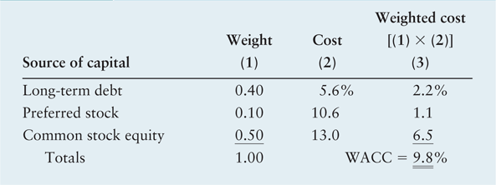
Calculation of the Weighted Average Cost of Capital for Duchess Corporation
Table 9.1 Calculation of the Weighted Average Cost of Capital for Duchess Corporation
Notes:
‹#›

Slide 42
Focus on Practice
Uncertain Times Make for an Uncertain Weighted Average Cost of Capital
As U.S. financial markets experienced and recovered from the 2008 financial crisis and 2009 “great recession,” firms struggled to keep track of their weighted average cost of capital since the individual component costs were moving rapidly in response to the financial market turmoil.
The financial crisis pushed credit costs to a point where long-term debt was largely inaccessible, and the great recession saw Treasury bond yields fall to historic lows making cost of equity projections appear unreasonably low.
Ron Domanico is the CFO at Caraustar Industries, Inc. and he reported that his company dealt with the cost-of-capital uncertainty by abandoning the one-size-fits-all approach.
Why don’t firms generally use both a short and long-run weighted average cost of capital?

Slide 43
Weighted Average Cost of Capital: Weighting Schemes
Book Value versus Market Value:
Book value weights are weights that use accounting values to measure the proportion of each type of capital in the firm’s financial structure.
Market value weights are weights that use market values to measure the proportion of each type of capital in the firm’s financial structure.
Historical versus Target:
Historical weights are either book or market value weights based on actual capital structure proportions.
Target weights are either book or market value weights based on desired capital structure proportions.
From a strictly theoretical point of view, the preferred weighting scheme is target market value proportions.

Slide 44
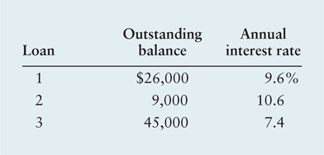
Personal Finance Example
Chuck Solis currently has three loans outstanding, all of which mature in exactly 6 years and can be repaid without penalty any time prior to maturity. The outstanding balances and annual interest rates on these loans are noted below.

Slide 45
Personal Finance Example (cont.)
Chuck found a lender who would loan him $80,000 for 6 years at an annual interest rate 9.2% on the condition that the loan proceeds be used to fully repay the three outstanding loans, which combined have an outstanding balance of $80,000 ($26,000 + $9,000 + $45,000).
Chuck wishes to choose the least costly alternative: (1) do nothing or (2) borrow the $80,000 and pay off all three loans.

Slide 46
Personal Finance Example (cont.)
Chuck calculates the weighted average cost of his current debt by weighting each debt’s annual interest cost by the proportion of the $80,000 total it represents and then summing the three weighted values as follows:
Given that the weighted average cost of the $80,000 of current debt of 8.5% is below the 9.2% cost of the new $80,000 loan, Chuck should do nothing and just continue to pay off the three loans as originally scheduled.
= | [($26,000/$80,000) × 9.6%] + [($9,000/$80,000) × 10.6%] + [($45,000/$80,000) × 7.4%]
= | (.3250 × 9.6%) + (.1125 × 10.6%) + (.5625 × 7.4%)
= | 3.12% + 1.19% + 4.16% = 8.47% ≈ 8.5%

Slide 47
Review of Learning Goals
LG1 Understand the basic concept and sources of capital associated with the cost of capital.
The cost of capital is the minimum rate of return that a firm must earn on its investments to grow firm value. A weighted average cost of capital should be used to find the expected average future cost of funds over the long run. The individual costs of the basic sources of capital (long-term debt, preferred stock, retained earnings, and common stock) can be calculated separately.

Slide 48
Review of Learning Goals (cont.)
LG2 Explain what is meant by the marginal cost of capital.
The relevant cost of capital for a firm is the marginal cost of capital necessary to raise the next marginal dollar of financing the firm’s future investment opportunities. A firm’s future investment opportunities in expectation will be required to exceed the firm’s cost of capital.

Slide 49
Review of Learning Goals (cont.)
LG3 Determine the cost of long-term debt, and explain why the after-tax cost of debt is the relevant cost of debt.
The before-tax cost of long-term debt can be found by using cost quotations, calculations, or an approximation. The after-tax cost of debt is calculated by multiplying the before-tax cost of debt by 1 minus the tax rate. The after-tax cost of debt is the relevant cost of debt because it is the lowest possible cost of debt for the firm due to the deductibility of interest expenses.

Slide 50
Review of Learning Goals (cont.)
LG4 Determine the cost of preferred stock.
The cost of preferred stock is the ratio of the preferred stock dividend to the firm’s net proceeds from the sale of preferred stock.

Slide 51
Review of Learning Goals (cont.)
LG5 Calculate the cost of common stock equity, and convert it into the cost of retained earnings and the cost of new issues of common stock.
The cost of common stock equity can be calculated by using the constant-growth valuation (Gordon) model or the CAPM. The cost of retained earnings is equal to the cost of common stock equity. An adjustment in the cost of common stock equity to reflect underpricing and flotation costs is necessary to find the cost of new issues of common stock.

Slide 52
Review of Learning Goals (cont.)
LG6 Calculate the weighted average cost of capital (WACC) and discuss alternative weighting schemes.
The firm’s WACC reflects the expected average future cost of funds over the long run. It combines the costs of specific types of capital after weighting each of them by its proportion. The theoretically preferred approach uses target weights based on market values.

Slide 53
Chapter Resources on MyFinanceLab
Chapter Cases
Group Exercises
Critical Thinking Problems

Slide 54
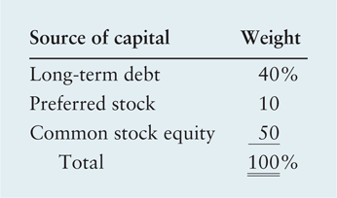
Integrative Case: Eco Plastics Company
The target capital structure for ECO is given by the weights in the following table:

Slide 55
Integrative Case: Eco Plastics Company
Eco can raise debt by selling 20-year bonds with a $1,000 par value and a 10.5% annual coupon interest rate.
Eco’s corporate tax rate is 40% and its bonds generally require an average discount of $45 per bond and flotation costs of $32 per bond when being sold.
Eco’s outstanding preferred stock pays a 9% dividend and has a $95-per-share par value. The cost of issuing and selling additional preferred stock is expected to be $7 per share.
Eco does not currently pay a dividend to common stockholders.

Slide 56
Integrative Case: Eco Plastics Company
In order to track the cost of common stock the CFO uses the capital asset pricing model (CAPM). The CFO and the firm’s investment advisors believe that the appropriate risk-free rate is 4% and that the market’s expected return equals 13%. Using data from 2012 through 2015, Eco’s CFO estimates the firm’s beta to be 1.3.
Although Eco’s current target capital structure includes 20% preferred stock, the company is considering using debt financing to retire the outstanding preferred stock, thus shifting their target capital structure to 50% long-term debt and 50% common stock.
If Eco shifts its capital mix from preferred stock to debt, its financial advisors expect its beta to increase to 1.5.

Slide 57
Integrative Case: Eco Plastics Company (cont.)
Calculate Eco’s current after-tax cost of long-term debt.
Calculate Eco’s current cost of preferred stock.
Calculate Eco’s current cost of common stock.
Calculate Eco’s current weighted average cost capital.
(1) Assuming that the debt financing costs do not change, what effect would a shift to a more highly leveraged capital structure consisting of 50% long-term debt, 0% preferred stock, and 50% common stock have on the risk premium for Eco’s common stock? What would be Eco’s new cost of common equity?
(2) What would be Eco’s new weighted average cost of capital?
(3) Which capital structure—the original one or this one—seems better? Why?

