Slide 1
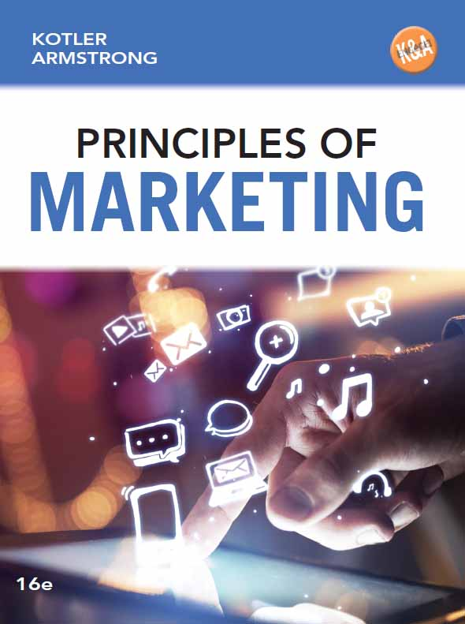
Principles of Marketing
Sixteenth Edition
Chapter 6
Business Markets and Business Buyer Behavior
Copyright © 2016, 2014, 2012 Pearson Education, Inc. All Rights Reserved
Notes:
If this PowerPoint presentation contains mathematical equations, you may need to check that your computer has the following installed:
1) MathType Plugin
2) Math Player (free versions available)
3) NVDA Reader (free versions available)

Slide 2
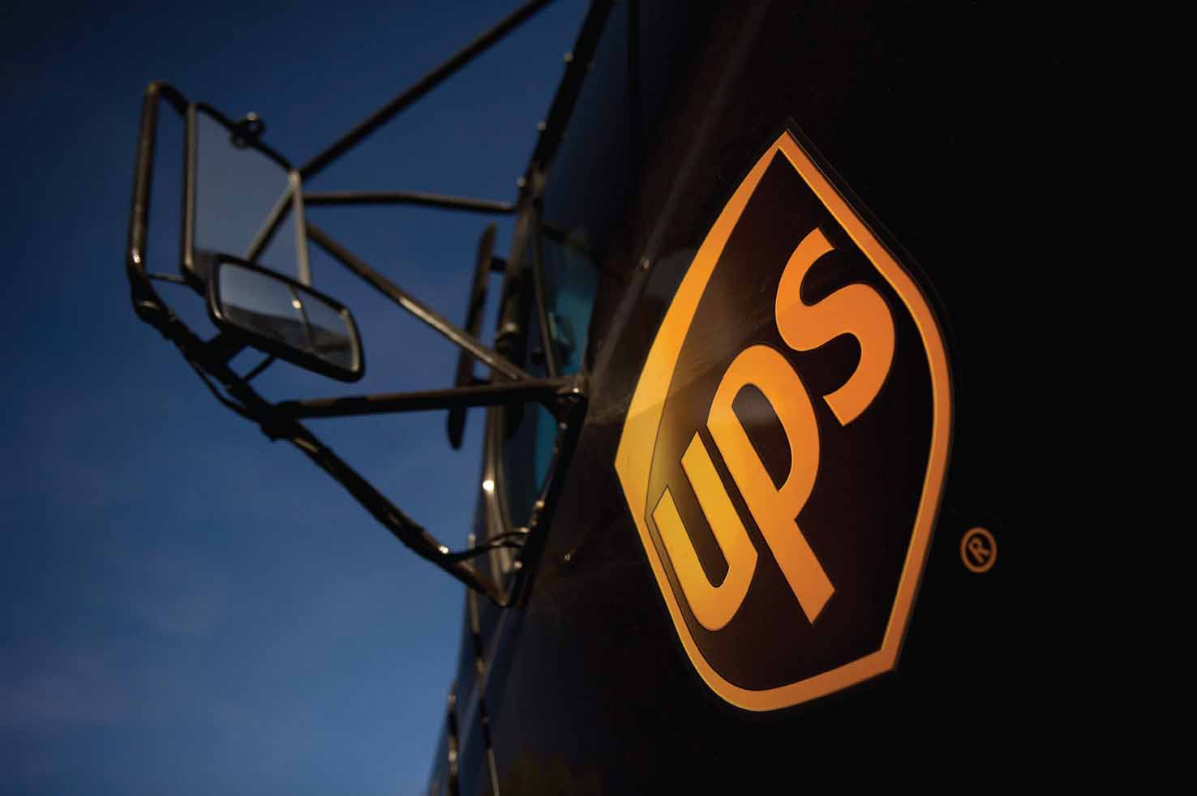
Business Markets and Business Buyer Behavior (1 of 2)
Notes:
Say UPS, and most people think of those familiar brown trucks with friendly drivers rumbling around the neighborhood. But to business customers, UPS becomes a strategic logistics
Partner.
In its business markets, UPS does much more than just deliver packages. It works hand in hand with business customers to become a logistics partner, helping them to shape and sharpen their entire logistics strategy and operations.

Slide 3
Learning Objectives
6.1 Define the business market and explain how business markets differ from consumer markets.
6.2 Identify the major factors that influence business buyer behavior.
6.3 List and define the steps in the business buying decision process.
6.4 Compare the institutional and government markets and explain how institutional and government buyers make their buying decisions.
Notes:
Objective 1 Define the business market and explain how business markets differ from consumer markets.
Objective 2 Identify the major factors that influence business buyer behavior.
Objective 3 List and define the steps in the business buying decision process.
Objective 4 Compare the institutional and government markets and explain how institutional and government buyers make their buying decisions.

Slide 4
Business Markets and Business Buyer Behavior (2 of 2)
Business buyer behavior refers to the buying behavior of the organizations that buy goods and services for use in the production of other products and services that are sold, rented, or supplied to others.
The business buying process is the process where business buyers determine which products and services are needed to purchase, and then find, evaluate, and choose among alternative brands.
Notes:
In one way or another, most large companies sell to other organizations. Companies such as Boeing, DuPont, IBM, Caterpillar, and countless other firms sell most of their products
to other businesses. Even large consumer-products companies, which make products used by final consumers, must first sell their products to other businesses(intermediaries).
Business-to-business (B-to-B) marketers must do their best to understand business markets and business buyer behavior. Then, like businesses that sell to final buyers, they must engage business customers and build profitable relationships with them, by creating superior customer value. The business market is huge. In fact, business markets involve far more dollars and items than do consumer markets.
In some ways, business markets are similar to consumer markets. Both involve people who assume buying roles and make purchase decisions to satisfy needs.
However, business markets differ in many ways from consumer markets. The main differences are in market structure and demand, the nature of the buying unit, the types of decisions, and the decision process involved.

Slide 5
Learning Objective 6.1 (1 of 2)
Define the business market and explain how business markets differ from consumer markets.
Business Markets

Slide 6
Business Markets (1 of 3)
Market Structure and Demand
Fewer but larger buyers
Derived demand
Inelastic demand
Fluctuating demand
Notes:
Business markets have far fewer but far larger buyers than the consumer marketer does. Even in large business markets, a few buyers often account for most of the purchasing.
Derived demand is ultimately derived from the demand for consumer goods. Consumers buy Intel processors only when they buy PCs, tablets,
smartphones, and other devices with Intel processors inside them from producers such as HP, Dell, Lenovo, Samsung, Sony, and Toshiba.
Inelastic demand and more fluctuating demand- demand for many business products is not affected much by price changes, especially in the short run.
And the demand for many business goods and services tends to change more—and more quickly—than does the demand for consumer goods and services.

Slide 7
Business Markets (2 of 3)
Nature of the Buying Unit
Business buyers usually face more complex buying decisions than do consumer buyers. Compared with consumer purchases, a business purchase usually involves:
    More decision participants
    More professional purchasing effort
    More buyer and seller interaction
Notes:
B-to-B marketers now face a new breed of higher-level, better-trained supply managers (buyers). Therefore, companies must have well-trained marketers and salespeople to deal with these well-trained buyers.
Business purchases tend to have the following characteristics.
Business buyers face more complex buying decisions than consumer buyers.
They involve large sums of money.
There are complex technical and economic considerations.
There are interactions among people at many levels of the buyer’s organization.
The process tends to be longer and more formalized.
They involve detailed product specifications and careful supplier searches.
They involve written purchase orders and formal approval.
Buyer and seller are often much more dependent on each other.
B-to-B marketers may roll up their sleeves and work closely with their customers during all stages of the buying process—from helping customers define problems, to finding solutions, to supporting after-sale operation. They often customize their offerings to individual customer needs. In the short run, sales go to suppliers who meet buyers’ immediate product and service needs. In the long run, however, business-to-business marketers keep customers by meeting current needs and by partnering with them to help solve their problems

Slide 8
Business Markets (3 of 3)
Decision Process
Supplier development is the systematic development of networks of supplier-partners to ensure an appropriate and dependable supply of products and materials for use in making products or reselling them to others.
Notes:
Walmart doesn’t have a “Purchasing Department”; it has a “Supplier Development Department.” The giant retailer knows that it can’t just rely on spot suppliers who might be available when needed. Instead, Walmart manages a robust network of supplier-partners that help provide the hundreds of billions of dollars of goods that it sells to its customers each year.

Slide 9
Learning Objective 6.1 (2 of 2)
Define the business market and explain how business markets differ from consumer markets.
Business Markets
Notes:
Discussion Question
Explain how the market structure and demand for business markets differs from consumer markets.
Learning Objective 1 Summary
The business market comprises all organizations that buy goods and services for use in the production of other products and services or for the purpose of reselling or renting them to others at a profit. As compared to consumer markets, business markets usually have fewer but larger buyers. Business demand is derived demand, which tends to be more inelastic and fluctuating than consumer demand. The business buying decision usually involves more professional buyers. Business buyers usually face more complex buying decisions, and the buying process tends to be more formalized. Finally, business buyers and
sellers are often more dependent on each other.

Slide 10
Learning Objective 6.2 (1 of 2)
Identify the major factors that influence business buyer behavior.
Business Buyer Behavior

Slide 11
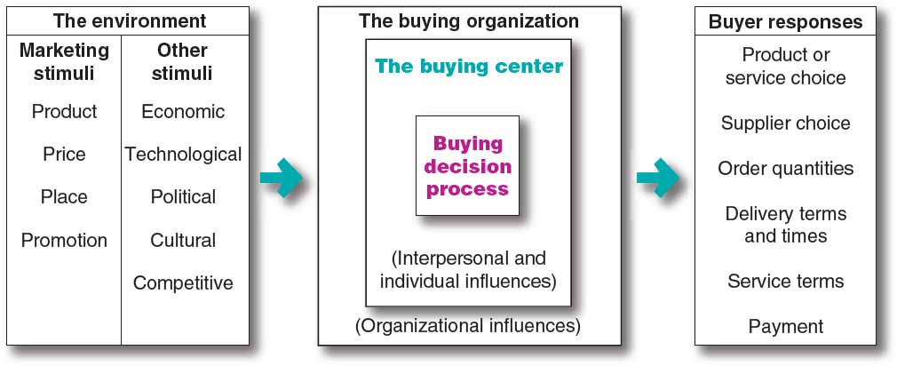
Business Buyer Behavior (1 of 12)
Major Types of Buying Situations
Figure 6.1 A Model of Business Buying Behavior
Notes:
In some ways, business markets are similar to consumer markets—this model looks a lot like the model of consumer buyer behavior presented in Figure 5.1. But there are some major differences, especially in the nature of the buying unit, the types of decisions made, and the decision process.
At the most basic level, marketers want to know how business buyers will respond to various marketing stimuli. Figure 6.1 shows a model of business buyer behavior. In this model, marketing and other stimuli affect the buying organization and produce certain buyer responses. To design good marketing strategies, marketers must understand what happens within the organization to turn stimuli into purchase responses.
Within the organization, buying activity consists of two major parts: the buying center, composed of all the people involved in the buying decision, and the buying decision process.
The model shows that the buying center and the buying decision process are influenced by internal organizational, interpersonal, and individual factors as well as external environmental factors.
The model in Figure 6.1 suggests four questions about business buyer behavior:
What buying decisions do business buyers make?
Who participates in the business buying process?
What are the major influences on buyers?
How do business buyers make their buying decisions?

Slide 12
Business Buyer Behavior (2 of 12)
Major Types of Buying Situations
Straight rebuy is a buying situation in which the buyer routinely reorders something without any modifications.
Modified rebuy is a buying situation in which the buyer wants to modify product specifications, prices, terms, or suppliers.
New task is a buying situation in which the buyer purchases a product or service for the first time.
Notes:
Discussion Questions
How would the purchase of a chair like the one you are sitting in be different for the University versus an end consumer like yourself buying a chair for your desk?
It may be difficult for students with no business buying experience to grasp the difference between business and consumer buying. Students will note how the university needs to buy more, that they need to ask users about the chairs, that they will organize more intricately for the buying effort, and that they will work with the vendors for reduced prices for bulk purchases. In addition, this can tie directly to the major types of buying situations.
How could the chair be a straight rebuy versus a modified rebuy? What implications would the different situation make on the process?
In addition to these three situations, many business buyers prefer to buy a complete solution to a problem from a single seller rather than buying separate products and services from several suppliers and putting them together. The sale often goes to the firm that provides the most complete system for meeting the customer’s needs and solving its problems. Such systems selling (or solutions selling) is often a key business marketing strategy for winning and holding accounts.

Slide 13

Business Buyer Behavior (3 of 12)
Major Types of Buying Situations
Systems selling is buying a complete solution to a problem from a single seller.
Notes:
Systems selling (or solutions selling)
Consider IBM and its customer Six Flags Entertainment Corporation:
Six Flags must carefully and effectively manage thousands of park assets—from rides and equipment to buildings and other facilities. Six Flags turned to IBM, which has software—called Maximo Asset Management software—that handles that very problem well. But IBM didn’t just hand the software over to Six Flags for implementation. Instead, IBM’s Maximo Professional Services group combined the software with an entire set of services designed to get and keep the software up and running.
IBM is working hand-in-hand with Six Flags to customize the application and strategically implement it across Six Flags’ far-flung facilities, along with on-site immersion training and planning workshops. Thus, IBM isn’t just selling the software, it’s selling a complete solution to Six Flags’ complex asset management.

Slide 14
Business Buyer Behavior (4 of 12)
Participants in the Business Buying Process
Buying center consists of all the individuals and units that play a role in the business purchase decision-making process.
    Users
    Influencers
    Deciders
    Purchasers
    Gatekeepers
Notes:
Who does the buying of the trillions of dollars’ worth of goods and services needed by business organizations?
The decision-making unit of a buying organization is called its buying center. This group includes the actual users of the product or service, those who make the buying decision, those who influence the buying decision, those who do the actual buying, and those who control buying information.

Slide 15
Business Buyer Behavior (5 of 12)
Participants in the Business Buying Process
Users are those that will use the product or service.
Influencers help define specifications and provide information for evaluating alternatives.
Buyers have formal authority to select the supplier and arrange terms of purchase.
Deciders have formal or informal power to select and approve final suppliers.
Gatekeepers control the flow of information.
Notes:
The buying center includes all members of the organization who play any of five roles in the purchase decision process.
Users - In many cases, users initiate the buying proposal and help define product specifications.
Influencers - Technical personnel are particularly important influencers.
Deciders - In routine buying, the buyers are often the deciders, or at least the approvers.
Gatekeepers - Purchasing agents often have authority to prevent salespersons from seeing users or deciders. Other gatekeepers include technical personnel and even personal secretaries.
The buying center is not a fixed and formally identified unit within the buying organization. It is a set of buying roles assumed by different people for different purchases. Within the organization, the size and makeup of the buying center will vary for different products and for different buying situations.

Slide 16
Business Buyer Behavior (6 of 12)
Participants in the Business Buying Process
The buying center concept presents a major marketing challenge given the varied groups involved in the decision.
Who participates in the decision?
  Relative influence on decision by various participants
  Evaluation criteria used by various participants
  Are there Informal participants involved in decision
Notes:
Many business buying decisions result from the complex interactions of ever-changing buying center participants.
The buying center usually includes some obvious participants who are involved formally in the buying decision. For example, the decision to buy a corporate jet will probably involve the company’s CEO, the chief pilot, a purchasing agent, some legal staff, a member of top management, and others formally charged with the buying decision.
It may also involve less obvious, informal participants, some of whom may actually make or strongly affect the buying decision. Sometimes, even the people in the buying center are not aware of all the buying participants. For example, the decision about which corporate jet to buy may actually be made by a corporate board member who has an interest in flying and who knows a lot about airplanes. This board member may work behind the scenes to sway the decision.

Slide 17
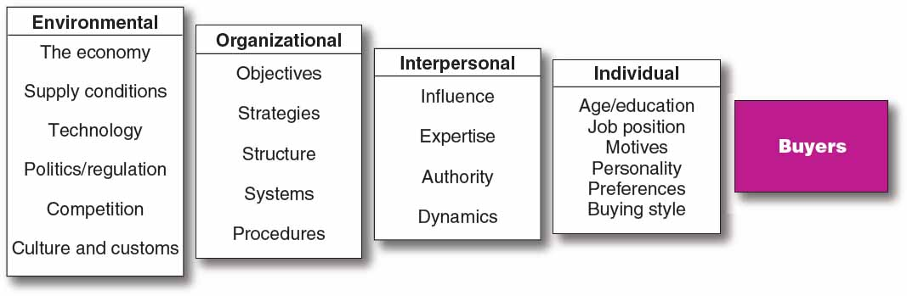
Business Buyer Behavior (7 of 12)
Major Influences on Business Buyers
Figure 6.2 Major Influences on Business Buying Behavior
Notes:
Like consumer buying decisions in Figure 5.2, business buying decisions are affected by an incredibly complex combination of influences, but with an extra layer of organizational factors thrown into the mix.
Figure 6.2 lists various groups of influences on business buyers—environmental, organizational, interpersonal, and individual.

Slide 18
Business Buyer Behavior (8 of 12)
Major Influences on Business Buyers
Economic Factors
  Price
  Service
Personal Factors
  Emotion
Notes:
Today, most B-to-B marketers recognize that emotion plays an important role in business buying decisions.
Business buyers are subject to many influences when they make their buying decisions. Economic factors are very important to most buyers, especially in a tough economy. However, business buyers actually respond to both economic and personal factors. Far from being cold, calculating, and impersonal, business buyers are human and social as well.

Slide 19
Business Buyer Behavior (9 of 12)
Major Influences on Business Buyers
Environmental Factors
  Demand for product
  Economic outlook
  Cost of money
  Supply of Materials
  Technology
  Culture
  Politics
  Competition
Notes:
Business buyers are heavily influenced by the many factors in the current and expected economic environment shown in this slide. The business buyer must watch these factors, determine how they will affect the buyer, and try to turn these challenges into opportunities.

Slide 20
Business Buyer Behavior (10 of 12)
Major Influences on Business Buyers
Organizational Factors
  Objectives
  Strategies
  Structure
  Systems
  Procedures
Notes:
Organizational factors are also important and each buying organization has its own. The business marketer must understand these factors well. Questions such as these arise: How many people are involved in the buying decision? Who are they? What are their evaluative criteria? What are the company’s policies and limits on its buyers?

Slide 21
Business Buyer Behavior (11 of 12)
Major Influences on Business Buyers
Interpersonal Factors
  Influence
  Expertise
  Authority
  Dynamics
Notes:
The buying center usually includes many participants who influence each other, so interpersonal factors also influence the business buying process. However, it is often difficult to assess such interpersonal factors and group dynamics. Buying center participants do not wear tags that label them as “key decision maker” or “not influential.” Nor do buying center participants with the highest rank always have the most influence. Interpersonal factors are often very subtle. Whenever possible, business marketers must try to understand these factors and design strategies that take them into account.

Slide 22
Business Buyer Behavior (12 of 12)
Major Influences on Business Buyers
Individual Factors
  Motives
  Perceptions
  Preferences
  Age
  Income
  Education
  Attitude toward risk
Notes:
Buying center participants’ individual factors are affected by personal characteristics which result in different buying styles.
Some buying center participants may be technical, analytical types and other buyers may be intuitive negotiators who are adept at pitting the sellers against one another for the best deal.

Slide 23
Learning Objective 6.2 (2 of 2)
Identify the major factors that influence business buyer behavior.
Business Buyer Behavior
Notes:
Discussion Question
What are the major influences on business buyers?
Learning Objective 2 Summary
Business buyers make decisions that vary with the three types of buying situations: straight rebuys, modified rebuys, and new tasks. The decision-making unit of a buying organization—the buying center—can consist of many different persons playing many different roles. The business marketer needs to know the following: Who are the major buying center participants? In what decisions do they exercise influence and to what degree? What evaluation criteria does each decision participant use? The business marketer also needs to understand the major environmental, organizational, interpersonal, and individual influences on the buying process.

Slide 24
Learning Objective 6.3 (1 of 2)
List and define the steps in the business buying decision process.

Slide 25
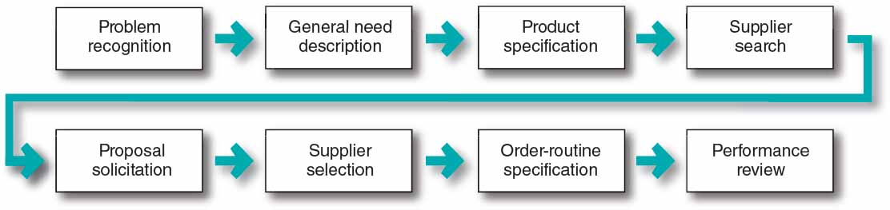
The Business Buying Process (1 of 5)
Figure 6.3 Stages of Business Buying Behavior
Notes:
Figure 6.3 lists the eight stages of the business buying process. Buyers who face a new task buying situation usually go through all stages of the buying process. In contrast, buyers making modified or straight rebuys may skip some of the stages. We will examine these steps for the typical new task buying situation.

Slide 26
The Business Buying Process (2 of 5)
Problem recognition occurs when someone in the company recognizes a problem or need.
Internal stimuli
  Need for new product or production equipment
External stimuli
  Idea from a trade show or advertising
Notes:
The buying process begins with problem recognition which can result from internal or external stimuli. In addition to the stimuli listed in the slide other stimuli may include:
a machine breaks down and requires new parts
purchasing manager is unhappy with a current supplier
salesperson offers a better product or a lower price
In their advertising, business marketers often alert customers to potential problems and then show how their products and services provide solutions. For example, an award-winning ad from Quill.com, an online office products supplier that strives for strong customer service, highlights an important customer problem: what to do when your printer runs out of toner.

Slide 27
The Business Buying Process (3 of 5)
General need description describes the characteristics and quantity of the needed item.
Product specification describes the technical criteria.
Value analysis is an approach to cost reduction where components are studied to determine if they can be redesigned, standardized, or made with less costly methods of production.
Notes:
For complex items, the buyer may need to work with engineers, users, and consultants to develop the general need description. The team may want to rank the importance of reliability, durability, price, and other attributes desired in the item. In this phase, the alert business marketer can help the buyers define their needs and provide information about the value of different product characteristics.
A product specification is developed by the buying organization, often with the help of a value analysis engineering team.
With a product value analysis, the team decides on the best product characteristics and specifies them accordingly. Sellers, too, can use value analysis as a tool to help secure a new account. By showing buyers a better way to make an object, outside sellers can turn straight rebuy situations into new task situations that give them a chance to obtain new business.

Slide 28
The Business Buying Process (4 of 5)
Supplier search involves compiling a list of qualified suppliers to find the best vendors.
Proposal solicitation is the process of requesting proposals from qualified suppliers.
Supplier selection is when the buying center creates a list of desired supplier attributes and negotiates with preferred suppliers for favorable terms and conditions.
Notes:
Supplier Search
The buyer can compile a list of qualified suppliers by reviewing trade directories, phoning other companies for recommendations, or conducting Internet searches. For marketers, the Internet has leveled the playing field, giving smaller suppliers many of the same advantages as larger competitors. The newer the buying task, and the more complex and costly the item, the greater the amount of time the buyer will spend searching for suppliers.
The supplier’s task is to get listed in major directories and build a good reputation in the marketplace. Salespeople should watch for companies in the process of searching for suppliers and make certain that their firm is considered.
Proposal Solicitation
Some suppliers will refer the buyer to its website and promotional materials or send a salesperson to call on the prospect. However, for more complex or expensive items, a detailed written proposal or formal presentation from each potential supplier is required.
Business marketers must be skilled in researching, writing, and presenting proposals in response to buyer proposal solicitations. Proposals should be marketing documents, not just technical documents. Presentations should inspire confidence and should make the marketer’s company stand out from the competition.
Supplier Selection
Desired supplier attributes include product and service quality, reputation, on-time delivery, ethical corporate behavior, honest communication, and competitive prices. The buying center will rate suppliers against these attributes based on their relative importance and identify the best suppliers.
Buyers may negotiate with preferred suppliers for better prices and terms before making the final selections. Many buyers prefer multiple sources of supplies to avoid being totally dependent on one supplier and to allow comparisons of prices and performance of several suppliers over time.
Today’s supplier development managers want to develop a full network of supplier-partners that can help the company bring more value to its customers.

Slide 29
The Business Buying Process (5 of 5)
Order-routine specifications includes the final order with the chosen supplier and lists all of the specifications and terms of the purchase.
Performance review involves a critique of supplier performance to the order-routine specifications.
Notes:
Order-Routine Specification
In the case of maintenance, repair, and operating items, buyers may use blanket contracts rather than periodic purchase orders. A blanket contract creates a long-term relationship in which the supplier promises to resupply the buyer as needed at agreed prices for a set time period.
Many large buyers now practice vendor-managed inventory, in which they turn over ordering and inventory responsibilities to their suppliers. Under such systems, buyers share sales and inventory information directly with key suppliers. The suppliers then monitor inventories and replenish stock automatically as needed. Most major suppliers to large retailers such as Walmart, Target, Home Depot, and Lowe’s assume vendor-managed inventory responsibilities.
Performance Review
The review may lead the buyer to continue, modify, or drop the arrangement. The seller’s job is to monitor the same factors used by the buyer to make sure that they are delivering the expected satisfaction.

Slide 30

E-Procurement and Online Purchasing (1 of 2)
Online purchasing
Company-buying sites
Extranets
Notes:
Staples operates a business-to-business procurement division called Staples Advantage, which serves the office supplies and services buying needs of business customers of any size. Staples.com is a leading supplier of office supplies for business and end consumers. It would be interesting to ask students what Staples can do to market themselves more effectively to businesses so they become the sole supplier of office products.
Online purchasing is standard procedure for most companies today. E-procurement gives buyers access to new suppliers, lowers purchasing costs, and hastens order processing and delivery. In turn, business marketers can connect with customers online to share marketing information, sell products and services, provide customer support services, and maintain ongoing customer relationships.
Companies can do e-procurement in any of several ways:
reverse auctions, in which they put their purchasing requests online and invite suppliers to bid for the business
trading exchanges, through which companies work collectively to facilitate the trading process
setting up their own company buying sites to post buying needs, invite bids, negotiate terms, and place orders
creating extranet links with key suppliers, which are direct procurement accounts where company buyers can purchase equipment, materials, and supplies directly

Slide 31
E-Procurement and Online Purchasing (2 of 2)
Advantages
  Access to new suppliers
  Lowers costs
  Speeds order processing and delivery
  Enhances information sharing
  Improves sales
  Facilitates service and support
Disadvantages
  Erodes relationships as buyers search for new suppliers
Notes:
Today’s business-to-business marketers are using a wide range of digital and social marketing approaches—from websites, blogs, and smartphone apps to mainstream social networks such as Facebook, LinkedIn, YouTube, and Twitter to reach business customers and manage customer relationships anywhere, anytime. Digital and social marketing has rapidly become the new space for engaging business customers.
Business-to-business e-procurement yields many benefits. In addition to the benefits listed in the slide, it frees buyers time to focus on strategic issues, such as finding better supply sources and working with suppliers to reduce costs and develop new products.
The rapidly expanding use of e-procurement, however, also presents some problems. Many buyers now use the power of the Internet to pit suppliers against one another and search out better deals, products, and turnaround times on a purchase-by-purchase basis.

Slide 32
Learning Objective 6.3 (2 of 2)
List and define the steps in the business buying decision process.
Notes:
Discussion Question
List the steps for a typical new task buying process. What is product value analysis and in which step of the buying process does it occur?
Learning Objective 3 Summary
The business buying decision process itself can be quite involved, with eight basic stages: problem recognition, general need description, product specification, supplier search, proposal solicitation, supplier selection, order-routine specification, and performance review. Buyers who face a new task buying
situation usually go through all stages of the buying process. Buyers making modified or straight rebuys may skip some of the stages.
Companies must manage the overall customer relationship, which often includes many different buying decisions in various stages of the buying decision process. Advances in information technology have given birth to “e-procurement,” by which business buyers are purchasing all kinds of products and services online. The Internet gives business buyers access to new suppliers, lowers purchasing costs, and hastens order processing and delivery. However, e-procurement can also erode customer-supplier relationships. Still, business marketers are increasingly connecting with customers online to share marketing information, sell products and services, provide customer support services, and maintain ongoing customer relationships.

Slide 33
Learning Objective 6.4 (1 of 2)
Compare the institutional and government markets and explain how institutional and government buyers make their buying decisions.

Slide 34
Institutional and Government Markets (1 of 2)
Institutional markets consist of schools, hospitals, nursing homes, and prisons that provide goods and services to people in their care.
  Characteristics
    Low budgets
    Captive patrons
Notes:
Institutional markets can be huge. Institutions differ from one another in their sponsors and their objectives, and each institution has different buying needs and resources. For example, the hospital purchasing agent must search for institutional-food vendors whose quality meets or exceeds a certain minimum standard and whose prices are low.
Many marketers set up separate divisions to meet the special characteristics and needs of institutional buyers. For example, the General Mills Foodservice unit produces, packages, prices, and markets its broad assortment of cereals, cookies, snacks, and other products to better serve the specific food service requirements of hospitals, schools, hotels, and other institutional markets. Similarly, P&G’s Procter & Gamble Professional Division markets professional cleaning and laundry formulations and systems to educational, healthcare, and other institutional and commercial customers.

Slide 35
Institutional and Government Markets (2 of 2)
Government markets tend to favor domestic suppliers, require them to submit bids, and normally award the contract to the lowest bidder.
  Affected by environmental factors
  Non-economic factors considered
    Minority firms
    Depressed firms
    Small businesses
Notes:
The government market offers large opportunities for many companies, both big and small. In most countries, government organizations are major buyers of goods and services. In the United States alone, federal, state, and local governments contain more than 89,000 buying units that purchase more than $1 trillion in goods and services each year.
Like consumer and business buyers, government buyers are affected by environmental, organizational, interpersonal, and individual factors.
One unique thing about government buying is that it is carefully watched by outside publics, ranging from Congress to a variety of private groups interested in how the government spends taxpayers’ money.
Most governments provide would-be suppliers with detailed guides describing how to sell to the government. For example, the U.S. Small Business Administration provides on its website detailed advice for small businesses and the General Services Administration operates Business Service Centers with staffs to provide a complete education on the way government agencies buy, the steps that suppliers should follow, and the procurement opportunities available.
Noneconomic criteria also play a growing role in government buying. Government buyers are asked to favor depressed business firms and areas; small business firms; minority-owned firms; and business firms that avoid race, gender, or age discrimination.
Many companies that sell to the government have not been marketing oriented for a number of reasons. Total government spending is determined by elected officials rather than by any marketing effort to develop this market. Government buying has emphasized price, making suppliers invest their effort in technology to bring costs down.
Several companies, however, have established separate government marketing departments or customized marketing programs for government buyers.
A great deal of the government’s buying has gone online allowing authorized defense and civilian agencies to buy everything from office supplies, food, and information technology equipment to construction services through online purchasing.

Slide 36
Learning Objective 6.4 (2 of 2)
Compare the institutional and government markets and explain how institutional and government buyers make their buying decisions.
Notes:
Discussion Question
What type of organizations make up institutional markets? What factors characterize institutional markets?
Describe the major elements of government buying practices.
Learning Objective 4 Summary
The institutional market consists of schools, hospitals, prisons, and other institutions that provide goods and services to people in their care. These markets are characterized by low budgets and captive patrons.
The government market, which is vast, consists of government units—federal, state, and local—that purchase or rent goods and services for carrying out the main functions of government. Government buyers purchase products and services for defense, education, public welfare, and other public needs.
Government buying practices are highly specialized and specified, with open bidding or negotiated contracts characterizing most of the buying. Government buyers operate under the watchful eye of the U.S. Congress and many private watchdog groups. Hence, they tend to require more forms and signatures and respond more slowly and deliberately when placing orders.

Slide 37
Copyright

