Slide 1
2
The Recording Process
Learning Objectives
Describe how accounts, debits, and credits are used to record business transactions.
1
2
Indicate how a journal is used in the recording process.
Explain how a ledger and posting help in the recording process.
3
4
Prepare a trial balance.

Slide 2
Steps in the Accounting Cycle:
1- Analyze, understand and record the transaction in the General Journal (This is called Journalizing).
2- Transfer (copy) the information from the General Journal to the different Ledger Accounts for each account, or to T- Accounts. (This is called Posting).
We can use either Ledger accounts OR T- Accounts.
3- At the end of the period, prepare/ calculate the balance in every Ledger account Or T- Account.
4- Prepare the TRIAL BALANCE.
These are all shown in chapter 2

Slide 3
LEARNING
OBJECTIVE
Describe how accounts, debits, and credits are used to record business transactions.
1
The
Account
Record of increases and decreases in a specific asset, liability, owners’ equity, revenue, or expense item.
Debit = “Left”
Credit = “Right”
An account can be illustrated in a T-account form.
LO 1

Slide 4
The Account
DEBIT AND CREDIT PROCEDURES
Double-entry system
  Each transaction must affect two or more accounts to keep the basic accounting equation in balance.
  Recording done by debiting at least one account and crediting at least one other account.
  DEBITS must equal CREDITS.
LO 1

Slide 5
Debits and Credits
If the sum of Debit entries are greater than the sum of Credit entries, the account will have a debit balance.
Transaction #1
$10,000
$3,000
Transaction #2
Transaction #3
8,000
Balance
$15,000
LO 1

Slide 6
Debits and Credits
If the sum of Credit entries are greater than the sum of Debit entries, the account will have a credit balance.
Transaction #1
$10,000
$3,000
Transaction #2
8,000
Transaction #3
Balance
$1,000
LO 1

Slide 7
Debits and Credits
Assets - Debits should exceed credits.
Liabilities – Credits should exceed debits.
Normal balance is on the increase side.
LO 1

Slide 8
Debits and Credits
Owner’s investments and revenues increase owner’s equity (credit).
Owner’s drawings and expenses decrease owner’s equity (debit).
Helpful Hint Because
revenues increase owner’s
equity, a revenue account
has the same debit/credit
rules as the Owner’s
Capital account. Expenses
have the opposite effect.
LO 1

Slide 9

Debits and Credits
The purpose of earning revenues is to benefit the owner(s).
The effect of debits and credits on revenue accounts is the same as their effect on Owner’s Capital.
Expenses have the opposite effect: expenses decrease owner’s equity.
LO 1

Slide 10
Debits/Credits Rules
Normal Balance Debit
Normal Balance Credit
LO 1

Slide 11


Debits/Credits Rules
Balance Sheet Income Statement
Asset
Liability
+
-
=
Equity
Revenue
Expense
Debit
Credit
LO 1

Slide 12
When the item | Increases | Decreases
Asset | DR | CR
Liability | CR | DR
Owner’s Capital (Equity) | CR | DR
Revenue | CR | DR
Expense | DR | CR
Drawing | DR | CR

Slide 13
Debits/Credits Rules
Question
Debits:
  increase both assets and liabilities.
  decrease both assets and liabilities.
  increase assets and decrease liabilities.
  decrease assets and increase liabilities.
LO 1

Slide 14
Debits/Credits Rules
Question
Accounts that normally have debit balances are:
  assets, expenses, and revenues.
  assets, expenses, and equity.
  assets, liabilities, and owner’s drawing.
  assets, owner’s drawing, and expenses.
LO 1

Slide 15
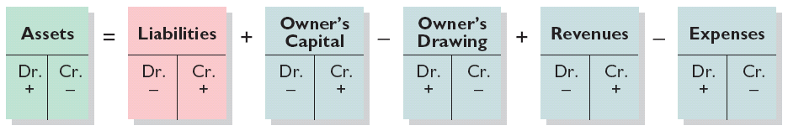
Summary of Debit/Credit Rules
Relationship among the assets, liabilities and owner’s equity of a business:
Illustration 2-11
Basic Equation
Assets = Liabilities +
Owner’s Equity
Expanded Equation
Debit/Credit Effects
The equation must be in balance after every transaction. Total Debits must equal total Credits.
LO 1

Slide 16

DO IT!
1
Normal Account Balances
Kate Browne has just rented space in a shopping mall. In this space, she will open a hair salon to be called “Hair It Is.” A friend has advised Kate to set up a double-entry set of accounting records in which to record all of her business transactions. Identify the balance sheet accounts that Kate will likely need to record the transactions needed to open her business. Indicate whether the normal balance of each account is a debit or a credit.
Assets
Liabilities
Equity
Cash (debit)
Supplies (debit)
Equipment (debit)
Notes payable (credit)
Accounts payable (credit)
Owner’s Capital (credit)
LO 1

Slide 17
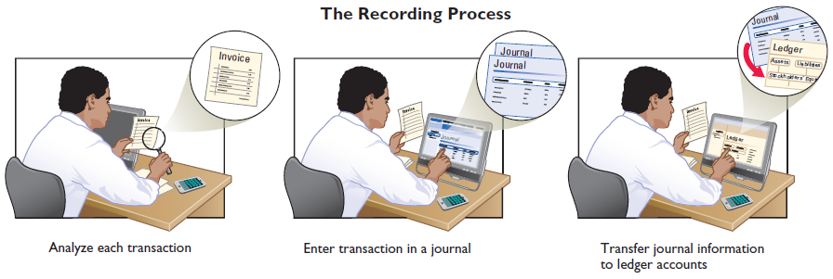
LEARNING
OBJECTIVE
Indicate how a journal is used in the
recording process.
2
Steps in the Recording Process
Illustration 2-12
Analyze each transaction
Enter transaction in a journal
Transfer journal information to ledger accounts
Business documents, such as a sales slip, a check, or a bill, provide evidence of the transaction.
LO 2

Slide 18
Steps in the Recording Process
The Journal
Book of original entry.
Transactions recorded in chronological order.
Contributions to the recording process:
  Discloses the complete effects of a transaction.
  Provides a chronological record of transactions.
  Helps to prevent or locate errors because the debit and credit amounts can be easily compared.
LO 2

Slide 19
Steps in the Recording Process
JOURNALIZING - Entering transaction data in the journal.
Illustration: On September 1, Ray Neal invested $15,000 cash in the business, and Softbyte purchased computer equipment for $7,000 cash.
Illustration 2-13
GENERAL JOURNAL
Sept. 1
Cash
15,000
  Owner’s Capital
15,000
Equipment
7,000
  Cash
7,000
LO 2

Slide 20
Steps in the Recording Process
SIMPLE AND COMPOUND ENTRIES
Illustration: On July 1, Butler Company purchases a delivery truck costing $14,000. It pays $8,000 cash now and agrees to pay the remaining $6,000 on account.
Illustration 2-14
Compound journal entry
GENERAL JOURNAL
July 1
Equipment
14,000
  Cash
8,000
  Accounts payable
6,000
LO 2

Slide 21
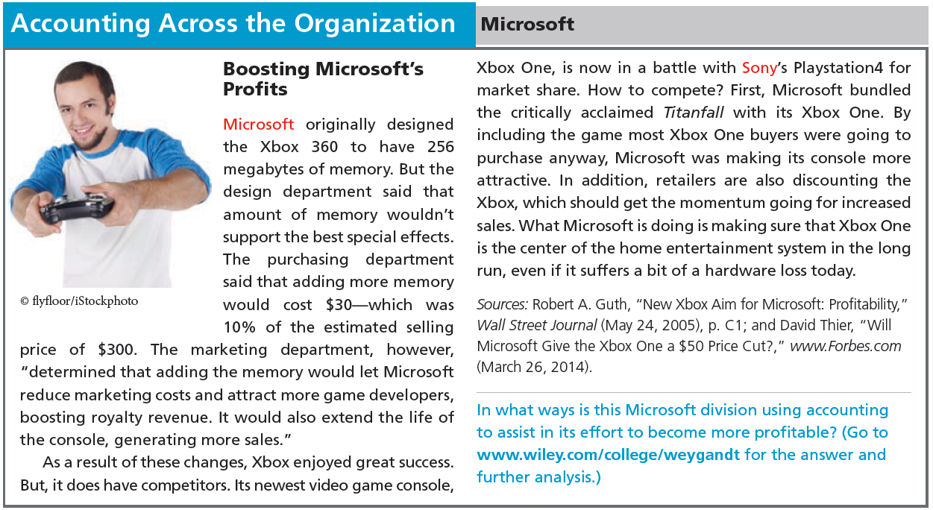
LO 2

Slide 22
DO IT!
2
Recording Business Activities
Kate Browne engaged in the following activities in establishing her salon, Hair It Is:
Opened a bank account in the name of Hair It Is and deposited $20,000 of her own money in this account as her initial investment.
Purchased equipment on account (to be paid in 30 days) for a total cost of $4,800.
Interviewed three persons for the position of hair stylist.
Prepare the entries to record the transactions.
LO 2

Slide 23
DO IT!
2
Recording Business Activities
Prepare the entries to record the transactions.
Opened a bank account and deposited $20,000.
Purchased equipment on account (to be paid in 30 days) for a total cost of $4,800.
Interviewed three persons for the position of hair stylist.
Cash 20,000
Owner’s Capital 20,000
Equipment 4,800
Accounts Payable 4,800
No entry
LO 2

Slide 24
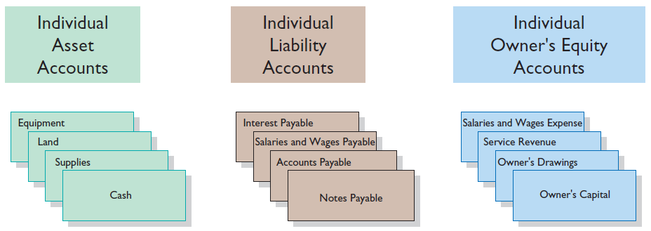
LEARNING
OBJECTIVE
Explain how a ledger and posting help in the recording process.
3
The Ledger
General Ledger contains all the asset, liability, and owner’s equity accounts.
Illustration 2-15
LO 3

Slide 25

LO 3

Slide 26
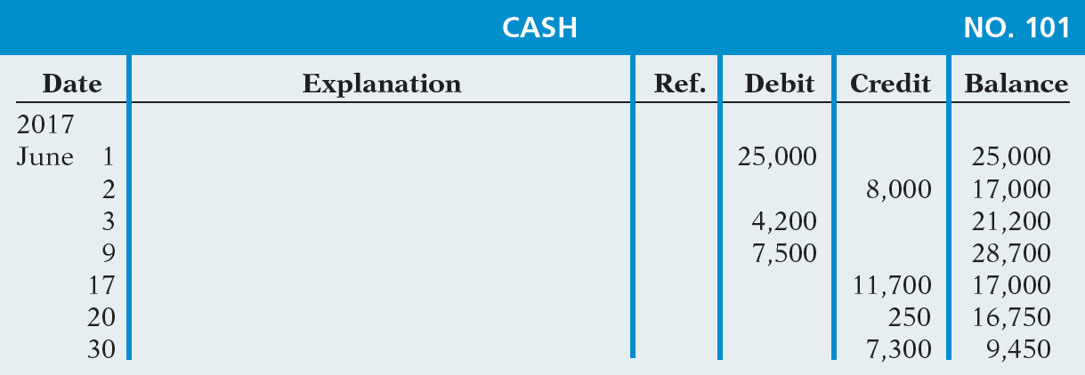
The Ledger
STANDARD FORM OF ACCOUNT
Illustration 2-16
Three-column form of account
LO 3

Slide 27
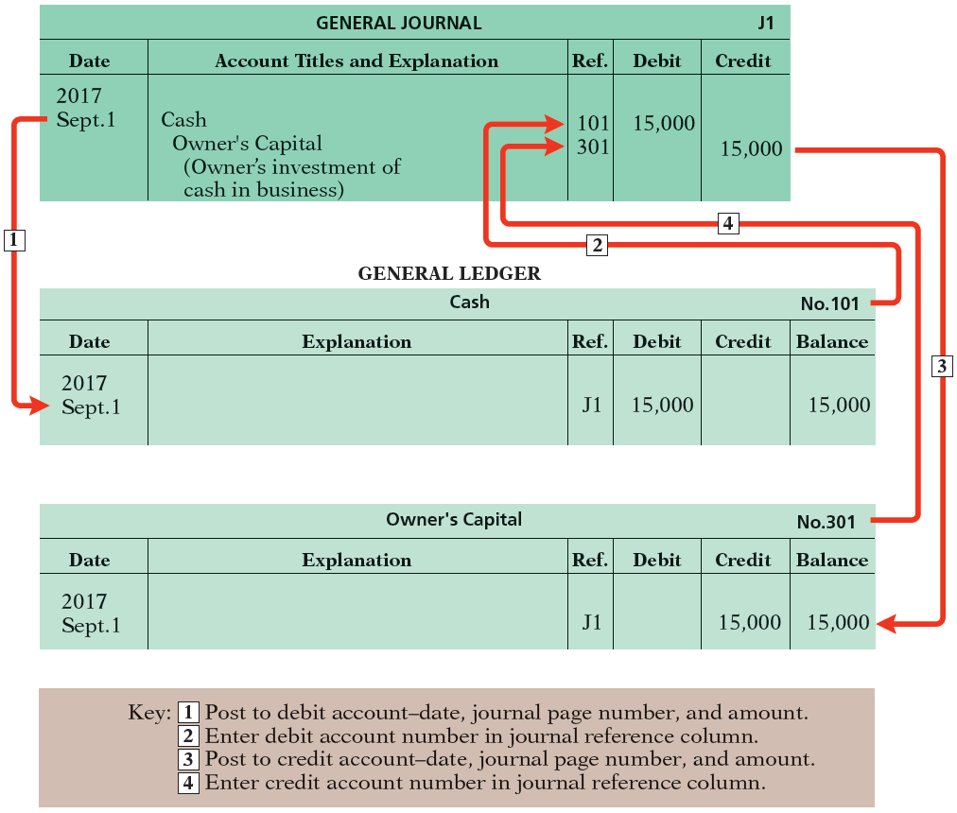
Ledger
POSTING Transferring journal entries to the ledger accounts.
Illustration 2-17
Posting a journal entry
LO 3

Slide 28
Posting
Question
Posting:
  normally occurs before journalizing.
  transfers ledger transaction data to the journal.
  is an optional step in the recording process.
  transfers journal entries to ledger accounts.
LO 3

Slide 29
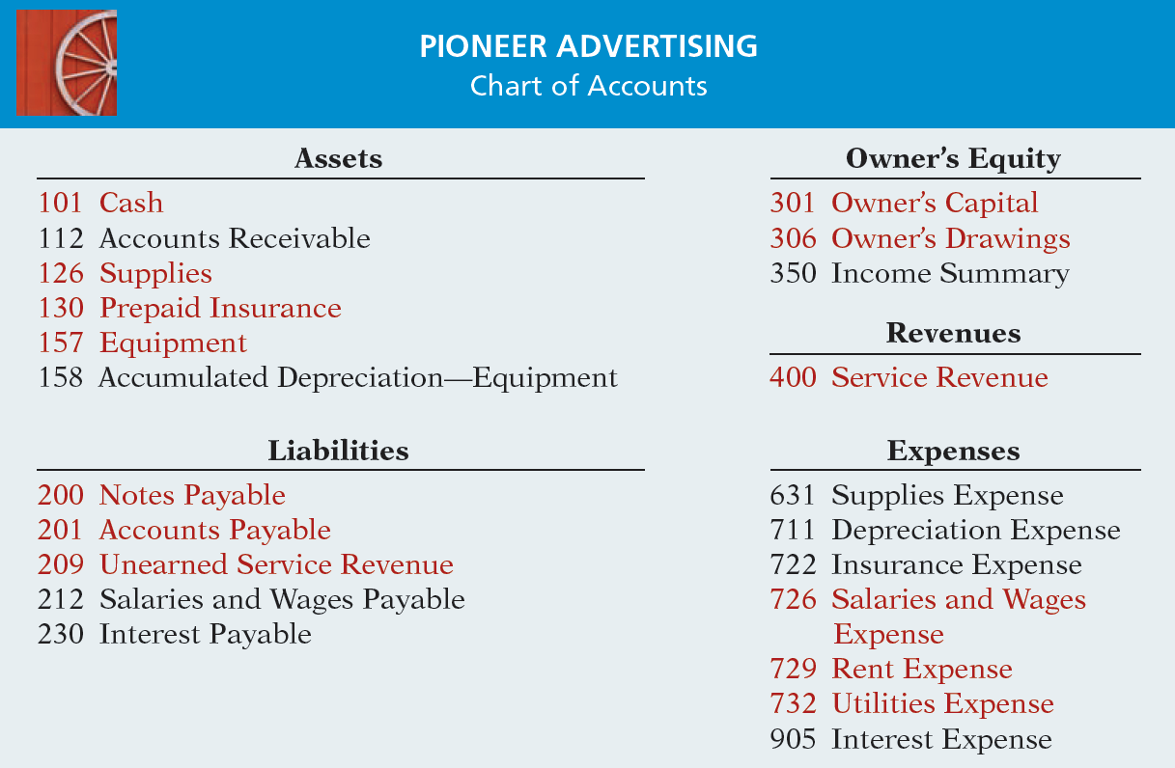
Chart of Accounts
Illustration 2-18
LO 3

Slide 30
When the item | Increases | Decreases
Asset | DR | CR
Liability | CR | DR
Owner’s Capital (Equity) | CR | DR
Revenue | CR | DR
Expense | DR | CR
Drawing | DR | CR

Slide 31
Steps in the Accounting Cycle:
1- Analyze, understand and record the transaction in the General Journal (This is called Journalizing).
2- Transfer (copy) the information from the General Journal to the different Ledger Accounts for each account, or to T- Accounts. (This is called Posting).
We can use either Ledger accounts OR T- Accounts.
3- At the end of the period, prepare/ calculate the balance in every Ledger account Or T- Account.
4- Prepare the TRIAL BALANCE.
These are all shown in chapter 2

Slide 32
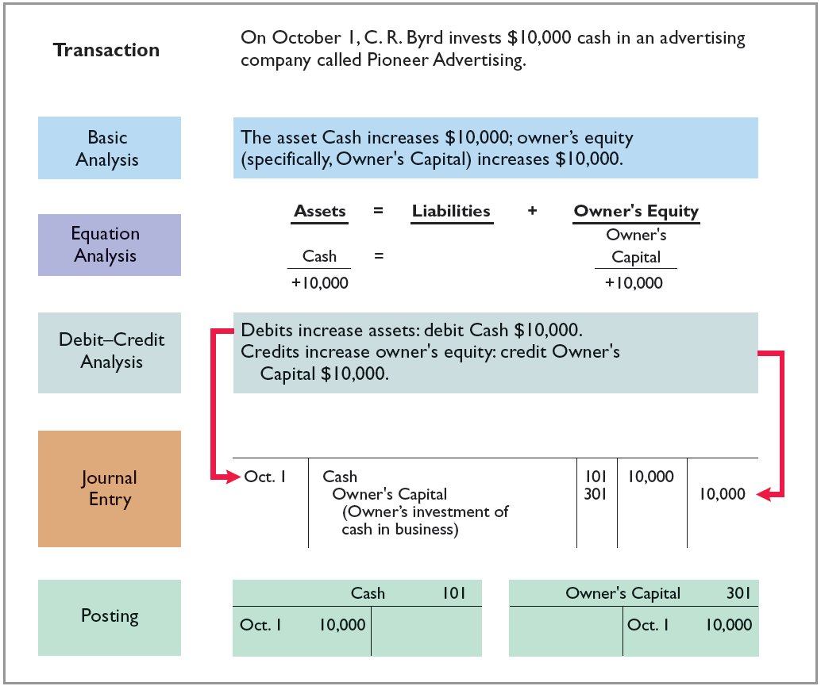
The Recording Process Illustrated
Follow these steps:
1. Determine what type of account is involved.
2. Determine what items increased or decreased and by how much.
3. Translate the increases and decreases into debits and credits.
Illustration 2-19
LO 3

Slide 33
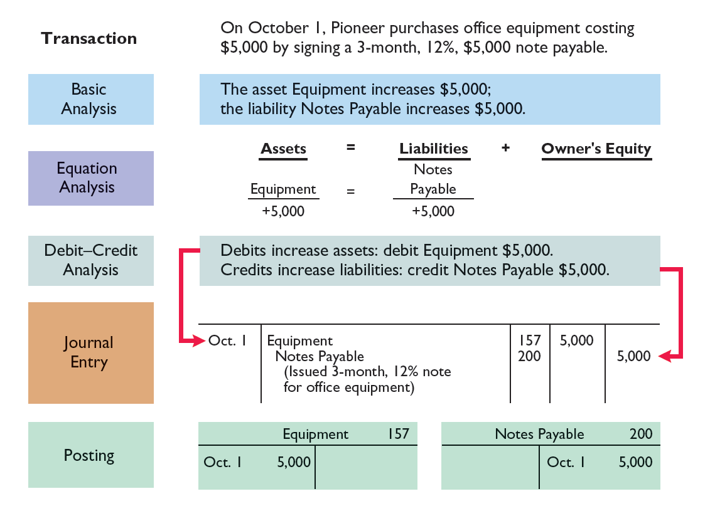
Illustration 2-20
Purchase of office equipment
LO 3

Slide 34
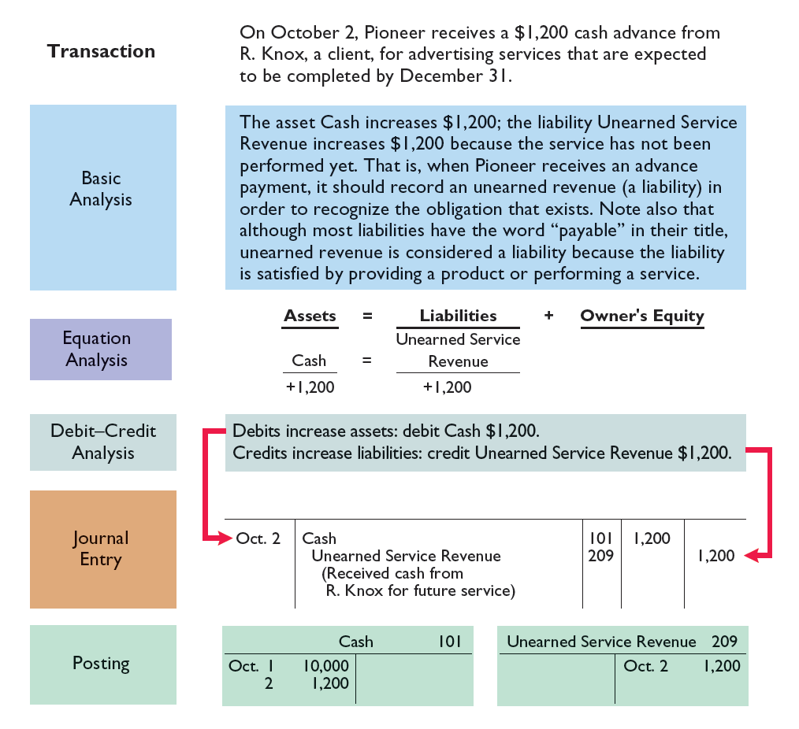
Illustration 2-21
Receipt of cash for future service
LO 3

Slide 35
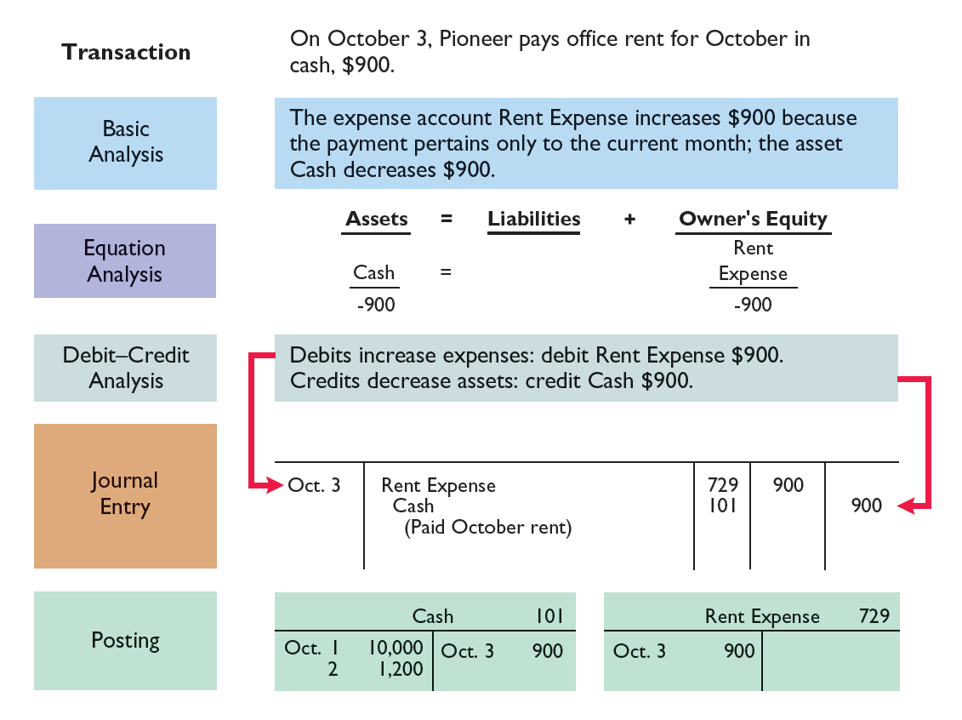
Illustration 2-22
Payment of monthly rent
LO 3

Slide 36
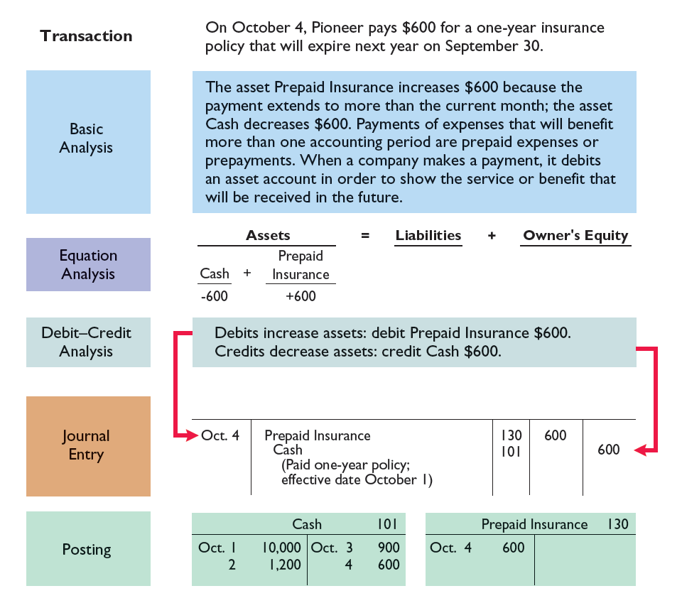
Illustration 2-23
Payment for insurance
LO 3

Slide 37
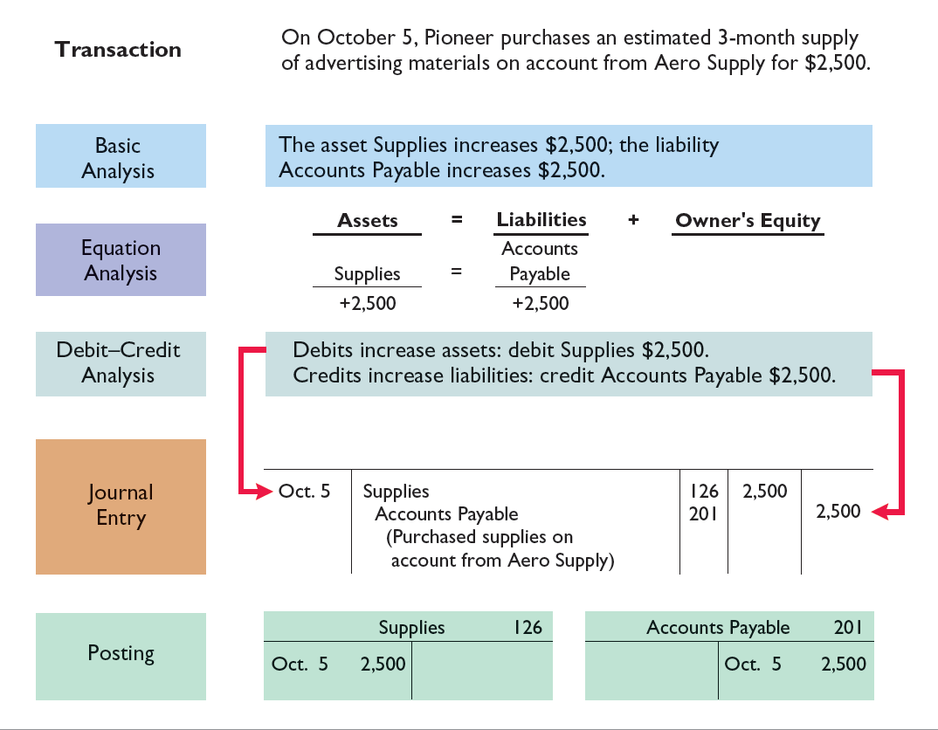
Illustration 2-24
Purchase of supplies on credit
LO 3

Slide 38
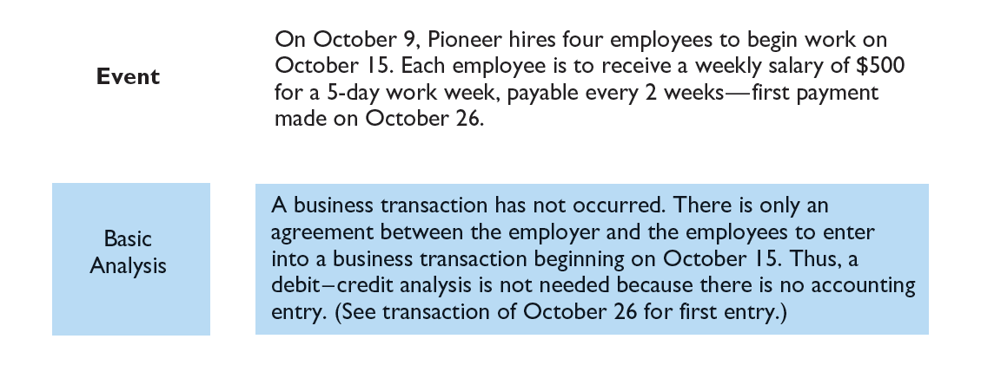
The Recording Process Illustrated
Illustration 2-25
Hiring of employees
LO 3

Slide 39
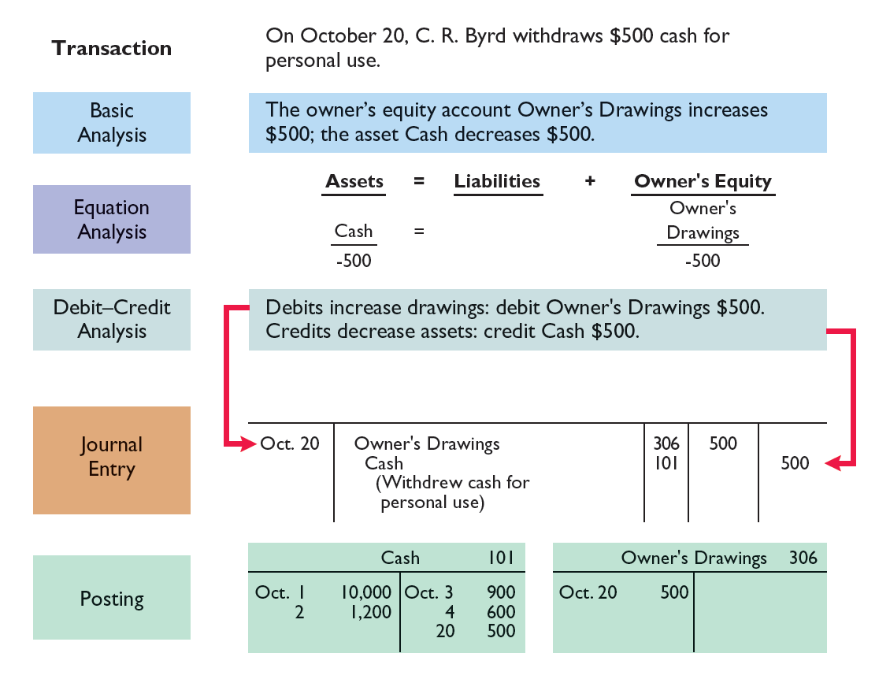
Illustration 2-26
Withdrawal of cash by owner
LO 3

Slide 40
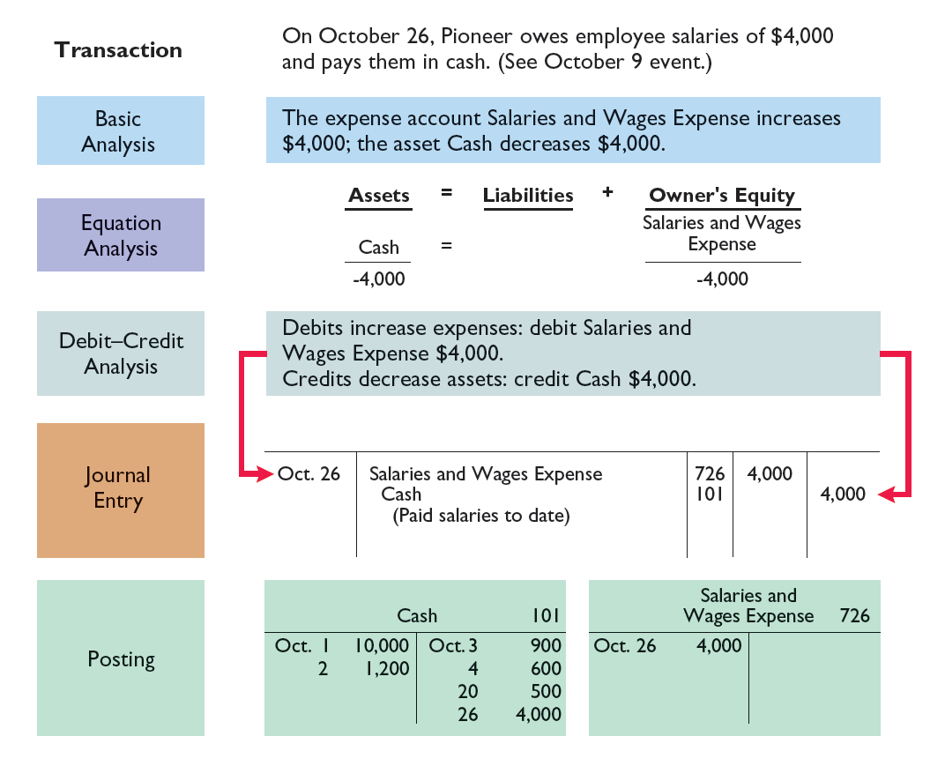
Illustration 2-27
Payment of salaries
LO 3

Slide 41
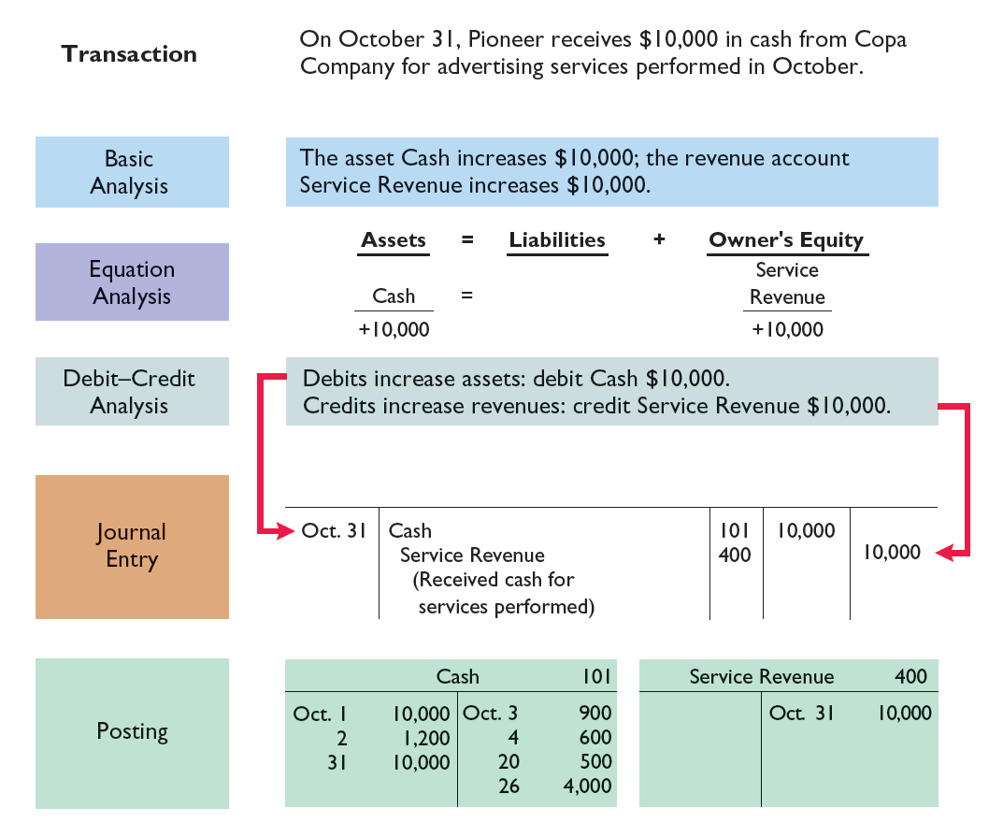
Illustration 2-28
Receipt of cash for services performed
LO 3

Slide 42
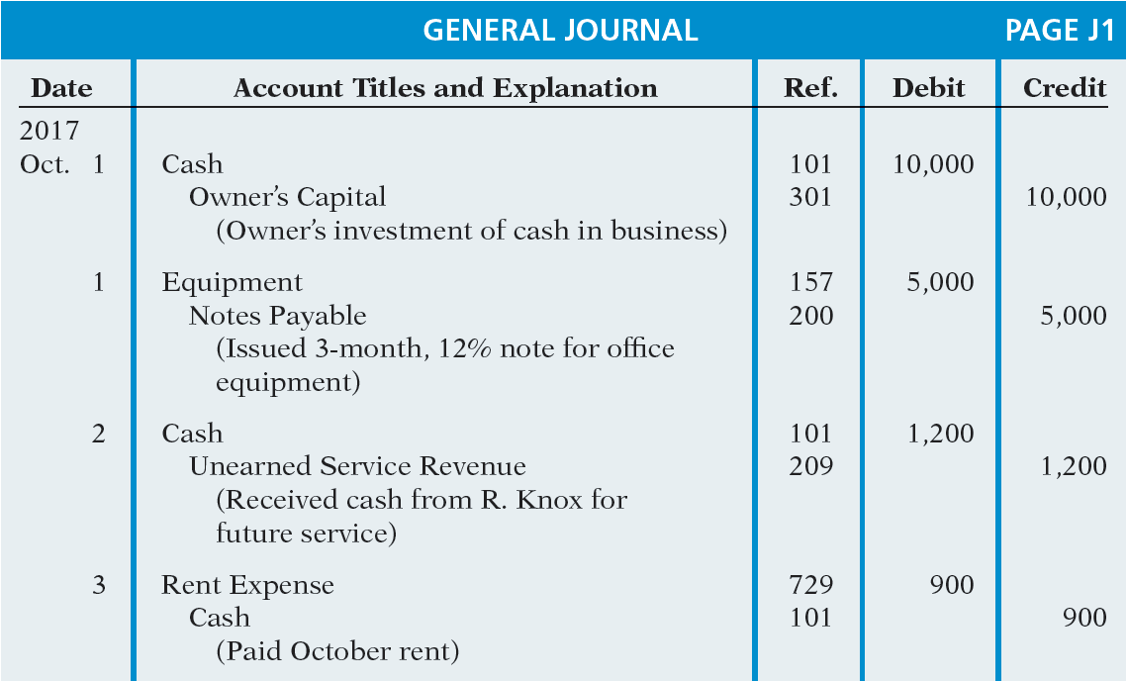
Summary Journalizing and Posting
Illustration 2-29
LO 3

Slide 43
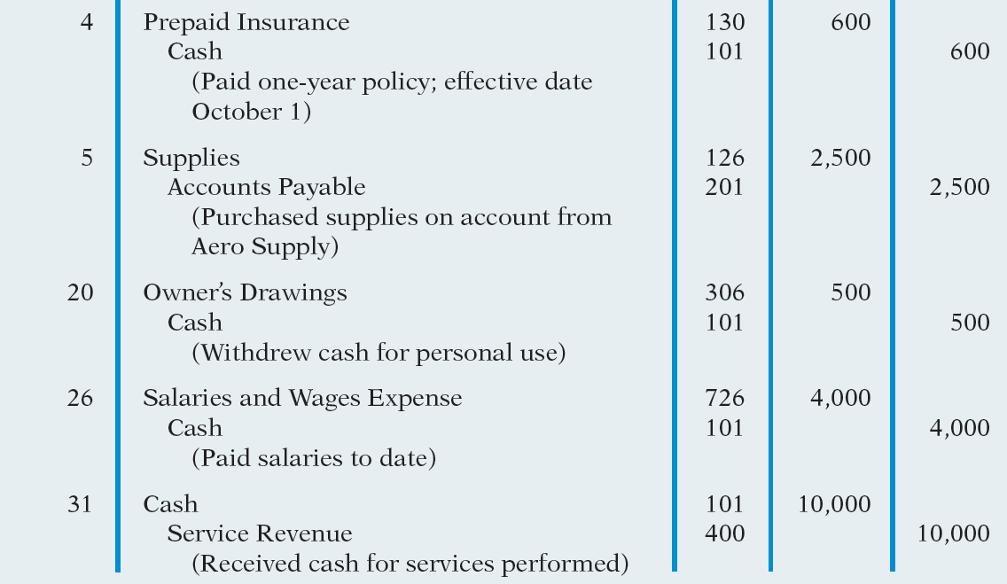
Illustration 2-29
LO 3

Slide 44
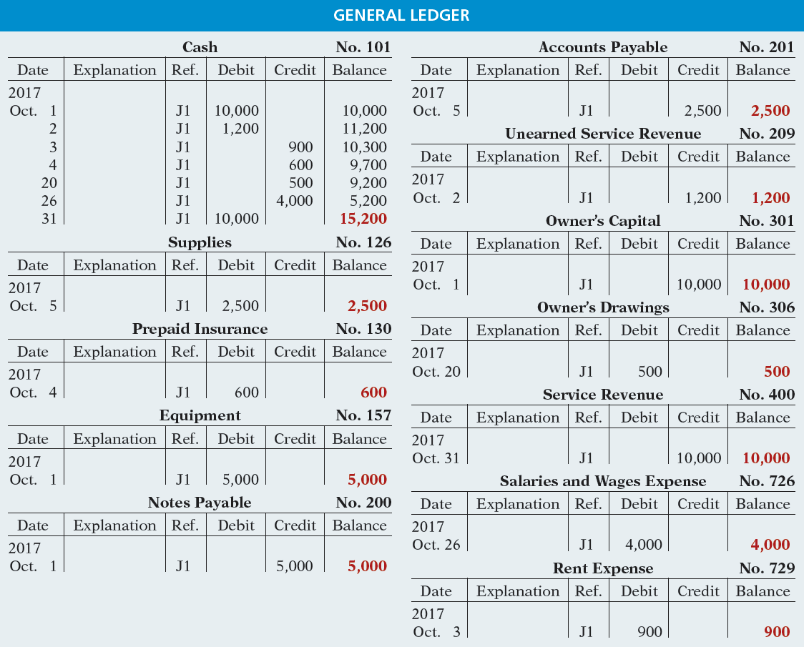
Illustration 2-30
LO 3

Slide 45
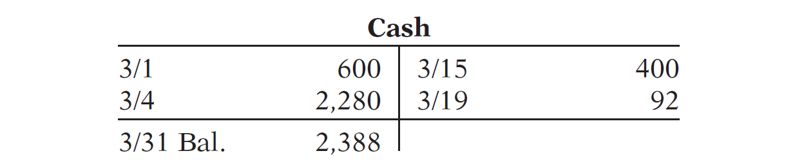
DO IT!
3
Posting
Kate Brown recorded the following transactions in a general journal during the month of March. Post these entries to the Cash account.
Mar. 4 Cash 2,280
Service Revenue 2,280
Mar. 15 Salaries and Wages Expense 400
Cash 400
Mar. 19 Utilities Expense 92
Cash 92
LO 3

Slide 46
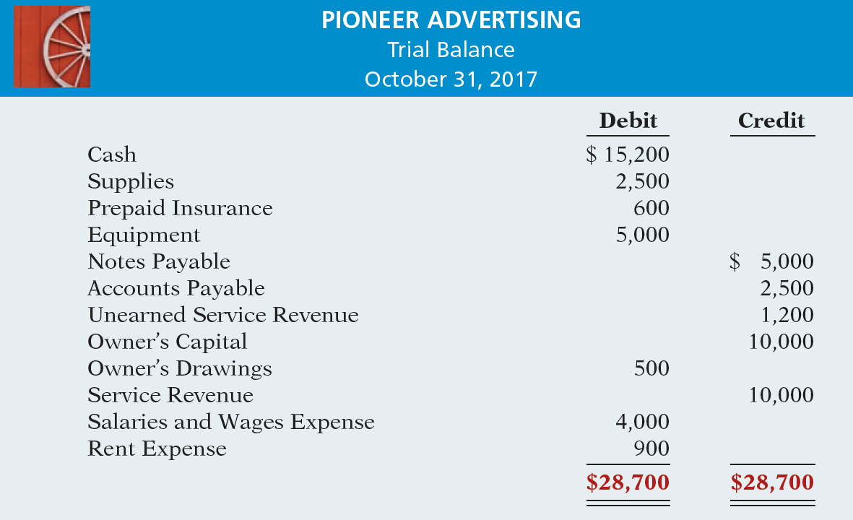
LEARNING
OBJECTIVE
Prepare a trial balance.
4
Illustration 2-31
LO 4

Slide 47
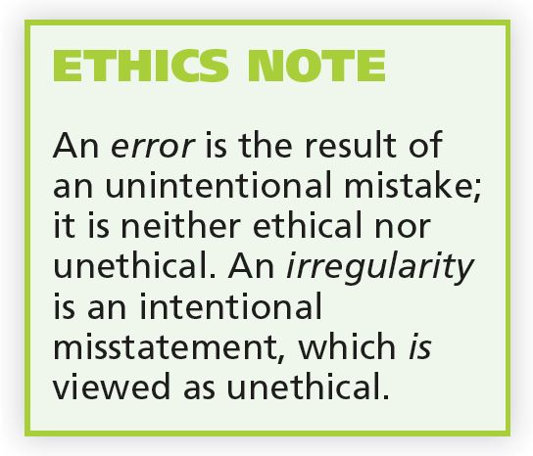
Trial Balance
Limitations of a Trial Balance
Trial balance may balance even when:
  A transaction is not journalized.
  A correct journal entry is not posted.
  A journal entry is posted twice.
  Incorrect accounts are used in journalizing or posting.
  Offsetting errors are made in recording the amount of a transaction.
LO 4

Slide 48
Dollar Signs and Underlining
Dollar Signs
Do not appear in journals or ledgers.
Typically used only in the trial balance and the financial statements.
Shown only for the first item in the column and for the total of that column.
Underlining
A single line is placed under the column of figures to be added or subtracted.
Totals are double-underlined.
LO 4

Slide 49
Trial Balance
Question
A trial balance will not balance if:
  a correct journal entry is posted twice.
  the purchase of supplies on account is debited to Supplies and credited to Cash.
  a $100 cash drawing by the owner is debited to Owner’s Drawing for $1,000 and credited to Cash for $100.
  a $450 payment on account is debited to Accounts Payable for $45 and credited to Cash for $45.
LO 4

Slide 50
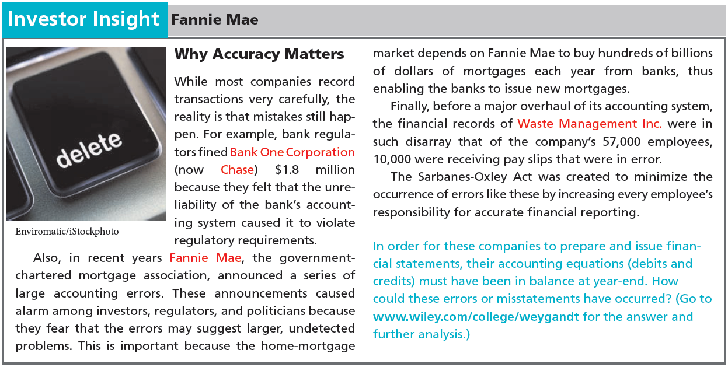
LO 4

Slide 51
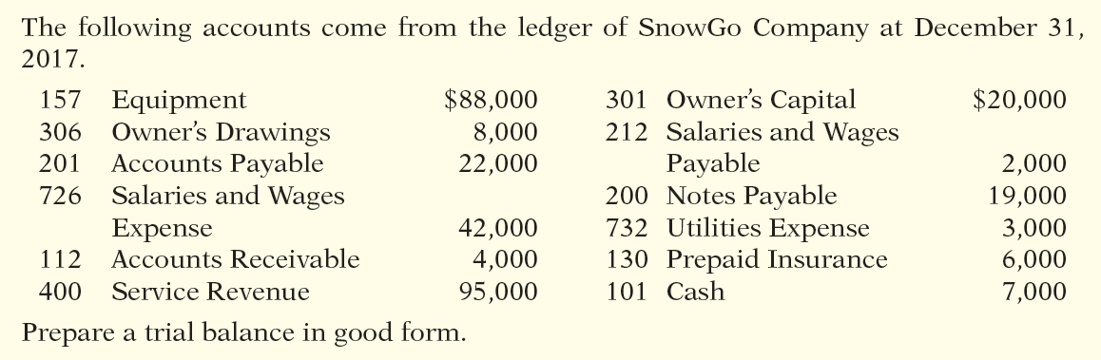
DO IT!
4
Trial Balance
LO 4

Slide 52
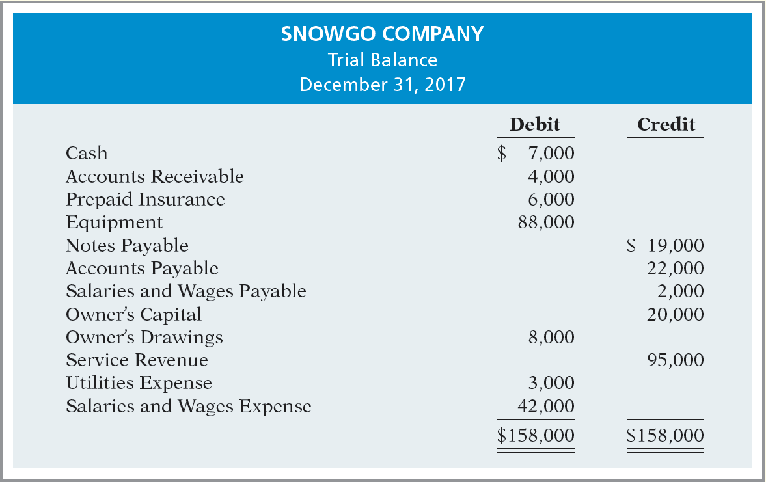

DO IT!
4
Trial Balance
LO 4

Slide 53

A Look at IFRS
LEARNING
OBJECTIVE
Compare the procedures for the accounting process under GAAP and IFRS.
5
Key Points
  Similarities
  Transaction analysis is the same under IFRS and GAAP.
  Both the IASB and the FASB go beyond the basic definitions provided in the textbook for the key elements of financial statements, that is assets, liabilities, equity, revenue, and expenses. The implications of the expanded definitions are discussed in more advanced accounting courses.
LO 5

Slide 54
A Look at IFRS
Key Points
  Similarities
  As shown in the textbook, dollar signs are typically used only in the trial balance and the financial statements. The same practice is followed under IFRS, using the currency of the country where the reporting company is headquartered.
  A trial balance under IFRS follows the same format as shown in the textbook.
LO 5

Slide 55
A Look at IFRS
Key Points
  Differences
  IFRS relies less on historical cost and more on fair value than do FASB standards.
  Internal controls are a system of checks and balances designed to prevent and detect fraud and errors. While most public U.S. companies have these systems in place, many non-U.S. companies have never completely documented the controls nor had an independent auditors attest to their effectiveness.
LO 5

Slide 56
A Look at IFRS
Looking to the Future
The basic recording process shown in this textbook is followed by companies across the globe. It is unlikely to change in the future. The definitional structure of assets, liabilities, equity, revenues, and expenses may change over time as the IASB and FASB evaluate their overall conceptual framework for establishing accounting standards.
LO 5

Slide 57
A Look at IFRS
IFRS Self-Test Questions
Which statement is correct regarding IFRS?
  IFRS reverses the rules of debits and credits, that is, debits are on the right and credits are on the left.
  IFRS uses the same process for recording transactions as GAAP.
  The chart of accounts under IFRS is different because revenues follow assets.
  None of the above statements are correct.
LO 5

Slide 58
A Look at IFRS
IFRS Self-Test Questions
A trial balance:
  is the same under IFRS and GAAP.
  proves that transactions are recorded correctly.
  proves that all transactions have been recorded.
  will not balance if a correct journal entry is posted twice.
LO 5

Slide 59
A Look at IFRS
IFRS Self-Test Questions
One difference between IFRS and GAAP is that:
  GAAP uses accrual-accounting concepts and IFRS uses primarily the cash basis of accounting.
  IFRS uses a different posting process than GAAP.
  IFRS uses more fair value measurements than GAAP.
  the limitations of a trial balance are different between IFRS and GAAP.
LO 5

Slide 60
Copyright
“Copyright © 2015 John Wiley & Sons, Inc. All rights reserved. Reproduction or translation of this work beyond that permitted in Section 117 of the 1976 United States Copyright Act without the express written permission of the copyright owner is unlawful. Request for further information should be addressed to the Permissions Department, John Wiley & Sons, Inc. The purchaser may make back-up copies for his/her own use only and not for distribution or resale. The Publisher assumes no responsibility for errors, omissions, or damages, caused by the use of these programs or from the use of the information contained herein.”

