Slide 1
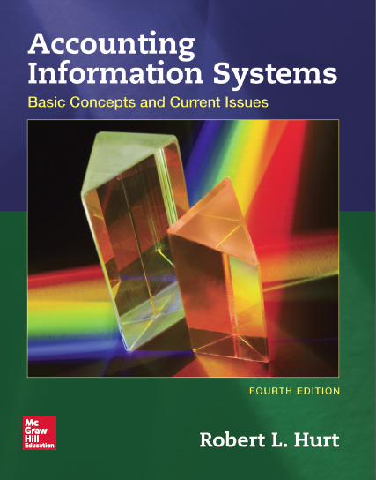
PowerPoint Presentation Materials
Accounting Information Systems:
Basic Concepts and Current Issues
4th edition
Robert L. Hurt

Slide 2
Chapter 1
Role and Purpose of Accounting Information Systems

Slide 3
Outline
Learning objectives
Definition of AIS
AIS importance
AIS generic structure
Information literacy

Slide 4
Learning objectives
Define “accounting information systems.”
Discuss why AIS is an important area of study for future accountants.
Compare and contrast AIS with other areas of accounting.
Explain the structure of most AIS.
Locate and evaluate information sources on AIS.

Slide 5
Definition of AIS
An accounting information system is:
A set of interrelated activities, documents and technologies
Designed to collect data, process it and report information
To a diverse group of internal and external decision makers in organizations

Slide 6
Definition of AIS
Activities
Business processes
Sales / collection
Acquisition / payment
Conversion
Financing
Human resource
Accounting cycle steps
Documents
Purchase orders
Remittance advices
Technologies
General ledger software
ERP systems
Which steps in the accounting cycle do you recall from previous study?

Slide 7
Definition of AIS
Data
Stacks of sales invoices
Receipts for the payment of rent
Information
General purpose financial statements
Cost variance analysis
Decision makers
Management (internal)
Shareholders (external)
Organizations
For profit (Microsoft)
Not for profit (Red Cross)
Governmental (State of California)

Slide 8
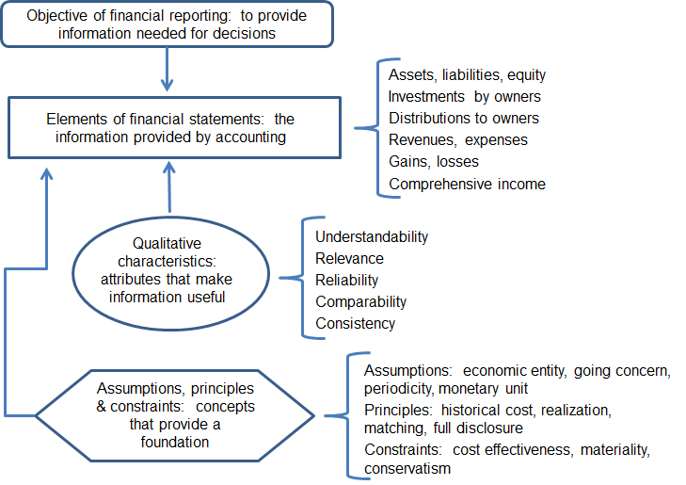
AIS importance
Developing a strong AIS helps achieve some of the components of the FASB Conceptual Framework of Accounting
Figure 1.1

Slide 9
AIS importance
Broad business perspective competencies
Studying AIS helps students develop many of the core competencies suggested by the American Institute of Certified Public Accountants
Functional
competencies
Personal
competencies

Slide 10
AIS importance
Acquiring knowledge about AIS helps students learn more about common business processes
Sales / collection process
Acquisition / payment process
Conversion process
Human resource process
Financing process

Slide 11
AIS generic structure
Internal control
Input
Process
Output
Storage

Slide 12
AIS generic structure
Inputs: source documents
Processes: steps in the accounting cycle
Outputs: general purpose financial statements
Storage: customer master file
Internal controls: separation of duties

Slide 13
Information literacy
Sometimes called “information competence”
The ability to find, evaluate, use and communicate information in all of its various formats

Slide 14
Information literacy
UMUC criteria for evaluating information
Authority: Who created it? Why?
Accuracy: Is the source identified? Is the information accurate?

Slide 15
Information literacy
UMUC criteria for evaluating information
Objectivity: Does it include advertising? Is it available freely?
Currency: How old is the information?
Coverage: Does the information have sufficient depth?

