Slide 1
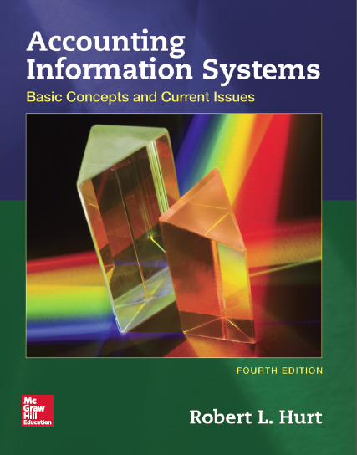
Chapter 2
Transaction Processing in the AIS

Slide 2
Outline
Learning objectives
Accounting and bookkeeping
Accounting cycle
Internal controls
Coding systems
Human judgment and information technology

Slide 3
Learning objectives
Differentiate accounting and bookkeeping.
List, discuss and complete, in order, the steps in the accounting cycle.
Identify common internal controls associated with the accounting cycle.
Describe common coding systems and how they are used in the AIS.
Explain how human judgment and information technology affect the accounting cycle.

Slide 4
Accounting and bookkeeping
Accounting
Accounting is the process of identifying, measuring, and communicating economic information to permit informed judgments and decisions by users of the information.
Bookkeeping
The part of accounting associated with identifying and measuring economic information.

Slide 5
Accounting and bookkeeping
Identifying
Recognizing events that give rise to journal entries vs. those that do not
Measuring
Historical cost, such as supplies
Present value, such as long-term bonds payable
Market value, such as certain investments in marketable securities
Net realizable value, such as accounts receivable

Slide 6
Accounting cycle
Ten steps used to gather data, process it and create general purpose financial statements
Two groups
Steps that occur throughout the fiscal year
Steps that occur at the end of the fiscal year

Slide 7
Accounting cycle
Steps that occur throughout the fiscal year
Obtain information about external transactions from source documents.
Analyze transactions.
Record the transactions in a journal.
Post from the journal to the general ledger accounts.
Prepare an unadjusted trial balance.

Slide 8
Accounting cycle
Steps that occur at the end of the fiscal year
Record adjusting journal entries and post to the ledger accounts.
Prepare an adjusted trial balance.
Prepare financial statements.
Close the temporary accounts to retained earnings.
Prepare a post-closing trial balance.
Some organizations prepare adjusting entries multiple times throughout the year, such as at the end of each quarter.

Slide 9
Internal controls
Policies, processes & procedures designed to:
Safeguard assets.
Ensure reliable financial reporting.
Promote operating efficiency.
Encourage compliance with management directives.
Accounting cycle controls
Numbering source documents sequentially
Enforcing transaction limits
Using general ledger / other appropriate software for transaction processing

Slide 10
Coding systems
Methods for identifying source documents for easier reference later
Four broad types
Sequential
Block
Hierarchical
Mnemonic

Slide 11
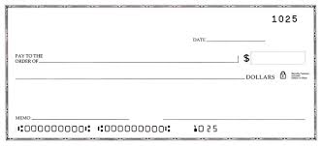
Coding systems
Sequential
Documents are numbered in sequence
Example: checks in your checkbook
Block
First digit specifies a group
Example: simple chart of accounts

Slide 12
Coding systems
Hierarchical
Groups of digits have meaning
Example: more complex chart of accounts
Mnemonic
Code is a reminder of its meaning
Example: accounting certifications
CPA, Certified Public Accountant
CFE, Certified Fraud Examiner
EA, Enrolled Agent
CMA, Certified Management Accountant
department
03.514.101
geographic location
account number

Slide 13
Human judgment & information technology
Often incorporated in accounting information systems
Information technology is not the system; it is a tool used in the system.
Human judgment
Determining which events lead to journal entries
Information technology
Spreadsheets, relational databases, general ledger software, ERP systems

