Slide 1
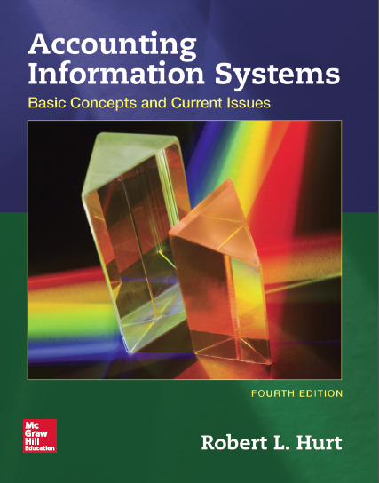
Chapter 3
Internal Controls

Slide 2
Outline
Learning objectives
Internal control definition
Internal control purposes
Risk exposures
Risk / control matrix
COSO framework

Slide 3
Learning objectives
Define internal control and explain its importance in the accounting information system.
Explain the basic purposes of internal control and its relationship to risk.
Describe and give examples of various kinds of risk exposures.

Slide 4
Learning objectives
Prepare a simple risk/control matrix.
Summarize and explain the importance of COSO’s 2013 “Internal Control—Integrated Framework.”
Critique existing internal control systems and design effective internal controls.

Slide 5
Internal control definition
A process, effected by an entity’s board of directors, management and other personnel, designed to provide reasonable assurance regarding the achievement of objectives relating to operations, reporting and compliance.
From COSO’s 2013 Internal Control Integrated Framework

Slide 6
Internal control definition
Key elements of the definition
Process. Internal control is not a list of rules or “boxes to check off.”
Effected by [various groups]. Internal control is the responsibility of the whole organization—not just the accounting function.

Slide 7
Internal control definition
Key elements of the definition
Reasonable assurance. No internal control ever provides absolute assurance. The benefits of a control must outweigh its costs.
Objectives relating to:
Operations: business processes, such as the sales / collection process.
Reporting: financial, tax, internal.
Compliance: applicable laws & regulations, such as SOX and the Foreign Corrupt Practices Act.

Slide 8
Internal control purposes
Safeguard assets, such as by depositing cash daily in the bank.
Ensure reliable financial reporting, such as through financial statement audits.

Slide 9
Internal control purposes
Promote operating efficiency, such as with a procedures manual.
Encourage compliance with management directives, such as by appropriate training & performance reviews.

Slide 10
Risk exposures
To develop strong internal controls that achieve the four purposes, many organizations think in terms of risk.
By identifying their risk exposures, they can develop and implement internal controls to address them.
“Address” can refer to preventive, detective or corrective controls.
Identify risk exposures.
Develop internal controls.

Slide 11
Risk exposures
Brown’s taxonomy provides one good organizing structure for talking about risk.
Four major categories
Financial
Operational
Strategic
Hazard

Slide 12
Risk exposures
Financial risk
Market risk
Credit risk
Liquidity risk
Operational risk
Systems risk
Human error risk
Strategic risk
Legal & regulatory risk
Business strategy risk
Hazard risk
Directors’ & officers’ liability risk

Slide 13
Risk / control matrix
Table 3.2

Slide 14
COSO framework
Committee of Sponsoring Organizations of the Treadway Commission on Fraudulent Financial Reporting
www.coso.org
Original internal control framework: 1995
Updated framework: 2013

Slide 15
COSO framework
Five components, all necessary for strong internal control
Control environment
Risk assessment
Control activities
Information and communication
Monitoring

Slide 16
COSO framework
Control environment
Organization’s overall attitude about internal control
Must be established at the top of the organization (CEO, CFO)
Often called the “tone at the top” or “tone from the top”

Slide 17
COSO framework
Risk assessment
Organization’s risk exposures
Tools like the Brown framework can help ensure “all the bases are covered”
Control activities
Specific internal controls to address risks
Preventive / detective / corrective
A control may address multiple risks; a single risk may involve multiple controls.
Identify risk exposures.
Develop internal controls.

Slide 18
COSO framework
Information and communication
How the entire internal control plan is disseminated throughout the organization
This framework element relates to the plan in its totality.
Monitoring
Ensuring the plan’s ongoing effectiveness
May be entrusted to the internal audit department

Slide 19
COSO framework example
1
4
Information & communication: Required annual training on internal control for all employees.
Control environment: Open door policy from CEO / CFO regarding internal control
3
Control activities: Strong network security. Data encryption. Firewalls. Continuous monitoring.
2
5
Risk assessment: Wireless network may be compromised.
Monitoring: A cross-functional committee reviews and updates the plan annually based on employee and other input.

Slide 20
COSO framework
In the 2013 update, COSO added 17 principles to provide more detail about the five components.
Control environment. “The board of directors demonstrates independence from management and exercises oversight of the development and performance of internal control.”

