Slide 1
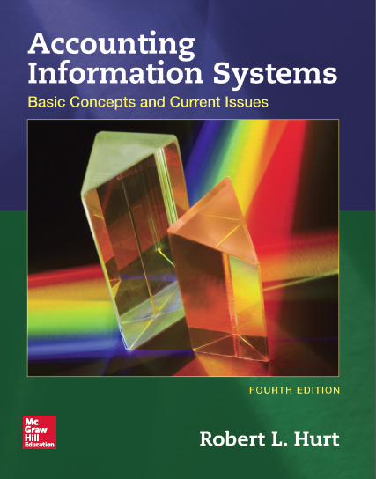
Chapter 4
Management Concepts

Slide 2
Outline
Learning objectives
COSO enterprise risk management framework
Business process management
Expectancy theory

Slide 3
Learning objectives
Summarize and explain the importance of COSO’s Enterprise Risk Management—Integrated Framework.
Define business process management, including a generalized model of BPM.
List and discuss some basic principles of business process management.
Explain expectancy theory.
Apply all three topics within the context of accounting information systems.

Slide 4
COSO ERM framework
Definition of enterprise risk management
Enterprise risk management is a process, effected by an entity’s board of directors, management and other personnel, applied in strategy setting and across the enterprise, designed to identify potential events that may affect the entity, and manage risk to be within its risk appetite, to provide reasonable assurance regarding the achievement of entity objectives.
What similarities & differences do you see between the ERM and internal control definitions?

Slide 5
COSO ERM framework
Internal environment
Objective setting
Event identification
Risk assessment
Risk response
Control activities
Information and communication
Monitoring
What similarities & differences do you see between the ERM and internal control frameworks?

Slide 6
COSO ERM framework
Internal environment
Organization’s overall attitude toward managing risk
Objective setting
What the organization is trying to achieve (in general, not just with respect to risk management)
Event identification
What could happen to interfere with achieving those objectives?

Slide 7
COSO ERM framework
Risk assessment
How likely is each event to occur?
Inherent and residual risk
Assessed qualitatively
Risk response
Generic response(s) to each risk
Four alternatives
Accept
Reduce
Avoid
Share
A single risk may have multiple generic risk responses.

Slide 8
COSO ERM framework
Control activities
Specific ideas for implementing the generic response(s)
Information & communication
Similar to the same element of the internal control framework
Monitoring
Similar to the same element of the internal control framework

Slide 9
COSO ERM framework
Internal environment
The Board of Directors forms a “risk assessment” committee, which includes both directors and employees.
Objective setting
The Red Cross wants to increase monetary donations by 10% in the coming year.

Slide 10
COSO ERM framework
Event identification
The Red Cross does not adequately identify potential new donors.
Risk assessment
Inherent: high
Residual: moderate
Risk response
Accept
Reduce

Slide 11
COSO ERM framework
Control activities
Accept: Acknowledge and discuss the risk.
Reduce: Ask each current donor to provide contact information for a potential new donor.
Information & communication
A company’s SEC filings and other external communications outline the ERM plan.

Slide 12
COSO ERM framework
Monitoring
On a quarterly basis, a sample of employees completes a survey about the effectiveness of the ERM plan; the survey results are analyzed by the risk assessment committee.

Slide 13
Business process management
One definition
A systematic approach to analyzing, redesigning, improving and managing a specific process
Processes can include:
Sales / collection
Acquisition / payment
Conversion
Financing
Human resources

Slide 14
Business process management
Generalized model of BPM
Select the process and define its boundaries.
Observe, document, and map the process steps and flow.
Collect process-related data.
Analyze the collected data.
Identify and prioritize potential process improvements.
Optimize the process.
Implement and monitor process improvements.

Slide 15
Business process management
Capital One wants to improve its process for requesting insurance verification from mortgage holders.
Capital One creates an ordered list of the steps it currently uses to request insurance verification from mortgage holders.

Slide 16
Business process management
Capital One tracks the length of time and cost involved in its current process. It also collects data on employee & customer satisfaction with it.

Slide 17
Business process management
A process improvement team analyzes the data using appropriate tools (e.g., statistical analysis, benchmarking with similar firms).

Slide 18
Business process management
The process improvement team suggests three ways to improve the process. They prioritize them for implementation.
The highest priority change is implemented.
The process improvement team collects additional data and analyzes it to determine the success of the implemented change.

Slide 19
Expectancy theory
Suggested by Victor Vroom
A way to conceptualize human motivation
So long as organizations employ people, understanding human motivation will be critical.

Slide 20
Expectancy theory
Expectancy
If I put in the effort, will I be successful in achieving my goal?
Instrumentality
If I’m successful, will I be rewarded?
Valence
Do I value the reward?
Three elements
Motivation is the product of the three.
If any one of the three is “zero,” then motivation is zero.
Motivation =
Expectancy X Instrumentality X Valence

Slide 21
Expectancy theory
Expectancy
If I work a lot of extra hours, will I complete all my assigned tasks?
Instrumentality
If I complete all my assigned tasks, will I get a pay raise?
Valence
Do I value getting a pay raise?
Here’s an example of each element.

