Slide 1
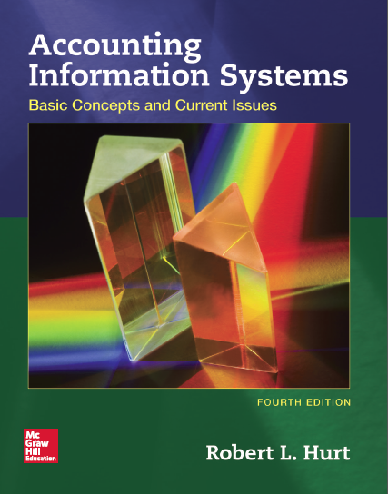
Chapter 5
Information Systems Concepts

Slide 2
Outline
Learning objectives
Systems development life cycle
Capability maturity model
IT decision factors

Slide 3
Learning objectives
List and discuss, in order, the steps in the systems development life cycle.
Explain the advantages and disadvantages of using the SDLC.
Apply the SDLC in accounting contexts.
List and discuss the levels of the capability maturity model.
Classify organizations’ processes according to the CMM.
Explain factors managers should consider when choosing IT for an AIS.

Slide 4
Systems development life cycle
A structured methodology for developing information systems
Advantages
Structure
User input
Widely known
Disadvantages
Rigid
Time consuming
Costly
Does not fit every situation

Slide 5
Systems development life cycle
Initiation / planning
Requirements analysis
Design
Build
Test
Implementation
Operations & maintenance

Slide 6
Systems development life cycle
Initiation / planning. JKR Corporation has a lot of data in its AIS; it wants to use a data analytics tool to make sense of it.
Requirements analysis. The tool must be comprehensive and widely used in similar organizations.
Here’s an example of how to apply the SDLC in accounting information systems.

Slide 7
Systems development life cycle
Design. JKR wants to use decision trees, neural networks and various statistical tests to analyze its data.
Build. Rather than creating a tool from scratch, JKR evaluates several data analytics packages from various vendors: Excel, SAS Enterprise Miner and SAP HANA.
Here’s an example of how to apply the SDLC in accounting information systems.

Slide 8
Systems development life cycle
Test. After examining each package, JKR chose SAS Enterprise Miner. The software is installed on a few computers; users provide feedback on training and customization issues.
Here’s an example of how to apply the SDLC in accounting information systems.

Slide 9
Systems development life cycle
Implementation. JKR installs SAS Enterprise Miner throughout the organization, and provides training to staff who will use it.
Operations & maintenance. JKR’s IT department supports users via its help desk and other means.
Here’s an example of how to apply the SDLC in accounting information systems.

Slide 10
Capability maturity model
Developed by Watts Humphreys
Five levels
Initially used to evaluate the sophistication of business processes in government contractors
Can be used in other contexts
Business processes
Sales / collection
Acquisition / payment
Conversion
Human resources
Financing

Slide 11
Capability maturity model
Level One: chaotic
Business processes are not standardized. Individuals develop their own processes, but they do not share them with others.
Level Two: repeatable
Business processes involve major milestones and specific deliverables. They may yield consistent results over time.

Slide 12
Capability maturity model
Level Three: defined
Business processes are developed based on broader organizational standards. They are described in more detail.
Level Four: managed
Processes are measured; that is, the organization uses metrics to evaluate their performance.

Slide 13
Capability maturity model
Level Five: optimized
The organization uses a “total quality” philosophy for its business processes and other important elements.
Optimized
Managed
Defined
Repeatable
Chaotic

Slide 14
IT decision factors
Things to consider when developing / purchasing a new form of information technology
Macro-level
Need
Strategic fit
Personnel involvement
Financing
Micro-level
Cost
Adaptability
Training
Vendor reliability

