Slide 1
Chapter 6
Flowcharting

Slide 2
Outline
Learning objectives
Flowchart types and uses in AIS
Symbols
Design considerations
Design steps
Examples

Slide 3
Learning objectives
List and discuss the purpose and use of systems flowcharts, document flowcharts, program flowcharts, and hardware flowcharts.
Explain the basic parts of and design considerations common to all types of flowcharts.
Identify and describe common symbols and information technology tools used in flowcharting.
Discuss ways flowcharts impact the design, implementation, and evaluation of accounting information systems.
Create and interpret systems flowcharts.

Slide 4
Flowchart types & uses in AIS
Systems flowcharts
Provide a “big picture” overview of a system
Often used in AIS to understand business processes
As part of an audit
As a training tool
Document flowcharts
Track the flow of documents through an information system
Sometimes used in AIS to check & improve document processing
Documents include
Invoices
Checks
Remittance advices

Slide 5
Flowchart types & uses in AIS
Hardware flowcharts
Show the relationships between hardware elements of an information system
Occasionally used in AIS to understand network components
As a form of internal control
As a basis for changing network configuration
Program flowcharts
Show the logic associated with a computer program
Almost never used in AIS

Slide 6
Symbols
Four groups
Data
Symbols for databases and documents
Process
Symbols for actions
Line
Symbol for following the flow
Special
Various symbols, such as terminators and page connectors

Slide 7
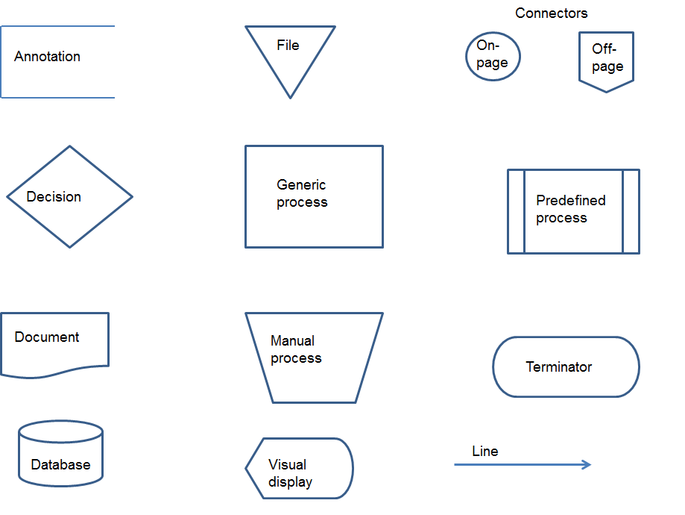
Symbols
Figure 6.1

Slide 8
Symbols
Here are some examples of how some of the preceding flowcharting symbols might be labeled.
Error routine not shown
By date
Grant credit?
Yes
No

Slide 9
Symbols
Prepare purchase order
Process payroll
Receive inventory

Slide 10
Symbols
Purchase requisition
Start
Employee database

Slide 11
Design considerations
Flowcharting is at least as much “art” as “science.”
Independently drawn flowcharts of the same process will almost never be identical.
The goal is to produce a flowchart that is concise and understandable—not to reproduce someone else’s work.

Slide 12
Design considerations
Title
One start, one end
Columns based on areas of responsibility
Plenty of white space
Top to bottom, left to right (in general)
Clear origin and termination for all documents

Slide 13
Design steps
Establish the system boundary.
Determine column headings.
List actions performed within each column.
Select appropriate symbols.
Prepare a first draft.
Discuss the draft with others.
Revise as needed.

Slide 14
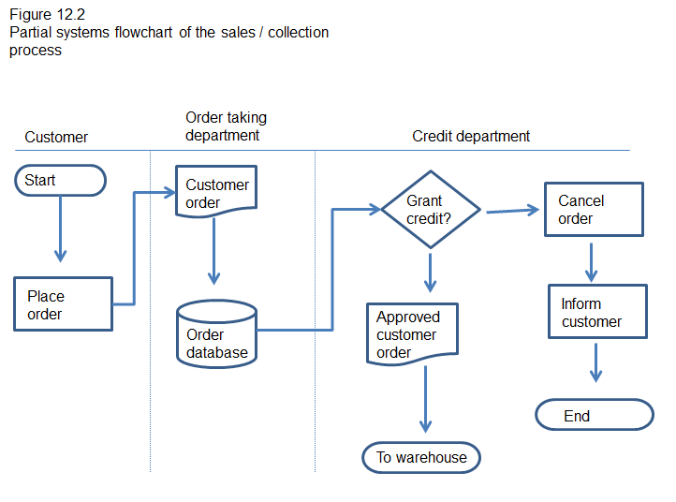
Examples

Slide 15
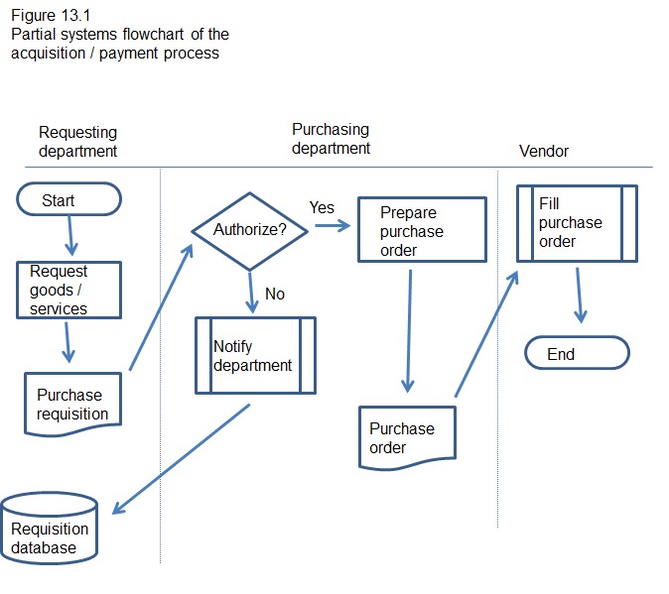
Examples

