Slide 1
Chapter 7
Data Flow Diagramming

Slide 2
Outline
Learning objectives
Nature and purpose of DFDs
DFD symbols
Leveling and balancing
Database design
Normal forms

Slide 3
Learning objectives
Explain the symbols and design considerations associated with DFDs.
Compare and contrast flowcharts and DFDs with regard to purpose, content, structure, and use in accounting information systems.
Discuss ways DFDs are used in AIS work.
Construct a leveled set of DFDs.
Design normalized database tables from a DFD.

Slide 4
Nature and purpose of DFDs
Not as widely used as flowcharts in accounting practice
Two main purposes
Understanding a business process
Understanding the relational database that underlies the AIS
Focus on data

Slide 5
DFD symbols
external entity
process
data store
data flow

Slide 6
DFD symbols
1.0
Take customer order
customer
order database
customer order

Slide 7
Leveling and balancing
Data flow diagrams are prepared in leveled sets.
Each level reveals more detail than the one before it.
Levels must be balanced, which means that external entities and data flows at the boundary cannot “disappear” between levels.

Slide 8
Leveling and balancing
Level names
Context diagram
Level Zero diagram
Level One diagrams
Level Two diagrams
And so on. . .

Slide 9
Leveling and balancing
Customer
Context diagram
Highest level view of the system
Exactly one in a leveled set
Exactly one process
One or more external entities
No data stores
Invoice
Customer
order
0
Order taking process

Slide 10
Leveling and balancing
Customer
Level Zero diagram
Exactly one in a leveled set
More detail than the context diagram
Preserve data flows at the boundary
Invoice
Customer
order
2.0
Bill customer.
1.0
Process customer order.
Processed customer
order

Slide 11
Leveling and balancing
Level One diagram
May be more than one in a leveled set
More detail than the Level Zero diagram
Each Level One focused on a single “bubble” from Level Zero
Preserve data flows at the boundary
See the example on the next slide, which “explodes” Process 1.0 (Process customer order) from the Level Zero diagram.

Slide 12
Leveling and balancing
Customer
Processed customer order
Customer
order
1.2
Evaluate customer credit.
Credit
decision
1.1
Verify customer order.
Credit
inquiry
Verified customer
order
Customer database

Slide 13
Leveling and balancing
Processes are decomposed (“exploded”) until they are primitive.
Processes may be decomposed to different levels.
Numbering conventions
Level One diagram of Process 2.0: 2.1, 2.2
Level Two diagram of Process 1.2: 1.2.1, 1.2.2

Slide 14
Database design
Objects
Terminology
Normal forms

Slide 15
Database design
Objects: tables
Every relational database must include at least one table.
Most will include multiple tables
Organization
Fields (columns)
Records (rows)
See the example on the next slide.

Slide 16
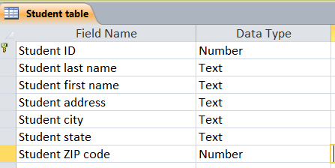
Database design
Student table in design view
Student table in datasheet view

Slide 17
Database design
Objects: queries
Sets of instructions that examine current data in tables and / or other queries
Output data according to the instructions
Can include simple computations (e.g., total, average)
See the example on the next slide

Slide 18
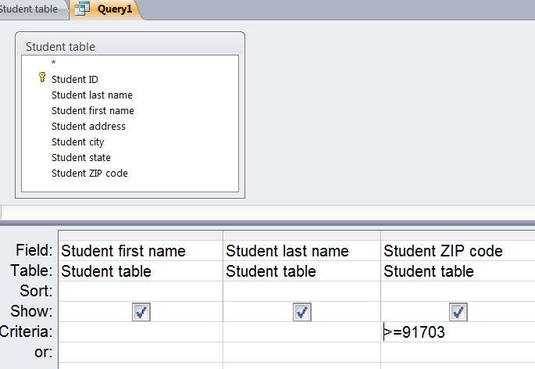
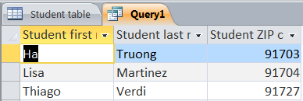
Database design
Query in design view
Query in datasheet view

Slide 19
Database design
Objects: forms
Allow a user to interact with a database even if they know nothing about design and structure
Two uses: data input, data lookup
See the example on the next slide

Slide 20
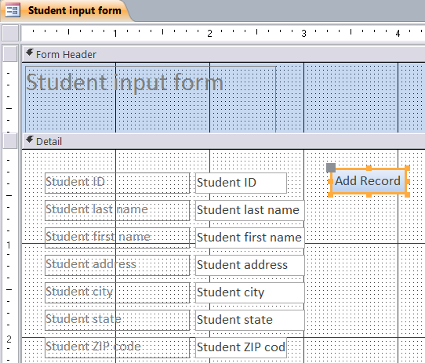
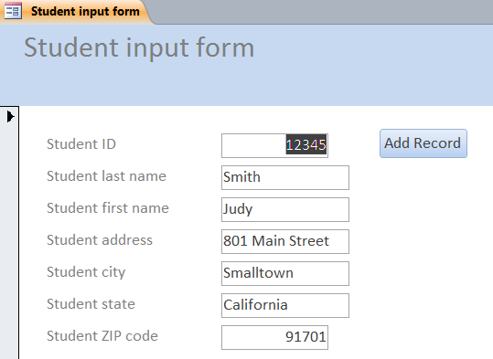
Database design
Form in design view
Form in form view

Slide 21
Database design
Objects: reports
Well formatted output of a relational database
Can be based on tables and / or queries
Can incorporate simple calculations
See the example on the next slide

Slide 22
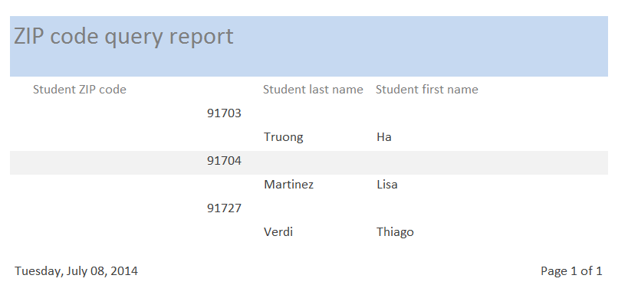
Database design
Report in report view
(Design view not shown)

Slide 23
Database design
Terminology
Primary key: a field in a table that uniquely identifies every record in that table
Foreign key: a primary key in one table that is included in another table for linking purposes
Compound primary key: two or more fields in a table that together comprise its primary key

Slide 24
Database design
Terminology
Junction table
A table that joins together two separate tables.
Required when the two separate tables have a “many-to-many” relationship
Every student may enroll in many classes.
Every class has many students.
Named by joining the separate table names
Student table
Class table
Student / class table
See the illustration on the next slide
This is the junction table.

Slide 25
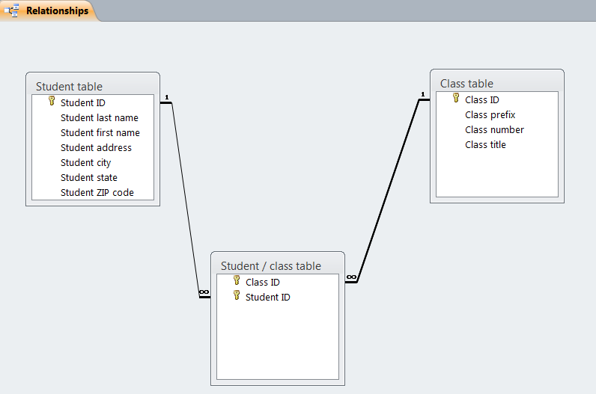
Database design
Relationship grid

Slide 26
Database design
Normal forms
Table characteristics that ensure a relational database is organized as efficiently and effectively as possible
Minimize space allocations
Facilitate searches
Establish relationships between tables

Slide 27
Database design
First normal form (1NF)
Eliminates repeating groups
Second normal form (2NF)
Eliminates repeating groups
Eliminates redundant data
Third normal form (3NF)
Eliminates repeating groups
Eliminates redundant data
Eliminates columns not dependent on the primary key

Slide 28
Database design
The next few slides show you how to start with a “flat file” (such as a spreadsheet) and create normalized database tables.
With practice, you’ll be able to design normalized tables “from scratch.”
The following example is drawn from the 23 January 2014 post on Dr. Hurt’s AIS blog.

Slide 29
Normal forms
This data array is a “flat file” comprising two fields and five records. It is not normalized, as the “courses” field includes repeating groups of data (i.e., two courses in one field).

Slide 30
Normal forms
To put the array in 1NF, we need to eliminate repeating groups.
This array, while not fully normalized, is closer to that state. Note that we could search for specific course prefixes and / or numbers more easily than in the flat file.

Slide 31
Normal forms
To put the data in 2NF, we need to eliminate redundant data.
Neither table has repeating groups or redundant data; however, we’re missing key information: which students are in which courses?

Slide 32
Normal forms
Junction table
Completes 2NF by marrying data from two other tables
Requires a compound primary key
Many-to-many relationship
Each student can take many courses.
Each course can have many students.

Slide 33
Normal forms
To put the data in 3NF, we must ensure that each table contains only fields that give us more information about the primary key.
Student table: last name, first name, area code, phone number
Course table: course title, instructor, building, classroom, section number
Student / course table: probably does not need any information beyond the primary keys of the two other tables

