Slide 1
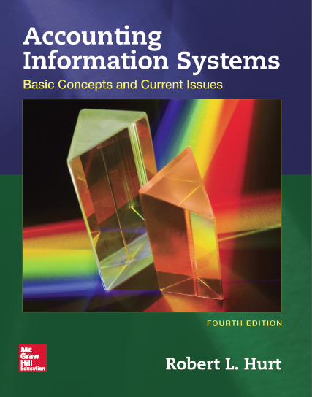
Chapter 11
Computer Crime and Information Technology Security

Slide 2
Outline
Learning objectives
Carter’s taxonomy
Risks and threats
IT controls
COBIT

Slide 3
Learning objectives
Explain Carter’s taxonomy of computer crime.
Identify and describe business risks and threats to information systems.
Discuss ways to prevent and detect computer crime.
Explain the main components of the CoBIT framework and their implications for IT security.

Slide 4
Carter’s taxonomy
Target
Targets system or its data
Example: DOS attack
Instrumentality
Uses computer to further criminal end
Example: Phishing
Four-part system for classifying computer crime
A specific crime may fit more than one classification
The taxonomy provides a useful framework for discussing computer crime in all types of organizations.

Slide 5
Carter’s taxonomy
Four-part system for classifying computer crime
A specific crime may fit more than one classification
The taxonomy provides a useful framework for discussing computer crime in all types of organizations.
Incidental
Computer not required, but related to crime
Example: Extortion
Associated
New versions of old crimes
Example: Cash larceny

Slide 6
Risks and threats
Fraud
Service interruption and delays
Disclosure of confidential information
Intrusions
Malicious software
Denial-of-service attacks
Please consult the chapter for the full list.

Slide 7
IT controls
Confidentiality
C-I-A triad
Data integrity
Availability

Slide 8
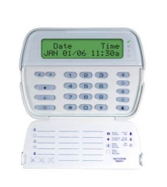
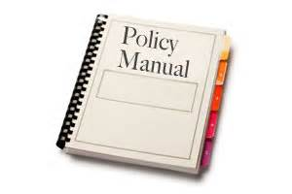
IT controls
Physical controls
Guards, locks, fire suppression systems
Technical controls
Biometric access controls, malware protection
Administrative controls
Password rotation policy, password rules, overall IT security strategy

Slide 9
COBIT
Two main parts
Principles
Five ideas that form the foundation of strong IT governance and management
Enablers
Seven tools that match the capabilities of IT tools with users’ needs
Control Objectives for Information and Related Technology
Information Systems Audit and Control Association (ISACA)
Framework for IT governance and management

Slide 10
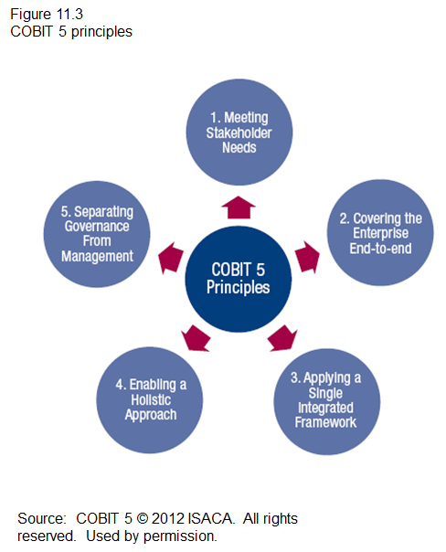
COBIT

Slide 11
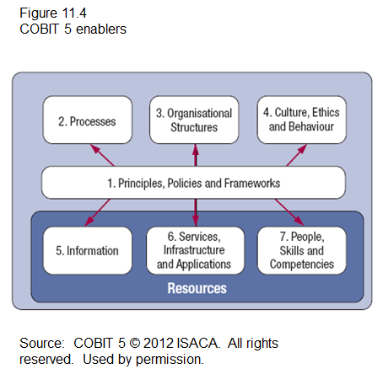
COBIT

