Slide 1
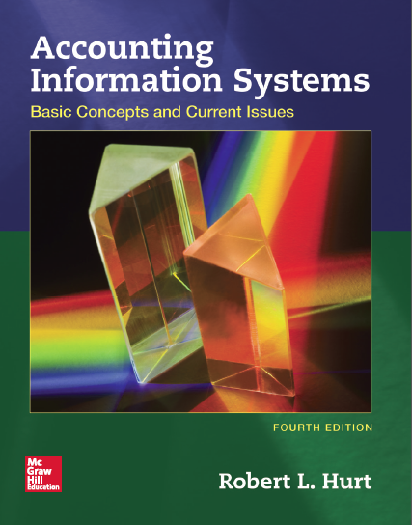
Chapter 12
Sales/Collection Process

Slide 2
Outline
Learning objectives
Value chain
Process steps
AIS elements

Slide 3
Learning objectives
Explain its role and purpose.
List and discuss, in order, the steps in the process.
Explain how the generic structure of most AIS applies to the process.
Process common transactions.
Design & critique internal controls based on common risk exposures.
Develop & interpret process-related systems documentation.
Relate Porter’s value chain to the process.
With respect to the sales / collection process, you should be able to:

Slide 4
Value chain
Organizations exist to create value for their stakeholders.
Porter’s value chain is a classic, well recognized model for describing generic value creating activities.
It comprises two main parts:
Primary activities
Support activities

Slide 5
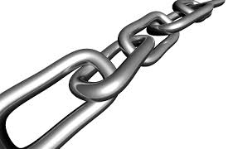
Value chain
Primary activities create value directly.
Inbound logistics
Operations
Outbound logistics
Marketing and sales
Service

Slide 6
Value chain
Support activities create value indirectly.
Procurement
Information technology
Human resource management
Infrastructure

Slide 7
Process steps
Overall, the sales / collection process comprises everything from taking a customer’s order through collecting payment from the customer.
Details may vary across organizations, but the sales / collection process generally comprises seven generic steps.

Slide 8
Process steps
Take the customer’s order.
Approve the customer’s credit.
Fill the order based on approved credit.
Ship the product.
Bill the customer.
Collect payment.
Process uncollectible receivables as needed.

Slide 9
AIS elements
Inputs
Processes
Outputs
Storage
Internal controls
Recall from your study in Chapter 1 that most accounting information systems comprise five generic elements. The next series of slides will show how those elements are applied in the context of the sales / collection process.

Slide 10
AIS elements
Customer order
Picking list
Packing list
Bill of lading
Customer invoice
Customer check
Remittance advice
Deposit slip
Input and output documents associated with the sales / collection process include those listed on the right.

Slide 11
AIS elements
Processes
Seven generic steps
Accounting cycle steps, including the following journal entries:
Sale on credit / for cash
Payment of outgoing freight charges
Cash collections
Bad debt write-offs as needed

Slide 12
AIS elements
Master files
Customer
Inventory
Employee
Cash
Transaction files
Sales
Cash receipts
Junction files
Sales / inventory
Sales / cash receipts
Storage
Three broad file types
Master files
Transaction files
Junction files
Examples for the sales / collection process are listed on the right.

Slide 13
AIS elements
Internal controls
Segregation of duties
Adequate documentation
Insurance
Proper inventory storage
Employee training
Daily cash deposits
Serially-numbered documents
Document matching
Information technology
And a host of others!

