Slide 1
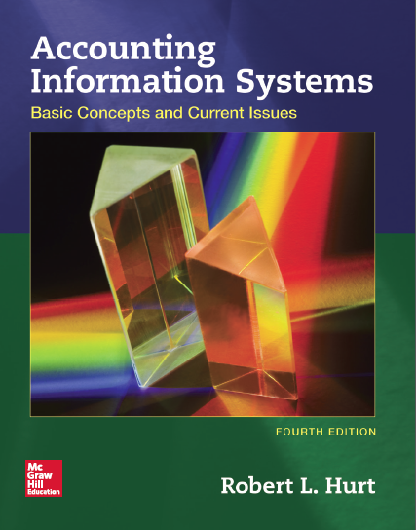
Chapter 13
Acquisition/Payment Process

Slide 2
Outline
Learning objectives
Value chain
Process steps
AIS elements

Slide 3
Learning objectives
Explain its role and purpose.
List and discuss, in order, the steps in the process.
Explain how the generic structure of most AIS applies to the process.
Process common transactions.
Design & critique internal controls based on common risk exposures.
Develop & interpret process-related systems documentation.
Relate Porter’s value chain to the process.
With respect to the acquisition / payment process, you should be able to:

Slide 4
Value chain
The acquisition / payment process is most closely related to the following elements of the value chain:
Primary: inbound logistics
Support: procurement
Although this process can be applied to virtually anything the organization needs to buy, it is most commonly described in terms of inventory.

Slide 5
Process steps
Request goods & services based on monitored need.
Authorize a purchase.
Purchase goods / services.
Receive goods / services.
Disburse cash.
When necessary, process purchase returns.

Slide 6
AIS elements
Recall from your study in Chapter 1 that most accounting information systems comprise five generic elements. The next series of slides will show how those elements are applied in the context of the acquisition / payment process.
Inputs
Processes
Outputs
Storage
Internal controls

Slide 7
AIS elements
Purchase requisition
Purchase order
Receiving report
Vendor invoice
Check
Input and output documents associated with the acquisition / payment process include those listed on the right.
Consider how those documents interact with the sales / collection process documents. For example, the “purchase order” is one form of a “customer order.”

Slide 8
AIS elements
Processes
Six generic steps
Accounting cycle steps, including the following journal entries:
Purchases on credit / for cash
Payment of inbound freight charges
Cash payments
Purchase returns as needed

Slide 9
AIS elements
Master files
Vendor
Inventory
Employee
Cash
Transaction files
Purchases
Cash payments
Junction files
Purchases / inventory
Purchases / cash payments
Storage
Three broad file types
Master files
Transaction files
Junction files
Examples for the acquisition / payment process are listed on the right.

Slide 10
AIS elements
Internal controls
Inventory monitoring
Purchase approvals
Conflict of interest policy
Supplier qualifications
Strategic alliances
Additionally, many internal controls from the sales / collection process can be applied to the acquisition / payment process.

