Slide 1
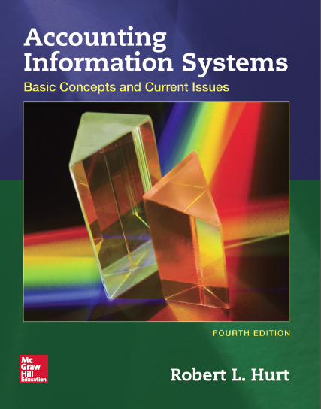
Chapter 14
Other Business Processes

Slide 2
Outline
Learning objectives
Processes overview
AIS elements

Slide 3
Learning objectives
Explain its role and purpose.
Explain how the generic structure of most AIS applies.
Identify and process common transactions.
Design and critique internal controls based on common risk exposures.
Develop and interpret process-related systems documentation.
Appropriately use terminology common to each process.
Explain how each process is related to Porter's value chain.
For each process discussed in this chapter:

Slide 4
Processes overview
This chapter considers three business processes:
Conversion
Financing
Human resources
While at least as important as the sales / collection & acquisition / payment processes, they do not generalize as well.

Slide 5
Processes overview
Conversion process
Purpose: convert direct material, direct labor and manufacturing overhead into finished products
Connected to cost accounting
Value chain element: operations
Types
Job order
Process
Hybrid

Slide 6
Processes overview
Financing process
Purpose: acquire & pay for additional funding through debt and equity securities
Connected to intermediate accounting & finance
Value chain: infrastructure

Slide 7
Processes overview
Human resources process
Purpose: manage human assets from hiring through departure
Connected to intermediate accounting and management
Value chain: human resource management

Slide 8
AIS elements
The following slides will explore the five generic AIS elements within the context of each business process:
Conversion
Financing
Human resources
Inputs
Processes
Outputs
Storage
Internal controls

Slide 9
AIS elements
Conversion process
Input & output documents
Materials requisition
Job cost sheet
Production cost report

Slide 10
AIS elements
Conversion process
Processes
Manufacturing steps depend on the specific product
Common transactions
Raw material purchased
Raw material used
Overhead allocated
Cost flows through the AIS

Slide 11
AIS elements
Conversion process
Storage
Master files
Raw materials
Employee
Transaction files
Purchase raw materials
Issue raw materials to production
Junction file
Issue raw materials / raw materials

Slide 12
AIS elements
Conversion process
Internal controls
Equipment maintenance schedule
Adequate training and supervision
Video surveillance
Quality testing
And a host of others!

Slide 13
AIS elements
Financing process
Input & output documents
Bonds
Shares of stock
Dividend checks

Slide 14
AIS elements
Financing process
Processes & common transactions
Initial public offering
Bond issuance
Dividend payments
Stock splits
Principal & interest payments on bonds
Purchase of treasury shares

Slide 15
AIS elements
Financing process
Storage
Master files
Stockholders
Bondholders
Cash
Transaction files
Issue capital stock
Pay bond interest
Junction file
Bonds payable / pay bond interest

Slide 16
AIS elements
Financing process
Internal controls
Budgets
Appropriate approvals, such as for dividend payments
Information technology
Separation of duties
And many others!

Slide 17
AIS elements
Human resources process
Input & output documents
Forms W-2 and W-4
Form 1099
Payroll register
Forms 940 and 941

Slide 18
AIS elements
Human resources process
Processes & common transactions
Hiring new employees
Evaluating employee performance
Terminating employees
Paying employee pensions
Depositing withholdings

Slide 19
AIS elements
Human resources process
Storage
Master files
Employees
Independent contractors
Cash
Transaction files
Pay employees
Conduct performance reviews
Junction file
Employee / assign employee to project

Slide 20
AIS elements
Human resources process
Internal controls
Written performance reviews
Code of ethics / code of conduct
Separate payroll bank account
Separation of duties
Adequate supervision
And many others!

