Slide 1
Chapter 6
Heat Transfer in Cooking

Slide 2
What is Heat?
Is a form of energy
Results from the rapid movement or vibration of molecules within a substance.
As the molecules move, they collide with each other, rapid ones transfer some of their energy to the slower ones.
This movement is called Kinetic energy.
The average intensity of heat (amount of heat that results) from molecular movement is recorded as temperature by the thermometer.
Cooking results when heat is transferred to food, or produced within it; this heat is distributed throughout the food.

Slide 3
Cooking
Cooking is the act of applying heat to foods.
When foods are cooked, changes occur during the process in:
Flavor
Texture
Aroma
Color, and
Nutritional value

Slide 4
Why Cook Food?
1: To ensure that food is safe and edible (fit to be eaten).
Cooking destroys most pathogenic microorganisms that might be found in raw food,
For example:
Pasteurization of milk: heating the milk to a specific well controlled time and temperature, then cooling it quickly.

Slide 5
Why Cook Food? Cont’d
2: To improve the digestibility of food components
For example:
Grains and legumes are more readily attacked by our digestive enzyme
3: Starch gelatinization : Gelatinization is also known as thickening of a
liquid .
How?
When heated the grains/starch granules absorb the liquid, swell and then burst, releasing starch into the liquid. The granules/grains swell up to 5 times their original size.
Pre-gelatinized starch is starch cooked and then dried in the starch factory on a drum dryer or in an extruder making the starch cold water soluble

Slide 6
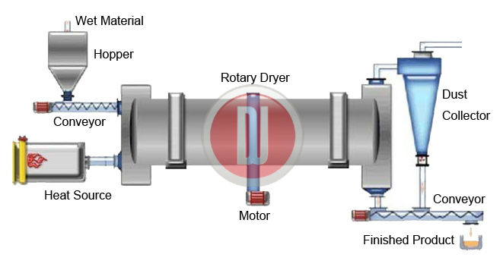
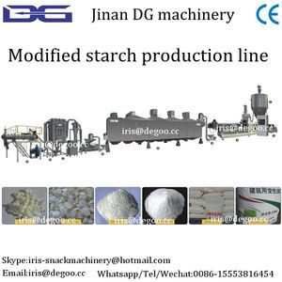
Drum Dryer
Pre-gelatinized Starch Extruder

Slide 7
Why Cook Food? Cont’d
4: To destroy some anti-digestive factors found in dry beans
For example:
Protease inhibitors: Widely distributed among plants, especially in seeds, grains and legumes. They interfere with protein digestion by inhibiting protein digestive enzymes (proteases).
Therefore cooking makes food more available to nourish the body
Thus increasing ↑ the nutritive value of the food.
But cooking brings about some nutrient losses such as water soluble vitamins
So avoid overcooking.

Slide 8
Why Cook Food? Cont’d
5: To improve the flavor, texture, color; makes food more
appealing.
Flavor: New flavors are obtained by heating or cooking; e.g. grilled meat, baked bread etc.
Texture: e.g. eggs become firmer, connective tissue in meat become more tender when cooked, fried food becomes crisp
Color: e.g. cooked meat versus raw, dough versus bread, green vegetables change color.
But overcooking brings about negative results, e.g. green vegetables become dull (bright green is more appealing)

Slide 9
Why Cook Food? Cont’d.
6: To increase the shelf life of food; e.g.
cooked versus raw, canned versus raw.
7: To add variety: people get board of eating
the same food all the time.

Slide 10
Physical Forms of Substances
A substance may exist in 3 physical forms: Solid, liquid, and gas;
e.g. Water
Solid phase: water as ice: as ice water molecules have a fixed arrangement, they don’t move.
Liquid phase: when heat is applied to ice, water molecules vibrate and push against each other (they collide); in this phase the molecules are free to move to a certain extent, they take the shape of the container.
Gaseous phase: molecules are widely separated and free to move in space.
Water (H2O) needs to absorb energy to break the H-H bonds and then turn into the gaseous state.

Slide 11
When does Water Boil? And how?
When water is heated
Molecules (heated, have more energy in them) start to change into gas (vapor)
This gas creates vapor pressure at the surface of the water
When this vapor pressure becomes more than the
> atmospheric pressure, then water boils.
Steam: is the water vapor coming from boiling water; is hot water vapor.

Slide 12
Water Boiling Point at High Altitudes
At high altitudes water boils at a lower temperature because atmospheric pressure is lower than at sea level
Which means water needs less heat to:
Boil
Overcome the atmospheric pressure at high altitudes
For every 900 feet elevation (270 m) above sea level,
The boiling point goes down ↓ by 1 degree C. (which means there is less heat in it.)
So food needs to boil longer in order to absorb enough heat and cook.

Slide 13
Cooking Time at High Altitudes
Cooking time is affected by the amount of heat in the food and not by when it boils
So on mountains:
Food boils quicker but it
Takes longer to absorb enough heat in order to cook
Food takes longer to cook
e.g.
Pasta and rice take longer to cook on mountains than at sea level.

Slide 14
Cooking in Pressure Cookers
In the pressure cooker food cooks faster
Why ?
Because food absorbs much more heat before it boils and starts making pressure.

Slide 15
Latent Heat
Definition of Latent Heat:
Heat needed to change the “physical form” of a substance without changing its temperature
4 types of latent heat
Latent Heat of Fusion
Latent heat of Solidification
Latent heat of Vaporization
Latent heat of Condensation

Slide 16
Latent Heat of Fusion
For example
Amount of heat needed to change ice to water remaining at zero⁰
In this case heat is absorbed by the melting ice
1 gram ice → liquid water
80 calories are needed

Slide 17
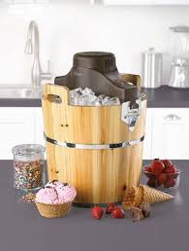
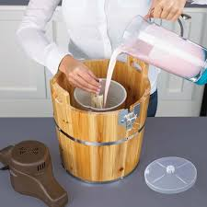
Latent Heat of Solidification
Amount of heat needed to change water to ice at 0⁰
In this case heat is released from water.
E.g.
Ice-cream making:
Ice cream mixture is surrounded by ice and salt mixture;
Ice-cream mixture melts the ice which absorbs the latent heat in the ice-cream mixture, and
Salt makes the process faster.

Slide 18
Latent Heat of Vaporization
Amount of heat needed to break the H-H bonds in H²O, and form water vapor which is a gas
In this case heat is absorbed by water molecules
1 gram water → vapor or steam
540 calories are needed

Slide 19
Latent Heat of Condensation
Hot water vapor condenses when it touches a cold surface;
Latent Heat of Condensation is the amount of heat that is released when steam condenses
E.g.
Steaming food:
Steam touches the cold surface of the food,
Steam condenses into liquid, and
Steam releases its latent heat of condensation,
This heat is absorbed by the food, thus cooks it.
Skin burns by steam: same idea, meaning the Latent Heat of Condensation of steam is absorbed by the skin, thus burns it.

Slide 20
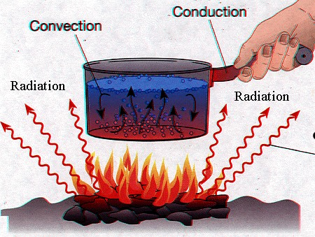
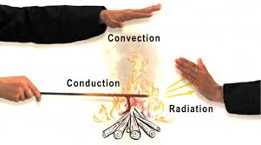
There are three ways that heat is transferred to food.

Slide 21
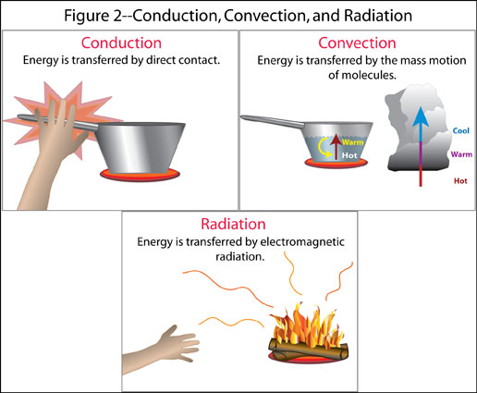

Slide 22
Conduction
Direct transfer of heat between adjacent molecules.
An example of conduction is cooking on a flattop range.
Heat is transferred from the molecules of the hot range surface to the molecules of the adjacent pan bottom, then from the pan bottom to the pan sides and to food contained within the pan.
The pan must be in direct contact with the range for conduction to occur.
Flat bottomed pans are more ↑efficient in heat conduction.

Slide 23
Conduction Materials
Some materials are better conductors of heat than others.
Good conductors are Fe, Al, and Cu
Stainless steel (an alloy of Fe and other metals like chromium and nickel) is less ↓ efficient.
Stainless steel is sometimes mixed with Al or Cu to make it more ↑efficient.
Glass and ceramic ware: are ↓ less efficient

Slide 24
Conduction Characteristics
Conduction is:
A relatively slow method of heat transfer because it relies on direct contact.
Slow direct transfer of heat between adjacent molecules allows the food to be cooked from the outside → in.
Results in a completely cooked exterior with a moist and juicy interior.

Slide 25
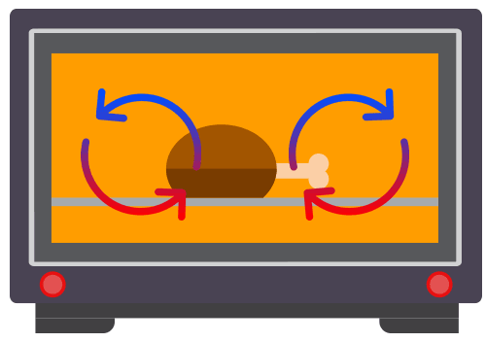
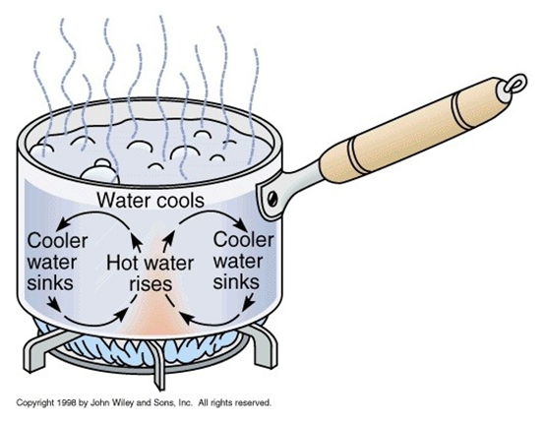
Convection
Convection is the transfer of heat through air or liquid that surrounds the food.
Hot air or liquid are lighter and rise upwards in the container
Colder air or liquid move downward
This movement creates a circular current that distributes heat around the food.

Slide 26
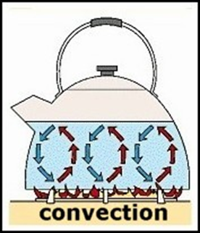
Convection Media
Water: boiling
Fat: Deep fat frying
Hot oil or water move around
Create the circular current
Distribute the heat around
This heat touches the surface of the food, and heats it up.
The rest of heat transfer occurs by conduction (heat moves from hot particles to colder ones within the food and so on).

Slide 27
Convection Media Cont’d.
3. Air: Baking in the oven
Hot air
Moves upwards, cold air moves downward
Creates hot air circular current that moves around the food.
This is important in the browning process of baked goods.
The rest of heat transfer occurs by conduction (heat moves from hot particles to colder ones within the food and so on).
To make the best use of this hot air current in the oven, do not place two pans on two shelves exactly on top of each other.

Slide 28
Types of Convection
Natural
Mechanical

Slide 29
Natural Convection
Natural convection occurs when:
e.g.
A pot of water is placed on the stove to boil.
Conduction transfers heat from the stove to the pot to the water molecules in contact with the interior of the pot.
Water molecules heat up, convection causes them to move up and be replaced by cooler molecules that move down.
This continual movement results in convection currents within the water.
Example: if a potato is added to the water, the convection currents transfer heat to the surface of the potato, at which point conduction takes over to transfer heat to the interior of the potato.
In conventional ovens : air in contact with the heating element circulates, but the majority of heat transfer in a conventional oven is the result of infrared radiation.

Slide 30
Mechanical Convection
Mechanical convection occurs when
Stirring either manually or
Installing a fan in ovens
To speed up and equalize heat distribution.
Examples:
When you stir a thick sauce to heat it faster and keep it from scorching on the bottom of the pan, you are creating mechanical convection.

Slide 31
Mechanical Convection
Convection ovens use fans to rapidly circulate hot air, allowing for quicker and more even cooking than conventional ovens.
≈ 25% less time to cook
≈ 25⁰ F (≈ 14 ⁰ C) lower ↓oven temperature
Because of more even distribution of heat.

Slide 32
Radiation
Transfer of energy through waves of electromagnetic energy
Waves travel through space
Waves strike the surface of the food
Food absorbs the waves
Absorbed waves cause molecules in the food to vibrate more rapidly, increasing their temperature.
No direct contact between the energy source and food.
Examples of cooking by radiation: Broiling, Barbequing, Grilling
Pans holding the food also absorb radiant waves and transfer the energy that is absorbed by the pan to the food in it by conduction.

Slide 33
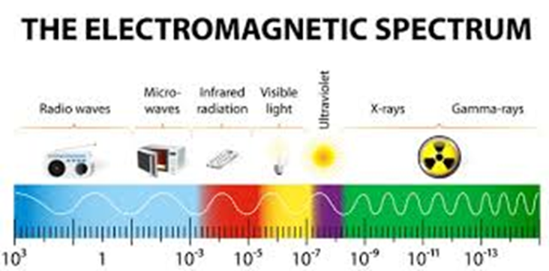
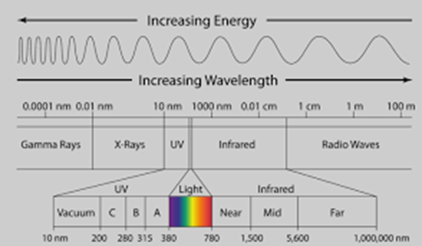
Types of Radiation
2 types of radiation are important in cooking:
Infrared
Microwave

Slide 34
Sources of Infrared Radiation
Infrared radiation is: Electromagnetic radiation emitted by hot objects such as:
Glowing coals of a charcoal grill
Glowing coils of an electric toaster, broiler, or oven
Waves of radiant energy travel in all directions from these heat sources.
Food and cookware that absorb the radiant energy (waves of electromagnetic energy) are heated.

Slide 35
Good Absorbers of Radiant Energy
Dark dull rough surfaces (pans) are better absorbers of radiant energy than bright shiny smooth surfaces which reflect the waves and absorb less energy.
Shiny (Al) bakeware is good when we need a light crust in baking things like cakes and cookies.
Glass bake ware is a good absorber of radiant waves.
So conventional oven temperatures should be lowered by ≈25°F /≈ 14°C to offset the additional energy transfer that occurs when using glass baking dishes.

Slide 36
Microwave Radiation
Microwave radiation
Produced by microwave ovens
Short high-frequency electromagnetic waves of radiant energy.
Microwaves are absorbed by food
Cause the food molecules to vibrate faster, creating heat.
Microwave radiation cooks food much faster than infrared radiation because it penetrates foods 1-2 inches deep, whereas infrared is mainly absorbed at the surface.
Depending on their composition, foods react differently to microwaves.
Foods with high: moisture, sugar, & / or fat content absorb microwaves best and heat up more readily.

Slide 37
Advantages of Microwave Cooking
Speed
Reduction of nutrient loss because of:
Minimal ↓ ↓ ↓water is used, and
Short ↓ cooking time.
Conservation of energy

Slide 38
Microwave Drawbacks
It is best suited to cooking small batches of foods.
Metal cannot be used in microwave ovens because metal reflects the microwaves, which can cause fires and damage the oven.
Human exposure to the microwaves decreases as one moves farther away from the unit:
Exposure is 100 times higher at a distance of 5 cm from the unit than it is at 50 cm.

Slide 39
Microwave Drawbacks Cont’d
Lack of browning because the air in the unit remains cool.
Some foods do not cook faster or better than conventional cooking because rehydration must take place, such as in rice & pasta cooking.
Easy to over - cook food, few seconds make a big difference in the result.
Foods dry out easily; e.g. bread becomes tougher.
Food Safety concerns: studies show that hot and cold spots can be found near each other; e.g. chicken (salmonella).

Slide 40
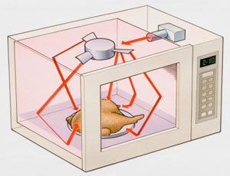
Microwave Radiation
Microwave ovens:
Some contain a turntable and
Others contain a stirrer
For more uniform distribution of the electromagnetic waves.

Slide 41
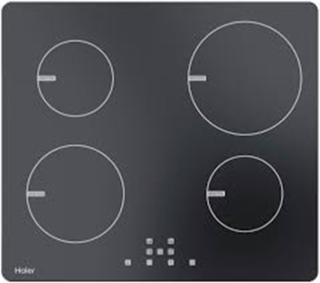
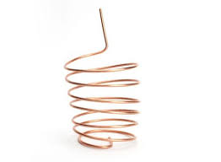
Induction Cooking
Is a relatively new cooking method.
Uses specially designed cook tops made of a smooth ceramic material over an induction coil.
An induction cooktop transfers electrical energy by induction from a coil of wire.
Induction coil creates a magnetic current that causes a metal pan on the cook top to heat up quickly.
Heat is then transferred to the food in the pan through conduction.
The cook top itself remains cold.

Slide 42
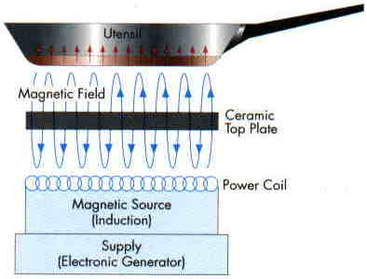
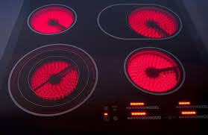
Induction & Induction Cooktops
Induction Cooktop

Slide 43
Induction Cookware
Cookware used for induction cooking must be:
Flat at the bottom for good contact with the cook top
Made of ferrous (iron containing) metals, such as cast iron, magnetic stainless steel, or enamel over steel.
Other materials will not heat up on these cook tops.

Slide 44
Advantages of Induction Cooking
Rapid heating
Easy cleanup because
Spilled food does not stick because the surface:
Remains cool
Is smooth ( no nooks)

Slide 45
Media of Heat Transfer
Air
Water
Steam
Fat

Slide 46
Air Dry Heat Cooking Method
Why dry?
Because the surface of food comes in contact with dry air where food is not covered.
Such as in:
Roasting
Baking
Broiling
Outdoor grilling

Slide 47
Water Moist Heat Cooking Method
Such as:
Simmering:
To cook at below the boiling point.
Temperature remains between 85- 96 degrees C, just below the boiling point
It is a slow cooking method
Boiling:
To cook at the boiling point, e.g. 100 degrees C at sea level.
Stewing:
To cook in a small amount of liquid.

Slide 48
Water Moist Heat Cooking Method Cont’d.
Such as:
Poaching
To cook in hot liquid (put food in the liquid after it gets hot) and
To carefully handle food to keep its shape or form, e.g. poached eggs or fish.
Braising
To brown meat or poultry in a little fat
Then slowly cook it in a small amount of liquid or in steam in a covered pan.

Slide 49
Water Moist Heat Cooking Method Cont’d
Such as:
Blanching: heating for a few minutes by:
Immersing in boiling water, or
Exposing to steam, or
In the microwave oven.
Blanching Advantages:
Is applied to vegetables to preserve color and taste by stopping enzymatic action which can cause loss of flavor, color, and texture,
Cleanses the surface of dirt and organisms,
Brightens the color ,
Helps retard loss of vitamins,
Wilts or softens vegetables and makes them easier to pack.

Slide 50
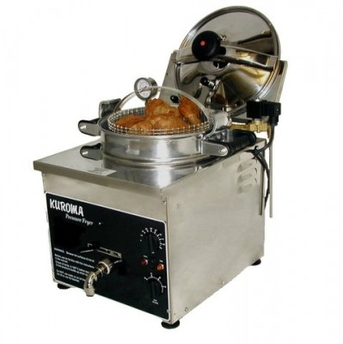
Steam Moist Heat Cooking Method
Steaming:
Food is placed on a rack above boiling water in a covered container.
e.g. couscous, vegetables
Steaming also occurs:
When food containing water is wrapped in aluminum foil and baked.
e.g. baked potatoes (steam develops inside the potato)
In pressure fryers: food cooking oil are brought to high temperatures while pressure is held high enough to cook the food more quickly.

Slide 51
Moist Heat Cookery Vs Dry Heat Cookery
Moist heat cookery is faster than dry heat cookery
Why?
Because water is a better conductor of heat than air.
Both convection and conduction take place in moist cooking.

Slide 52
Fat Dry Heat Cooking Method
Why?
Because fat, not moisture, comes in contact with food and
Usually high temperature is involved.

Slide 53
Fat Dry Heat Cooking Method Cont’d.
Includes cooking methods such as:
Deep Fat Frying:
Food is immersed in fat.
Fat can be heated to a much higher temperatures than the boiling point of water (100 degrees C at sea level)
Fat is absorbed by the food changing its flavor and texture.

Slide 54
Fat Dry Heat Cooking Method Cont'd.
Includes cooking methods such as: cont'd:
Pan Frying:
Amount of fat used covers 1/3-1/2 the food.
Food is usually breaded.
Heat source is usually moderate.
Food is flipped over when one side is done.

Slide 55
Fat Dry Heat Cooking Method Cont’d.
Includes cooking methods such as: Cont’d.
Saute’ing:
To cook very quickly ,
In a very small amount of fat ,
On high heat,
Involves stirring of food in pan,
Stir Frying:
Similar to saute’ing but done in a wok.

