Slide 1
Chapter 11
Sugars

Slide 2
Energy Foods
Sugar (table sugar):
Provides only energy for the body.
It is 100% CHO.
Other foods that contain relatively large amounts of sugar
Generally have low nutrient density.
E.g.
Molasses and honey: both are also energy foods
Molasses is around ≈ 5% ash (minerals); manmade
Honey provides around ½ % nutrients such as Fe and Ca.

Slide 3
Sugar Solutions
Sugars in the natural state of foods:
Are in solution such as the sucrose in fruits and vegetables.
Solutions, depending on the amount of sugar that is dissolved in the solution, may be:
Unsaturated
Saturated
Supersaturated
The crystallization of sugar occurs from a sufficiently concentrated sugar solution.
Table sugar is:
Crystalline sucrose
Derived from sugar cane and sugar beets.

Slide 4
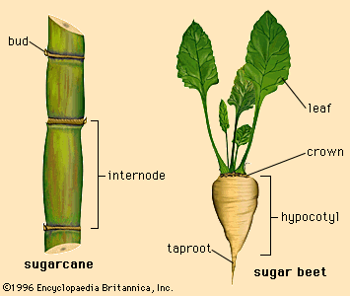

Slide 5
Properties of Sugars and their Functions in Food Production
Solubility of sugars:
Fructose: is the most soluble
Lactose: is the least soluble
Increases with heat
With the application of enough dry heat, sugars melt;
With continued dry heating → sugar caramelizes (starts to brown)

Slide 6
Types of Browning
Caramelization
Maillard reaction
Decomposition

Slide 7
1. Caramelization
Is Thermal Decomposition of Sugar
Is the oxidation of sugar when sugar is exposed to dry heat
Sugar + heat → (Caramel) + more heat → Carbon and Water.
Is one type of browning
Is non-enzymatic browning.

Slide 8
Caramelization Cont’d.
Caramelized sugar
Dissolves in hot liquid → Caramel solution.
Dissolved caramelized sugar
Can be used for flavoring of items such as puddings, ice cream, cake frostings, sauces

Slide 9
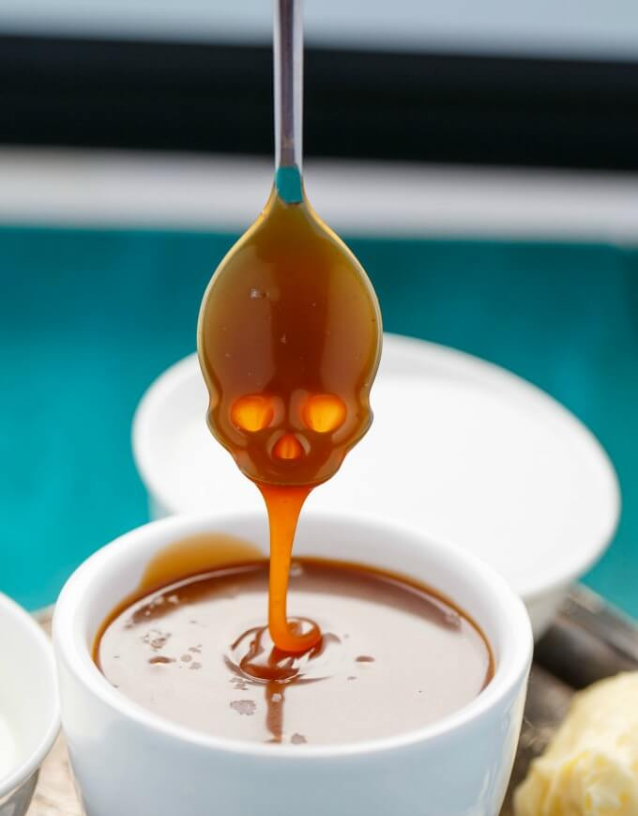
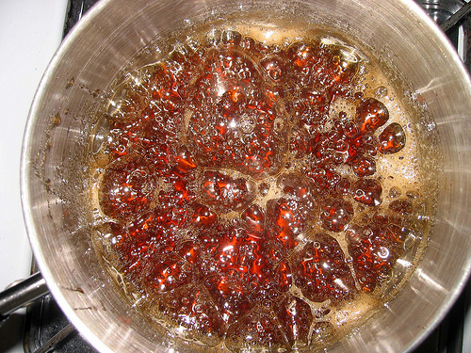
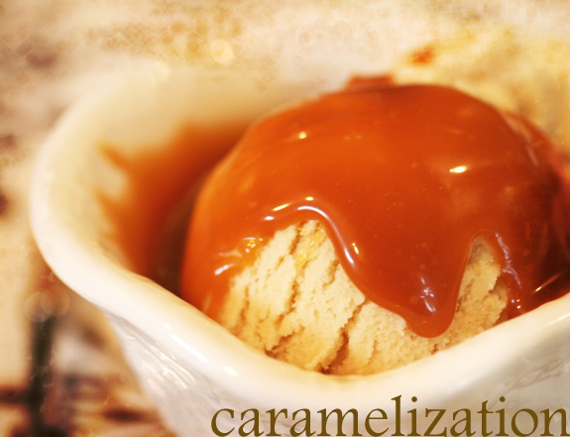
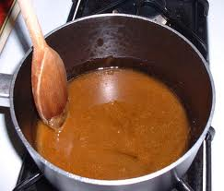

Slide 10
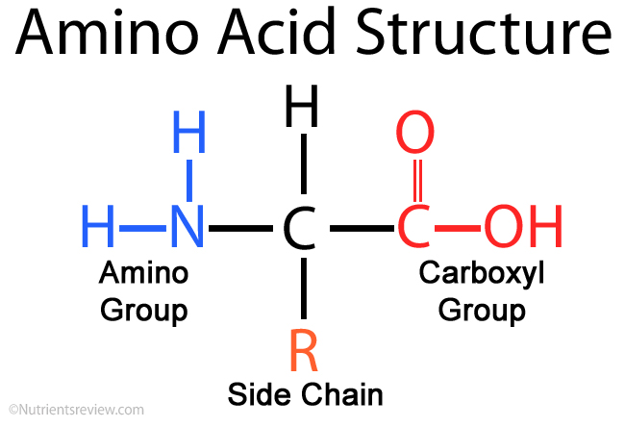
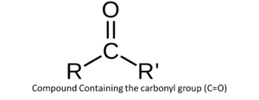
2. Maillard Reaction
Sugar
Carbonyl Groups (C=O)
Amino Acid
Amino Group (NH ₂)
+
=
Brown Pigment
H₂O
Then a series of chemical reactions occur
Is a form of non-enzymatic browning.

Slide 11
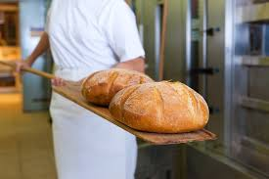
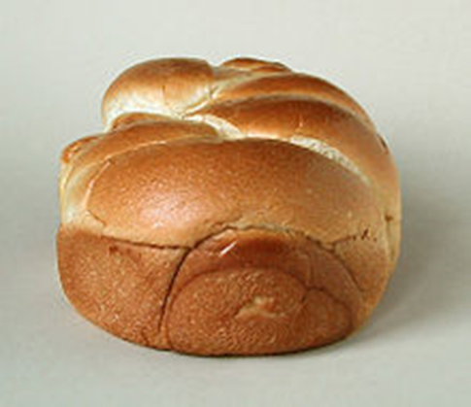
Maillard Reaction Cont’d.
E.g. the browning of :
Bread & other baked products (desirable)
Non-fat dry milk (not desirable); browning and off flavor when stored for a long time

Slide 12
3. Decomposition of Sugar
Alkaline decomposes sugar into its constituent units
Producing a brownish color
Baking soda in cake and cookie mixtures produces:
Darker Brown products
Product with Stronger Flavor
Extensive decomposition of sugar produces:
Even darker color
Stronger flavor with a Bitter taste

Slide 13
Properties of Sugar Cont’d.
Sugars are Hygroscopic
Have a tendency to absorb moisture from the atmosphere.
Fructose is more hygroscopic than other sugars that are commonly found in foods.

Slide 14
Properties of Sugar Cont’d.
Fermentation:
Most sugars, except lactose
May be fermented by yeasts to produce carbon dioxide gas and alcohol.
Fermentation is an important reaction in the making of bread and other baked products.

Slide 15
Properties of Sugar Cont’d.
Hydrolysis : producing invert sugar.
Invert sugar:
Is a mixture of fructose + dextrose (glucose)
Produced by breaking sucrose into its two constituent monosaccharides.
Inversion can be achieved by heating a sucrose syrup with either acid or by using the enzyme invertase.
Sucrase ( also known as invertase) hydrolyzes sucrose into glucose and fructose

Slide 16
Properties of Sugar Hydrolysis Cont’d.
Invert sugar Cont’d.
Is important in sugar products such as candy, fondant etc.
Helps in controlling the crystallization of sugar
Improves the:
Texture (smooth vs rough)
Consistency (firm, viscous, dense)
Agitation or stirring helps in producing finer crystals, meaning smooth texture.

Slide 17
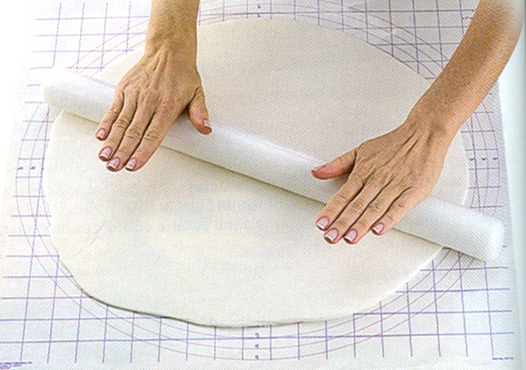
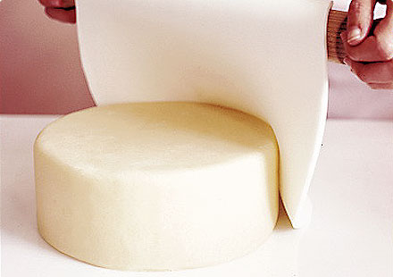
The enzyme sucrase: Is used in the candy industry to hydrolyze some of the sucrose.
Confectionary
Fondant
Rolling the fondant

Slide 18
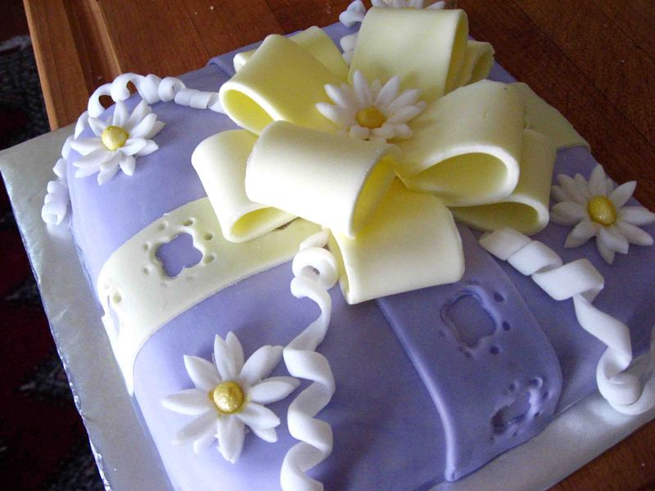
Decorating with Fondant

Slide 19
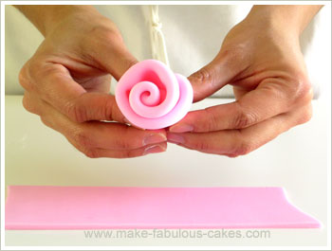
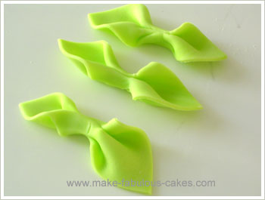
Colored Fondant

Slide 20
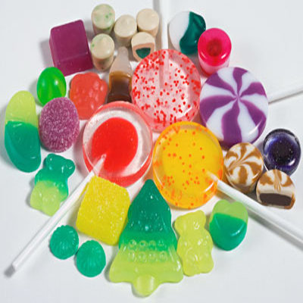
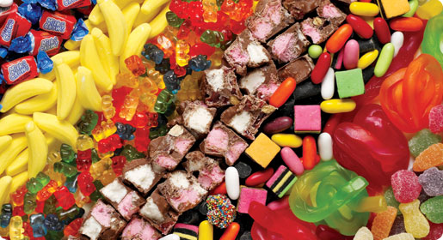
The enzyme sucrase: Is used in the candy industry to hydrolyze some of the sucrose Confectionery Cont’d.

Slide 21
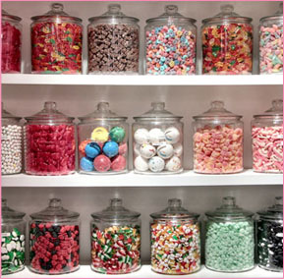
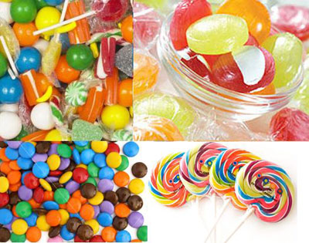
Confectionery

Slide 22
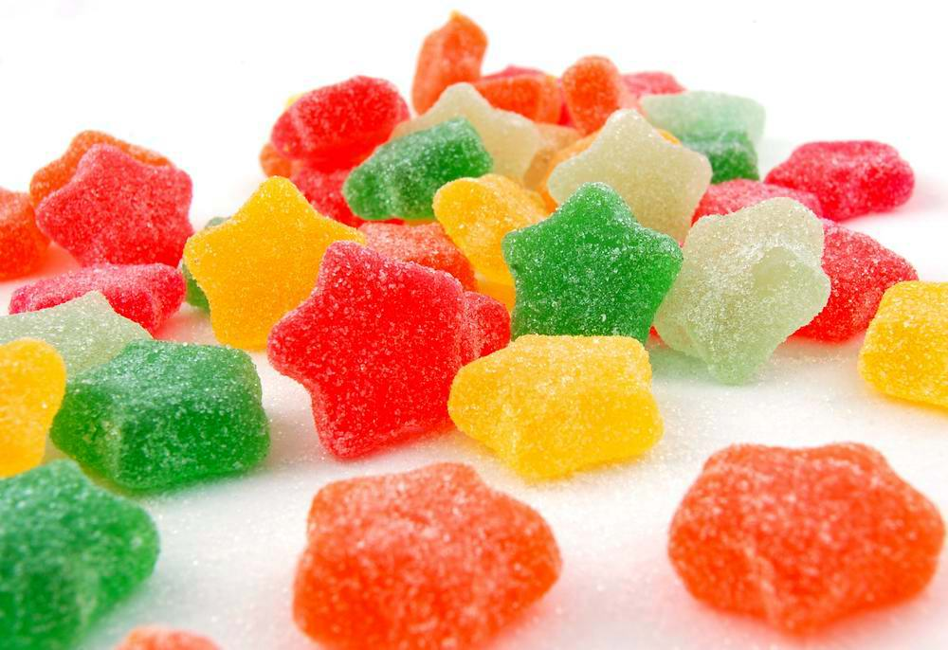
Confectionery

Slide 23
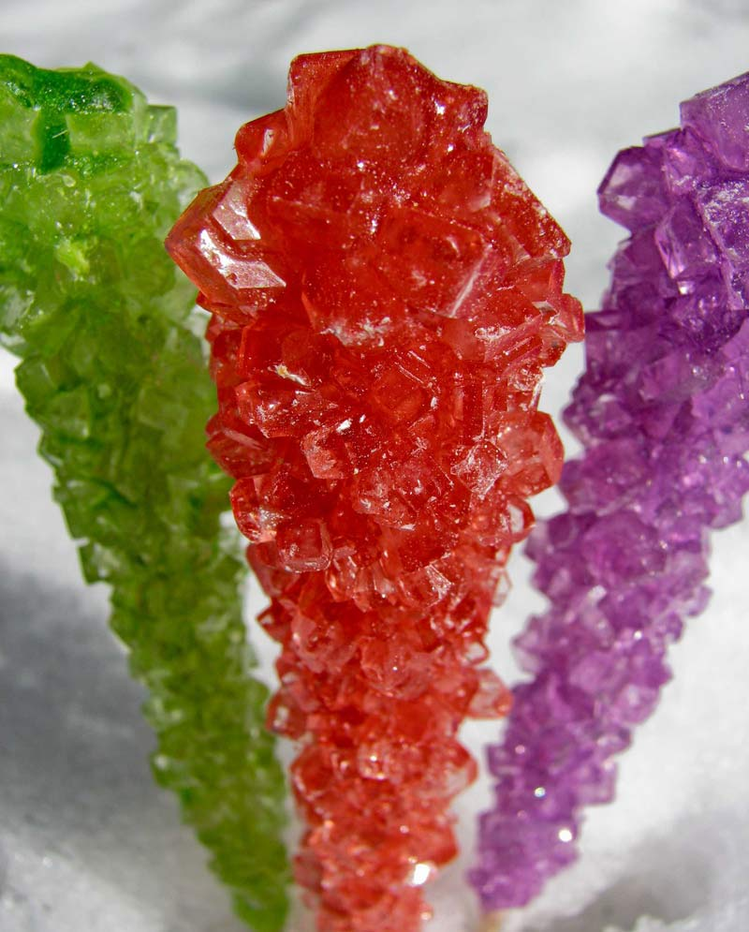
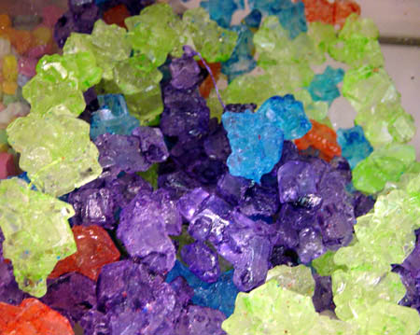
Rock Candy

Slide 24
Properties of sugars Cont’d.
Sweetness:
Fructose is the sweetest then glucose then lactose (least sweet)
The perceived degree of sweetness: is affected by several factors, including
Genetic variation among individuals
Concentration of the sweetener : higher concentration feels sweeter

Slide 25
Properties of sugars Cont’d.
Sweetness Cont’d.
Perceived degree of sweetness also affected by:
Temperature: The main effect is that relatively:
Low concentrations gain sweetness as temperature increases,
Hotter feels sweeter with lower concentration
Viscosity : thicker feels sweeter with lower concentration

Slide 26
Properties of sugars Cont’d.
Sweetness Cont’d.
Perceived degree of sweetness Cont’d.
pH : the lower the pH the less sweet the mixture feels, meaning: high acidic feels less sweet

Slide 27
Other Roles of Sugar in Food Products
Improve the texture of many products such as:
Pastries and
Cakes and
Ice cream
Preservative: jams and jellies by retarding the growth of microorganisms.

Slide 28
Types of Sugars or Nutritive Sweeteners
Granulated sugar
Castor sugar
Finer than granulated sugar but not powdered.
Confectioners’ sugar:
Is powdered sugar and is machine ground from granulated sucrose.

Slide 29
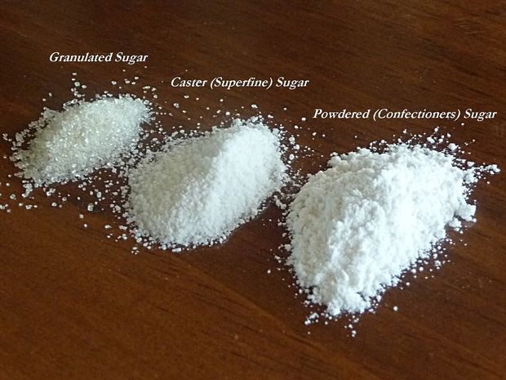

Slide 30
Types of Sugars or Nutritive Sweeteners Cont’d.
Brown sugar
Is obtained from cane sugar during the late stages of refining and it is composed of:
Clumps of sucrose crystals
Coated with a film of molasses.
Corn syrup:
Made from corn starch
(Substitute: 1 c corn syrup with 1 c sugar + ¼ c water)

Slide 31
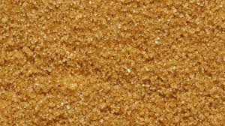
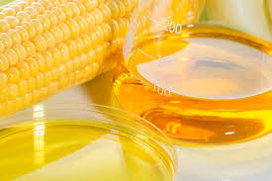
Brown Sugar
Corn Syrup

Slide 32
Types of Sugars or Nutritive Sweeteners Cont’d.
Honey
(Substitute: 1 c honey with 1¼ c sugar + ¼ c water)
Molasses:
(Substitute: 1c molasses with ¾ c brown sugar + ¼ c water)

Slide 33
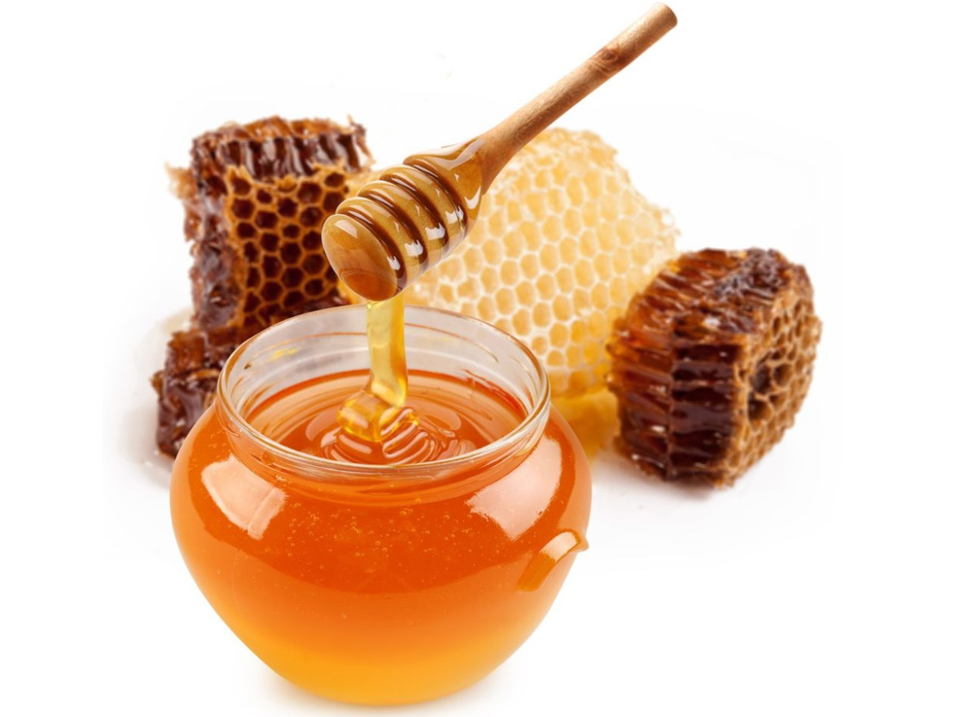
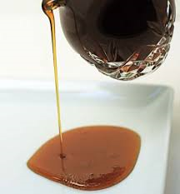
Honey
Molasses

Slide 34
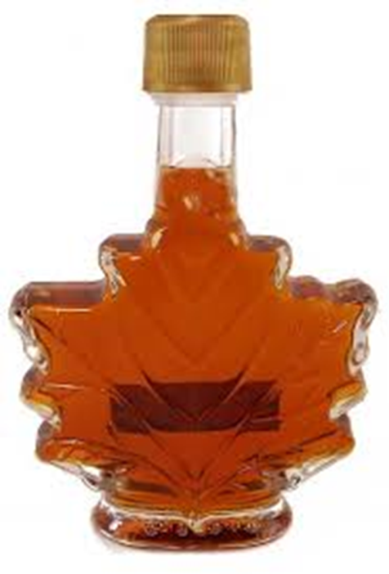
Types of Sugars or Nutritive Sweeteners Cont’d.
Maple syrup :
(substitute: 1 c maple syrup with)
1/2 cup granulated sugar +
1 cup brown sugar, firmly packed +
1 cup boiling water +
1 tsp butter. +
1 tsp maple extract or vanilla extract.
Each type of sweeteners offers unique properties and flavors that are useful in food preparation.
Maple Syrup

Slide 35
Non-Nutritive Sweeteners
Are very low in calories or contain no calories at all.
Are called Artificial Sweeteners
Are chemically prepared or processed

Slide 36
Types of Non-Nutritive Sweeteners
Saccharine
300-500 times as sweet as sucrose
Has a bitter aftertaste at high concentrations
Brand names: Sweet’N Low; Sugar Twin
Sucralose
600 times as sweet as sucrose
no bitter aftertaste
Stable at high temperature
Brand name: Splenda

Slide 37
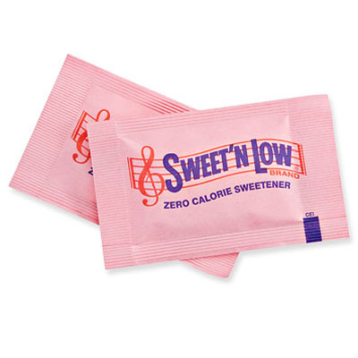
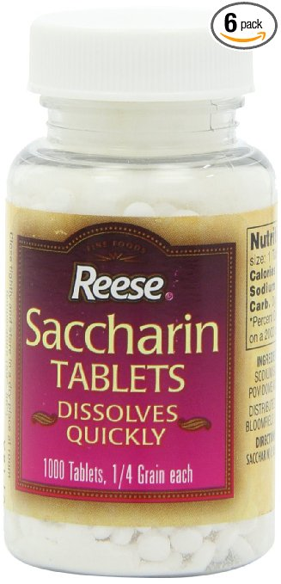
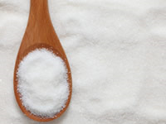
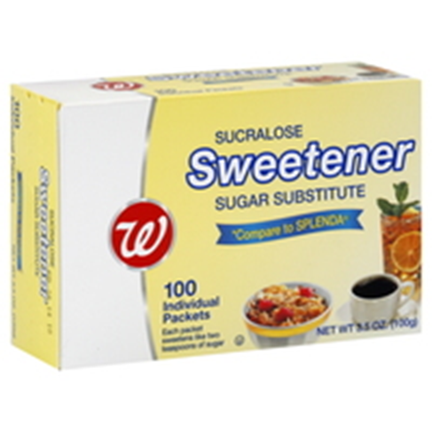
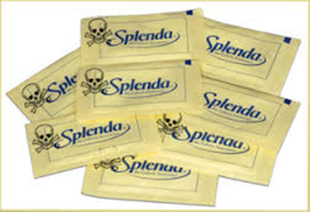
Saccharine

Slide 38
Types of Non-Nutritive Sweeteners Cont’d.
Aspartame
200 times sweeter than sucrose
Is a tabletop sweetener
Loses sweetness with heat
Metabolized to phenylalanine, PKU people
Brand names Nutra Sweet; Equal
Neotame
Designed to overcome some of the problems with aspartame.
7,000-13,000 times as sweet as sucrose
It is heat stable
Brand name: Nutra Sweet company

Slide 39
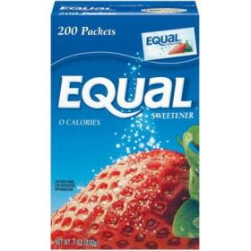
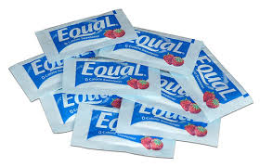
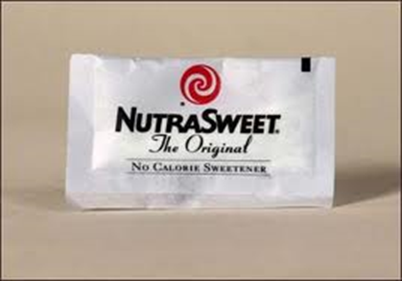
Aspartame
Neotame

Slide 40
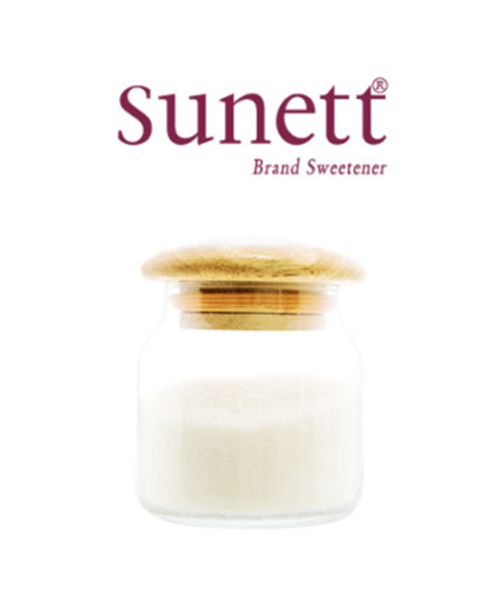
Types of Non-Nutritive Sweeteners Cont’d.
Acesulfame-K
Up to 200 times as sweet as sucrose
Heat stable
Brand names: Sunett , Sweet One
Acesulfame -K

Slide 41
Types of Non-Nutritive Sweeteners Cont’d.
Stevia
Is a sweetener and sugar substitute extracted from the leaves of the plant species Stevia
Is native to South America
Is 200-300 sweeter than sugar
Is often blended with another nonnutritive sweetener to reduce bitterness.
Is sold as a liquid or powder tabletop sweetener in many grocery stores, specialty food stores and pharmacies.
Is also added to certain foods and drinks like snacks, yogurt, cereals and drinks.

Slide 42
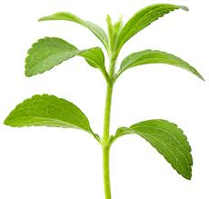
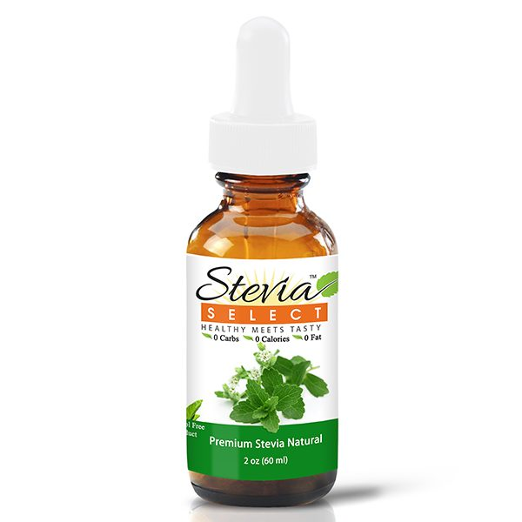
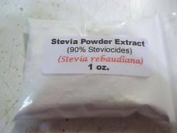
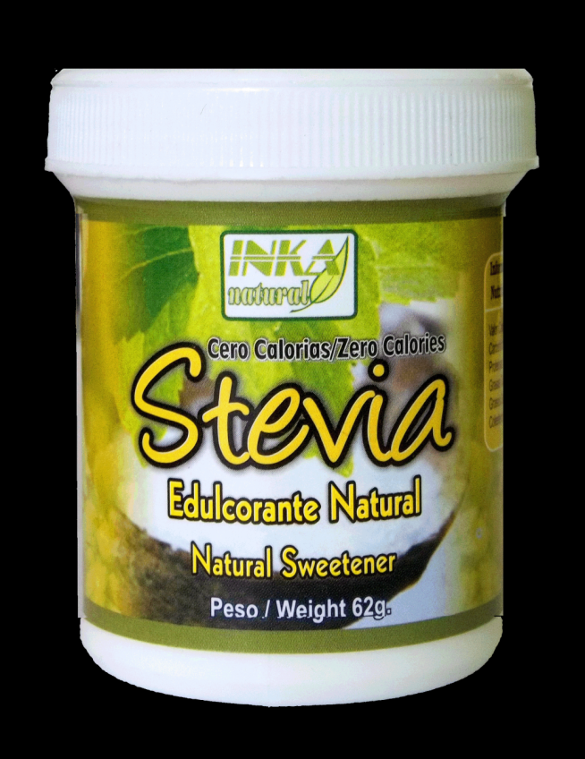
Stevia Leaves
Stevia Liquid

Slide 43
Sugar Alcohols
Sugar alcohols (polyols):
Are carbohydrates that occur naturally in certain fruits and vegetables.
But they also can be manufactured
Have less calories per gram than sucrose; about half the calories of sugar
Are absorbed by the body at a much slower rate than sugar
Are less sweet

Slide 44
Sugar Alcohols Use
Can be used with artificial sweeteners to improve bulk, mouth feel, and texture because:
Artificial sweeteners lack the bulk needed for many products.
8 sugar alcohols are approved including: erythritol, mannitol (may have a laxative effect if over consumed), lactitol, maltitol, xylitol, sorbitol, isomalt.
Sugar alcohols can be used in many products like chewing gum, candies, bakery products, beverages etc.

