Slide 1
Metabolic syndrome LIFE CYCLE

Slide 2
TOPICS :
What is Metabolic syndrome?
The metabolic factors According to the National Heart Lung and Blood Institute (NHLBI).
Who is at risk for metabolic syndrome?
What causes metabolic syndrome?
What are the symptoms of metabolic syndrome?
What is the relation between metabolic syndrome and vitamin D?
How is metabolic syndrome diagnosed?
How do I prevent or reverse metabolic syndrome?
How Do You Treat Metabolic Syndrome?

Slide 3
What is Metabolic syndrome?
is the name for a group of risk factors for heart disease, diabetes, high blood presser and obesity. That can have just one risk factor, but people often have several of them together. When you have at least three of them, It puts you at greater risk of getting coronary heart disease, stroke and other conditions that affect the blood vessels. it is called metabolic syndrome.

Slide 5
The metabolic factors According to the National Heart Lung and Blood Institute (NHLBI):
Abdominal obesity: This means having a waist circumference of more than 35 inches for women and more than 40 inches for men. An increased waist circumference is the form of obesity most strongly tied to metabolic syndrome.
High blood pressure of 130/80 mm Hg (millimetres of mercury) or higher. Normal blood pressure is defined as less than 120 mm Hg for systolic pressure (the top number), and less than 80 mm Hg for diastolic pressure (the bottom number). High blood pressure is strongly tied to obesity. It is often found in people with insulin resistance.

Slide 6
Impaired fasting blood glucose. This means a level equal to or greater than 100 mg/dL
High triglyceride levels of more than 150 mg/dL. Triglycerides are a type of fat in the blood.
Low HDL (good) cholesterol. Less than 40 mg/dL for men and less than 50 mg/dL for women is considered low.

Slide 7
Most people who have metabolic syndrome have insulin resistance. The body makes insulin to move glucose (sugar) into cells for use as energy. Obesity, commonly found in people with metabolic syndrome, makes it more difficult for cells in the body to respond to insulin. If the body can’t make enough insulin to override the resistance, the blood sugar level increases, causing type 2 diabetes. Metabolic syndrome may be a start of the development of type 2 diabetes.
Because the population of the U.S. is aging, and because metabolic syndrome is more likely the older you are, the American Heart Association (AHA) has estimated that metabolic syndrome soon will become the main risk factor for cardiovascular disease, ahead of cigarette smoking. Experts also think that increasing rates of obesity are related to the increasing rates of metabolic syndrome.

Slide 9
Who is at risk for metabolic syndrome?
Knowing your risk factors for any disease can help guide you to take the appropriate actions. This includes changing behaviours and being monitored by your healthcare provider for the disease.
Risk factors most closely tied to metabolic syndrome include:
Age: You are more likely to have metabolic syndrome the older you are.
Ethnicity: African Americans and Mexican Americans are more likely to get metabolic syndrome. African-American women are about 60% more likely than African-American men to have the syndrome.
Body mass index (BMI) greater than 25. The BMI is a measure of body fat compared with height and weight.
Personal or family history of diabetes. Women who have had diabetes during pregnancy (gestational diabetes) or people who have a family member with type 2 diabetes are at greater risk for metabolic syndrome.
some habits like: Smoking, History of heavy drinking, Stress, Being past menopause, High-fat diet Sedentary lifestyle.

Slide 10
What causes metabolic syndrome?
Experts don't fully understand what causes metabolic syndrome. Several factors are interconnected. Obesity plus a sedentary lifestyle contributes to risk factors for metabolic syndrome. These include high cholesterol, insulin resistance, and high blood pressure. These risk factors may lead to cardiovascular disease and type 2 diabetes.
Because metabolic syndrome and insulin resistance are closely tied, many healthcare providers believe that insulin resistance may be a cause of metabolic syndrome. But they have not found a direct link between the two conditions. Others believe that hormone changes caused by chronic stress lead to abdominal obesity, insulin resistance, and higher blood lipids (triglycerides and cholesterol).
Other factors that may contribute to metabolic syndrome include genetic changes in a person's ability to break down fats (lipids) in the blood, older age, and problems in how body fat is distributed.

Slide 12
What are the symptoms of metabolic syndrome?
Having high blood pressure, high triglycerides, and being overweight or obese may be signs of metabolic syndrome. People with insulin resistance may have acanthosis nigricans. This is darkened skin areas on the back of the neck, in the armpits, and under the breasts. In general, people do not have symptoms.
The symptoms of metabolic syndrome may look like other health conditions. See your healthcare provider for a diagnosis.

Slide 13
acanthosis nigricans

Slide 14
What is the relation between metabolic syndrome and vitamin D?
Advanced clinical and epidemiological studies have provided data on the factors that contribute to inadequate vitamin D₃ levels and the metabolic syndrome in humans.
Many researchers point to vitamin D₃ deficiency as a factor in the pathogenesis of hypertension (vitamin D₃ inhibits renin and endothelin synthesis and the proliferation of smooth muscle cells)
diabetes (development of insulin resistance).
Obesity and vitamin D deficiency in the body are inverse relationships. Interestingly, some evidence suggests that getting enough vitamin D can help with weight loss.

Slide 15
How is metabolic syndrome diagnosed?
diagnosed metabolic syndrome if you have three or more of the following:
A waistline of 40 inches or more for men and 35 inches or more for women (measured across the belly)
A blood pressure of 130/85 mm Hg or higher or are taking blood pressure medications
A triglyceride level above 150 mg/dl
A fasting blood glucose (sugar) level greater than 100 mg/dl or are taking glucose-lowering medications
A high density lipoprotein level (HDL) less than 40 mg/dl (men) or under 50 mg/dl (women)

Slide 16
How do I prevent or reverse metabolic syndrome?
Since physical inactivity and excess weight are the main underlying contributors to the development of metabolic syndrome, exercising, eating healthy and, if you are currently overweight or obese, attempting to lose weight can help reduce or prevent the complications associated with this condition. Your doctor may also prescribe medications to manage some aspects of your problems associated with the metabolic syndrome. Some of the ways to reduce your risk:
Healthy eating and attempting to lose weight if currently overweight or obese:
Healthy eating and moderate weight loss, in the range of 5 percent to 10 percent of body weight, can help restore your body’s ability to recognize insulin and greatly reduce the chance that the syndrome will become a more serious illness. This can be done through diet, exercise, or even with help from weight-loss medications if recommended by your doctor.

Slide 17
Exercise: Increased activity alone can improve your insulin sensitivity. Aerobic exercise such as a brisk 30-minute daily walk can promote weight loss, improved blood pressure and triglycerides levels and a reduced risk of developing diabetes. Most healthcare providers recommend 150 minutes of aerobic exercise each week. Exercise may reduce the risk for heart disease even without accompanying weight loss. Any increase in physical activity is helpful, even for those unable to perform 150 minutes of activity per week.
Dietary changes: Maintain a diet keeps carbohydrates to no more than 50 percent of total calories. The source of carbohydrates should be from whole grains (complex carbohydrates), such as whole grain bread (instead of white) and brown rice (instead of white). Whole grain products along with legumes (for example, beans), fruits and vegetables allow you to have a higher dietary fiber. Eat less red meats and poultry. Instead, eat more fish (without the skin and not fried). Thirty percent of your daily calories should come from fat. Consume healthy fats such as those in canola oil, olive oil, flaxseed oil and tree nuts.

Slide 19
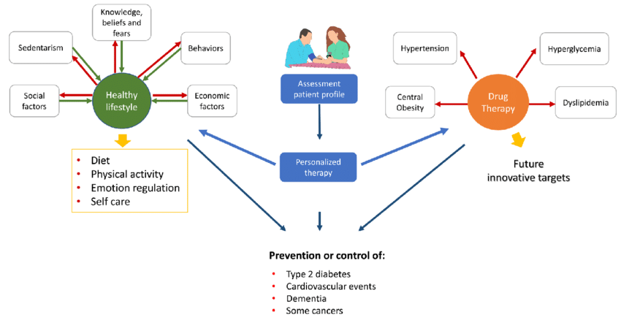
How Do You Treat Metabolic Syndrome?
In most cases, the best treatment for metabolic syndrome rests with you. Changes to your behavior -- such as eating healthier and getting more exercise -- are the first things your doctor will suggest. By adopting some healthy habits, you may be able to eliminate your risk factors completely.

Slide 20
DONE BY:
OLA HAMMAD
LAMIS RAMADAN
MAJDAL ALKHATEEB
DR. SAFAA MUHANNA
30.MAY.2022

