Slide 1
NUT 321 Introduction to Dietetics
Hind Eliyan

Slide 2
Main Textbook
Dietetics, Practice and Future Trends. Esther A. Winterfeldt; Margaret L. Bogle; Lea L. Ebro, Johns & Bartlett, 5th edition, 2018.

Slide 3
Evaluation
Presentation 1: 20%
Personal statement : 10%
Assignment 2 & Presentation: 30%
Final exam: 40%

Slide 4
Assignments 1
Discuss a specific topic / area in dietetics that you are interested in learning more about
Group presentations
10-15-minute presentation
Use credible resources and proper citation

Slide 5
Clinical:
providing medical nutrition therapy
Define unit, its missions and objectives (e.g. adult inpatient, dialysis clinics- renal nutrition, oncology, pediatrics etc.)
Describe the characteristics of patients in this unit. What will you look out for, what kind of MNT is provided?
Describe the role of the dietitian / do you require a specialty certification to work in this unit?
Discuss different examples
Discuss these departments in Palestine
Recommendations

Slide 6
Community Nutrition
Define the role of community dietitians/importance
Describe set of skills/expertise that enhance working in this field
Work opportunities in Palestine
Examples of programs in Palestine and abroad
Opportunities and need for future programs in Palestine

Slide 7
Food management
Dietitians that work in food management plan, organize, direct and evaluate food service systems. Potential in working in food service in schools’ universities, health care facilities, hotels
Describe food management, the role of dietitians in this field
Role in food production/marketing and Disaster planning and emergency training
Work opportunities in Palestine
Describe detailed examples
Suggest improvements of current utilization of food management and dietetics in Palestine

Slide 8
Other possible topics
Education
Outpatient care- business and consultancy
Private practice
Research
Food and nutrition-related business and industries (food labeling, marketing, product development or consulting with chefs in restaurants and culinary schools, supplement industry)

Slide 9
Assignment 2
Group presentations:
Discuss these current topics and emerging fields in the dietetics practice
Use 1-2 scientific papers
Use proper citations
20-minute presentations
Nutritional genomics
Microbiome
Functional foods
Veganism and research behind it
The health impact of eating red meat- good or bad?
Genetically Modified Foods
Organic Foods
Synbiotics
Nutrition and mental health
Nutrition and global warming
The relationship between diet and cognitive health

Slide 10
Personal statement ( 1 page paper)
Individual assignment
Your paper should discuss the following points
Interest in the dietetic field
Experiences relevant to nutrition and dietetics (work, volunteer, personal experiences) and the skills you gained from these experiences that will help you succeed as a dietitian/ or any other experiences that helped you develop professional skills
Short term and long-term goals
What are your strengths and weaknesses or areas needing improvement?

Slide 11
What is a dietitian?
The use of diet in the treatment of disease was already an ancient practice even though it was based more on trial and error than on scientific knowledge
In 1917: recognition of dietitian as a food and nutrition expert
The practice of dietetics began even earlier
The use of diet in the treatment of disease was already an ancient practice even though it was based more on trial and error than on scientific knowledge.

Slide 12
Religious leaders and scientists and physicians throughout history have been giving recommendations on what to eat and hypothesizing theories- many of those theories were not based on any real science
Discovery of nutrients in the 19th and 20th century
Fats, carbohydrates, and amines were known by the mid-1800s
Vitamins and minerals were not discovered until the early 1900s

Slide 13
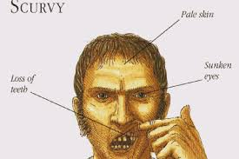
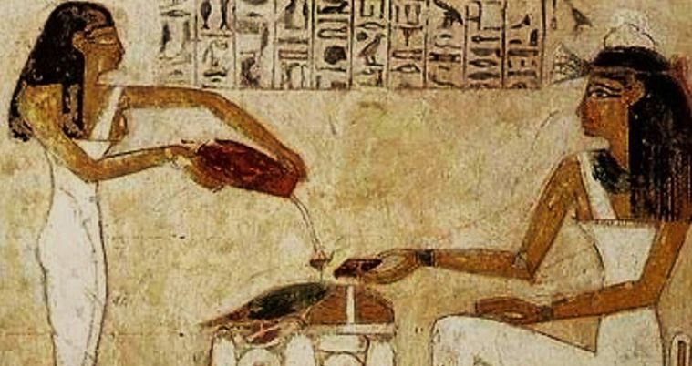
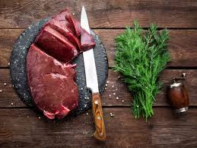
Earliest connections between specific foods and disease
1700’ Vitamic C and scurvy
Vitamin A

