Slide 1
Ethics Theories
NUTD 3290

Slide 2
The question of ethics
How do I have to act?
What is the right thing to do
What are the rules?
What are the consequences of my action?
Who is affected?
Me
Family, friends, etc…
The whole society
What kind of person I ought to be?
Belief that a good person will do the right thing

Slide 3
Actions are based on two major factors
Basic question of ethics
How should I act?
Consequentialism
Deontology
What type of person am I?
Virtues are important for the flourishing of the human being

Slide 4
How should I act?
Consequentialism
Ethical Egoism?
Group consequentialism?
Utilitarianism?

Slide 5
Deontology
Deontology
Universal moral laws
Prima Facie duties
Fidelity & reparation
gratitude
non-maleficence
justice
beneficence
self-improvement
Divine Command theory

Slide 6
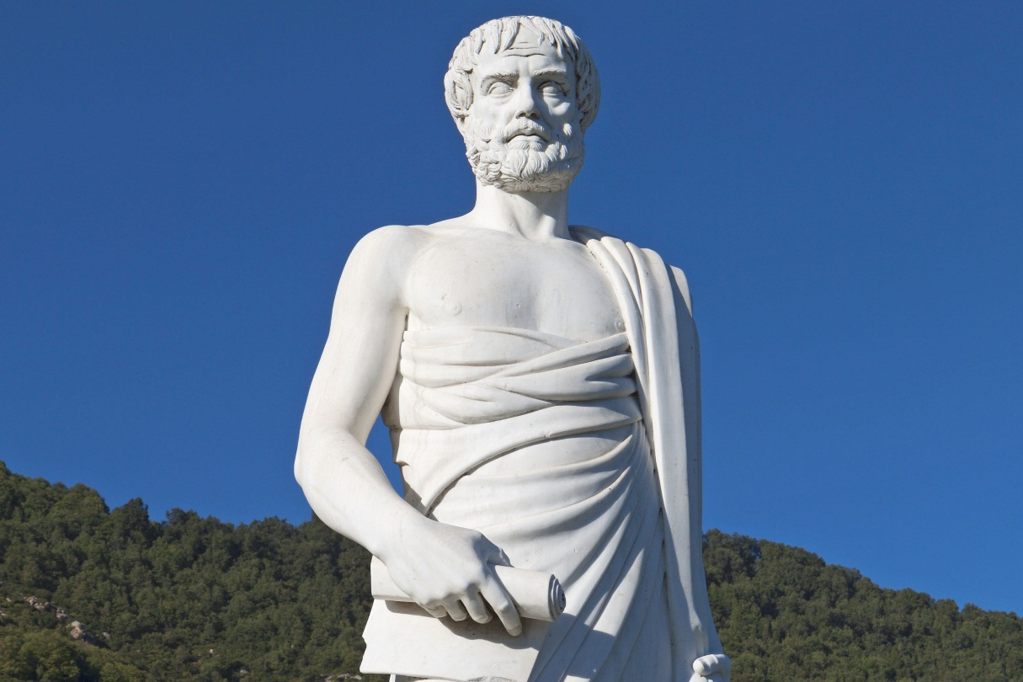
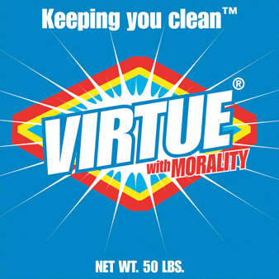
What type of person am I?
Virtues
What are they?
Important for the flourishing of humanity
Good human will act in the right way

