Slide 1
Community Nutrition

Slide 2
Health Promotion
Health promotion The process of enabling people to achieve their maximum potential for good health.
Encouraging healthy diets, physical activity , rest, leisure-time, hobbies , social networks with family and friends, work-life balance.
Behavior change is the desired outcome of a health promotion activity
Intervention A health promotion activity aimed at changing the behavior of a target audience

Slide 3
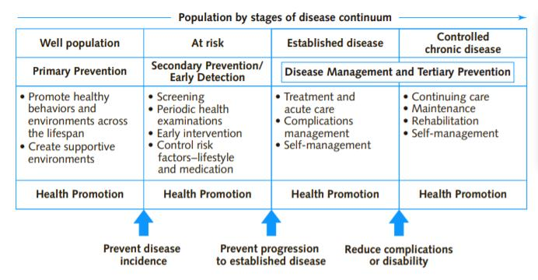
Three types of prevention efforts
Primary, secondary and Tertiary preventions

Slide 4
Nutrition Monitoring and Surveillance
How do we solve nutrition problems?
We need evidence that the problem exists
Assessment of the current problems that exist,
  The severity, and who is affected (surveillance, needs assessment, and data collection)
We have to set goals and objectives for the efforts to solve the problems

Slide 5
Community Needs Assessment
Why conduct a community needs assessment ( A snapshot of the nutritional problem in our community)
Imagine we are trying to assess food insecurity in the West Bank.
What type of questions should we be asking?

Slide 6
How many people in our community experience food insecurity?
What is the mean income of a Palestinian family living in the West Bank?
Unemployment rates, movement restrictions?
What available food assistance programs exist?
What are the barriers to participation in these programs?
What factors contribute to food insecurity in this population?
Notes:
Helps community nutritionist understand the extent of the problem in their community; identify resources available at the national, state, and local levels to alleviate it; determine where existing services and programs can be improved; and suggest areas where new programs and services are needed.

Slide 7
Community needs assessment
An evaluation of the community in terms of its health and nutritional status,its needs, and the resources available to address those needs
The process of evaluating the health and nutrition status of a community
  By determining what those health and nutrition needs are
  Identifying places where those needs are not being met.

Slide 8
HEALTH AND nutrition STATUS
Health status: the condition of a population’s or individual’s health (estimates of quality of life, physical functioning, and psychosocial functioning)
Nutrition status: the condition of a population’s or individual’s health as affected by the intake and utilization of nutrients and nonnutrients.

Slide 9
nutrition STATUS: Questions we are trying to answer
Who has nutrition needs that is not being addressed?
What programs and services exist to address these needs?
Why do existing programs and services fail to address these needs?
How do the community environment, background factors, and culture affect the ease and desirability of making healthy food choices?
What can be done to improve the health and nutrition status of the population?

Slide 10
What triggers a community needs assessment?
A need for new data on the community’s health because existing data are several years old and may no longer accurately reflect a population’s health
Data have never been collected on some segment of a population.
An agency has a mandate to carry out such activities
Research findings are sometimes the impetus for taking action
A community leader / action group may raise awareness about a health or nutrition issue and prompt action to undertake a community needs assessment
The availability of funds
Others ...

Slide 11
Community assessment
Community assessment
Large- scale Assessment
Small-scale Assessment
Notes:
The amount of time available to conduct the needs assessment, the staff members responsible for conducting it, and the scope of the assessment must all be specified.

Slide 12
Large- scale Assessment
Purpose: identify the health /nutritional problems of a large population, such as all residents of a nation, state, or city.
The assessment cuts across all income, educational, and geographical sectors
large-scale assessments use statistical methods to select a sample of people whose age, sex, race, and other characteristics reflect the demographic profile of the entire population.
Example : In the USA , the National Health and Nutrition Examination Survey (NHANES) conducted annually on a nationally representative sample of about 5,000 persons
Target population: All residents of a nation/ country
Notes:
Behavioral Risk Factor Surveillance System: identified increases in overweight and diabetes as two nutrition-related problems in all demographic and geographical segments of the U.S. population.Blacks had the highest rates of both obesity and diabetes among all races and ethnic groups, and people with less than a high school education had higher rates of both obesity and diabetes than those with a high school education

Slide 13
Problems
Expensive
Time- consuming
Requires hundreds of people with expertise in public health, nutrition, epidemiology, statistics, management, and survey design and analysis
Because time and labor intensive, may be done once in five or ten years.
Notes:
Target group in large-scale assessment all residents of the nation.
because it is not practical or feasible to obtain information about every resident, large-scale assessments use statistical methods to select a sample of people whose age, sex, race, and other characteristics reflect the demographic profile of the entire population

Slide 14
Small-scale Assessment
limited in scope, focusing on a particular subgroup of the community
Relatively inexpensive to conduct
Conducted by a small team of community nutritionists and other professionals from several organizations and agencies
Small-scale assessments evaluate every member of a significantly more limited population

Slide 15
EXAMPLE of a small-scale assessment
Assessment of the nutritional status of schoolchildren
May require collaboration between/ efforts of:
  Experts from departments of public health and education,
  A local dietitian/s involved in school lunches at the community
  faculty members of the local hospital that is associated w/ ministry of health
  Graduate students from the local university
Usually high risk groups are chosen because of the constraints in terms of funding, personnel and time

Slide 16
Steps in Needs Assessment
Define the problem
Set the parameters of the assessment
Collect data
Analyze and interpret data
Share the findings
Set priorities
Choose a plan of action

Slide 17
Step 1: Define the problem
“What is the nutritional problem?
Used to help plan the assessment and motivate agencies to join the assessment team
Infants at nutritional risk
obesity.
Low-birthweight infants
Inadequate food intake of immigrants
Poor quality of diets of high school students

Slide 18
First National Health and Nutrition Survey (1999-2000) in Palestine about Overweight and Obesity among Palestinian Adults
A random representative sample of 3617 adults aged 18–64 years was collected between October 1999 and October 2000.
Results. The prevalence of overweight was 35.5% in women and 40.3% in men, obesity was 31.5% in women and 17.5% in men
Obesity contributes to increased morbidity, including increased risk of hypertension and diabetes mellitus. People who are successful at losing weight and maintaining the weight loss report using a combination of diet, physical activity, and behavior modification to achieve their goals
The prevalence of obesity in Ramallah is not known, nor is information available about the strategies used by overweight people in Ramallah to lose weight successfully
Abdeen, Z., Jildeh, C., Dkeideek, S., Qasrawi, R., Ghannam, I., & Al Sabbah, H. (2012). Overweight and obesity among Palestinian Adults: Analyses of the Anthropometric data from the first national health and Nutrition survey (1999-2000). Journal of Obesity, 2012, 1-12. doi:10.1155/2012/213547

Slide 19
Step 2: Set the Parameters of the Assessment
To set the parameters we need to
Define the community: The scope of the community to be assessed, could be under certain geographical/city limits
Determine the Purpose of the Needs Assessment: what factors influence the nutritional problem: social, economic, political etc. and population at risk
  Example: Identify groups within the community who are at risk nutritionally.
  Determine whether existing resources and programs meet the community’s or target nutritional needs.
  Identify the factors that contribute to a nutritional problem within the community or target population.
Define the Target Population
Set goals and objectives for assessment
Specify type of data needed
Notes:
Set the direction for the assessment

Slide 20
example
Obesity contributes to increased morbidity, including increased risk of hypertension and diabetes mellitus in Palestine
Prevalence of obesity was 31.5% in women
The prevalence of obesity among adult women in Ramallah is not known, nor is information available about the strategies used by overweight women in Ramallah to lose weight successfully
No data on knowledge and awareness of obesity risk factors or obesity prevention programs/services in Ramallah

Slide 21
Community: Women living in Ramallah
Purpose: To obtain information about the dietary patterns of women in Ramallah and to determine prevalence of overweight and obesity in this population
Target population: Females above the age of 18
Goal: To assess factors affecting dietary patterns of adult women living in Ramallah, and to assess the prevalence of overweight and obesity
  Help determine whether a program or other interventions should be developed
Notes:
Goals are more broad

Slide 22
Objectives:
Assess eating habits of adult women living in Ramallah
̈Determine prevalence of overweight and obesity
̈Determine main food sources
Identify existing services offered to women to help reduce obesity/overweight
Assess women’s use of existing services designed to reduce risks
  Identify gaps in nutrition education resources
  Identify available nutrition counselling services in Ramallah
(use strong verbs when writing objective such as increase, reduce, begin, or identify ---- describes a measurable outcome)
Notes:
Each objective should state a single purpose
Objectives Statements of outcomes and activities needed to reach a goal.

Slide 23
Types of data needed:
̈Number of overweight / obese women
Dietary habits
Types of counselling services available
̈how many women actually use these services
̈Eligibility to use services
Cost of food/ healthy food

Slide 24
Example:
Palestine has been experiencing a nutritional transition in food choices from the typical Mediterranean diet to the fast food pattern with possible consequences on obesity. Dietary habits of young adults are likely to have been affected. There are no data on prevalence of overweight and obesity in university students and on risk factors for obesity in this population.
Notes:
Goal: identify knowledge, attitudes, and practices related to obesity and existing programs and services designed to reduce obesity

Slide 25
Step 3: collect Data
Collect data about the “big picture”- the environment and community in which the target population lives and works– what lead to the development of the nutritional problem
Once you understand the big picture, collect data about individuals who make up the target population

Slide 26
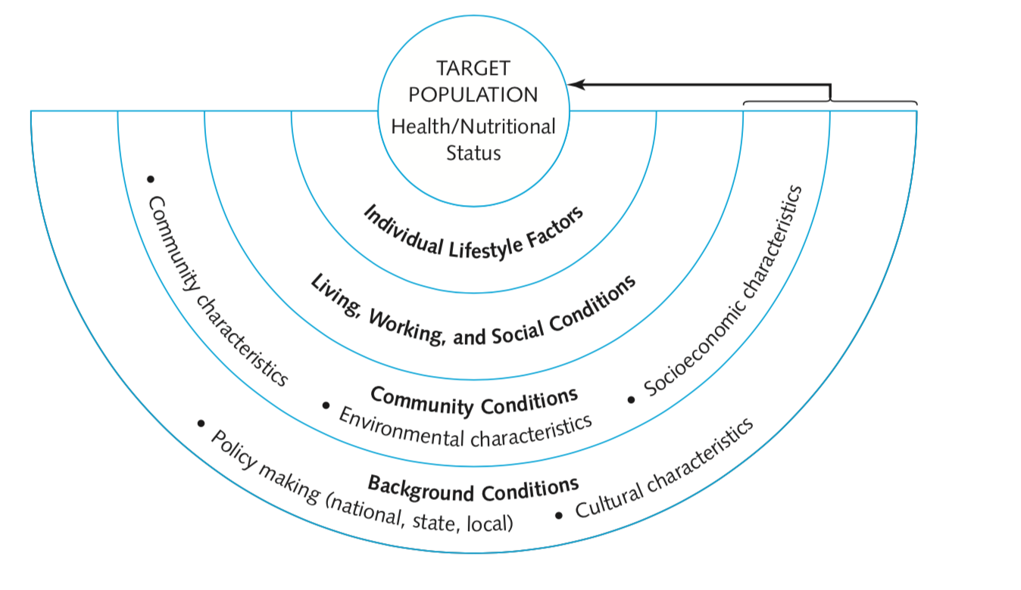
Collect Data
Examples of general categories of data that might be collected over the course of the assessment

Slide 27
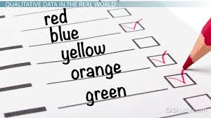
Collect DATA
Qualitative and Quantitative data help describe the community and its values, health problems, and needs
Qualitative (primarily words, images)
  Interviews
  Focus groups and town hall meetings
  Questionnaires using open‐ended questions
    Gathering insights from key informants and stakeholders (people and organizations invested in identifying and addressing the nutritional problem) in the community

Slide 28

COLLECT DATA
Quantitative data (primarily numbers)
Vital statistics
School and medical records
Surveys of target groups
Published research studies

Slide 29
Community characteristics data
Community organizational power and structures
How the community operates politically/ power structure ( information about the health services/policies in the community
Demographic data and trends ( sex, age, race, living arrangements in a community)
Community health ( health data about disease rates and causes, disability, death
Existing community services and programs

Slide 30
Where to collect data about the community?
Methods of Obtaining Data about the Target Population
Using existing data from large-scale/small scale surveys/literature
New data
  Survey (more specifically a Nutrition Survey)
  Screening
  Focus groups
  Health Risk Appraisal
  Interviews with key informants
  Direct assessment of nutrition status
Notes:
A health risk assessment usually includes questions in the following areas:
Demographic characteristics – age, gender
Lifestyle behaviors – exercise, eating habits, alcohol and tobacco use
Emotional health – mood, stress, life events
Physical health – weight, blood pressure, cholesterol levels
Current and previous health conditions
Preventive screenings
Readiness to change behaviors to improve health

Slide 31
For Palestine, consider the following resources:
PCBS: http://www.pcbs.gov.ps/default.aspx
WHO: http://www.emro.who.int/pse/publications-who/
WFP: https://www1.wfp.org/countries/state-palestine
Palestinian MoH: https://www.site.moh.ps/
UNICEF: https://www.unicef.org/sop/
Institute for Health Metrics and Evaluation (IHME): http://www.healthdata.org/palestine

Slide 32
Surveys
A systematic study of a cross-section of individuals who represent the target population
  Relatively inexpensive
  can be used to collect qualitative or quantitative data
  Can be used in formal, structured interviews;
  By phone, by mail, or online
  Some surveys are self administered
  Other surveys can be administered by an expert

Slide 33
SURVEYS
When conducting surveys, consider the
Purpose
Most nutrition surveys are carried out to assess the food consumption of households or individuals, evaluate eating patterns etc.
Trained professionals conduct and analyze surveys
Readability, clarity of the survey, literacy issues ..

Slide 34
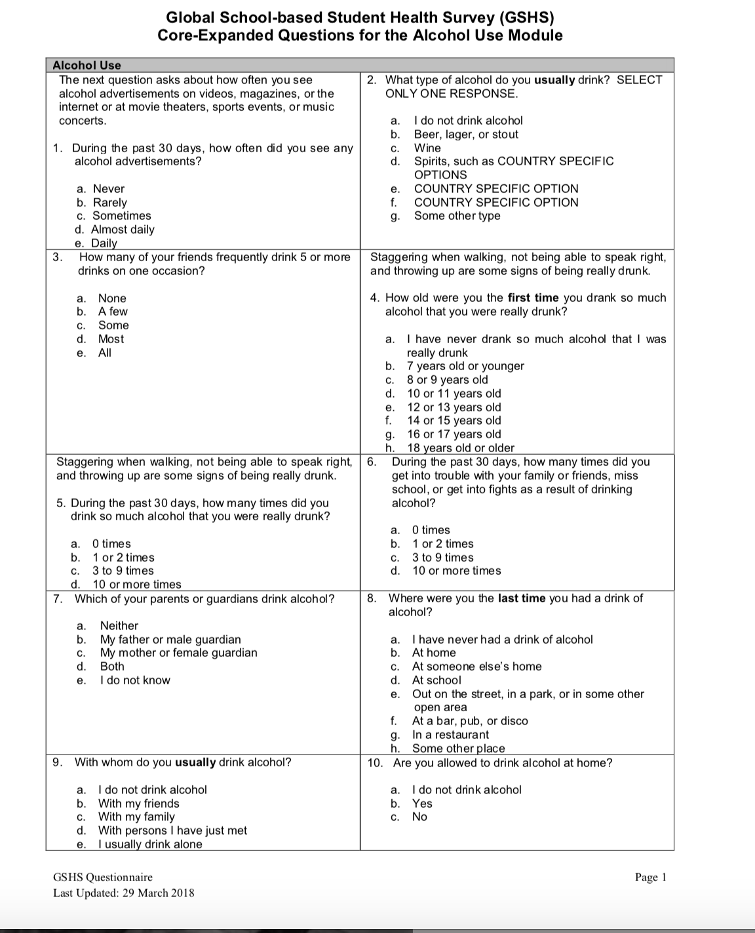
Example of PAHO/ WHO survey
https://www.paho.org/en/documents/global-school-based-student-health-survey-gshs-core-expanded-questions-alcohol-use-module

Slide 35
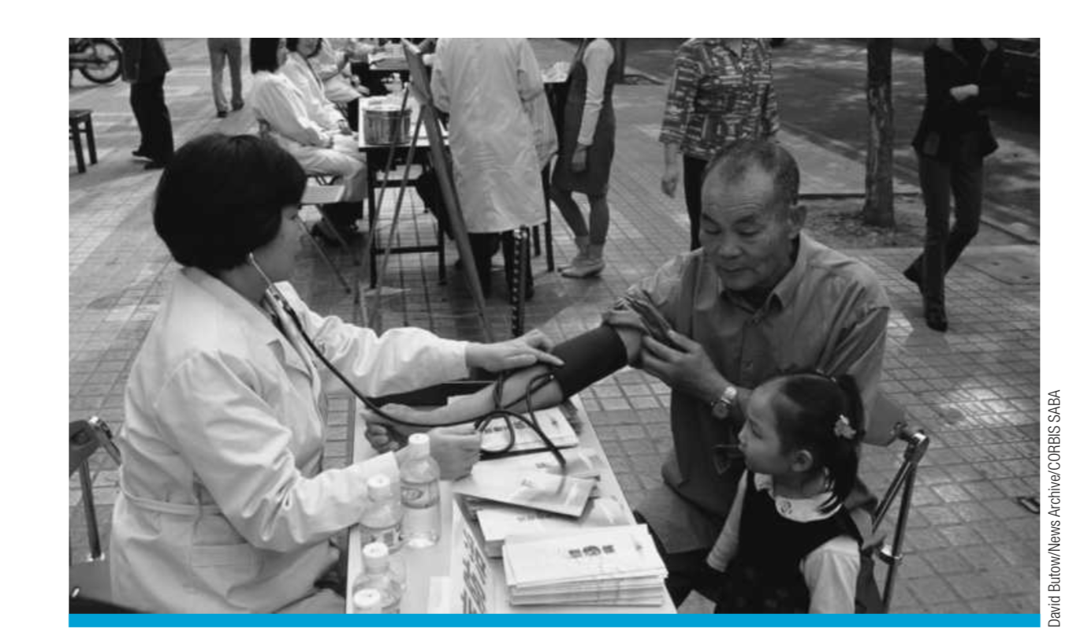
Screening
In a screening, people from the community are invited to have an assessment made of a health risk or behavior. Their screening value is then compared with a predetermined cut point or risk level
Screenings occur in both clinical practice and community settings

Slide 36
Focus Groups
Focus groups usually consist of 5 to 12 people who meet in sessions lasting about 1 to 3 hours
Discuss concerns, experiences, beliefs, or problems
Focus groups provide insights about new products and services, research data and information about key variables used in quantitative studies
A trained moderator leads focus groups
Asking open-ended questions
The information obtained from focus group interviews is then used to provide direction for the needs assessment or to change a marketing strategy, product, or existing program
Provide qualitative data

Slide 37
“The Johns Hopkins Hospital staff, for example, used focus groups to help them understand why some clients were not complying with cardiovascular health promotion programs to control hypercholesterolemia”
We gather information about development of disease/behavior and barriers in accessing resources and programs

Slide 38
Interviews with Key Informants
Key informants may have worked with the target population
Interviews with key informants may also reveal whether the target population perceives a nutritional problem and which actions for addressing the problem are culturally appropriate

Slide 39
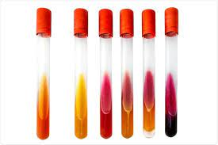

Direct Assessment of Nutritional Status
Using dietary, laboratory, anthropometric, and clinical measurements of individuals to identify those with malnutrition or a nutritional deficiency state

Slide 40
Measuring food consumption at the Individual level by using
Food Frequency questionnaires (FFQ)
24 hour dietary recall
Food diaries/records
diet history interview
Family/household based
Food records
population level
food balance sheets and market databases

Slide 41
Diet History Method
Long-term dietary intake is often more relevant than the current diet
Trends can be assessed
Easy to administer BUT time-consuming and requires a trained interviewer
not practical for large populations
Earliest diet history: HSPH and diet history questionnaire for pregnant women
Notes:
dietary history is a retrospective structured interview method consisting of questions about habitual intake of foods from the core food groups (e.g. meat and alternatives, cereals, fruit and vegetables, dairy and ‘extras’) and dietary behaviours (e.g. skipping breakfast, dieting).
The interview technique can use open ended questions to determine foods and drinks consumed at each meal, followed by specification of amounts.
usual intake in the past 3, 6, or 12 months, depending on the aims of the assessment

Slide 42
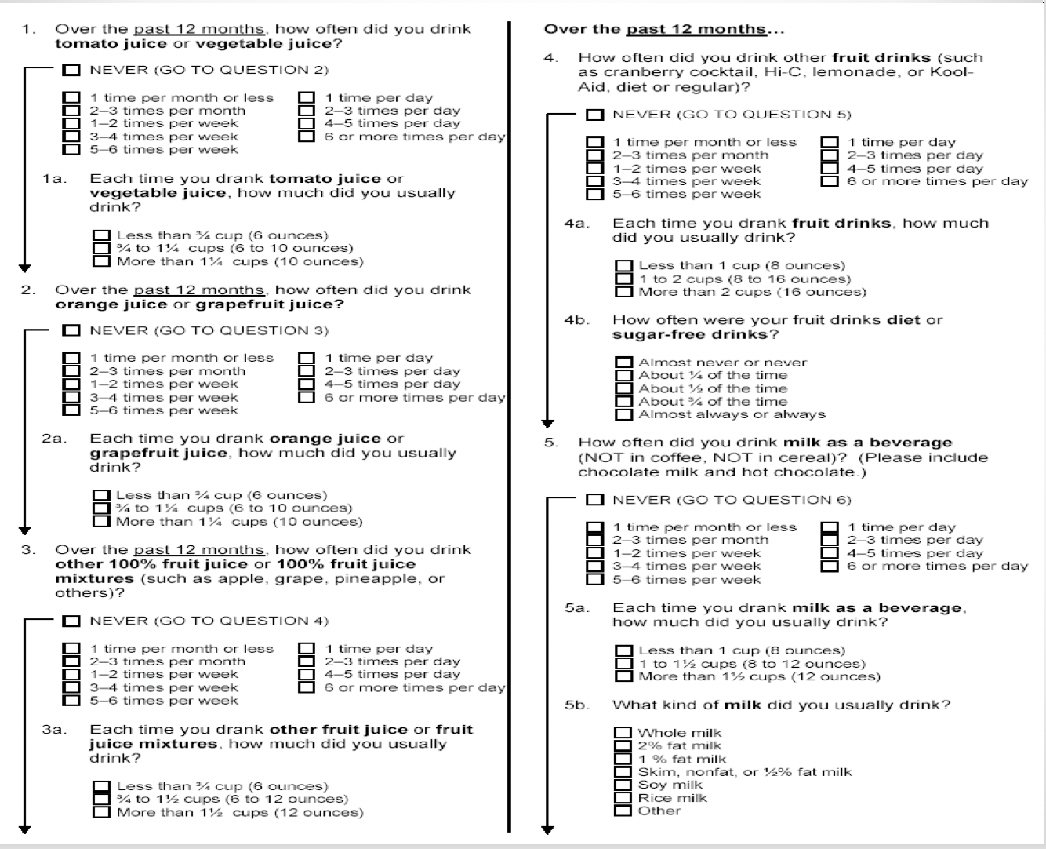

Slide 43
Twenty-Four-Hour Recall Method
Recall of the previous day’s intake
OR
Recall of a “typical day”
Easy to administer in person or by phone
Used in large studies
Subject to recall bias
Validity questionable
Repeated recalls are done to address validity

Slide 44
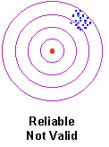
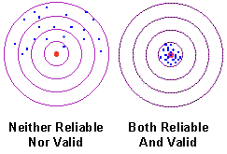
FACTORS DURING DATA COLLECTION
Scientific Data
Reliability The consistency of a measure
Validity The accuracy of a measure

Slide 45
FACTORS DURING DATA COLLECTION
Issues in Data Collection 1
Practical Issues
  Number of staff available to collect and analyze data
  Cost of administering the test
  Time needed to identify and interview or sample members of the target population.

Slide 46
food FREQUENCY method
Simple FFQ in which no information on portion sizes is collected- only frequencies.
Semi-quantified FFQ in which a certain portion size is specified for each food item or foods.
Open-ended FFQ in which subjects can select portion sizes , or indicate freely

Slide 47
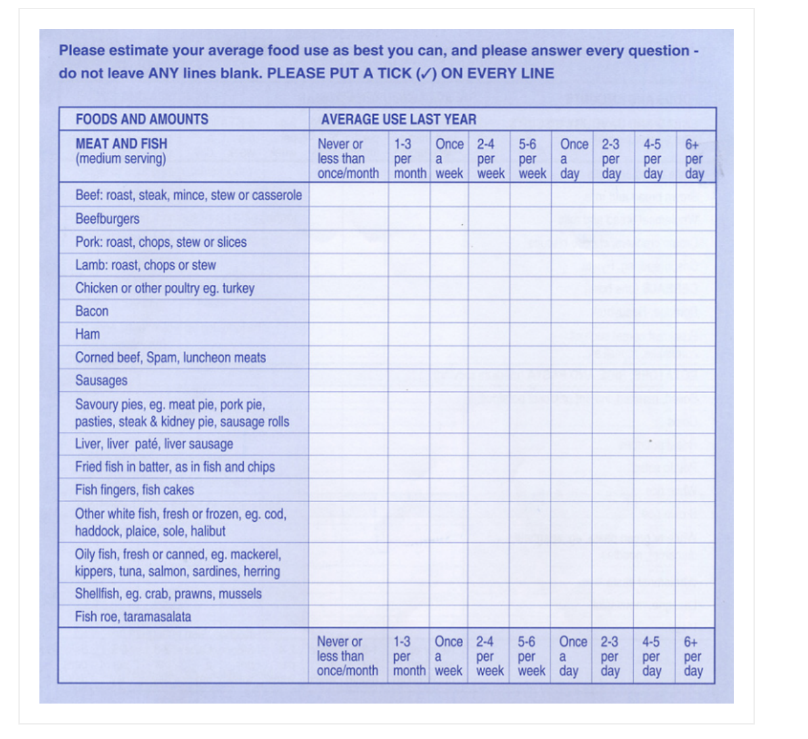
self-administered
requires only about 15 to 30 minutes to complete
Analyzed at a reasonable cost
https://dapa-toolkit.mrc.ac.uk/diet/subjective-methods/food-frequency-questionnaire

Slide 48
food balance sheets
food balance sheet shows the amount of food available for human consumption, taking into account amount of food grown , imported, exported, used for animal feed, used for food industry.

Slide 49
Step 4: Analyze and interpret the data
Merging Data - community background data and data about target population ( dietary and nutrition assessment data )
Make a diagnose about the community.
Four steps:
  Interpreting the nutrition status of the target population within the community
  Interpreting the pattern of health care services and programs designed to address the target population’s nutrition status
  Interpreting the relationship between the target population’s nutrition status and community characteristics
  Summarizing the evidence linking the target population’s nutrition status to their community environment.

Slide 50
The summary here should include:
The dimensions of the nutritional problem: severity, extent, frequency, distribution across the regional setting, distribution among age groups, it’s causes, associated morbidity and mortality
Community: what resources can you find in your community, the strength of these services, areas where it can be improved, areas where health problems are concentrated
Costs: what is the cost of treating this nutritional problem, compared with the costs of preventing it?
Executive summary: three or four key points that emerged from the assessment

Slide 51
Step 5: Share the Findings of the Assessment
Results are useful to other agencies and organizations
Prevents duplication of effort
Promote cooperation among organizations and agencies
Increase awareness of nutritional problem so that more communities can address it

Slide 52
Step 6: Set Priorities
When several nutritional problems are identified by the assessment—as often happens—the question asked by the community nutritionist is “Which health outcome is most important?”
Based on resources, community/target group priorities (not yours), political realities, public and administrative opinion

Slide 53
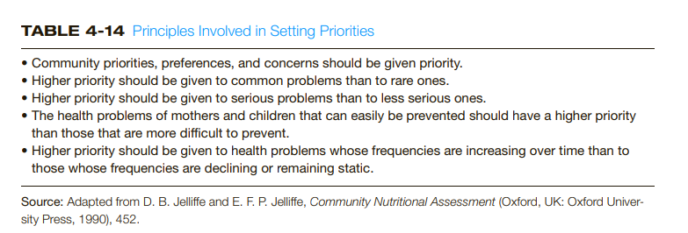

Slide 54
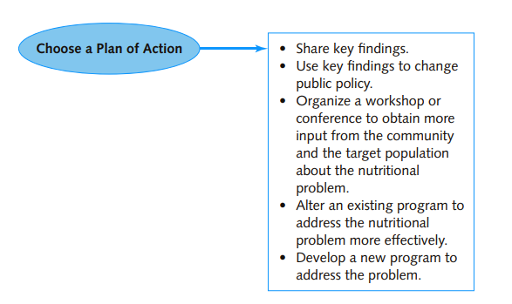
Step 7: Choose a plan of action

Slide 55
Goals and Objectives
Goals – broad (visionary) statements of desired changes or outcomes
“Reduce the incidence of overweight among adults.”
Objectives – specific measurable actions or outcomes to be completed within a specific time frame
“By 2019, the incidence of anemia among children from a specific population will be reduced by 15%.”

Slide 56
Types of Goals and objectives
Outcome objectives
Examples
Process objectives
In 2020 , the staff will distribute food baskets with iron rich foods designed to meet the iron needs of pregnant women in their first and third trimester.

Slide 57
Objectives/examples
Health:
By 2020, the incidence of iron deficiency anemia in low income pregnant women who are in their first and third trimester living in the region of Utuado will decrease by 30%
Behavioral:
By 2020, 60% of low income pregnant women will be able to explain the risk of anemia in pregnancy, how iron is related to anemia, as well as as list foods high in iron

Slide 58
when WRITING OBJECTIVES CONSIDER
SMART objectives
• Specific, Measurable, Attainable, Relevant, Time‐limited
Structure of objectives
• Time frame in which objective will be met
• Measurable characteristic, behavior, or action
Target population
Indication of how success will be evaluated
Example
By 2019, the incidence of anemia among children from a specific population will be reduced by 15%.

Slide 59
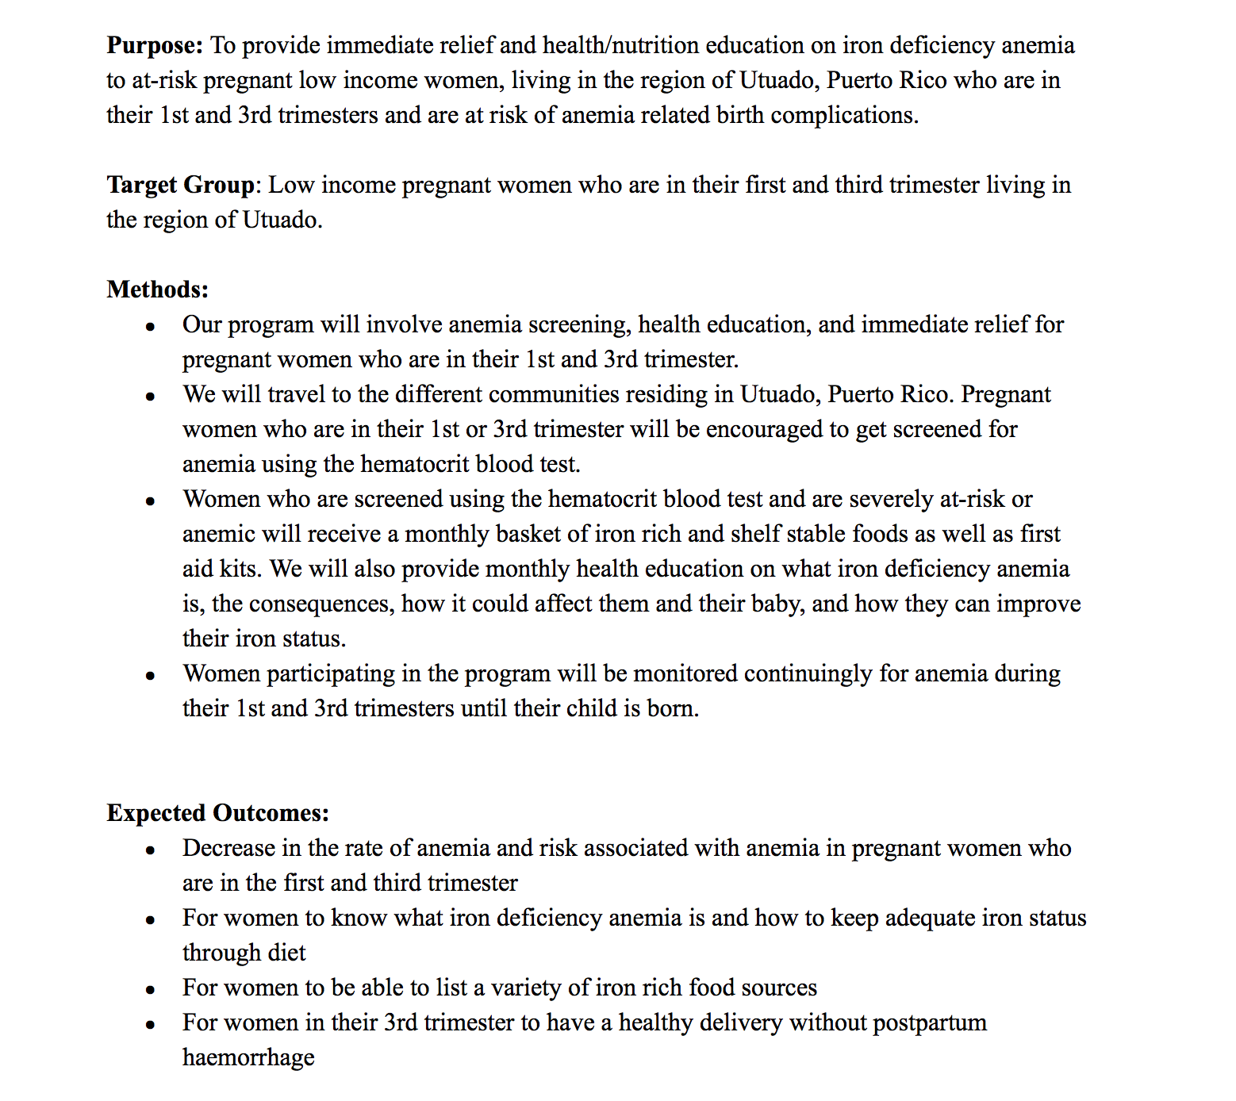
Abstract due next week
Thursday 14/4

Slide 60
ABSTRACT
Purpose
Target Group
Methods
Expected outcomes

Slide 61
Thursday’s class
Part 1: Introduction & Part 5 The impact of global food prices- Group 7
Part 2: Food Sovereignty and Food Security- Group 6 & Group 2
in the occupied Palestinian territories
Part 3: Israel’s Policies of Land and Resource Confiscation as a Cause of Food Insecurity – Group 1
Part 4: Israel’s movement and Business restrictions – Group 4
Part 5 : Environmental factors- Group 3
Part 6: Creating Food Sovereignty in the oPt: Overcoming Food Insecurity – Group 5
https://reliefweb.int/sites/reliefweb.int/files/resources/FS.pdf

