Slide 1
FOOD MICROBIOLOGY
FUNDAMENTAL FOOD MICROBIOLOGY, Fifth Edition
Bibek Ray and Arun Bhijnia, 2014

Slide 2
Physiology, Growth, and Inhibition of Microbes in Foods
This lecture covers:
(i) the ability of bacteria to use different biochemical pathways to generate the energy required to grow under adverse conditions
in foods;
(ii) the interaction of bacteria and foods in ecosystems in which the cells may exist in a variety of physical and physiological states and in which the roles of intrinsic and extrinsic factors are discussed
(iii) the kinetics of microbial growth.

Slide 3
Microbial Physiology and metabolism
Foodborne bacteria (all living things) must generate energy by oxidation reduction of compounds.
Aerobic organisms
the C-source is oxidized to CO2+water+ 38 molecules of ATP.
Most ATP is generated through oxidative phosphorylation in the electron transport chain:
Energy is generated in the presence of O2, and a high-energy bond between inorganic phosphate and ADP forms ATP.
Anaerobic bacteria,
By fermentation: one or two moles of ATP per mole of hexose
ATP is formed by substrate level phosphorylation
Phosphate (P) is transferred from organic compound to ADP.

Slide 4
Microbial Growth Kinetics
The growth of bacteria, yeasts, and molds is characterized by growth curves
lag, exponential (logarithmic or log), stationary, and death phases.
All four phases of microbial growth is important in food microbiology.
Bacteria replicates by binary fission (1 to 2 to 4 ...etc)
The growth curve is plotted as the number of cells (CFU/ml) on a logarithmic scale or log10 CFU/ml versus time.
Yeasts replicate by budding, (each cell may have many buds)
the log of the optical density vs. time will give accurate estimates of growth.

Slide 5
Principles of Microbial Growth
Importance Being Small Size
Bacteria are very small, ~ 0.2–4.0 μ in diameter
Surface area/ volume (s/v) ratio is high for spherical bacteria: (4πr²/(4/3πr³)=3/r)
High s/v ratio indicates high rate of metabolism and growth.
A newly divided cell has a higher surface s/v ratio.
young cells can easily use nutrients to obtain energy and synthesize cellular components.
As the cell size increases, s/v ratio decreases
It adversely affects the transport of nutrients and end-products
Therefore, growth rate of large cells is lower than small cells.

Slide 6
Bacterial Cell Reproduction
Bacteria reproduce by binary fission
When a bacterial cell is ready to divide, the cell material gradually increases until its volume is almost doubled. The cell then constricts in the middle.
constriction deepens until the cell contents are separated in two distinct compartments separated by a wall. The two compartments finally separate to form two new cells -
form colonies on Agar media
“Bacterial growth” refers to an increase in the number of bacteria present, not to the increase in size of the individual bacterial cells.

Slide 7
Growth
Occurs under favorable conditions
Availability of nutrients in food
Outcome of growth
food spoilage
foodborne diseases
food bio-processing
Isolation in pure cultures and subsequent identification of all organisms causing food spoilage and foodborne disease

Slide 8
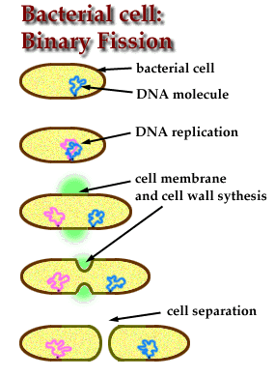
Growth or reproduction
Growth indicates increase in number/ mass of cells
Bacteria reproduce asexually by binary fission
Start with DNA attachment to the CM, replication and separation
partition between the 2 new DNA forms,
invagination and septum formation of wall, and cell separation.
Surface/Volume ratio is high in new cells to absorb more nutrients

Slide 9
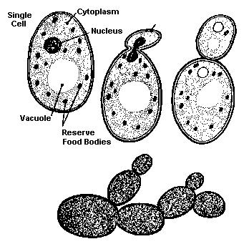
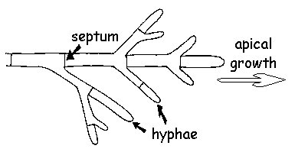
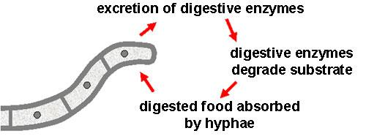
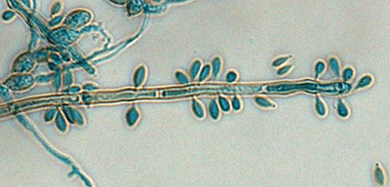
Growth
Yeasts/molds
Budding – asexual reproduction
yeast cell produces a small bud on its surface
Bud grows and separates
Molds grow by elongation of hyphae
They also produce conidia

Slide 10
Growth Curve
Growth rate can be determined by counting cells, viable vs. dead cells
or by cell density (O.D. 600 nm)
Plot on semi-logarithmic paper for the counts, linear for cell density
The plot represent different conditions of growth:
Lag phase
Log phase
Stationary phase
Death phase
Cryptic Phase

Slide 11
Nature of microbial growth in food
Mixed population
food harbors mixed population of microorganisms
bacteria, yeasts, and molds
Depending on the nutrients, storage conditions etc.. one species (even if initially present at low number) may grow better than others under these conditions and become predominant
Example under 4 C storage, only few organisms will continue growing while the one that grow better at 37 C will stop growing

Slide 12
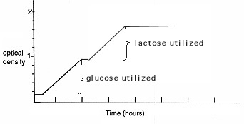
Sequence of growth in food
If 2 organisms are initially present with equal numbers, stored under identical conditions
The species with the shorter generation time will predominate
Some species are poor competitors in mixed culture (Listeria)
Some species in mixed culture will grow better than others, but it creates conditions that will halt its growth and favors the growth of other species. Example, P. aeruginosa and anaerobic bacteria
Diauxic Growth: Organisms can utilize more than one nutrient, growth will be interrupted by a lag phase (Figure):
E. coli in food containing glucose and lactose and
P. aeruginosa in food containing carbohydrates and proteins

Slide 13
Symbiotic growth
Symbiosis - helping one another during growth in food
if > 2 types of organisms are present.
One may produce metabolic products that the second can not but needs it to grow better.
The second species produces a nutrient that stimulates the first one to grow better.
Example:
In yogurt: A Streptococcus spp. hydrolyzes milk proteins to amino acids (AA)
AA are necessary for good growth of Lactobacillus spp.
Lactobacillus then produces formate which stimulates the growth of Streptococcus spp.

Slide 14
Synergistic Growth
Occurs when > microbes grow together in food
When each type grows alone it produces some metabolites at low rate in small amounts
Synergistic growth – when mixed - growth rate and production of metabolites is increased (not additive)
Example – in milk
S. thermophilus and Lab. delbrueckii subsp. blllgarictls produce tiny amounts of acetaldehyde (8-10 ppm) during growth in milk independently
Acetaldehyde gives a desirable flavor in yogurt
Together in milk > 30ppm of acetaldehyde is produced, much higher than the additive amounts produced independently

Slide 15
Antagonistic Growth
> organisms present in a food can adversely interfere with the growth of another -sometimes one can kill the other (toxic substances/enzymes..)
Examples:
Enterococcus - produce antibacterial proteins (bacteriocin) that can kill/suppress the growth of Gram +ve bacteria
some yeasts can produce enzymes that interfere with the growth of molds – degrade hyphae
Penicillium produce penicillin- used to inhibit the growth of staph
Bacteriophages can lyse susceptible bacteria (E. coli)
This is used to control growth of undesirable spoilage and pathogenic microorganisms in food.

Slide 16
Conclusion
It is important to study the interaction of microbial growth in food
provides basic information to understand the mechanisms of food spoilage
foodborne diseases
food bio-processing and strain improvement
Food quality
Preservation and storage

Slide 17
Growth Phases
Lag phase
Increase Lag Phase to Prevent Food Spoilage
Logarithmic Phase
Stationary Phase
Death Phase
Cryptic Phase
Plot on semi log paper, growth vs, Time
1 x 10⁹ is maximum growth of most microorganisms

Slide 18
Generation Time - Doubling Time
The time that one cell takes to divide into two
generation time of cells is called the doubling time
Cells do not divide at the same time or rate
Calculating generation time under different conditions provides valuable information for developing methods to preserve foods.
Optimal growth conditions (culture), bacteria have the shortest generation time ~12 m but slower in foods
Factors that affect optimal growth:
nutrients, Temp, time, water activity, redox potential
yeasts and molds have slower generation time ~40 m

Slide 19
Generation Time - Doubling Time
G = Log 2 t/ log N – log N0
N0 initial number (10⁴)
N final number (10⁶)
t duration in minutes when initial number reaches the final (here in this example = 120 minutes)
G = 0.3 x 120/6-4 = 18 minutes

Slide 20
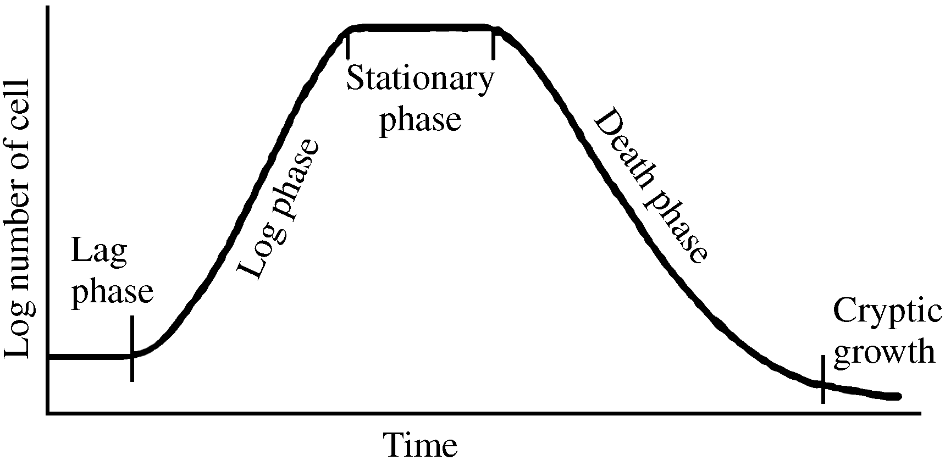
Growth curve

Slide 21
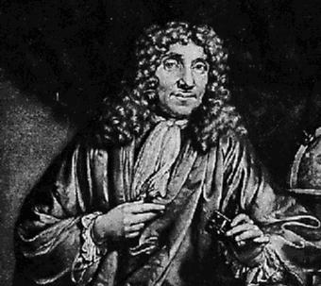
History/Discovery of microrganisms The discovery of microorganisms began with the invention and improvement of the microscope.
Antonie Philips van Leeuwenhoek, Father of microbiology, 1st microbiologist
observed bacteria in saliva, rainwater, vinegar, and other materials; sketched the three morphological groups (cocci, rods and spiral); and described some to be motile

Slide 23
Classification System
Prokaryotes
Bacteria
Unicellular with cell wall containing peptidoglycan
Archaea
Unicellular with no peptidoglycan in cell wall (not in food)
Eukaryotes
Animalia, Plantae, Fungi
Viruses
Protista
unicellular microscopic organisms
may share morphological and physiological characteristics with animals plants or both.
Notes:
Archaea Methanogens, Halophiles, Extreme Thermophiles

Slide 24
Organisms studied in food
Bacteria
GNB- E,coli, Salmonella, Shigella, Yersinia, Campylobacter
GPB – Bacillus cereus, Listeria
Fungi—molds and yeasts
S. cerevisiae, Rhodatorula, Candida, Aspergillus, penicillium
Protozoa
Amoeba, Giardia, cryptosporidium
Parasites
Tapeworms, Ascaris, Toxoplasma
Viruses
Hepatitis, Norovirus
Prions
Infectious protein such as causing mad cow disease

Slide 25
MicrobialTaxonomy Conventional time consuming techniques Do not rely on genome sequencing
The study of phylogenetic relationships between organisms
sorting based on phenotypic information from culture
Kingdom -archaebacteria, eubacteria, fungi, animal
Phylum -related classes
Class -related orders
Order - related families
Family - related genera
Genus - closely related species
Species -similar organisms within a genus designated by:
biochemical and phenotypic criteria
DNA relatedness or genetic similarity: G+C content

Slide 26
Genus, Species, Strain and Type
Genus:
first name – first letter always capitalized
Species:
second name – all letters always in lower case letters
Both are always italicized or underlined
Example: Staphylococcus aureus or Staphylococcus aureus
Strain refers to a genetic change which makes the organism different – virulence, drug resistance
MRSA, VRE, KPC, ESBL,
Type refers to surface changes that make the organisms distinguishable from other species
Serotypes, phage typing

Slide 27
Eubacteria vs. Archaea
 | Bacteria | Archaea
Cell Wall | Peptioglycan NAGA-NAMA present | Pseudopeptidoglycan NAGA only
 | Muramic acid | No muramic acid
16s RNA | No similarity between them, sequences are completely different

Slide 28
Prokaryotes vs. eukaryotes
 | Prokaryotic cell | Eukaryotic cell
Nucleus | Absent | present
DNA Chromosome Introns/histones | Nucleoid in the cytoplasm Single, haploid circular absent | Contained in the nucleus Diploid, > 1 present
Reproduction | Asexual by binary fission | Sexual & asexual by meiosis and mitosis
Sterols | None in the CM except in mycoplasma | Cholesterol and ergosterol in CM
Cell wall PG layer | Present Present except in archaea | Present in fungi/plants Chitin & cellulose
Membrane bound organelles | None | Present Mito, ER, Golgi,

Slide 29
Why Study Food Microbiology?
Provide Clean, Safe, Healthful Food to Consumer
Prevent Food Spoilage
Prevent Food-borne Illnesses
Food Preservation and Production
Monitor microorganisms Commonly Found in Foods
Sources of microorganisms
Environmental: water, air, dust, dirt, Fertilizer
Animals/Birds– Feces, Hide, GI
Fruits/Vegetables /Grains
Control
Economic and Public Health Issues

Slide 30
Foodborne illness
Foodborneillness.com
describes some of the most commonly recognized bacteria and viruses that cause food poisoning
>90% of illnesses are caused by these pathogens:
Salmonella – most fatalities
Norovirus
Campylobacter
Toxoplasma
Cryptosporidium
E. coli O157:H7
Listeria
Clostridium perfringens
Salmonella
Shigella
MRSA

Slide 31
Food-Borne Illness
CDC estimates that 76 million foodborne illness, or food poisoning, cases occur in the US every year, which means that one in four Americans contracts a foodborne illness annually after eating foods contaminated with foodborne pathogens
~128,000 Americans are hospitalized
3,000 die after eating contaminated food
Economic Research Service calculator (works with USDA,FDA): -
Cost of illness: $6.9 Billion/Year Cost of Food Borne Illness
Notes:
Expriment in US hospitals:

Slide 32
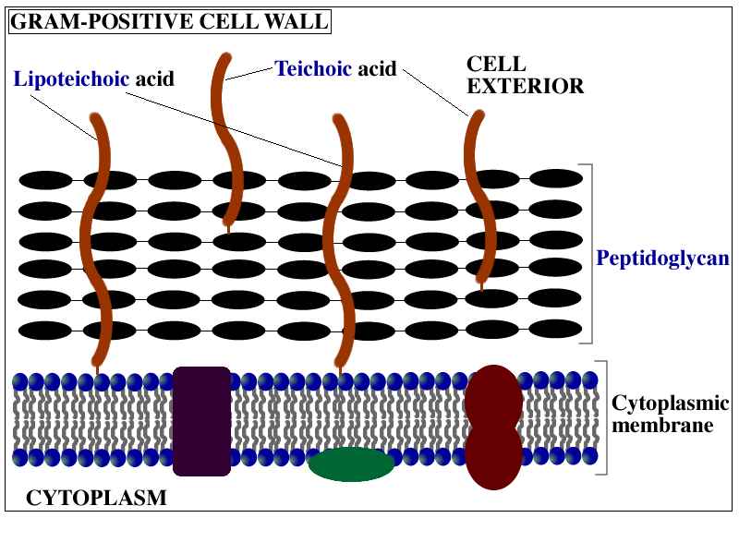
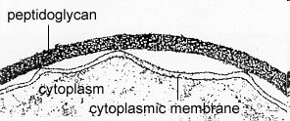
Bacterial Cell Wall
Gram positive CW
Thick peptidoglycan layer
N-acetyl glucosamine
N-acetyl muramic acid
Teichoic Acid, either attached to the CM- lipoteichoic acid (5-C ribitol) or 3C glycerol

Slide 33
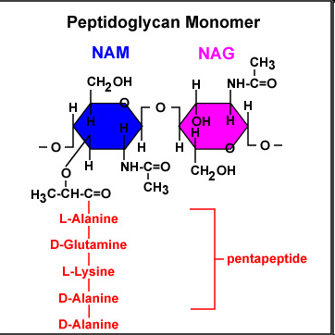
Bacterial Cell Wall
PG Layer:
Backbone consists of alternating:
N-acetyl glucoasamine (NAG) attached (via b-1,4 linkage) to
N-acetyl-muramic acid (NAM).
A penta-peptide chain is attached to the NAM to cross link the strands together.

Slide 34
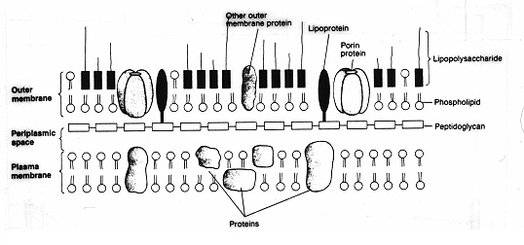
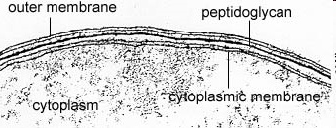
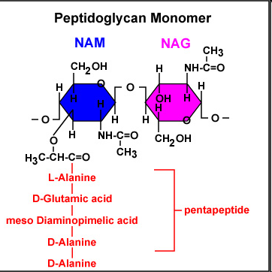
Gram Negative Cell Wall
Complex CW
Consists of a thin rigid PG layer
PG layer is surrounded by an outer membrane
The periplasmic space is found between the CM and OM
In the OM Lipopolysaccharides (LPS) molecules are found
cross linkage is between the terminal D-alanine on one chain and meso-DAP on the adjacent chain

Slide 35
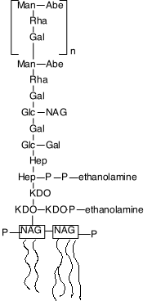
Gram Negative Cell Wall
LPS - 3 components:
Lipid A:
2 NAG units with up to 7 fatty acids that anchor the LPS in the OM
The endotoxin activity in patients with gram negative sepsis
Core Polysaccharide (Conserved)
2 unique CHOs
KDO, 8-C sugar or ketodeoxyoctulonic acid
Heptose, a 7-C sugar
“O” specific side chain - Repeating units of 3-5 sugars
Antigenic,
The O-antigen is species specific
Provide protection against host defenses

