Slide 1
Mycotoxins

Slide 2
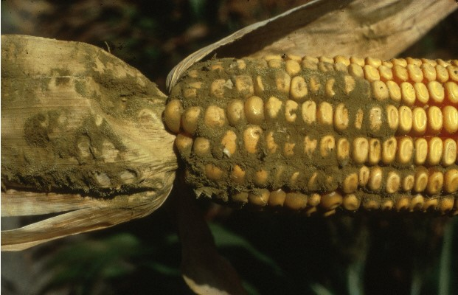
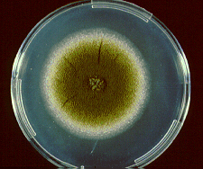
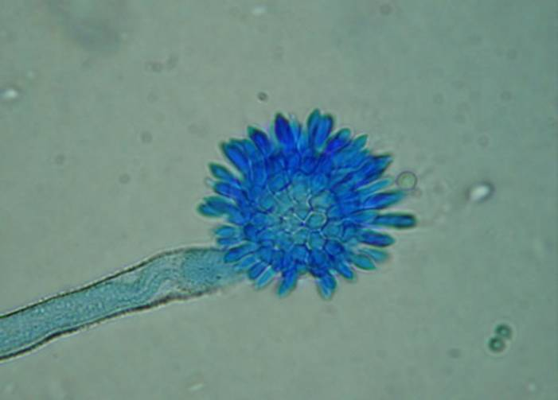
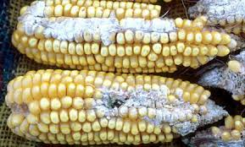
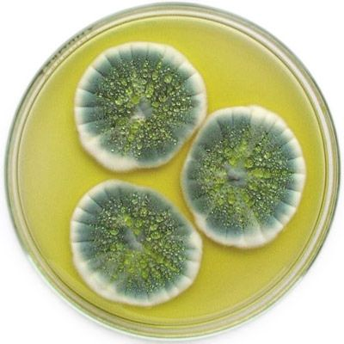
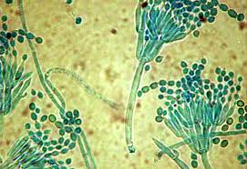
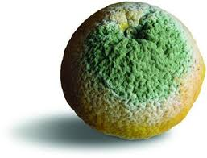
Fungi, Mycotoxins

Slide 3
Mycotoxins
Mycotoxins are fungal metabolites which when ingested, inhaled or absorbed through the skin, can cause disease or death in man and domestic animals, including birds.
the toxins produced by macrofungi (the mushrooms) are not included
Mycotoxins are produced during fungal growth. They are chemically stable once formed, and persist in food even
after the destruction of the fungi that produced them
Mycotoxins may occur in processed foods, but are much less important than when they occur in commodities such as grains or nuts.

Slide 4
Mycotoxins
Mycotoxins effects on human/animal health
Most important mycotoxins
Neurotoxin: interfere with the function of nervous tissue, may cause irreversible cell damage and death
Teratogens: interfere with the development of a fetus, causing birth defects.
Nephrotoxins: causes damage to kidneys
Hepatotoxins: cause acute/chronic liver disease
Immunosuppressive agents: inhibit or prevent activity of the immune system
Carcinogens: cause cancer
Aflatoxins,
Ochratoxin A
Fumonisins
Deoxynivalenol
Zearalenone

Slide 5
Aflatoxins
Chemical Characterization
Four important naturally occurring
Aflatoxins B1 and B2, named because of their blue fluorescence under UV light
Aflatoxins G1 and G2, fluoresce greenish
When aflatoxins B1 and G1 are ingested by lactating animals, small proportions (1 to 2%) are excreted in milk
Aflatoxins M1 and M2,are hydroxylated derivatives of the parent compounds.

Slide 6
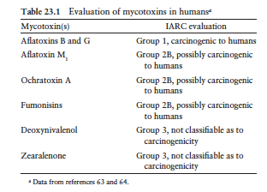
Aflatoxins

Slide 7
Fungal Sources
Aflatoxins are produced in foods primarily by:
Aspergillus flavus – growth range 10-48 C, aw 0.82, pH 3.4-10
A. parasiticus closely related species
Both species produce rapidly growing colonies characterized by green conidia (asexual spores) borne on phialides
A. flavus bears conidia on two sets of supporting cells (metulae
and phialides), while A. parasiticus spores are borne on phialides alone.
A. flavus isolates produce B aflatoxins (only 40% of strains)
A. parasiticus- all strains produce both A and B mycotoxins

Slide 8
Growth characteristics
Detection from food of A. flavus:
culturing on A. flavus and parasiticus agar for 48 hours at 30^{O} C
the reverse will display a brilliant orange-yellow color
growth range 10-48 C,
aw 0.80 to .82
pH 3.4-10
Heat resistance of A. flavus conidia
D43 of >160 hours
D52 of 40-45 min
D60 of 1 min at neutral pH and hi aw

Slide 9
Analysis of aflatoxins
Unevenly distributed in foods especially in peanuts
Sampling is the largest source of error
Sampling plans developed for 10-ton lots, and for bag stacks
All methods use samples of >8 kg and Subsamples of >500 g
Extraction by solvents depends on food matrix
Methanol:water-80:20 used for maize, peanuts, cottonseed
The method for aflatoxin assays is thin-layer chromatography (TLC), inexpensive, reliable, recommended for less developed economies.
For acceptable/not acceptable testing immunochemical methods are used.
For high-volume analytical labs or regulatory authorities, TLC is used with mass spectroscopy
Detection limits are < 1 mg kg–1

Slide 10
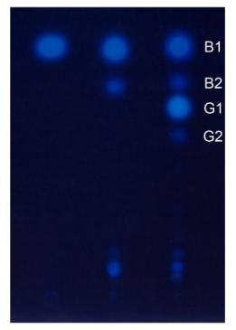
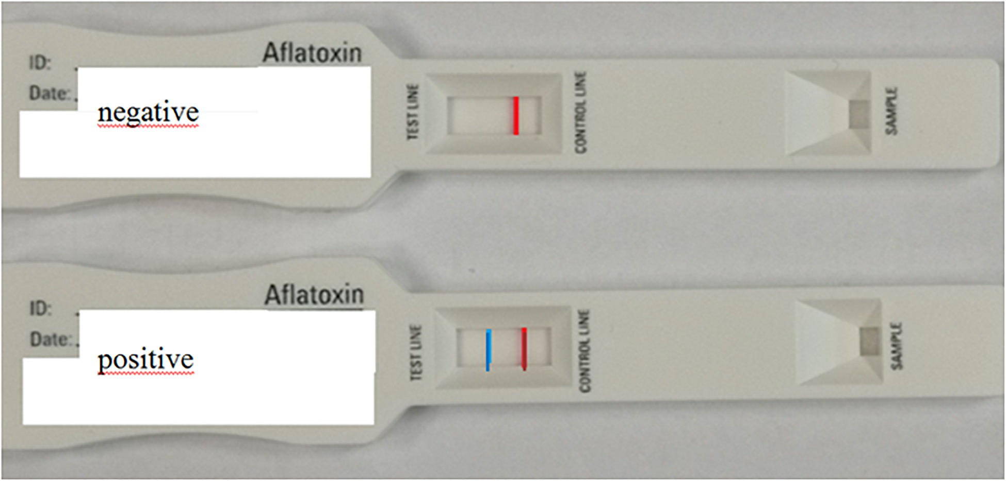
Analysis of aflatoxins
Figure 1: TLC profile of aflatoxin production
From left to right:
AFB 1 standard
flavus A-11 (isolated from soybean)
parasiticus NRRL 2999.
Source: Mycobiota and aflatoxin B1 contamination of rainbow trout (Oncorhinchus mykiss) feed with emphasis to Aspergillus section flavi

Slide 11
Occurrence of Aflatoxins in Foods, and Regulation
Levels of aflatoxins in foods are highly variable
Peanuts, maize, and cottonseed
contain unacceptable levels of aflatoxins,
assays are carried out at wholesale and finished products
Other closely watched commodities are tree nuts
pistachios and brazil nuts, figs, and spices. levels in these items may exceed regulatory limits
Under inadequate storage conditions, other grains
rice may permit growth of A. flavus and aflatoxin production.

Slide 12
Occurrence of Aflatoxins in Foods, and Regulation
Regulation of aflatoxin levels in foods:
Limit of detection: 5 mg kg–1 , as the permitted limit, this level is hard to achieve in peanuts
safe limit for human consumption : 15 mg kg–1 of peanuts.
Levels in most foods where aflatoxin is less likely to occur, remain lower, usually <5 m g kg–1
safe levels of aflatoxins have now been established
aflatoxin levels are closely controlled in developed countries,
it has been estimated that up to 5 billion people worldwide are at risk from exposure to uncontrolled levels of aflatoxins in their diets

Slide 13
Control of Aflatoxins in Foods
Control of aflatoxins is very difficult - invasion of A. flavus (A. parasiticus in peanuts) occurs before harvest
In peanuts, infection by A. flavus may occur while nuts are still in the ground - responsible for high levels of aflatoxins
In the absence of pre-harvest infection + rapid and effective drying: peanuts can be produced free of any appreciable level of aflatoxin.
Preharvest infection is due to high spore numbers in soil
Reduction of spores is used for control
plant stress induced by drought:
Irrigation, is regarded as the most effective method for reducing aflatoxin formation in peanuts
Use of drought resistant crop
Weed control and wider spacing between rows

Slide 14
Food Association
Spores and hyphae of toxigenic molds are detected in many foods
corn, wheat, barley, rye, rice, beans, peas, peanuts, bread, cheeses, dry sausages, spices, apple cider
Feeding moldy products to food animals/birds result in contamination of products as milk, eggs with mycotoxins
Many of the mycotoxins are resistant to heat used in the normal preparation of foods
Molds do not grow in vacuum packaged foods
In the US, the regulatory agencies have set limits of aflatoxins in peanut butter 20 ppb and milk 2 ppb

Slide 15
Prevention of mycotoxin-induced disease
Avoiding
Prevent contamination and growth in food/feed
Eating a product in which molds have grown
Trimming foods with mold growth is not a good practice
Diluting
heating can reduce the load of mold/spores
Use anaerobic packaging, reduce Aw to 0.6, freezing
Cleaning
solvent extraction methods, treatment with chemicals to inactivate aflatoxins: NH3
Adding preservatives- organic acids prevent mold growth
Testing: old and new methods (HPLC , immune, molecular)
Drying of grains and storage environment

Slide 16
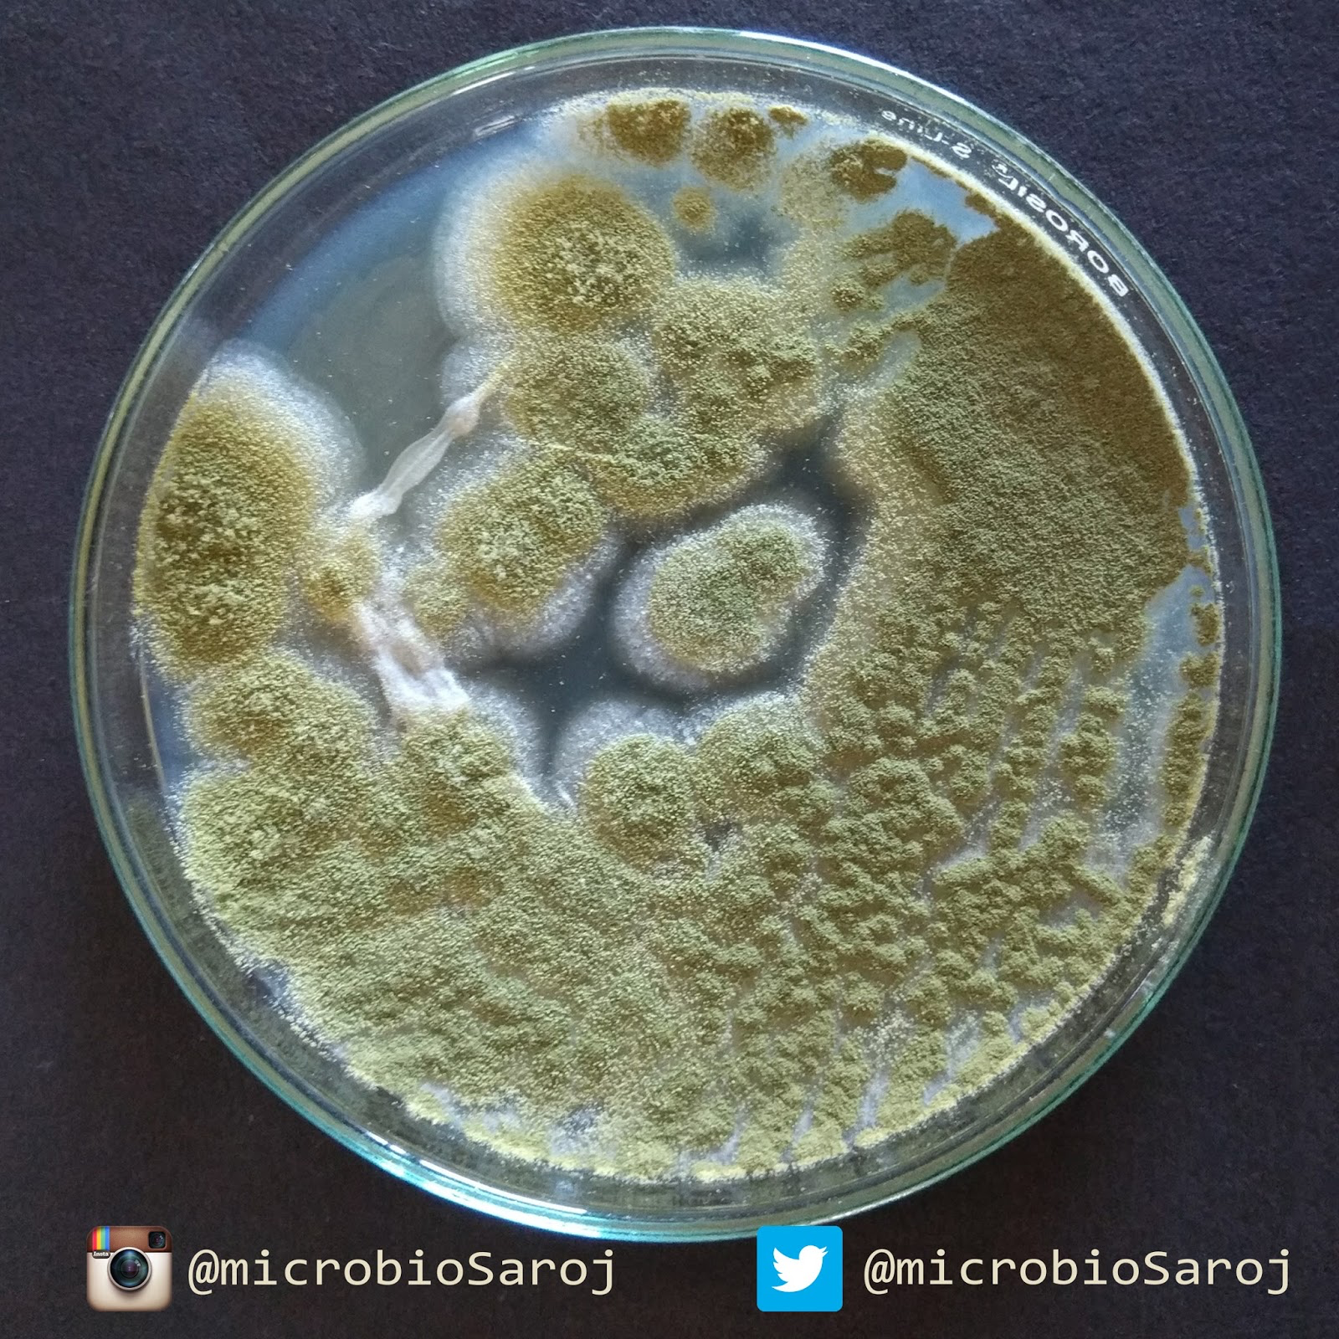
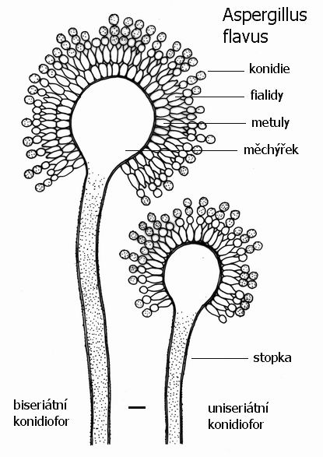
Identification
Aspergillus flavus
Colony is cottony to granular
Yellow
Long rough conidiophores
Globose vesicle
Uni and bi-seriate phialides that cover the entire vesicle
Long chains of circular conidia

Slide 17
Brucella, Brucellosis Foodborne Viral Pathogens
Reference:Ewen CD Todd, Judy D Greig. Viruses of foodborne origin: a review. Virus Adaptation and Treatment 2015:7 25–45

Slide 18
Brucellosis
Human brucellosis:
A zoonotic infection caused by Brucella spp.
B. abortus, B. suis, and B. melitensis.
Gram-neg, nonmotile, non-spore forming, aerobic small rods
pathogenic to animals/humans, in infected animals it is found:
In the uterus of pregnant animals
In the mammary glands of lactating females -
the pathogens can be excreted in milk
People who get infected with Brucella Sp.
People working with animals
people working with meat
Consumption of raw milk and some products made from raw milk (cheese) have been implicated in foodborne brucellosis.

Slide 19
Brucellosis
Brucella survive for a long time in milk and milk products.
Pasteurization of milk/milk products kills Brucella cells.
The infectious dose for human infection is 10–100 cells
Symptoms appear in 3–21 d after eating contaminated food:
undulant fever with irregular rise and fall of temperature
Profuse sweats, body aches, joints pain, chills, and weakness
Outbreaks in US from consumption of imported cheese
CDC estimate about 839 cases of brucellosis annually
Control measures:
pasteurization of milk
Manufacturing of dairy products from pasteurized milk
proper sanitation
Diagnosis: culture, serology , PCR
food

Slide 20
Viruses
Obligate intracellular parasites
Non-viable, referred to as particles
Host specific, tropic to certain cells/tissues and to a specific host, HAV, NOR
Consist of DNA or RNA but never both, protein and glycoprotein
Viruses are the most common pathogens transmitted via food, for example:
cause 66.6% of food related illnesses in the US compared to
9.7% salmonella
14.2% campylobacter

Slide 21
Viral life cycle
Attachment
of Virus to a receptor on susceptible cells
Genetic material enters the cell
Integration
into the host DNA
Virus control the replication of the cell to produce viral components
Assembly
of the viral particles inside the cell
Rupture
of the host cell and release of mature virus particles

Slide 22
Human enteric viruses
Transmitted by fecal-oral route due to consumption of contaminated foods, water
contact with fomites associated with human sewage/ vomitus
The most significant enteric viruses are:
human noroviruses (NoVs)
most common of acute gastroenteritis in industrial countries
leading causes of foodborne disease.
in the US, NoVs cause about 58% of all domestically acquired foodborne disease (>5 million people)/Y
responsible for ~15,000 hospitalizations & 150 deaths /y.

Slide 23
The source of enteric virus contamination is human fecal matter, harbor 10⁶ to 10¹² genomic RNA copies per gram
NoVs virus particles can be liberated during a vomiting episode
Viruses are
species specific and tissue tropic
infect only humans
From an epidemiologic perspective:
human NoV and hepatitis A virus (HAV) are the two most important.
NoV is most significant by virtue of numbers of cases
HepA causes a more severe disease

Slide 24
Enteric Viruses Importance
Most of food microbiology is dedicated to bacteria
difficult to detect/culture viruses from contaminated food
some may die rapidly during food storage and preservation
food is not routinely examined for contamination by enteric viruses
In the US (73-87), viral foodborne infection was the fifth leading cause of foodborne disease in terms of (outbreaks and cases)
Between (86 -87) viral infection caused by hepatitis A and Noro viruses (major viruses) ranked third after salmonellosis and shigellosis in total number of foodborne disease cases during outbreaks

Slide 25
Characteristics
Enteric pathogenic human viruses cause foodborne disease
<1940s- polio viruses were the only viruses known to cause foodborne infections transmitted through raw milk
hepatitis A viruses, noroviruses, Rota viruses, non-A-non-B hepatitis viruses have been associated with foodborne infections WW
hepatitis A and Noroviruses are the most important human borne pathogens in terms of outbreaks and cases
Hepatitis A virus can be cultured and used to produce Vaccines but norovirus can not be cultured
Norovirus can be detected by:
ELISA, PCR, sequencing

Slide 26
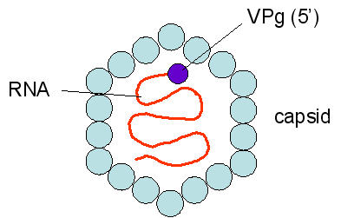
Disease and Symptoms
Transmission:
Occurs via food or person-to-person with low infective dose
Common in children < 5 years in developing countries
hepatitis A virus infect hepatocytes
Symptoms:
symptoms occur after 2-7 weeks, last 1-2 weeks or longer
fever, malaise, nausea, vomiting, abdominal discomfort
inflammation of liver followed by jaundice
viruses are excreted in the feces of infected persons

Slide 27
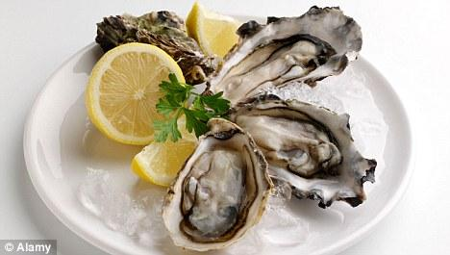
Noroviruses
Major cause of foodborne disease
In the top 10 agents, sometimes number 1
Over 90% of diarrheal disease outbreaks on cruise ships are caused by NoV
Norovirus infect only mature enterocytes in the intestinal villi leading to massive cell damage and malabsorption
causes self-limiting gastroenteritis, characterized by nausea, explosive projectile vomiting and diarrhea, abdominal pain, occasional headache and fever
Symptoms appear 12-24 h after ingestion and last for 1-2 days
viruses are excreted in the feces of infected persons

Slide 28
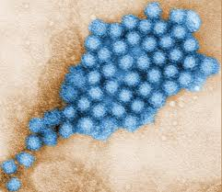
Noroviruses
Detection
EM microscope
Antibodies
Molecular techniques
Transmission:
Fecal to oral route

Slide 29
Foodborne Transmission
From a foodborne disease standpoint, three types of commodities are commonly associated with viral disease outbreaks:
1. molluscan shellfish (clams, oysters) growing in waters contaminated by feces (storms, sewage, sewage treatment plants..)
2. fresh produce items contaminated by human feces during production or packing, usually through workers’ hands or contact with contaminated water
3. ready-to-eat (RTE) and prepared foods contaminated by infected food handlers as a result of poor personal hygiene

Slide 30
Viruses – agents of foodborne illness
Source of foodborne viruses is human feces
Virus infect human GI tract cells and release large numbers of progeny into the feces
10⁸ viruses/g feces
10⁷ virus particles in in one droplet vomit
Example
If an infected food handler fails to wash his hands after using the toilet
If 0.01 g feces get trapped under his fingernail, then: 0.01 g X 10⁸ particles/g = 10⁶ particles
If the infectious dose is 1000 particles when mixed with food served to people, 1000 people can get sick

Slide 31
Food Association
Source of HAV/NOV contamination in food:
Direct from food infected handlers even without symptoms
Indirect via sewage and polluted water
Vegetables, shellfish (oysters, clams..) exposed to water polluted with sewage and eaten raw or improperly heated have been implicated in many outbreaks
viral disease outbreaks are due to
contamination of ready-to-eat foods
poor personal hygiene
contaminated equipment used with foods in cafeterias and restaurants

Slide 32
Prevention
to kill the viruses in contaminated foods
to adopt good sanitation/personal hygiene to control contamination
Proper heat treatment- pasteurization can kill the viruses
Steaming lightly is not effective heat-treatment procedure
Hydrostatic pressure processing is effective
Sanitation using oxidative agents such as hypochlorite can kill viruses in contaminated equipment or in water used in food processing
keeping suspected individuals away from handling ready-to eat foods can control viral foodborne infections
Vaccination against hepatitis A is available and is used to control the disease

Slide 33
Detection Methods
enteric viruses do not multiply in food and are present in low numbers
For identification of hepatitis A virus
cell culture procedures
immunological methods
reverse transcription-polymerase chain reaction (RT-PCR) nucleic acid amplification method is effective in detecting both hepatitis A and NoVs from shellfish
a total of 10²⁻ ³ viruses were detected in suspected food samples (ham, turkey, and roast beef)

Slide 34
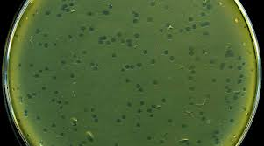
Bacteriophages
Attack bacteria such as Lactic acid bacteria
If 1 million pounds of milk with infected bacteria
Bacteria can't finish converting lactose to lactic acid
Get infected and lyse
To combat bacteriophages :
Fogging the plant with 20 ppm Cl₂ kills the phage
Use different tested starter culture strains
Keep starter culture bacteriophage free
Beneficial use of Bacteriophages
can be added to foods containing bacteria
infect bacteria- multiply at high rates- produce hi conc. Progeny -infects more bacteria - eventually eliminating it.

Slide 35
Prions
Prions
Cause a transmissible neurodegenerative disorder
Consist of single protein molecule, part of the food
Causative agents of mad cow disease
Cause Creutzfeldt disease in humans
Controversial subject because a prion is devoid of nucleic acid
Prions are not inactivated by heat, irradiation or preservatives
Once they get into the food, we can not get rid of them

Slide 36
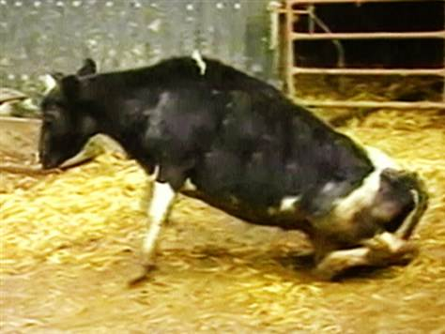
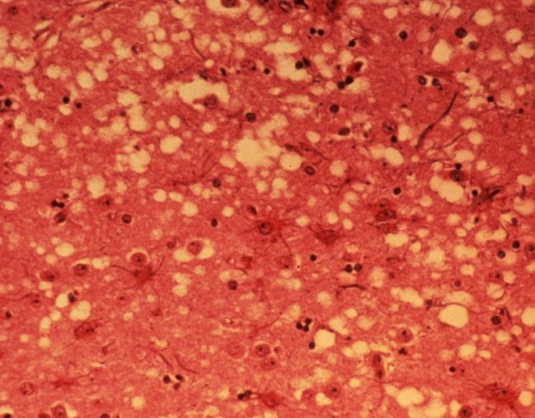
Prions
Mad cow disease:182,000 cattle were destroyed in the UK
Meat industry was almost ruined
1st appeared in cows in 1986
In 1972 in a patient (CJD) – Prusiner – a doctor
A patient had the disease, her brain only was affected eaten up
No immune response
The rest of the body was not touched
The prion theory was put by Pruisner in 1982

Slide 37
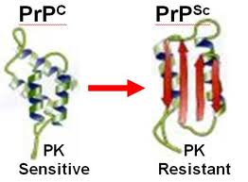
Prions
The prion theory:
A prion is an infectious protein particle devoid of nucleic acids
A normal prion is normally found in healthy brain
Another infectious modified prion may contact the normal prion which changes its morphology to the infectious particle and destroys the brain
Infectious prion (PrP^{sc}) is Transmitted by eating meat from infected cows

