Slide 1
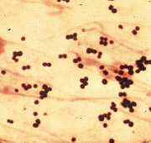
Foodborne Intoxications
Staphylococcus aureus

Slide 2
Staph aureus
one of the most prevalent causes of gastroenteritis worldwide.
results from ingestion of one or more preformed staph- enterotoxins (SEs) in staph-contaminated food.
This form of food poisoning is considered an intoxication
does not involve infection and growth of the bacteria in the host
To understand SFP etiology, in 1930 Dack et al., voluntarily consumed supernatants from cultures of “a yellow hemolytic staphylococcus” grown from contaminated sponge cake.
Upon ingestion, Dack became ill with vomiting, abdominal cramps, and diarrhea - staph toxin exerted the effect on the GI tract
its activity was “not destroyed by heating for 30 minutes at 100°C.” (Heat stable)

Slide 3
Characteristics of the organism
Staphylococci- group of small, spherical, gram-positive bacteria.
Catalase- positive with typical gram-positive cell wall containing peptidoglycan and teichoic acids.
Family Micrococcaceae.
Genus Staphylococcus have 32 species and subspecies.
Many are present in food due to human, animal, or environmental contamination.
Several species of Staphylococcus, including both coagulase-negative and coagulase-positive isolates, can produce SEs.
Nearly all cases of SFP are attributed to S. aureus.

Slide 4
Foodborne Intoxications or food poisoning
occurs from the ingestion of a food containing preformed toxin
  staph intoxication: S aureus
  Botulism: Clostridium botulinum
  Mycotoxicosis: molds
General characteristics of food poisoning:
Toxin is produced by a pathogen during growth in food
Toxin can be heat labile or heat stable
Ingestion of a food containing active toxin, not viable microbial cells, is necessary for poisoning
Symptoms occur quickly – 1 hr after ingestion, average 4 hrs)
Symptoms differ with type of toxin;
Enterotoxins produce gastric symptoms
Neurotoxins produce neurological symptoms

Slide 5
Importance
Staph food poisoning (from toxins) of S. aureus:
  considered one of the most frequently occurring foodborne diseases worldwide
In the US before the 1980s- it was implicated in many outbreaks, but recently the number of outbreaks has declined
This is due to:
  Better practices of refrigerating food
  improved sanitary practices that can control contamination and growth
the number of staph outbreaks and number of cases of gastroenteritis is high

Slide 6
Characteristics and Growth
Gram-positive cocci, grape-like clusters, Non-motile, facultative anaerobe
ferment mannitol, produce coagulase, thermonuclease and hemolysin
The cells are killed at 66°C in 12 min, and at 72°C in 15 s.
cause proteolysis by the proteolytic enzyme
They are mesophiles - growth temperature range of 7-48°C, with rapid growth 20 and 37°C
ability to grow at low Aw of 0.86
Tolerate low pH (4.8) and high salt and sugar of 15%
can grow in many foods of animal and plant sources

Slide 7
Toxins and Toxin Production
Main reservoir – people
  skin, armpits, feet, hands, upper RT, anterior nares (20%-40% of adults), mouth, GI
  People are the natural carriers
Enterotoxigenic strains of S. aureus produce 17 enterotoxins:
A, B, C1, C2, C3, D, and E through R
designated as staph enterotoxin A or B (SEA, SEB)
Toxins are produced in food left at RT for long time
The toxins are heat stable, can withstand a temperature of 60°C for 16 h
SEB is more stable than SEA
  SEB has been considered as a potential weapon in bioterrorism

Slide 8
Toxins and Toxin Production
Normal cooking of foods will not destroy the potency of the toxins
Outbreaks from SEA are more frequent because the rate of production of this toxin is directly related to the rate of growth and cell concentrations
optimum growth occurs of staph is 37-40°C
Under optimum conditions of growth, toxins can be detected within 4 h
the lowest environmental parameters of toxin production:
  10°C, pH 5.0, Aw 0.86

Slide 9
Characteristics of disease
Symptoms of SFP in Humans
SFP is usually a self-limiting illness presenting with vomiting
Other symptoms include nausea, abdominal cramps, watery diarrhea, headaches, muscular cramping, and/or prostration, no high fever (why?), weakness, dizziness
Has short incubation period. ~4 hrs (1 hr reported)
Death (0.03%), may occur from severe dehydration or electrolyte imbalance
Treatment – not needed in most cases, administration of fluids is indicated when diarrhea and vomiting are severe.

Slide 10
Disease and Symptoms
Staph toxins cause gastroenteritis
A healthy adult has to consume about 30 g/mL of food containing 100-200 ng toxins produced by 10⁶-10⁷ cells/g or mL, (less in infants and the old )
Upon consumption, the toxin stimulates vagus nerve in stomach and induces severe vomiting
symptoms occur within 1-4 h, a range of 30 m - 8 h, and directly related to potency and amounts ingested
The disease lasts for about 1-2 d and is rarely fatal

Slide 11
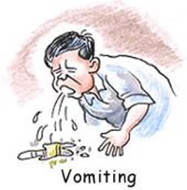
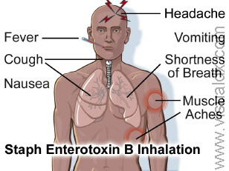
Disease and symptoms
The primary symptoms are due to stimulation of the autonomic nervous system by the toxins:
  salivation, nausea and vomiting (emetic effect of SEs), abdominal cramps, and diarrhea
Secondary symptoms are:
  sweating, chills, headache, and dehydration

Slide 12
Food Association
Many foods have been implicated with staph foodborne outbreaks
Staph grows in the food and produces toxins without adversely affecting the acceptance quality
Types of foods associated with staph gastroenteritis:
protein-rich foods
foods that have been temperature abused
Some of these foods include:
  ham, corned beef, salami, bacon, barbecued meat, Turkey, chicken, eggs
  salads, baking products containing cream, custard (puddings), salad dressings, sauces, and cheeses

Slide 13
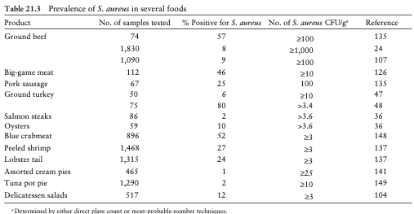

Slide 14
Food Association
Three major contributing factors in the outbreaks
  improper holding temperature
  poor personal hygiene
  contaminated equipment
A high percentage of outbreaks occurred between May and October with the highest frequency in August
imported raw or processed food that has been contaminated with S. aureus toxin
  six outbreaks of staph gastroenteritis in 1989 in the US from consumption of dishes prepared using enterotoxin canned mushrooms processed in China

Slide 15
Sources of S. aureus food contamination
Animals
  Mastitis in cows is most commonly caused by S. aureus
  it is a serious problem for dairy industry – costly
  Contaminate drinking milk and dairy products
Canning
  Inadequate storage of foods before processing
  Storage in plastic bags – created anaerobic conditions
  Staph can grow and produce toxins without causing food spoilage

Slide 16
Foodborne outbreaks
Incidence of SFP
isolated cases or outbreaks affecting large number of people.
self limiting, not an officially reportable disease, ~ 1-5% of all SFP cases are reported in the US
Staph account for ~14% of total of foodborne disease outbreaks in the US
study by U.S. Department of Agriculture more than 1.5 million cases of SFP occurred in one year-1993, result in 1,210 deaths and cost $1.2 billion
an average of ~ 25 major outbreaks of SFP reported annually in the US
Occurrence of SFP is cyclical, the highest incidence occurs in late summer, when food is stored improperly. A second peak occurs in November and December associated with holidays
Outbreaks due to improper manufacturing of canned corned beef have been reported in England, Brazil, Argentina,, Europe, Australia
Cases in Great Britain have been attributed to contaminated milk and cheese produced from milk from mastitic sheep
In some countries, ice cream has been a major vehicle of SFP.

Slide 17
Reservoirs
Sources of Staphylococcal Food Contamination
Humans - main reservoir for staph involved in human disease
S. aureus.– normally inhabit the external regions of the body
Colonized individuals- may be carriers - are important source for dissemination of staph to others and to food.
In humans - anterior nares (20-40% carriage rate) are predominant site of colonization, the skin or perineum.
Dissemination of S. aureus among humans and from humans to food can occur by direct contact
Today, most sources of SFP are traced to humans who contaminate food during preparation
S. aureus may be introduced into food by contaminated equipment during processing- grinders, knives, storage utensils, cutting blocks, and saw blades

Slide 18
Reservoirs
Sources of Staphylococcal Food Contamination
A survey of over 700 foodborne disease outbreaks most associated with food poisoning:
(i) inadequate refrigeration
(ii) preparation of foods far in advance
(iii) poor personal hygiene- not washing hands/instruments properly
(iv) inadequate cooking or heating of food
(v) prolonged use of warming plates when serving foods, a practice that promotes staph growth and SE production
Animals are important source of S. aureus, causes mastitis (infection of mammary tissue)-serious problem for dairy industry
bovine mastitis is the most costly disease of animal agriculture in the US, a public health concern- staph may contaminate milk/dairy products prior or during processing.

Slide 19
Prevention (reduction) of the Disease
S. aureus is found in many foods
impossible to produce foods free of S. aureus
Eating a food with 100-500 cells/g , ml will not make us sick
  unless the food has large amounts of preformed toxin
Incidents of S. aureus food poisoning can be avoided:
reduce initial load of Staph in food by selecting good quality raw materials/ingredients,
sanitation of the food environments
proper personal hygiene among the food handlers
People with respiratory diseases/S. aureus nasal carriers, any skin disease -rash, boils should not handle the food

Slide 20
Prevention (reduction) of the Disease
products should be heat-treated to ensure killing of the live cells, recontamination should be avoided
Chill processed products/ready-to-eat foods to < 5°C quickly
the inside of the food should reach the chilled temperature within 1 h
Avoid temperature abuse of food and long storage at RT before eating
once the heat-stable toxins are formed, heating of food before eating will not ensure safety

Slide 21
Identification Methods
Tests must be done to associate food with staph/toxin:
The food, vomit samples should be analyzed for the presence of S. aureus cells and enterotoxins
Enumeration to determine the load of viable cells of S. aureus
Biochemical tests:
Hemolysis
  Coagulase +, Lysostaphene and Novobiocin sensitive
thermonuclease reactions
  Mannitol fermenter – salt tolerance (10-15%)
Ability to produce enterotoxin
Enterotoxins Identification by ELISA

Slide 22
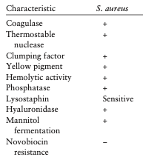

Slide 23
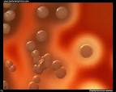
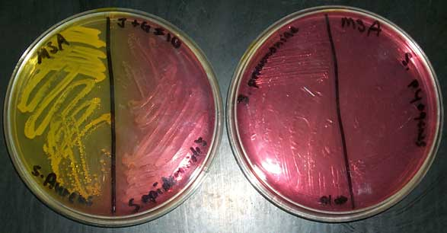



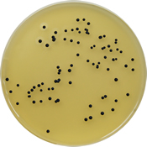
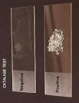


Microbiology
DNase Test Agar
w/Toluidine Blue

Slide 24
Staph food poisoning prevention
important to prevent the contamination of food with S. aureus before the toxin can be produced.
 | Wash hands and under fingernails vigorously with soap and water before handling and preparing food.
 | Do not prepare food if you have a nose or eye infection.
 | Do not prepare or serve food for others if you have wounds or skin infections on your hands or wrists.
 | Keep kitchens and food-serving areas clean and sanitized.
 | If food is to be stored longer than two hours, keep hot foods hot (>60° C) and cold foods cold (<4.5 °C ).
 | Store cooked food in a wide, shallow container and refrigerate as soon as possible.

Slide 25


