Slide 1
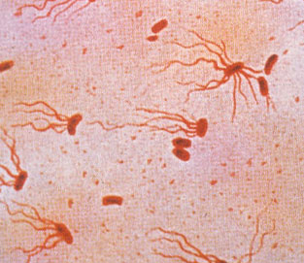
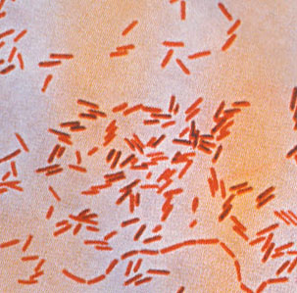
Foodborne Infections
Salmonella

Slide 2
Taxonomy
This nomenclature is officially accepted by the international community
The genus Salmonella consists of two species,
Contains multiple serovars
The two species are: S. enterica , and S. bongori
S. enterica is divided into
six subspecies, which are referred to by a Roman numeral and a name as in the Table

Slide 3
Salmonella spp. member of the family Enterobacteriaceae
Gram negative facultative anaerobic rod, motile, optimal growth at 37 C
Classified into Two species:
S. enterica – 6 subspecies with >2500 servars
S. enterica subsp. Enterica (I) is the most common in causing human disease (non-Typhoid Salmonella)
most reported serovars are:
S. enterica serovar Typhimurium
S. enterica serovar Enteritidis (eggs)
Salmonella ser. Typhi, and ser. Paratyphi (Typhoid Salmonella)
S. bongori –environmental rare
Used to be grouped according to the Kauffman-White Schema: Somatic antigens (O) – A, B, C, D etc. and flagellar antigens (H) – 1, 2, 3, 4 etc..

Slide 4
Habitats of Salmonella
In the intestinal tracts and bloodstream of humans, and in intestinal tracts of animals
The WHO groups Salmonella into 3 types:
Typhoidal (enteric) Salmonella
S. enterica serovar typhi
causes typhoid and paratyphoid fever
restricted to growth in human hosts
Habitat is in intestinal tracts and bloodstream

Slide 5
Habitats of Salmonella
Nontyphoidal Salmonella
S. enteritidis
S. typhimurium)
In gastrointestinal tracts of animals, mammals, reptiles, birds and insects
cause mainly gastroenteritis
transferred animal-to-person, through certain food products: fresh meat, poultry, eggs and milk
fruits, vegetables, seafood
House pets - contamination through contact with their feces

Slide 6
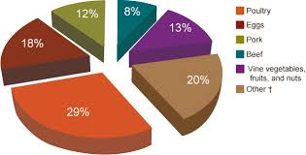
Foods associated with Salmonella outbreaks

Slide 7
characteristics of foodborne infections
1. Live cells have to be consumed through food
2. Surviving cells penetrate the mucus membrane, multiply, and produce toxins and other virulence factors.
3. Dose that cause infection vary greatly. Consumption of ~10 cells (E. coli O157:H7, shigella) to ~ >10⁵ cells (in less virulent spp. (Yer. enterocolitica)
4. Symptoms generally occur after 24 hours,
5. Enteric symptoms are local and result from enteric infection and the effect of toxins.
Symptoms include: abdominal pain, diarrhea (sometimes with blood), nausea, vomiting, and fever.
6. symptoms result when the pathogens or their toxins pass through the intestine and invade/affect other internal organs and tissues.

Slide 8
Virulence and infectivity
Sequence of steps:
Ingestion of Salmonella spp., survival the low stomach pH, adherence to small intestine epithelial cells, overcome defense mechanisms, initiate infection
virulence factors: Enable Salmonella to cause acute and chronic disease in humans
length and structure of the O side chains of lipopolysaccharide.
resistance to the action of complement is related to the length of the O side chain.
presence and type of fimbriae -
related to the ability to attachment
expression of genes (on pathogenicity islands SPI, SP-1,SP-2) responsible for invasion into cells

Slide 9
Virulence and infectivity
Production of toxins – 2 toxins both heat labile
enterotoxin cause loss of intestinal fluids, diarrhea
cytotoxin cause damage to intestinal mucosal surface and results in enteric symptoms and inflammation
Intracellular survival in phagocytes- associated with presence of plasmids which also cause spread from small intestine to spleen and liver.
Multiple antibiotic resistant strains of Salmonella have emerged
Example: S. Typhimurium definitive phage type 104 (DT104)
Multi-resistant S. Typhimurium DT104 infects both humans and animals (cattle and sheep)
it is a significant health problem in Europe, North America, Middle East, South Africa and South-East Asia.

Slide 11
Clinical Signs- Gastroenteritis
Most frequent: Mild to fulminant diarrhea with low grade fever, nausea and vomiting
Bacteremia and septicemia with high fever and positive blood cultures
Severe dehydration: infants, elderly
In most cases Symptoms resolve in 1 to 7 days
Deaths are rare except in very young, very old, debilitated or immunocompromised persons
Sequela: Reiter’s syndrome
Reactive Arthritis: a debilitating group of symptoms that follow gastrointestinal infection

Slide 12
Transmission
Transmission by fecal-oral route
by consumption of contaminated food or water
person-to-person contact
direct contact with infected animals (cats, dogs), poultry,
Reptiles – turtles carry the most virulent strains
Incidence of illness and outbreak data
Salmonellosis is one of the most commonly reported enteric illnesses worldwide
Children between 0–4 years had the highest notification rate
Outbreaks are associated with:
animal products: eggs, poultry, raw meat, milk and dairy products
fresh produce, salad dressing, fruit juice, peanut butter and chocolate

Slide 13
Selected major outbreaks associated with Salmonella spp. (>50 cases and/or ≥1 fatality)
year | serovar | No. cases | Food | Country | Comments
2010 | S. Typhimurium PT9 | 170 | Aioli Oil, garlic | Australia | Made with raw eggs
2009 | S. Montevideo | 272 | Salami with red or black pepper | US | Pepper added at the end, contained Salmonella
2007 | S. Tennessee | 628 | Peanut butter | Us | Raw material- positive
2006 | S. Oranienburg | 126 | Peanut butter | Australia | contamination with alfalfa
2005 | S. Typhimurium PT135 | 63 | Eggs in bakery products | Australia | Inadequate hygiene, eggs were externally dirty
2002 | S. Oranienburg | >439 | chocolate | Germany | Hi fat content caused salm. resistance to heat
1999 | S. Typhimurium PT135a | 507 | Fruit juice | Australia | Unpasteurized, found on oranges and in storage tank
1985 | S. Typhimurium | 16,284 (7) | Pasteurized milk | US | Cross contamination with the unpasteurized tank

Slide 14
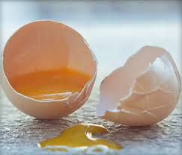
Salmonella sp.
Leading cause of foodborne bacterial illness
Due to consumption of contaminated foods/water
Global increase in foodborne salmonellosis (better detection methods)
Different types of food are involved
Poultry/Eggs
Egg containing potato salad
Mayonnaise
Cheddar cheese (mix raw with pasteurized milk)
Mixing Raw milk in pasteurized milk (biggest outbreak in the US, 1985, 16,284 people)
Ice cream (transported with raw eggs)

Slide 15
Diagnosis
Isolate organism from feces or blood
Grows on wide variety of media:
Blood agar, selective media – salmonella shigella agar (SS), MacConkey agar
Enrichment on selenite and gram negative broth
Biochemical tests done to identify foodborne and clinical Salmonella spp. is usually confirmed with serological agglutination tests with specific antisera
Serovars by serology
O, H, Vi
PCR

Slide 16
Treatment in Humans
Antibiotics
Ampicillin, amoxicillin, gentamicin, TMS, fluoroquinolones
Treatment indications
Septicemia, enteric fever
Elderly, infants, immunosuppressed
Healthy persons recover 2 to 7 days without antibiotics

Slide 17
Identification
Facultative anaerbe, GNB,
Biochemical tests used for presumptive identification should be coupled with serological confirmation
Motile, Oxidase and catalase negative
Citrate positive (sole source of C)
Produce H2S (bismuth sulfite agar-detects tiny amounts)
Lysine positive (negative in S. paratyphi biotypes)
Ornithine positive, Urea negative
Lactose and sucrose negative
Triple sugar iron

Slide 18
Serological confirmation
Complex and labor-intensive technique
Involves agglutination of surface antigens with Salmonella-specific antibodies.
Somatic (O) LPS: on the external surface of the bacterial outer membrane. heat-stable classified as major or minor antigens
Flagellin (H) antigens: associated with peritrichous flagella
Capsular (Vi) antigen: which occurs only in S. Typhi
Smooth (S) variants: strains with well- developed serotypic LPS that readily agglutinate with specific antibodies
Rough (R) variants: exhibit incomplete LPS antigens resulting in weak or no agglutination with Salmonella somatic antibodies. Flagellar (H) antigens: heat-labile proteins,

Slide 19
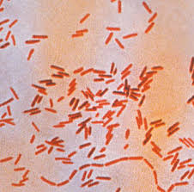
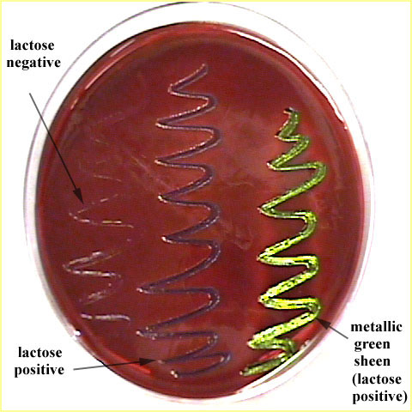
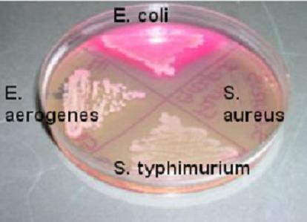
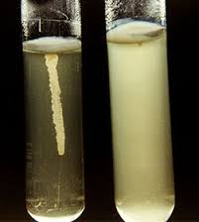
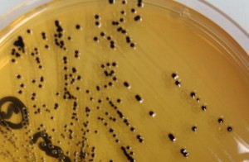
Identification
SS agar

Slide 20
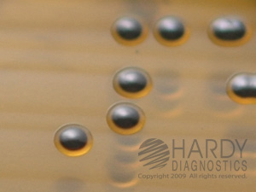
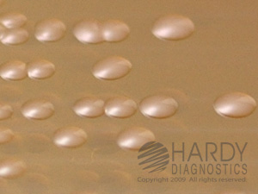
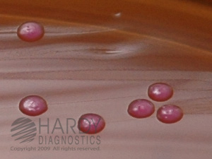
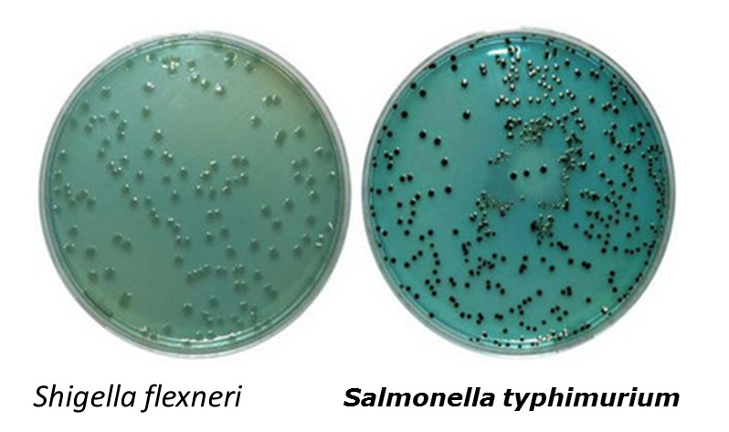
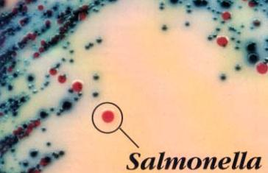
Salmonella on differential media

Slide 21
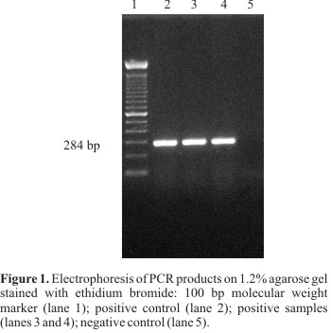
Identification – PCR:
PCR techniques will ever completely replace culture-based methods for detection,
help make important and timely decisions in the food microbiology laboratory. processing of samples for PCR analysis have-increased sensitivity of PCR techniques, shortened detection time, and standardized use in foods have been reported.
Real-time PCR and PCR-enzyme-linked immunosorbent assay (PCR-ELISA) may provide a qualitative, yes/no answer and a quantitative assessment of pathogen load in foods

Slide 22
Temperature
Resitance to heat and cold temperatures
Can grow in foods heated at 54 C (serovar Typhimurium)
Heat resistance is inversely correlated with the Aw
Adaptation to heat
Exposure to sub lethal T causes -
increased concentration of saturated FA in the CM
Results in less fluidity of the CM, lower Aw and higher resistance to heat
Able to grow in foods stored at 2 – 4 C
Resist drying – can survive on dry beans surfaces (chocolate) – when processed, the low heat used to melt the chocolate is not hi enough to eliminate the organism

Slide 23
pH
Can grow in a wide pH range: 4.5 – 9.5
Concerns about fermented foods, because salmonella can survive and contaminate fermented foods
Acid Tolerance response is enhanced when the organism is briefly pre-exposed to pH 5.5, result in survival at lower pH of 4.5
Due to synthesis of many pH shock proteins

Slide 24
Salt tolerance, infective dose
Hi salt – inhibits growth and used to extend shelf life of foods
Salmonella is inhibited in the presence of 3% - 4% salt
Tolerance to salt is increased in T range of 10 to 30 C
Infective dosage - low
Cheddar cheese 1-10 cfu
chocolate 10, ice cream 28, chips with paprika 45
hamburger 10 – 100

Slide 25
Modified Atmosphere
Salmonella can grow at low pH, high salt >2% with increasing Temperature
Presence of salt in acidified foods can reduce the antibacterial action of acids
Salm can survive in packaged refrigerated foods under vacuum
modified atmosphere (adopted to prolong shelf life):
gas mix of 60-80% CO2 with N2 can inhibit the growth of aerobic spoilage organisms (Pseudomonas) and do not promote the growth of salmonella

Slide 26
Reservoirs
Salmonella is a major human pathogen for the following reasons
Presence in the environment
Farming practices promote spread between animals
Recycling of animal remains in animal feed
Major reservoirs
Poultry, Meat, Eggs
Less common reservoirs
fruits and vegetables, fresh and dried due to lack of hygiene and not implementing the standards

Slide 27
Salmonellosis
Prior to the 1940s:
Sal. typhi and Sal. paratyphi were the major causes of WW foodborne, waterborne diseases in humans (typhoid fever)
pasteurization of milk and chlorination of water reduced the spread of typhoid and paratyphoid fever through food and water (in 3rd world countries)
worldwide incidence of foodborne salmonellosis caused by other Salmonella is high
foodborne salmonellosis is the major cause of foodborne diseases caused by pathogenic bacteria in the number of incidents and the number of cases

