Slide 1
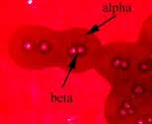
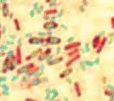
Clostridium perfringens
Toxicoinfection

Slide 2
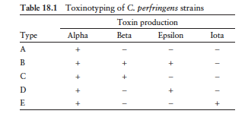
Clostridium perfringens
Characteristics : gram-positive, rod-shaped, encapsulated, non-motile anaerobe
Virulence: due to toxin production
C. perfringens enterotoxin (CPE) and β-toxin – have activity on the human GI tract.
toxin typing: classifies C. perfringens isolates into five types (A through E) according to production of 4 major enterotoxins: alpha, beta, epsilon, and iota (multiplex PCR)

Slide 3
Clostridium perfringens
Toxin types are associated with 2 foodborne diseases:
Type C isolates producing beta toxin: necrotizing enterocolitis, life threatening illness
Type A food poisoning: self-limiting, associated with Type A isolates producing CPE (75% chmromosomal cpe gene)
produce toxins active in the GI tract
has exceptional short doubling time (Type A<10 m at 43º C), rapid growth in foods to reach a pathogenic burden.
forms spores tolerant to radiation, desiccation, freezing, refrigeration, and heat- favors survival in incompletely cooked/inadequately held foods.

Slide 4
Terms
Foodborne illness:
results from consuming food contaminated with pathogenic microorganisms, or their toxins. The disease-causing microorganisms are most often bacteria, but can include fungi, viruses and protozoa.
Foodborne intoxication
is caused by ingesting food containing toxins
Toxico-infections:
A foodborne illness caused by ingesting bacteria that produce toxins within the digestive tract.

Slide 5
Toxicoinfection
Toxin is responsible for causing the illness
C. perfringens, B. cereus, entero-toxigenic E. coli
Toxicoinfection For spore formers
ingestion of large numbers of live vegetative cells
Vegetative cells do not multiply in the digestive tract, but sporulate and release toxins
Toxicoinfection For Gram-negative bacteria
live cells are ingested in moderate numbers
cells rapidly multiply in the digestive tract and release toxins

Slide 6
C. Perfringens Type A Foodborne illness
Toxicoinfection develops 8-16 h after consumption of contaminated food and last 12 – 24 h
Victims suffer from diarrhea and severe abdominal cramps
Illness occurs as follows:
Temperature abuse allows spores to germinate to vegetative cells
Rapidly divide in foods
Enough numbers will survive the acidity in the stomach
In small intestine where they multiply, sporulate and release enterotoxin during sporulation
Toxin quickly adhere and damage small intestinal cells, result in fluid loss

Slide 7
C. Perfringens type A Foodborne illness
Infectious dosage
Cells are killed by acid in stomach
Toxicoinfection develops when heavily contaminated food is eaten
Dose = 1x10⁶ – 1x10⁷ cells/g
Toxin is produced during sporulation
Disease is mild because
Continuous flushing of intestine removes unbound toxin
Infection is more serious in elderly and debilitated people
Antibodies to toxin is produced , but no evidence that previous exposure provides protection

Slide 8
Suceptibility to conditions -Temperature
Spores survive in undercooked foods
Survive boiling for several hours
Spores that cause toxicoinfection are more resistant to heat
This may be due to selective pressure
Incomplete cooking of foods
Fail to kill spores
Favor the development of Type A toxicoinfection by inducing spore germination
Vegetative cells are not thermophilic but their optimal growth Temp is 43 – 45º C, may reach 50º C
Vegetative cells of toxicoinfection are 2 fold more heat resistant than other isolates
Cells are not tolerant to refrigeration, NG at 6º C
Spores are cold resistant

Slide 9
Suceptibility to conditions Aw, Eh, pH
The cells need several amino acids for growth
can grow very well in many protein rich foods
Aw: 0.93 – 0.97,
Eh (OR potential): doesn't require extremely reduced environment for growth
pH: optimal is 6 -7
Poor growth or not at all at pH < 5 or > 8.3
Growth is affected by the presence of curing agents as nitrates
The cells fail to grow well at:
pH < 5.0,
in NaCl > 5%
at Aw <0.93,
in 500 ppm nitrite

Slide 10
Reservoirs for Type A
Present in natural environment- in soil ~ 10³ – 10⁴ cfu/g
Present in ~50%:
raw or frozen meat
Dust
Intestinal tract of humans, human feces contain 10⁴ – 10⁶ cfu/g
< 5% of all isolates harbor the C. perfringens enterotoxin gene (cpe gene)
CPE gene can be located on the chromosome or a plasmid
Only C. perfringenes CPE gene positive cause foodborne illness

Slide 11
Enterotoxin (heat labile) Evidence it is involved in foodborne illness
Cpe toxin –induces fluid and electrolytes loss from the intestinal tract
Epidemiological evidence:
Type A is associated with foodborne illness
Presence of toxin in the victim’s feces has strong association with the illness
Toxin cause serious intestinal effects in experimental animals
Toxin induced symptoms in human volunteers
Effects of toxin in experimental animals can be neutralized by antitoxin

Slide 12
C. Perfringens type A outbreaks
Specific characteristics
Outbreaks occur when food is prepared in advance by heating and then kept warm for several hours before serving
the majority of cases were associated with feeding many people within a short period of time in cafeterias, restaurants, schools, and banquets
the disease produces mild symptoms, that’s why many incidents are not reported

Slide 13
Outbreaks
1st outbreaks (OH) - From corned beef
Boiled 3 hrs, cooled to RT, then refrigerated
4 days later – warmed to 48 C and served
Sandwiches were left at RT from morning till afternoon then eaten
2nd outbreak (va)- Precooked/frozen corned beef
Thawed and cooked in 5 kg pieces
Stored in the fridge
Reheated under a heat lamp for 90 minutes before serving
When tested – it contained large numbers C. Perfringens
Conclusion: meat + Temp abuse are significant in outbreaks of C. perfringens type A

Slide 14
Prevention
keep the cell numbers low by using proper sanitation during food preparation and handling
Cook food to the highest temperature recommended to kill the cells and as many spores as possible
Cool food quickly and uniformly (within 1 h) to refrigerated temperature
A shallow container, in contrast to a deep container, facilitates rapid cooling (<10 C)
Reheat refrigerated foods quickly and uniformly (to kill vegetative cells)
Keep reheated food hot above 60°C while being served

Slide 15
Identification of outbreaks
Old methods relied on
Incubation time, Symptoms
More reliable methods
Presence of large numbers of spores in stool
Detection of specific toxins
CDC criteria:
Presence of 10⁵ organisms/g of stool in 2 or more ill people or
Presence of 10⁵ organisms/g of implicated food
CDC and FDA criteria:
Detection of C. perfringens enterotoxin in feces of several people

Slide 16
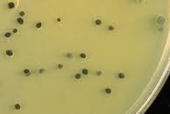
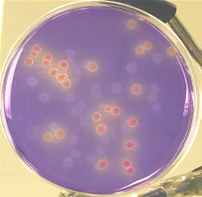
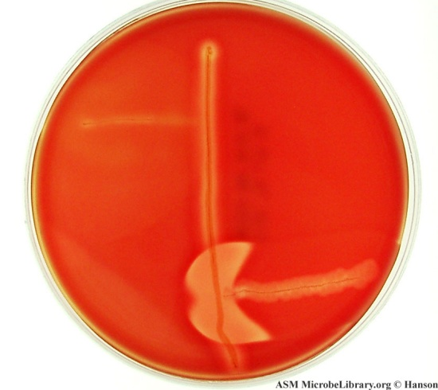
Identification
Gram stain and culture
Lab M agar – black colonies
m-CP Medium-recommended for testing the quality of water and sewage
Purple colonies or blue green colonies (sucrose not fermented Clostridium spp.)
characteristic opaque yellow Clostridium perfringens colonies
Reverse CAMP test (Strep group B is used to detect C. perfringens)
Spores in the food
Toxin detection

