Slide 1

Aerobic Gram Positive Bacilli
Listeria monocytogenes
Listeriosis

Slide 2
Listeriosis
Emerged as a major foodborne disease during the past 30 years
In 1981 an outbreak of listeriosis in Canada, was traced to contaminated coleslaw
1st documented case of human listeriosis in a soldier in WW1 who suffered from meningitis (السحايا)
Today, the estimated incidence of listeriosis in most developed countries is 2 to 5 cases per 1,000,000 population, with nearly 1,600 cases/Y in the US
Foodborne illness of major public health concern because of the severity of the disease (meningitis, septicemia, spontaneous abortion), and high case-fatality rate (20 -30%)

Slide 3
Listeriosis
Common in people with impairment of T-cell-mediated immunity
Control of L. monocytogenes in foods is a big challenge than most foodborne pathogens because of:
Its wide distribution in environment and prolonged survival
Resistance to diverse conditions (low pH, high NaCl)
Facultatively anaerobic and psychrotrophic.
L. monocytogenes can enter food and food processing plants via soil, plants, and water (no food can be expected to be free of listeria)
Investigations of outbreaks showed that listeria is transmitted by RTE foods

Slide 4
Characteristics of the Organism
Genus Listeria (contains 8 species)
L. monocytogenes is the only human pathogen of major public health concern
Susceptibility to Physical and Chemical Agents:
Temp - can grow at 0 to 45°C,
Average generation times was 43, 6.6, and 1.1 h at 4, 10, and 37°C
Temp below 0°C preserve the bacteriun, inactivated at > 50°C.
pH range for the growth is 5.6 to 9.6. can grow at low pH of 3.9 when the inculum is hi (1x10 ⁶ cfu/mL)
Optimal growth at water activty (aw) of > 0.97, the minimum is 0.93,
Grow in media with 10 -12% NaCl, grow to high populations at 6.5%.
Survives for long periods at high salt concentrations

Slide 5
Listeriosis and ready to eat foods
Certain RTE foods that support the growth of L. monocytogenes are high-risk to transmit listeriosis to susceptible people
These foods:
  usually preserved by refrigeration
  offer appropriate environment for multiplication of L. mono during manufacture, transportation, storage
The risk is increased if the RTE foods is likely to be exposed to marginal abuse temp 8 -15°C or have extended refrigerated shelf lives.
Foods in this category include:
unpasteurized milk and dairy products prepared from unpasteurized milk
frankfurters not reheated before consumption, lunch meats, smoked fish, and some sea-food.

Slide 6
L. monocytogenes
Widely distributed in nature, resist adverse conditions,
During last 25 y, Listeriosis became a major foodborne disease
  The disease is sporadic but severe
  Outbreaks: In 1981 was linked Coleslaw
  Other outbreaks linked to cheeses, milk, lunch meats, chicken nuggets and fish
  2000 cases listeriosis/y, 500 death (20%-30% death rate)
Factors that contribute to listeriosis:
  Elimination of spoilage bacteria that prevent listeria growth
  People at risk: old age, immunosuppressed, transplant pts
  Large scale food production may affect good hygiene
  Increasing preservation by refrigeration

Slide 7
Importance
Listeriosis is recent - 80s
Listeriosis is highly fatal (30%-40%) to:
  fetuses, newborns, infants, elderly. pregnant women, immunocompromised people, cancer pts on chemotherapy, renal diseases, heart diseases, AIDS , organ transplants, immunosuppressive therapy
grow in refrigerated foods- reach the infective dose during storage
Listeriosis is caused by:
– increase in consumption of ready to eat foods stored for long time
  many of these foods are consumed without reheating or by microwave
  Contamination occurs during processing and temperature abuse

Slide 8
Features
The genus Listeria contains 6 species
  L. monocytogenes : pathogenic to humans and animals
Morphology:
Non-spore-forming, facultative anaerobic small Gram +ve rods
Motile, umbrella like motility at 20-30 C
Based on somatic (O) and flagellar (H) antigens, 13 serotypes were recognized:
These are identified alphanumerically: 1/2a, 1/2b, 1/2c, 3a, 3b, 3c, 4a, 4ab, 4b, 4c, 4d, 4e and 7
Serotypes 1/2a, 1/2b and 1/2c are the most frequently isolated from food or food production environment

Slide 10
Habitat
L. monocytogenes is isolated from:
  soil, sewage, water, dead vegetation
  intestinal contents of domesticated animals and birds
  Humans can carry it in the intestine without symptoms and may harbor it in the gall bladder
  uncooked meat, milk, egg, sea foods, fish, leafy vegetables, potatoes and radishes
  heat-processed foods, such as pasteurized milk, dairy products and ready-to-eat meat preparations
  isolated in high frequency in different places of food processing and storage areas

Slide 11
Features
beta-hemolytic on sheep blood agar plates,
  Acid tolerant - essential for survival in stomach acid
  Acid tolerance - due to the presence of glutamate decarboxylase (GAD) enzyme system-found in many bacterial sp.
  Glutamine is abundant in food and is taken by the cell
  The enzyme is activated by the acid in the stomach to convert glutamine to glutamate with the release of ammonia which neutralizes the acid
  sensitive to pasteurization

Slide 12
Physiology
Optimal growth Temp: 30-37 °C
Growth at 0 - 45 °C, at pH 4.5 - 9.0, multiply at aw 0.92,
relatively resistant to freezing, drying, high salt > 10%
Ubiquitous - widely distributed:
  Soil is the principal reservoir, also in healthy humans/animals,
  psychrotrophic - multiply at low T under aerobic/anaerobic conditions, adapt to disinfectants
  spread in food processing facilities/and production lines
  Once introduced into a processing plants, it survives and persists for a long time under adverse conditions
  biofilm forming ability is an important cause of persistence

Slide 13
listeriosis
Since Listeria emerged as foodborne pathogen:
Regulatory agencies developed procedures to reduce the number of foodborne listeria
Determining the type of foods involved in listeriosis
steps in food processing that can contaminate ready-to-eat foods
people who are most susceptible to the disease
These steps led to:
  Make changes in the processing steps and
  Ensure that contaminated ready-to-eat foods do not reach the consumers
  Educate susceptible consumer groups about food choices, eating habits, and sanitary practices in food Preparation

Slide 14
Exposure models for risk assessment, what-if
Factors affected consumer exposure to L. monoc at time of food consumption:
(i) Amount and frequency of the food consumed
(ii) Prevalence and levels of L. monocytogenes in the food
(iii) pro[able growth in food during refrigerated storage
(iv) Refrigerated storage temperature
(v) Duration of refrigeration of food before consumption.
Risk assessment model used to estimate the impact of control strategies by changing one or two input parameters and measuring the change in outputs, Example of what if:
Predicted number of cases can be reduced by 69% if all home refrigerators are operating at or below 7.2°C.
reducing the maximum storage time of deli meats from 28 to 14 days would reduce the number of cases in the elderly by 13.6%.

Slide 15
Listeriosis
The steps taken by the regulatory agencies has resulted in
  Reduction in listeriosis in developed countries
  In the US- listeriosis cases has dropped from 2000 cases in 1986 to 1000 cases in 1991 to 500 cases recently
Listeria is highly infectious with high fatality rate - 25-30%
The infectious dose was estimated to 100-1000 and lower in the immunosuppressed
because of the high fatality rate, the U .S. government has established a "zero" tolerance policy for this pathogen in ready-to-eat products
  Despite that- there was recent increase in cases and outbreaks of listeriosis
  Increase in product recalls

Slide 16
Diseases and Symptoms
Febrile gastroenteritis
  mostly associated with healthy individuals
  symptoms appear within 1-7 days
  mild flu-like symptoms with slight fever, abdominal cramps, and diarrhea
  The symptoms subside in a few days
  the infected individual sheds Listeria in the feces

Slide 17
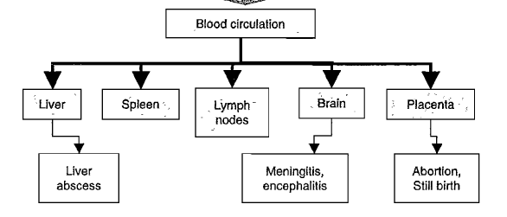
Diseases and Symptoms
Invasive Systemic Disease
Occur in immunosuppressed populations
Following ingestion, bacteria pass through the stomach to small intestine unharmed
  bile salt hydrolase protects it from bile salts
  Listeria rapidly pass through intestine via Peyer's patch and M cells phagocytoses and transport to the lamina propria

Slide 18
Prevention and Control
consumer education to reduce foodborne listeriosis
  thoroughly cooking raw foods of animal origin
  thoroughly washing raw vegetables before eating
  keeping uncooked meats separate from vegetables, cooked foods, and ready to-eat foods
  not consuming raw milk or foods made with raw milk
  washing hands, knives, and cutting boards after handling uncooked foods
Special recommendations provided to high-risk individuals such as pregnant women, elderly people, and the immunocompromised
  To avoid soft cheeses cream cheese, cottage cheese
  Reheat well all refrigerated leftover foods and ready-to-eat foods before eating

Slide 19
Detection
cold pre-enrichment
biochemical and serological tests
rapid methods, immunological and molecular

Slide 20
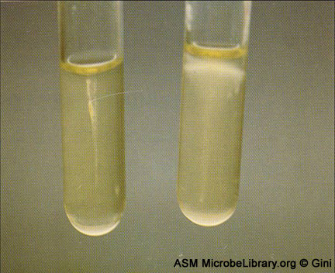
Listeria monocytogenes
Laboratory Diagnosis:
  Grows well on BAP in 5% CO2 after 18 - 24 h
  produces gray colonies (never white).
  Produces a narrow zone of beta -hemolysis
  On Gram stain: small G+ve or variable rods
  Typical motility - umbrella-like motility in semi-solid agar at RT
  Serology
  Chromogenic media can be used for rapid identification

Slide 21
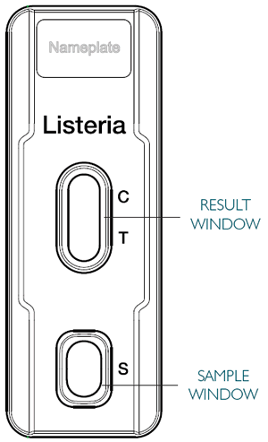
Rapid Test
For the qualitative detection of Listeria spp. in food
Enrichment steps
Extract flagellar antigens by heat (80 C for 20 M)
Put one drop in the sample window
Within few minutes watch the result window
C (control) must be positive
T ( test could be positive or negative

Slide 22
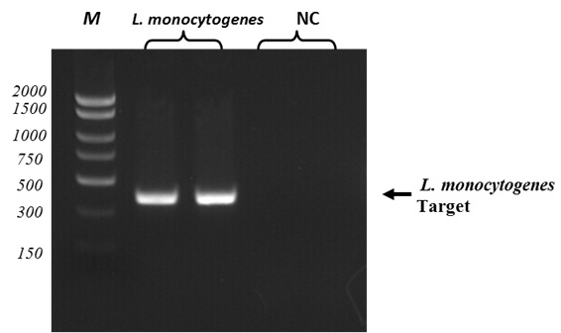
Molecular identification
Direct from milk

